Slide 1
Consolidation tasks
Using the case study and any other available research on Julian Richer and Richer Sounds, write a paragraph to that summarises the culture at Richer Sounds.
What evidence do you have to justify your description of the culture. Find 3 key examples to back up your claims.

Slide 2
Using the case study and any other available research on Julian Richer and Richer Sounds
Write a paragraph that summarises the management & leadership style at Richer Sounds.
What type of leader is Julian Richer? What skills does he show?
What evidence do you have to justify your points?

Slide 3
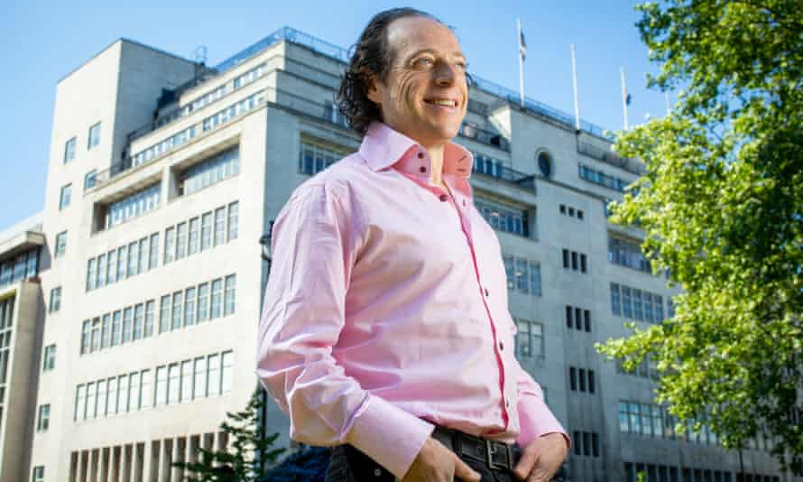
https://www.theguardian.com/business/2019/may/14/richer-sounds-staff-julian-richer
https://www.ft.com/content/3ff0250a-e8ea-11e9-85f4-d00e5018f061
https://www.institutelm.com/resourceLibrary/what-should-leaders-learn-from-richer-sounds-employee-ownership-switch.html
https://employeebenefits.co.uk/issues/december-2015/richer-sounds-offers-unusual-benefits-to-look-after-employees/
https://www.richersounds.com/information/the_richer_way
https://www.goodbusinesscharter.com/case-study-when-your-shops-have-to-close/

Slide 4
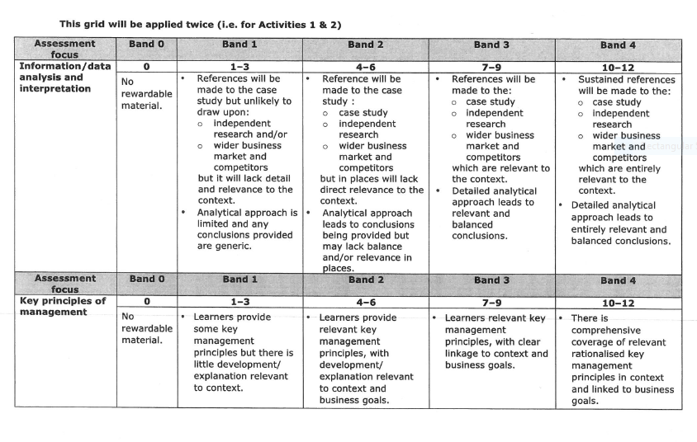

Slide 5
