Slide 1
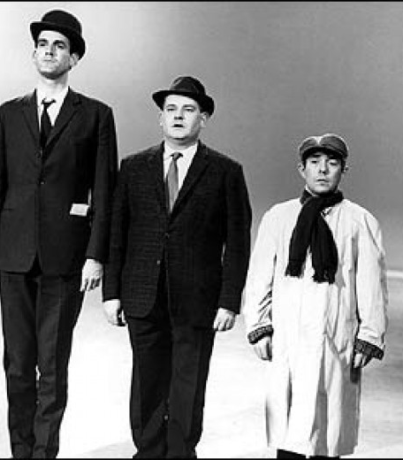
Why are there class based differences in education? (Intro to topic and External factors)

Slide 2
Objectives
To know the patterns and trends of class based differences in educational achievement
To be able to provide examples of EXTERNAL and INTERNAL reasons why such patterns occur
To be able to evaluate and analyse the above reasons and explain how they interact

Slide 3
What is class?
A form of social stratification, placing people into a hierarchy based on their occupational status
Class is said to be socially constructed – why? (Write your answer on p5)
Complete the diagram on p4 of your booklets – how can you identify a persons class background?

Slide 4
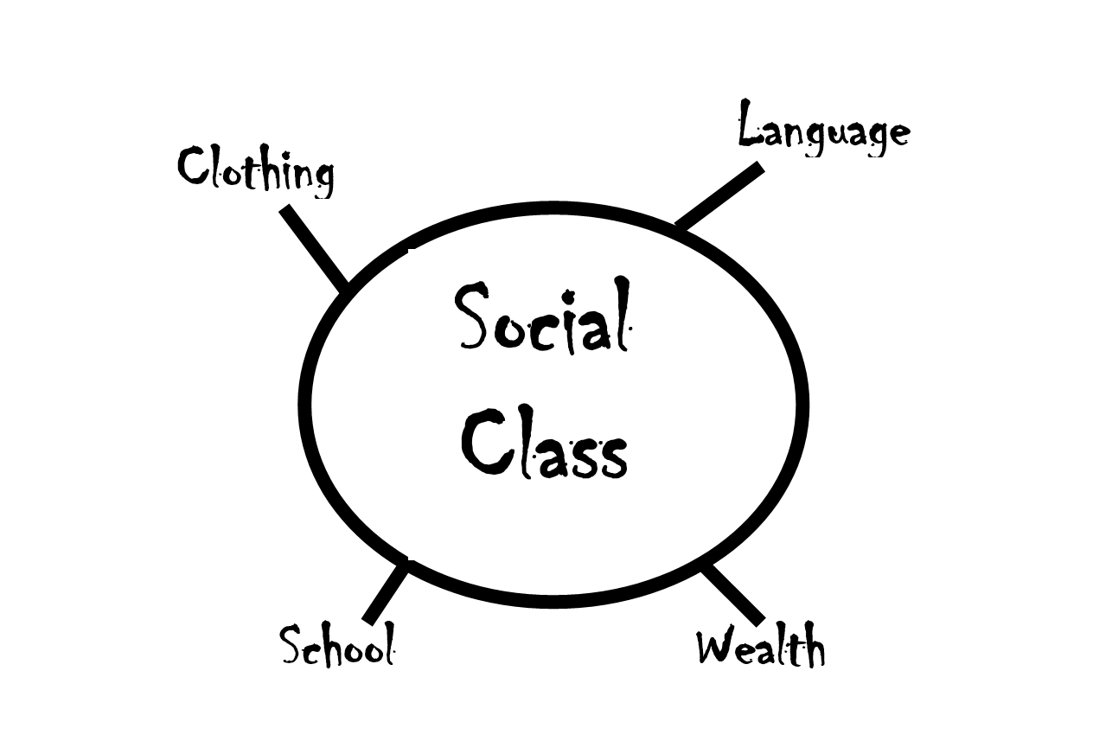

Slide 5
Ways to measure class
NS-SEC – current official way that class is measured, considers diverse range of occupation and the way in which people are paid (i.e salaried or not)
See details on P5
Bourdieu – types of capital – which ones do you remember?
Marxism – what do they say about class?

Slide 6
Which class are you?
Take the following class quizzes:
Social class test: Are you upper, middle or working class? (inews.co.uk)
Are you as working class or as middle class as you think? Take this quiz and find out - Cambridgeshire Live (cambridge-news.co.uk)
What are the different features of the different classes in this survey?
What does this tell us about the way in which class has changed?

Slide 7
Why does class matter?
Why does class matter?
When students from lower working class backgrounds have been compared to middle class children of the same ability, it has been found that;
They are more likely to start school unable to read
They will do less well in SATS
They are less likely to get places in the best state schools
They are more likely to be placed in lower streams and sets
They get poorer exam results – 75% of children from upper middle class backgrounds get 5 or more A*-C grades at GCSE compared to less than 33% from working class backgrounds
They are more likely to leave school at the minimum age of 16 (but they have to stay in some form of education and training until they are 18) with no qualifications. Around 50% of working class children stay in post 16 full time education, compared to 90% of middle class children
They are less likely to go to University – in 2008, 70% of children who went to University were from middle class backgrounds, 5% of children were from unskilled backgrounds.

Slide 8
Explaining class and underachievement (P7)
What possible reasons can you think of that explain why middle class students are more successful in the education system?
What goes on at home: | What goes on in the school:

Slide 9
External and Internal reasons
Reasons for class differences can be explained in the following ways:
EXTERNAL - Factors that occur OUTSIDE the school. These are….
Material explanations- social and economic reasons
Cultural explanations- socialisation, values, attitudes and lifestyles
INTERNAL - Factors that occur INSIDE the school. These are….
The way in which the school process works – how students are labelled and stereotypes, setting and streaming, language used and the hidden curriculum

Slide 10
Explaining class and underachievement (P7)
Functionalists (E.G Durkheim, Parsons, Davis and Moore) | Marxists (E.G Althusser, Bowles and Gintis, Willis, Bourdieu)
Think back to the activity we have just completed. (Factors explaining why middle class students are more successful in the education system). How might different theories explain the difference?

Slide 11
Recap: (Submit onto Teams)
Outline three types of ‘capital’ according to Bourdieu (6)
Outline three ways that class and underachievement can be explained, using internal and/or external factors (6)

Slide 12
External (out of school) factors
Material deprivation
Cultural deprivation
Cultural capital

Slide 13
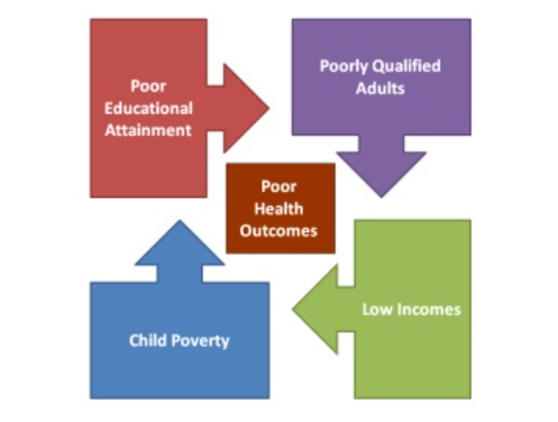
Material Deprivation – poverty (P9)
Sociologists of poverty have identified the cycle of deprivation or cycle of disadvantage ‑ this suggests that the "hard core" in society who are in poverty remain largely the same from one generation to another, i.e., deprived children in their turn become parents of deprived children.
Material deprivation is closely linked to the problem of educational failure, partly as cause and partly as effect.
How can poverty be linked to educational underachievement?
How might their education be affected?
How does the cycle of poverty impact upon someone’s life chances?

Slide 14
The Life Cycle
 | Stage in lifecycle | Typical Circumstances | Poverty status
[a] | Childhood | Low family income and children to rear | In Poverty
[b] | Working youngster | Earns more than is paid to parents for keep | Not in Poverty
[c] | Young married | Children to support | In Poverty
[d] | Middle age | Children earning or have left home | Not in Poverty
[e] | Old age | Income falls, living on a pension | In Poverty

Slide 15
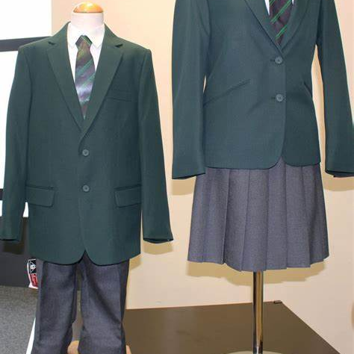
The cost of schooling (P10)
Using the list in the booklet and your own experiences, add up the cost of your own schooling per year.
Place the approx. amount in the teams chat.
How does it contrast to the amount in this article?
School costs parents £1,200 per child annually - BBC News

Slide 16
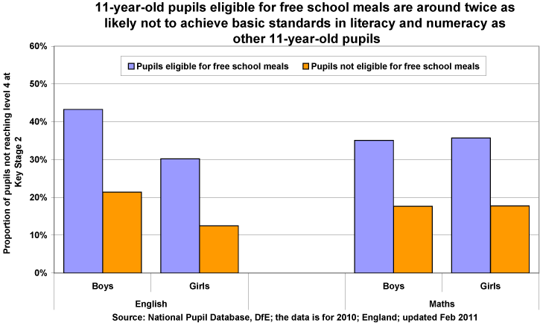
Free school meals and achievement
How does material deprivation affect achievement?

Slide 17
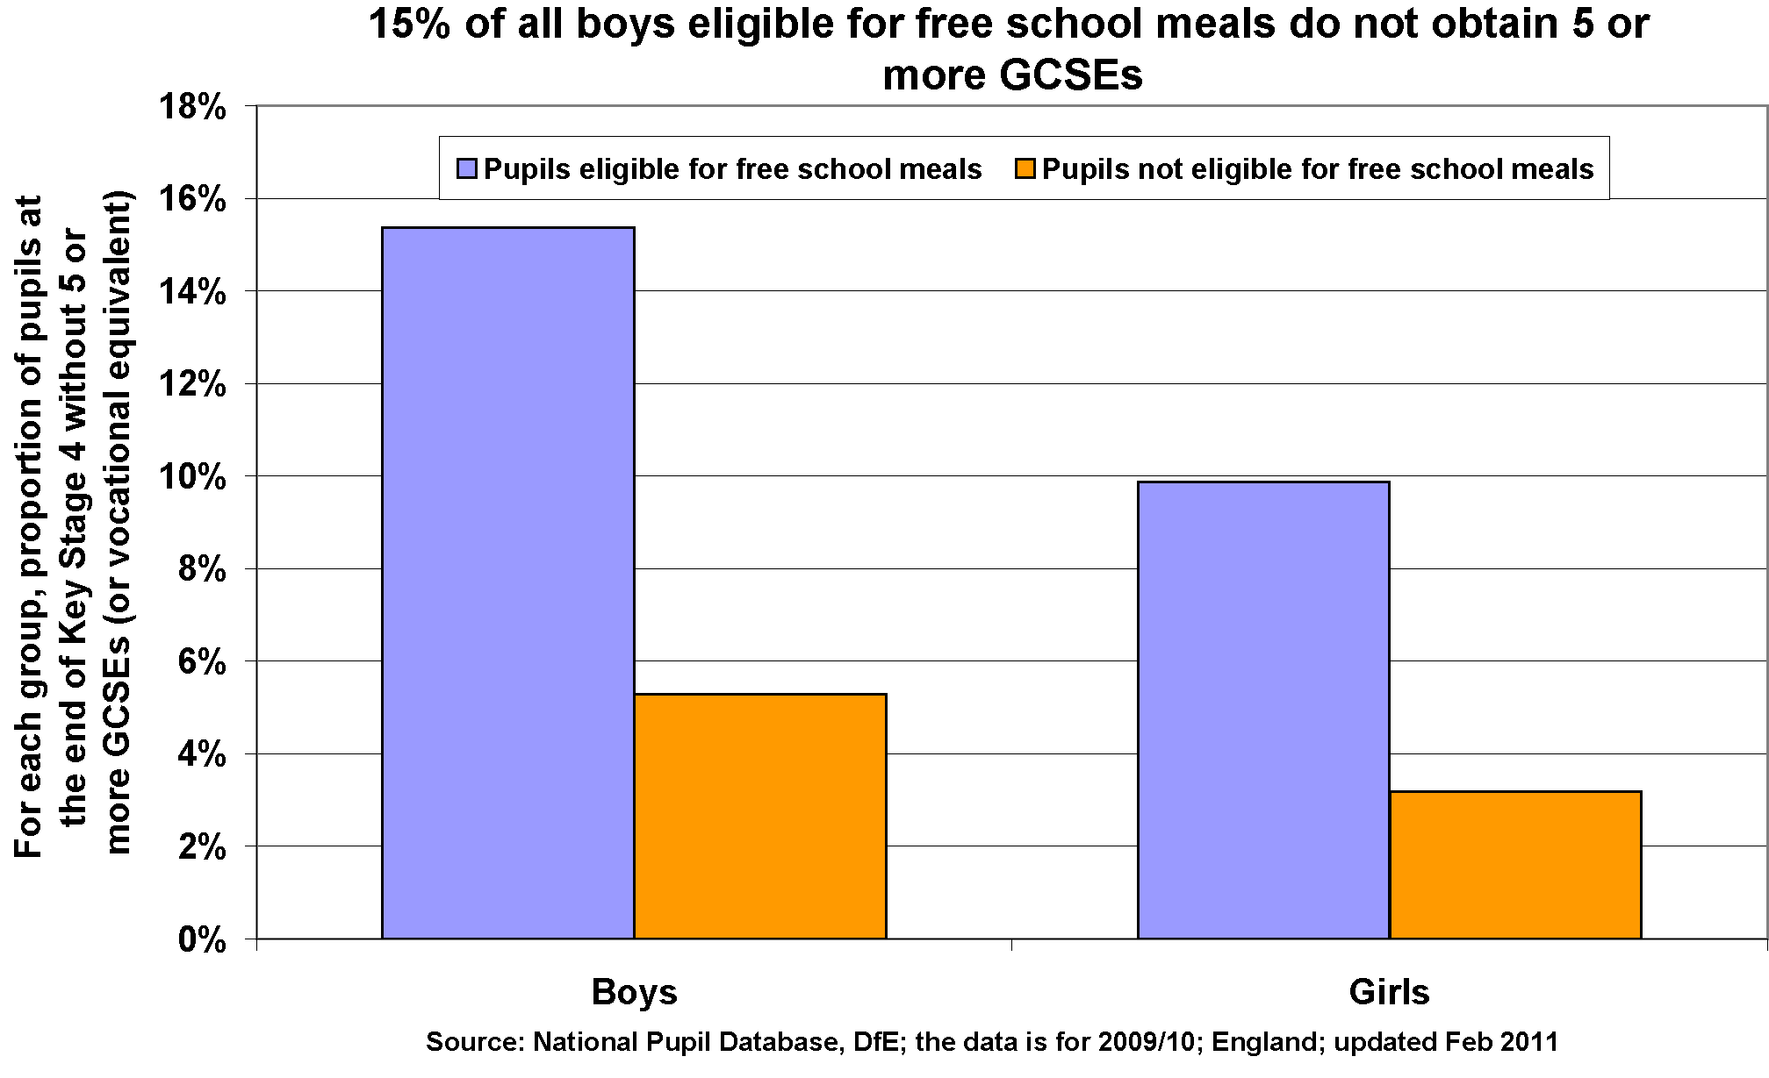
How does material deprivation affect achievement?
What do you think causes the link between free school meals and underachievement?
Place your ideas in the Teams chat.

Slide 18
What causes the link between free school meals and underachievement?
Waldfogel and Washbrook (2013) – children from lower income backgrounds are more likely to live in damp and crowded accommodation and a home that is unclean and unsafe. This makes study at home difficult. This may also mean poorer diet and higher levels of illness.
Cooper and Stewart (2013) – being poor may affect a childs cognitive and social-behavioural abilities.

Slide 19
Reasons continued….
Less likely to have access to good preschool facilities
Cannot afford educational toys, books, tutoring and other resources
Working class more likely to have part time jobs
Poor facilities and limited resources at state schools in disadvantage areas
Parents unable to financially support children in post 16 and higher education

Slide 20
Links to policy pg 21
Policy | Impact on working class pupils
Marketisation: Brought in by the 1988 Education Act- Marketisation policies such as publishing school exam results in league tables/ publishing Ofsted reports and increasing the diversity of schools | The highest performing schools can " cream skim" the best students- as they are fully subscribed they can " choose" some students ( once catchment students are enrolled) based on their educational achievement. Due to factors discussed in this topic, MC students perform better in Primary school tests, so high performing secondary school are more likely to attract these students.
Parentocracy - By publishing exam results and Ofsted reports- you create a market approach to education- where some parents are able to " choose" their child's school based on which one is the highest performing | The reality is only MC parents have a " choice" about where their children go to school- either by paying for private education or moving to an area with schools with the best exam results- they have both the economic and cultural capital to give their children an advantage in attending the best schools.
New Academies/ Free schools Part of 1988 Education act included reducing state control on schools and later policies introducing Academy and Free schools. | Evidence shows that Free schools have a lower % of students from disadvantaged areas than State schools – and tend to be set up in more middle class areas. The privatisation of education has been criticised by Marxists such as Rikowski as it puts making a profit before the needs of students.

Slide 21
(P12) Consider:
What studies from the previous booklet could we include here to support evidence of disadvantage?
What policies might be introduced to minimise the impact of poverty on educational success or failure?

Slide 22
Cultural deprivation
Cultural deprivation” is a kind of cultural “poverty” (as opposed to real, material poverty) and tends to view any culture which is not that of the teacher (white, middle class, etc.) as bad or inferior.
Assumes there is something ‘lacking’ in working class culture that causes underachievement
Working classes have a different value system.
Consider: can you be deprived of a culture?

Slide 23
Douglas (1964) The Home and the School (P13)
Working class parents are to blame.
They do not attend parents evenings and do not value school work, spending insufficient time helping with home work and reading with children.
Evaluation – how could we criticise this study?

Slide 24
Barry Sugarman
These the work of Herbert Hyman in the USA and Barry Sugarman in the UK have tended to emphasise the way that the values and norms of the working class household cannot sufficiently support the needs of the educational system.
Working class values and norms stand as obstacles to educational success and there is a tendency to regard working class values as in some sense inferior and inadequate

Slide 25
Sugarman – different values (P13/14)
Middle class | Working class
Deferred gratification | Immediate gratification
Individualism | Collectivism
Future orientated | Present time orientated
Optimistic about the future and their chances of success | Fatalistic

Slide 26
Evaluation of subcultural theories:
Subcultural theories of education may offer some insight but they have been criticised in a number of ways. They may simply reflect the prejudices and opinions of middle-class sociological researchers, blaming the victim of deprivation or discrimination for their own failure.
What other problems can you see with this approach?
Write your answer on page 14 of your workbook

Slide 27
Bernstein - Language
Elaborate code- used mainly by middle class people. Involves a far greater range of words and the ability to communicate and understand. This sort of language tends to be used in a more formal context.
Restricted code- Bernstein argues all people use the restricted code but lower-working class people tend to use this language predominately, and are constrained to its use. This is the more informal language used between friends and family. It tends to include slang and everyday language.

Slide 28
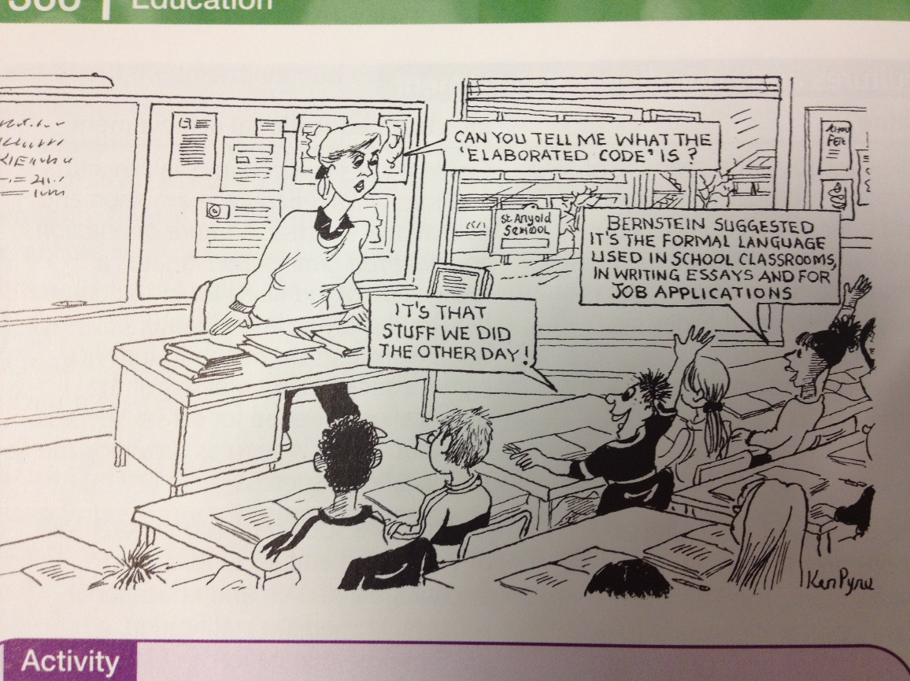
Bernstein:
How does this cartoon explain how access to elaborate code might provide advantages in education?
After discussion, write your answer on page 15 of your workbook.

Slide 29
Bourdieu – Cultural Capital
Cultural capital – high status knowledge that is valued by the school
Middle classes possess more of this.
Read the list in the article and consider whether you have cultural capital?!
In what ways might some of the examples help with achievement at school?!

Slide 30
Evaluations
Keddie (1973) states that cultural deprivation is a myth and argues it is a form of victim blaming. Argues that working classes are culturally different and not deprived – does this link with Bourdieus ideas?
Mortimore and Whitty (1997) state that material deprivation has a greater effect on achievement than cultural ones. Robinson says that addressing child poverty is the most important thing that can be done to solve the issue – how would a Marxist respond to this?
Sullivan (2001) argued that cultural capital only explains part of the picture. She states that greater resources and aspirations of the middle classes are the most significant factor.

Slide 31
(P15) Evaluation:
How is the cultural capital approach different to the cultural deprivation approach?
Which do you prefer and why?

