Slide 1
Gender issues in Education achievement
Explaining patterns in gender achievement

Slide 2
Gender: Key concepts
Pg 3
What do we mean by gender?
What forms our gender identity?
What are gender roles?
Write a definition and example for hegemonic femininity and masculinity.
Hegemonic femininity : the concept that an ideal, dominant picture of womanhood exists. “Traditional” feminine gender norms such as a sweet disposition and modesty, as well as an investment in physical appearance and sexual attractiveness e.g The ideal woman based on the topic of Hegemonic Femininity would be a woman who is heterosexual, gentile, kind, able to have children and stay home to take care of them, and also a woman who cooks and cleans within the house.
Hegemonic masculinity refers to a societal pattern in which stereotypically male traits are idealized as the masculine cultural ideal, explaining how and why men maintain dominant social roles over women and other groups considered to be feminine. E.g the ideal hegemonic male is Tall, physically domainate, manual job, strong and takes control.
Read the article on Gender bias and the damage to boys.

Slide 3
Key issues in Gender and D.E.A
Why do girls now generally achieve better results than boys?
Why do boys and girls opt to study different subjects?
How does schooling help to reinforce gender identities?

Slide 4
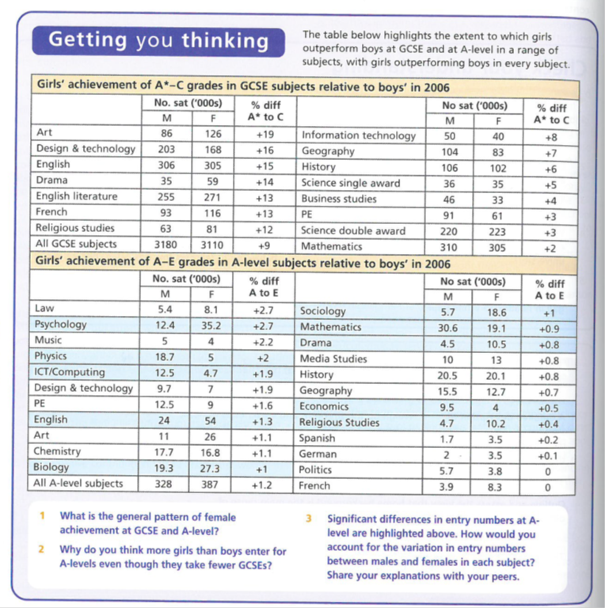
Gender and DEA: Data

Slide 5
Getting You Thinking
‘It is my view that boys are simply not socialised in a way that suits the process of being educated. The overstimulating, action-packed and exciting world they are now able to choose to belong to outside, more than ever conflicts with the relatively confined and passive nature of the classroom environment’.
Ray O’Neil, Deputy Head of a primary school in Gravesend, Kent.
What do the pictures suggest are the key differences in the socialisation of boys and girls?
What features of schooling might seem more in line with girl’s experiences outside school?
What features of schooling might seem to conflict with boy’s experiences outside school?
What, according to Ray O’Neil, has increased the mismatch between boy’s socialisation and schooling?

Slide 6
Activity 1: Gender & Educational Attainment
Item A: GCSE’s
Attainment of 5 or more GCSE’s A*-C in Year 11 England & Wales %
Item B: A Levels
Attainment at GCE A level or equivalent qualification
England & Wales %
Year |  | 1980 | 1985 | 1990 | 1995 | 2000 | 2015
Males |  | 33 | 37 | 40 | 42 | 44 | 46
Females |  | 40 | 46 | 49 | 51 | 54 | 56
 | Males |  | Females
 | 1 A level | 2 or more | 1 A level | 2 or more
1990 | 7 | 27 | 9 | 33
1995 | 7 | 27 | 8 | 33
2000 | 6 | 30 | 7 | 37
2005 | 6 | 30 | 7 | 37
2010 | 6 | 31 | 7 | 39
2015 | 4 | 33 | 5 | 42
Item C: Higher Education
Students in Higher Education per 1000
 | 1970/71 | 1980/81 | 1990/91 | 1997/98 | 2001/02
Males | 400 | 500 | 650 | 900 | 1000
Females | 200 | 300 | 550 | 1000 | 1250
Activity:
Briefly identify the trends shown in Items A. B & C

Slide 7
Gender and DEA: Data
Using the booklet and other research – google- gender differences in education- summarise the difference between boys and girls achievement on page 4 of your booklet.
Using your knowledge of internal and external factors- come up with some ideas to explain the trends- share with the group and write them on page 4

Slide 8
Gender and achievement
Read page 5
Over to you…
We know what the facts are concerning gender and achievement
Think of internal and external explanations for them
Internal | External

Slide 9
Child of our Time…..
http://estream.godalming.ac.uk/view2.aspx?id=3858~4y~AmgwJUFj

Slide 10
Changing times Old Explanations - Variations in levels of attainment
Previously there was worry over the underperformance of girls in the education system
Dale Spender (1983) considered the control and domination of education by men. This was not only in terms of SMT positions but also in terms of boys getting more attention in the classroom and the curriculum being ‘male-centred’.
Michelle Stanworth (1983) focussed on classroom interaction and the extent to which girls received less attention and were negatively labelled
The explanations have largely been replaced by new explanations as the trend shifted in the late 1980’s and early 1990’s to the underachievement of boys and the achievement of girls.

Slide 11
Student research task
You will be working in groups
Create a quiz for the content of the following areas – this could be done as a quizlet, kahoot, a paper multiple choice, but must be able to be given to the whole group.
Why are girls outperforming boys ( external)
Why are boys underachieving ( External)
Why are girls outperforming boys ( internal)
Why are boys underachieving ( internal)
Statistics and trends about achievement p.4-5
You will need to use the textbooks and information sheets- use a range of sources ( tables)
You need to email me the link to any internet quizzes you make

