Slide 1
Why are there Ethnic differences in Education?

Slide 2
Starter: Gender recap- 10 mins
Explain what is meant by ‘gender domains’ (2)
Explain what is meant by ‘crisis of masculinity’ (2)
Give three ways that gender identity is reinforced in school (6)

Slide 3
Aims and Objectives
To be able to explain the differences in achievement of ethnic groups
To know how factors already studied such as external reasons - material and cultural deprivation and internal reasons - labelling and subcultures - can be applied specifically to ethnicity
To be able to explain how other Internal factors such as Ethnocentrism and Institutional racism and racism in wider society also explain such changes
To be able to evaluate such reasons

Slide 4
Key concepts
Ethnicity: Often described as the cultural and/or social aspect of a group
Belonging to a particular ethnic group means you share a particular set of cultural practises
Race usually refers to the biological – skin colour – differences between groups. This is a socially constructed concept, why?
The two terms are used interchangeably, but race tends to carry with it issues of oppression
Racism:
Institutional racism:
Ethnocentric curriculum:

Slide 5
Ethnicity and Education – what is happening?

Slide 6
Why do Chinese pupils top the results?
Watch ‘Meet Britain's Tiger Mums’ documentary on e-stream.
What external factors may explain why British Chinese may be achieving so well?
Links to Francis and Archers study: The Construction of British Chinese Educational Success: exploring the shifting discourses in educational debate, and their effects. (Mentioned in most textbooks)

Slide 7
Why is Ethnicity and Achievement a problem? Complete page 5
Black Caribbean, Pakistani, Bangladeshi and the small number of traveller groups consistently have lower achievements than all other ethnic groups
Lower than average reading skills
Lower level of attainment across all levels of education
Black Caribbean children are over represented in schools for those with learning difficulties
Black Caribbean students are more likely to be excluded from school
BME (Black, minority ethnic) groups are more likely to be placed in lower sets
These groups are more likely to leave school with no qualifications
These groups are less likely to do academic A level courses

Slide 8
Ethnicity and Class
There are a higher proportion of those in BME groups that are working class – why?
Task: Complete page 6- using the your knowledge of internal/ external factors from previous topics- how can they be applied to Ethnicity?
Internal | External

Slide 9
Task
Use the ppt/ Webb textbooks to complete the A3 summary sheets with internal and external factors
If you are aiming for an A*-B read over the additional studies pgs 11-14 in your booklet.

Slide 10
Ethnicity and Class – External factors
Material deprivation ( Gillborn and Mirza ) - 20% ( 2/5) of those in ethnic minority groups are in poverty ( but does not apply to all EM groups)
Cultural deprivation – differences in attitudes and values towards the education system
Lack of cultural capital;
Bhatti (1999) Asian parents are very supported but do not always know how the education system works
Sewell (2010) high proportion of single parents account for lower achievement of black boys
Language differences
18% of pupils in Primary and 13% in secondary may have English as a second language

Slide 11
Other External factors
Racism in wider society
Material and cultural deprivation may be linked to racism and discrimination externally
Poverty (material deprivation) may be a result of racism as according to Rex (1986) this leads to social exclusion which causes poverty
Noon (1993) sent letters using different surnames – traditionally white British surnames appeared to be more encouraged to apply for the job

Slide 12
Ethnicity and Class – Internal Factors
Labelling and the self fulfilling prophecy
Gillborn and Youdell (2000) teachers have ‘racialized expectations’ of students and expect black students to present more discipline problems and interpreted their behaviour as threatening
Wright- found that Asian students are victims of labelling- teachers assume their English is not as good as WB students
Archer and Francis- however Chinese students are positively labelled as being bright and hardworking by teachers.
Subcultures
Sewell (1998) subcultures formed in school as a coping mechanism
Marketisation
Gilborn (1997) Educational Triage - BME students more likely to be assessed as ‘hopeless cases’- especially black working class boys.

Slide 13
Other Internal factors
Ethnocentric curriculum
Institutional racism
Ethnocentrism: the belief that one particular culture is superior and therefore only this culture is focused on
Why might school be described as ethnocentric?
Institutional Racism: when the way in which an organisation operates is racist

Slide 14
Will Britain Ever Have a Black Prime Minister?

Slide 15
External Factors
Cultural deprivation – culture of the home
Material deprivation – poverty
Racism
Solutions??

Slide 16
Family structure and parental support – New Right
Moynihan (1965)
Single mothers
No work/low paid work
No male role model
Inadequate socialisation

Slide 17
Family structure and parental support – New Right
Can we AO3 any of these ideas?
Charles Murray – single mothers
Charles Murray – Welfare dependent
Roger Scruton – rejection of British culture
Ken Pryce – Asians more resistant to racism
Ken Pryce – Black families destroyed by colonialism
Important! Ken Pryce is not New Right but sees the same outcomes from a different position

Slide 18
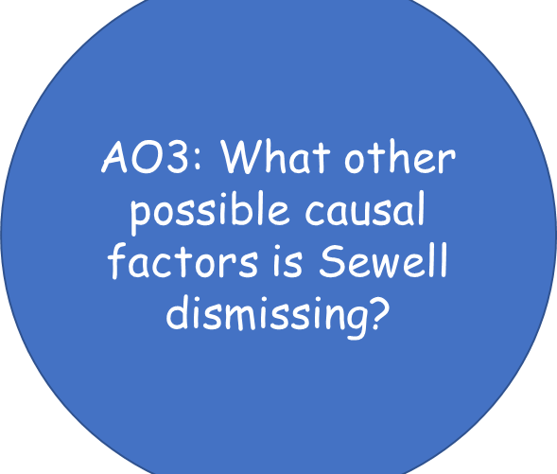
Sewell: Fathers, gangs and culture
“The biggest barrier facing black boys is actually black peer pressure. We need to talk about how black students discourage their peers”. Tony Sewell

Slide 19
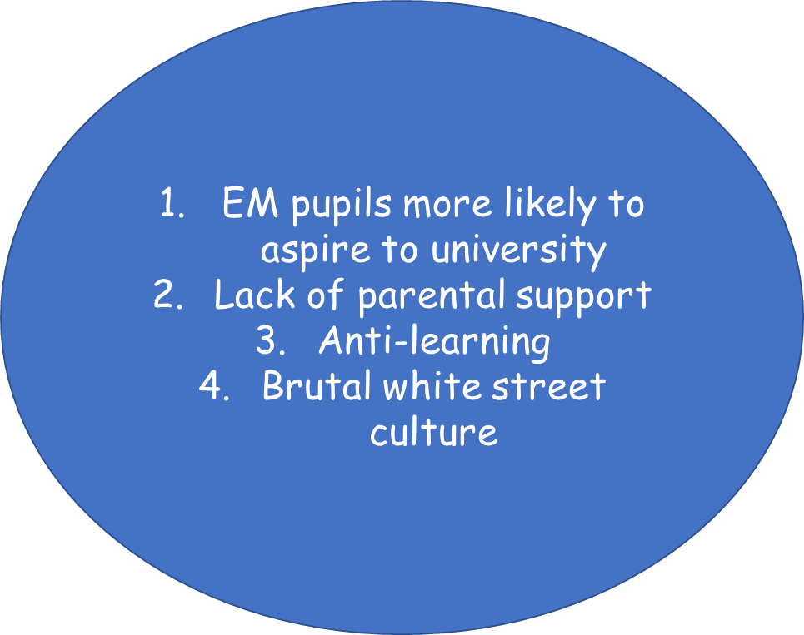
White working class families: McCulloch

Slide 20
Internal Factors
Labelling and Teacher Racism
Responses and subcultures
Ethnocentric curriculum
Institutional racism
Selection
Solutions??

Slide 21
What is the impact of an ethnocentric school curriculum?
An ethnocentric curriculum is one that reflects a narrow belief based on a dominant ethnic group or culture. In Britain, we can observe an ethnocentric curriculum that centres itself around a white, British culture.
Many sociologists see the ethnocentric curriculum as a prime example of institutional racism because it builds an everyday racial bias into the everyday workings of schools and colleges.
One way the ethnocentric curriculum may operate is through language and literature. Troyna and Williams argue how there is a lack of Asian languages (such as Hindi) being taught in comparison to European languages (such as French and Spanish).
IThe National Curriculum as a 'specifically British' curriculum that largely ignores non-European languages, literature and music.
Ball (1994) argues that the National Curriculum ignores ethnic diversity as it promotes an attitude of 'little Englandism' - criticising the subject History. The history curriculum tries to recreate an overly positive image of WB history while ignoring the history of black and Asian people.

Slide 22
Does class override ethnicity?
Chinese and Indian pupils in material deprivation do better than WBWC
Lower income effects WWC pupils than pupils from most EM

Slide 23
The Significance of Racism- complete page 15
Critical race theory – racism is a feature of society and is often so subtle and ‘normal’ that people do not recognise it leading to
‘Locked-in inequality’ – racism is embedded into everyday life and is ‘naturally’ reinforced in society
Access to new opportunities;
Gifted and talented more likely to be identified as white
Higher tiers of exams more likely to be taken by white students
New IQism – teachers make assumptions about pupils ‘fixed’ ability when there is no such way to measure ability. As school is Institutionally racist, this is based on teachers ‘racialised expectations’

Slide 24
Example exam questions
Outline two issues outside of school that explain the educational underachievement of some ethnic groups. (4)
Outline two ways cultural deprivation can contribute to the educational underachievement of some ethnic groups. (4)
Outline three ways in which an ethnocentric curriculum may operate in education (6)

Slide 25
Tutor2u Revision videos: good for BM4 prep
https://www.tutor2u.net/sociology/reference/differential-educational-achievement-by-ethnicity-parental-support

