Slide 1
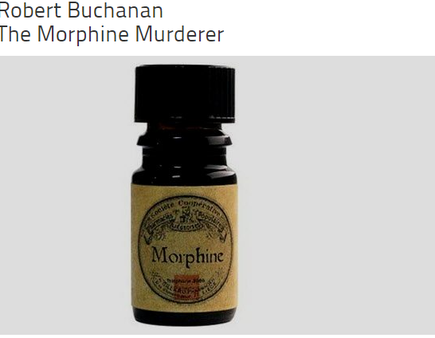
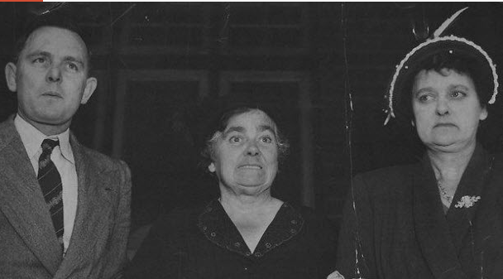
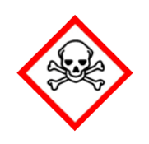
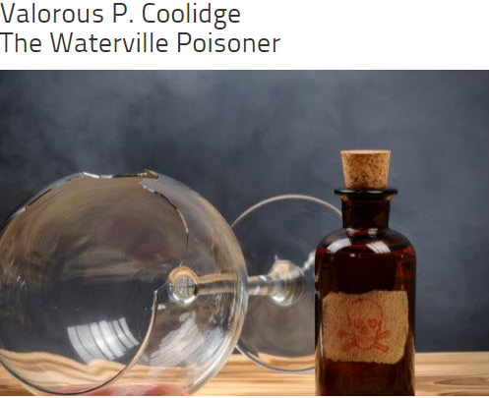
Poisons!!!!!!

Slide 2
Life as a Forensic scientist -careers
https://www.youtube.com/watch?v=Z6NappSFwPg

Slide 3
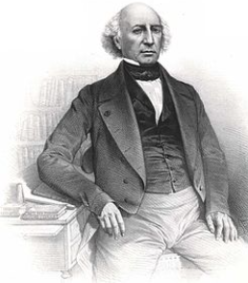
Poisons one oldest human weapons
Orfila spent 3 years testing poisons on several thousand dogs
Suffered horrendously

Slide 4
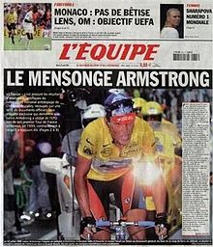
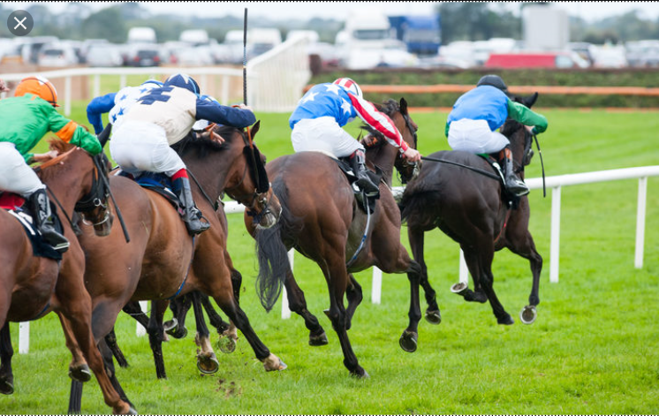
Toxicology- Not Just Involved in Deaths
Athletes
Employees
Driving accidents
Sexual assaults
Animals in racing industries
Industrial accidents
Notes:
Test for use of steroids and other drugs in athletes, drug use by employees, the presence of drugs and alcohol in persons involved in driving accidents. Were drugs used to assist in the rape of a victim? Did someone give drugs to an animal to enhance their ability in a race or other performance?

Slide 5
It is not just people who are poisoned – it can be animals, both pets and wildlife.
In many cases this is accidental poisoning, when chemicals such as pesticides are used incorrectly, but there have also been criminal cases of animal poisoning.
When animals are poisoned investigators often focus on tracking down the ‘bait station’ and in one case a piece of chicken was found to contain a poison made from a common household product.

Slide 6
Goal of Toxicologist
Examine tissue or fluids from humans and other animals to answer the questions:
Are drugs present?
Are poisons present?
Are there unknown chemicals present?

Slide 7
Also Must Determine
The effects the drug, poison or unknown chemical has on the human or other animal.
“All things are poison and nothing is without poison, only the dose permits something not to be poisonous.”
- Paracelsus, 16th Century
Notes:
Interestingly the term poison is a complicated term. Some substances are known to cause death in all humans even in incredibly small doses. Other substances it is the amount administered and the period of time that it is administered over that determines if it will cause death. Even over-the-counter drugs like acetaminophen (Tylenol®) can kill you if you take too much over a sort period of time. Other complications in determining effects are the effects for combining drugs. An example of this is the combination of alcohol and acetaminophen. Together they can be particularly damaging to the liver.

Slide 8
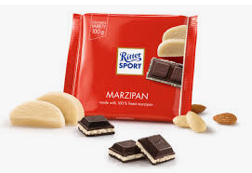
Poisons, medicines and food
We tend to think that a poison is a special type of chemical substance that can kill a person, usually by swallowing it.
But poisons are not special substances and many everyday substances can be poisonous if swallowed in large enough amounts.
For example, if you take paracetamol for a headache it works perfectly well so long as you use the correct dosage. The headache disappears and no harm is done.
However, if you take an overdose, the paracetamol can kill you.
It is the size of the dose that makes the difference.
Food can also be a poison. For example, marzipan contains cyanide and this is what gives it its almond flavour. In normal amounts it is harmless because the amount of cyanide is so small. However, if you ate a kilogram of marzipan you would soon be dead from cyanide poisoning.

Slide 9
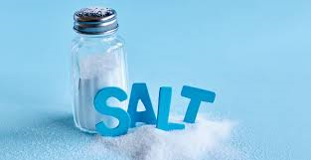
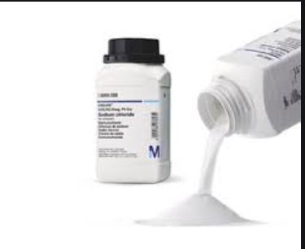
Dose-’The dose makes the poison’
Obviously some substances are more poisonous than others.
If you swallow a gram of sodium chloride (common salt) it will cause no harm.
However, if you swallow a gram of sodium cyanide you will be dead within seconds. In poisoning cases the substances used by the murderer are usually the more toxic chemicals so that a tiny amount may be put into a victim’s food or drink without it being noticed.
Water is also poisonous ( when drunk in very large amounts!!!!)
Demo

Slide 10
Demonstration of dose and size - Teacher
Step 3: Duration ~10 minutes Dose Demonstration
This is a demonstration to relay the importance of the amount of dose. Fill three 400mL beakers
about ¾ full with water. Place one drop of food coloring in the first beaker, five in the second,
and fifteen in the last beaker. Stir each beaker and discuss the change in color as a response to
increased dose (amount of food color) in each beaker. Use white paper as a backdrop for easy
visualization. The human body is about 75% water, thus the beakers represent the amount of
water in a human. Explain how some chemicals, like caffeine, are able to distribute throughout
the body, just like the food coloring they witnessed in the water.
Step 4: Duration ~5minutes Size Demonstration
Fill one 400mL and one 100mL beaker about ¾ full with water. The large beaker represents an
adult and a child is represented by the small beaker. Put the same amount of food coloring in
each beaker (1 or 2 drops). The small beaker will be darker than the larger one. Use white paper
as a backdrop for easy visualization. This is a demonstration on the importance of size or weight
of the organism/human. Children may be more severely affected than an adult by the same dose.
For example, a child who drinks one caffeinated soft drink will likely have a greater response
than an adult who drinks the same amount.
Step 5:

Slide 11
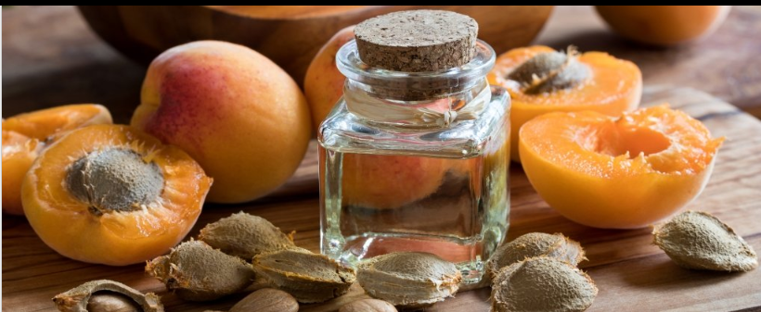
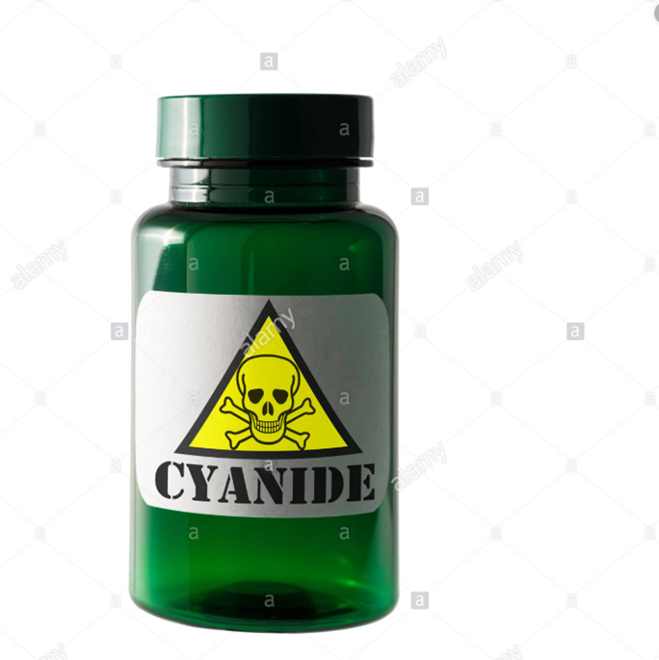
Metabolic Poisons –Heavy metal poisons
Cyanide (suicide or homicide - Tylenol murders)
Common industrial agent (plastics formation, electroplating, metal-ore processing)
NaCN reacts with acids to form HCN (gas) - weak odor of almonds
Naturally occurs in seeds (protects seeds until they germinate).=cherry seeds, almonds, cashews and chick peas
Very fast working (seconds)
Causes asphyxiation
binds tightly with iron so that, even though lots of oxygen gets to cells, they can’t use it to support life.
Eventually, cyanide is removed by enzyme.
Administer large amounts of thiocyanate can be effective - ANTIDOTE.
Notes:
A seemingly healthy 67-year old Australian man developed cyanide poisoning after ingesting apricot kernel extract.
The man in this case was making his own extract, and consuming two teaspoons of it daily, in addition to taking a commercial fruit kernel supplement called Novodalin. He had had prostate cancer, which had gone into remission. He thought taking the extract would prevent his cancer recurring
The Chicago Tylenol Murders were a series of poisoning deaths resulting from drug tampering in the Chicago metropolitan area in 1982. The victims had all taken Tylenol-branded acetaminophen capsules that had been laced with potassium cyanide.^{[1]} A total of seven people died in the original poisonings, with several more deaths in subsequent copycat crimes.
No suspect was ever charged or convicted of the poisonings. New York City resident James William Lewis was convicted of extortion for sending a letter to Johnson & Johnson that took credit for the deaths and demanded $1 million to stop them, but evidence tying him to the actual poisoning never emerged.
The incidents led to reforms in the packaging of over-the-counter substances and to federal anti-tampering laws. The actions of Johnson & Johnson to reduce deaths and warn the public of poisoning risks have been widely praised as an exemplary public relations response to such a crisis.^{[2]}

Slide 12
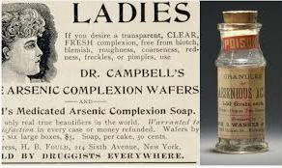
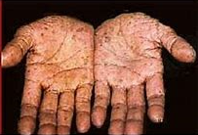
Arsenic Poisoning
As commonly occurs in pesticides, shrimp, pressure treated wood (Paris green), old wallpaper (green color)
React with SH groups of enzymes - stopping their normal function
Accumulates in the body (not eliminated)
Used as a poison gas in WWI - led to search for antidote
Notes:
As 1966 began, 35-year-old Janie Lou Gibbs was living a seemingly normal life in Cordele, Georgia with her husband, Charles. The couple had three sons together: 19-year-old Roger, 16-year-old Melvin, and 13-year-old Marvin. However, the family would soon suffer a series of tragedies. On January 21, shortly after eating a meal prepared by his wife, Charles Gibbs collapsed and died, and doctors blamed it on undiagnosed liver disease. Nine months later, Marvin died in a similar fashion, and only a few months after that, Melvin suddenly passed away of what was initially believed to be hepatitis.
Janie soon became a grandmother after Roger’s wife gave birth to their first child, Ronnie. However, by the end of 1967, both Roger and Ronnie were dead. When he was only one month old, Ronnie passed away of an apparent heart condition. Roger’s kidneys stopped working three weeks later.
The authorities finally became suspicious, so the bodies of the Gibbs family were exhumed, revealing traces of arsenic in their systems. Janie had been using rat poison to murder her family and collected over $31,000 in life insurance payouts. After her arrest, Janie was declared insane and sent to a state mental hospital until 1976. When she was found competent to stand trial, Janie received five life sentences for her crimes. She eventually suffered from Parkinson’s disease and was released on a medical reprieve to live in a nursing home until her death in 2010>.

Slide 13
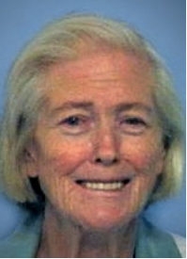
Janie Lou Gibbs
As 1966 began, 35-year-old Janie Lou Gibbs was living a seemingly normal life in Cordele, Georgia with her husband, Charles.
The couple had three sons together: 19-year-old Roger, 16-year-old Melvin, and 13-year-old Marvin.
On January 21, shortly after eating a meal prepared by his wife, Charles Gibbs collapsed and died, and doctors blamed it on undiagnosed liver disease.
Nine months later, Marvin died in a similar fashion, and only a few months after that, Melvin suddenly passed away of what was initially believed to be hepatitis.
Janie soon became a grandmother after Roger’s wife gave birth to their first child, Ronnie. However, by the end of 1967, both Roger and Ronnie were dead. When he was only one month old, Ronnie passed away of an apparent heart condition. Roger’s kidneys stopped working three weeks later.
The authorities finally became suspicious, so the bodies of the Gibbs family were exhumed, revealing traces of arsenic in their systems. Janie had been using rat poison to murder her family and collected over $31,000 in life insurance payouts.

Slide 14
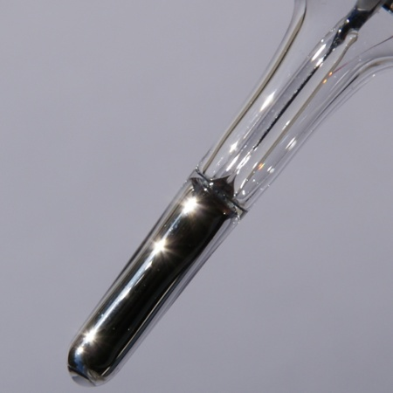
Mercury Poisoning
In Fluorescent lamps, dental amalgams, fungicides
Neuron toxin-many problems including:
Impaired vision, hearing, and speech
Brain damage
Interferes with enzymatic actions (seleno-enzymes which normally prevent oxidation damage)
Man who poisoned colleagues with mercury-laced sandwiches sentenced to life in prison
https://www.independent.co.uk/news/world/europe/german-sandwich-metal-poisoning-mercury-jail-klaus-o-a8813316.html

Slide 15
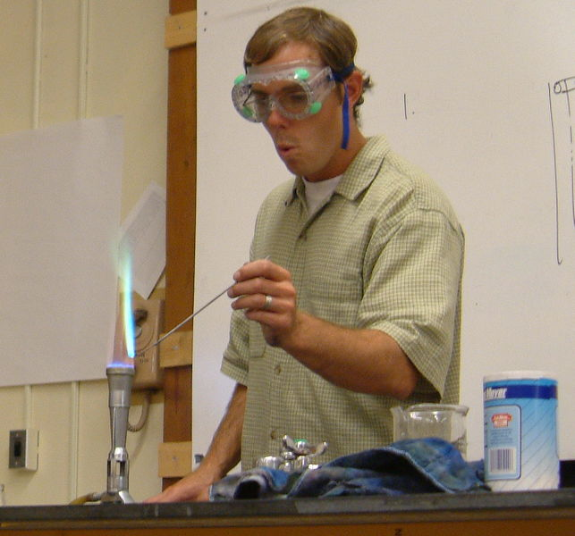
Flame Tests identify heavy metals
The flame test is a procedure used in chemistry to detect the presence of certain metal ions, based on each element's characteristic emission spectrum. The color of flames in general also depends on temperature.
The flame test is fast and easy to perform, and does not require any equipment not usually found in a chemistry laboratory. However, the range of detected elements is small, and the test relies on the subjective experience of the experimenter rather than any objective measurements.

Slide 16
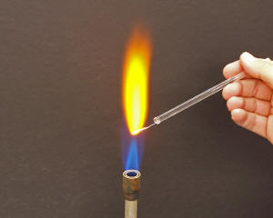
Flame Tests
The test involves introducing a sample of the element or compound to a hot, non-luminous (blue) bunsen flame, and observing the color that results.
Flame Test Calcium

Slide 17
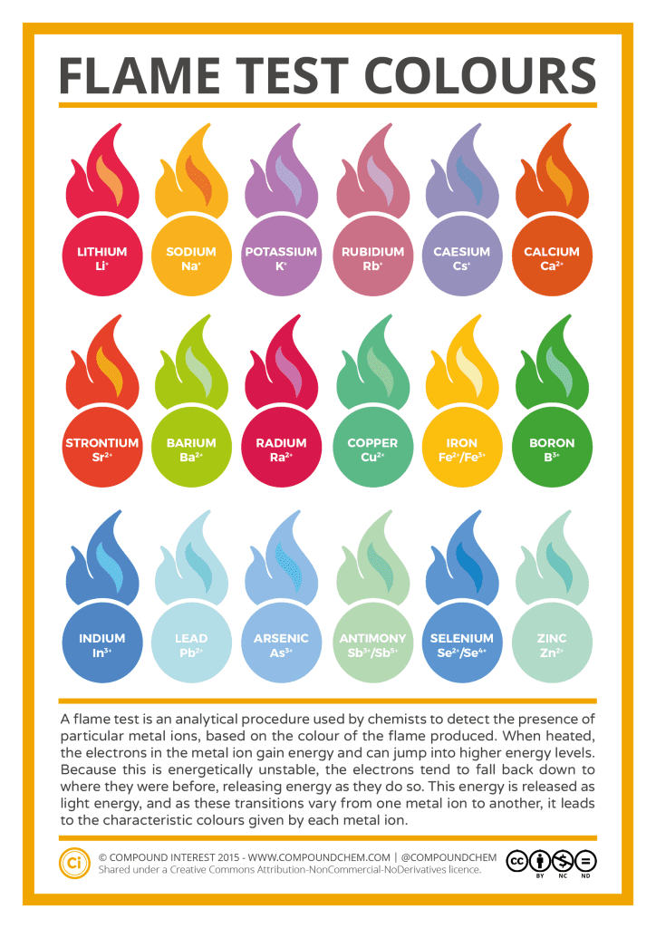
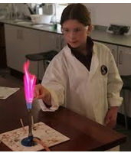
Lead
Mercury
Arsenic
Cadmium

Slide 18
Scenario - one
A sample has been obtained from a women who died unexpectedly
Three samples have been sent to you to try and identify the components
Use the flame test to test these substances.
Follow your worksheet and write the answers down

Slide 19
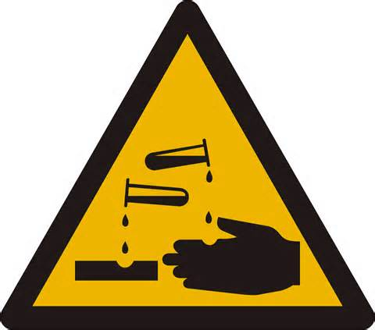
Safety
Hazard | Precautions
Corrosive | Avoid contact with skin Have sodium carbonate around to neutralise any spills
Oxidising | Avoid contact with skin Dispose of in designated beaker
Harmful/ Irritant | Avoid contact with skin Use small quantities
Harmful to the environment | Dispose of in designated beaker

Slide 20
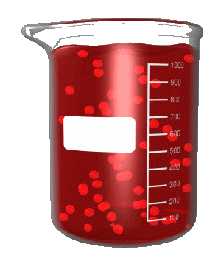
Safety precautions
Wear a lab coat and goggles
wear gloves if appropriate
Tie hair back

Slide 21
Results
Sample | Colour | Heavy Metal
1
2
3

Slide 22
Tests for drugs, stomach contents, and Aspirin

Slide 23
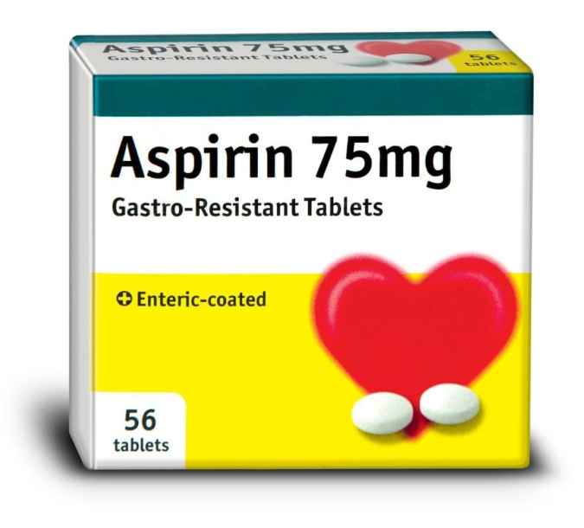
Aspirin and acid used as poisons
Aspirin is another name for acetylsalicylic acid, a common pain reliever (also called an analgesic).
The earliest known uses of the drug can be traced back to the Greek physician Hippocrates in the fifth century BC. He used powder extracted from the bark of willows to treat pain and reduce fever.
The earliest symptoms of acute aspirin poisoning may include ringing in the ears (tinnitus) and impaired hearing. More clinically significant signs and symptoms may include rapid breathing (hyperventilation), vomiting, dehydration, fever, double vision, and feeling faint.

Slide 24
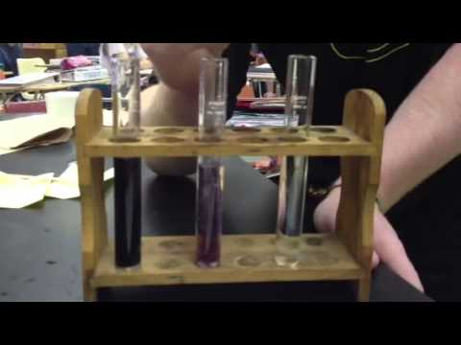
Test for Aspirin
Add 10 drops of Iron Chloride
If aspirin present solution will turn purple
This is again a complex being formed – the salicylic acid/aspirin binds to the Iron(III) which causes a difference in energy levels of the electrons and therefore a different colour

Slide 25
Alcohol
Most heavily abused drug in Western countries
accounts for 40% of all traffic deaths in the U.S.
(17,500 per year)
Leading cause of death in UK
How much consumed?
type of drink
Distilled or fermented
Distilled is 40-100% ethyl alcohol
Fermented is 3-15% ethyl alcohol
- Beer 4 -6 %
- Wine 12-15%
Proof ÷ 2 = % alcohol
Notes:
Difference in distilled verses fermented: Distilled the mixture with the alcohol in it is heated to separate the alcohol from the mixture that is produced during fermentation. The alcohol is boiled off and collected to make a product with higher alcohol content. In Fermentation the alcohol is produced by allowing yeast to consume sugars and convert them into alcohol.

Slide 26
Effects of Alcohol blood alcohol concentration (BAC)
BAC % | Effect
0.02 | Euphoria – more self-confident, poor judgment, flushed, shorter attention span
0.04 | Relaxation
0.06 | Impaired driving, poor judgment
0.08 | Impaired motor skills, poor coordination, legally intoxicated
0.12 | Vomiting begins for inexperienced drinkers
0.15 | Loss of balance (equivalent to 1/2 pint of liquor in the blood stream)
0. 4 | Loss of consciousness, death (LD50 – dose that causes death in 50% of the population)
Notes:
Alcohol poisoning occurs when a person drinks a toxic amount of alcohol, usually over a short period of time (binge drinking).
Being poisoned by alcohol can damage your health or even put your life in danger.
Alcohol poisoning is a leading cause of poisoning in England, especially among young people.
It's important to avoid misusing alcohol and to be aware of how much you're drinking and the effect this could have on your body.
Signs and symptoms of alcohol poisoning
The signs and symptoms of alcohol poisoning include:
confusion
severely slurred speech
loss of co-ordination
vomiting
irregular or slow breathing
pale or blue-tinged skin caused by low body temperature (hypothermia)
being conscious but unresponsive (stupor)
passing out and being unconscious
In the most severe cases, alcohol poisoning can lead to coma, brain damage and death.

Slide 27
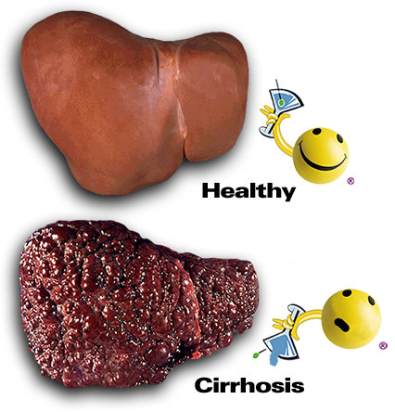
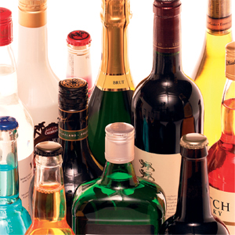
Image of a Liver damaged by Cirrhosis
An irreversible liver
disease caused by
excessive alcohol
consumption

Slide 28
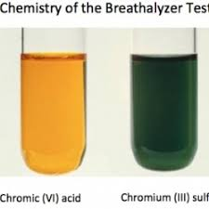
Test for Alcohol
Sodium Dichromate test
If alcohol is present then it will be oxidised to a carboxylic acid by the dichromate.
For example alcohol from alcoholic drinks will turn into Ethanoic acid (Vinegar).
This is an example of a redox reaction – the alcohol is oxidised (loses electrons) and the dichromate is reduced (gains electrons).
Dichomate is an orange colour (from the Chromium (VI) ion), when it is reduced it gains electrons and goes to the Chromium(III) ion which is green. You might even see it go slightly blue which is the Chromium (II)

Slide 29
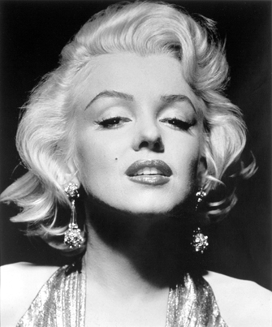
Multiple Drug Use
When drugs are used in combination, the results may be synergistic. That is, the effects of the combination are worse than two doses of a single drug.
Alcohol and barbiturates caused
the death of Marilyn Monroe
http://www.ranker.com/list/16-celebrity-drug-overdoses-we-should-have-seen-coming/joanne

Slide 30
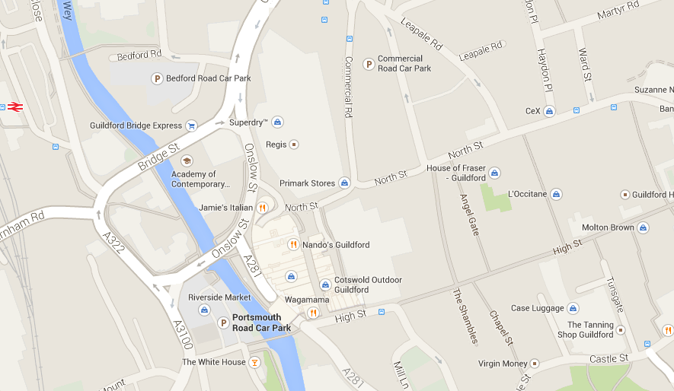
Scenario-2
You are working as a scientist in a forensics laboratory. A man in his 20s has been found dead.
The pathologist have sent you samples of his stomach contents in order to help determine how he died.
Scene of crime

Slide 31
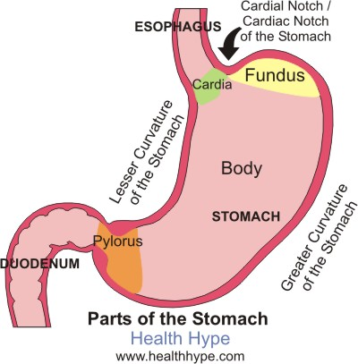
Stomach contents
How are we going to separate it out?

Slide 32
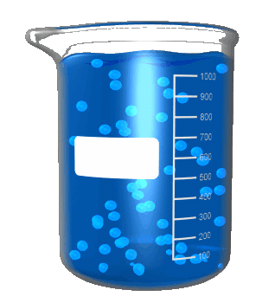
Test tube reactions
You are testing for the following substances to help determine how the man died:
Alcohol
Reducing sugars
Protein
Aspirin
Starch
Acid
Follow the method outlined on your worksheets

Slide 33
Other ways can detect Poisons
Chromatography
HPLC and Mass spectrometry
Separate out metabolites
Extremely sensitive

Slide 34
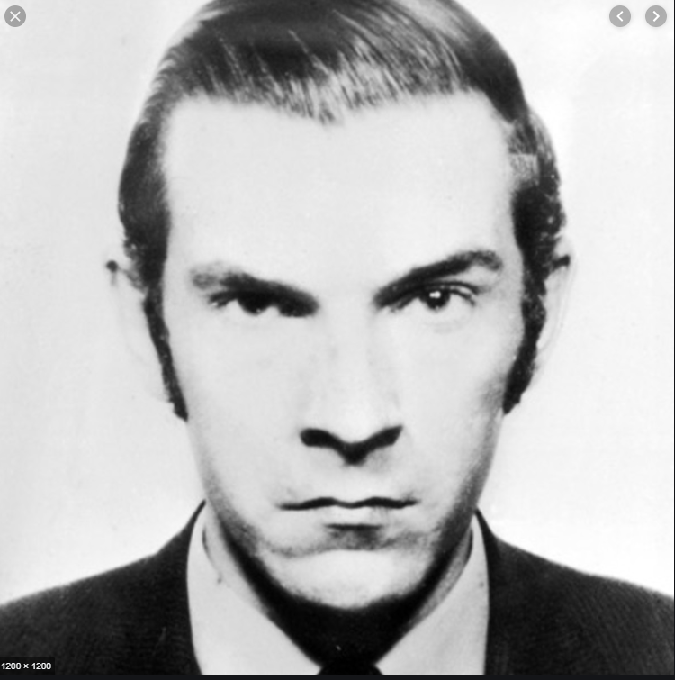
Some Famous Poisoners……..
Graham Young –The tea cup poisoner Graham Frederick Young (7 September 1947 – 1 August 1990) best known as the Teacup Poisoner and later the St. Albans Poisoner
Serial killer who used poison to kill his victims. He was sent to Broadmoor Hospital in 1962 after poisoning several members of his family.
In 1961, he started to test poisons (including antimony) on his family
In 1971 when he was released, he went on to poison 7 more people and killed two. He was then sent to HMP Parkhurst where he died of a heart attack in 1990.
Notes:
Beginning in February, 37-year-old Molly Young had suffered vomiting, diarrhoea and excruciating stomach pain, which she initially dismissed as bilious attacks. Before long her husband Fred, 44, was also suffering, with similar stomach cramps debilitating him for days at a time. Then Young's sister was violently ill on a couple of occasions that summer. Shortly afterwards, Young himself was violently sick at home.
It even seemed as if the mystery bug had spread beyond their household: a couple of Young's school friends had also been off school ill a couple of times with similar painful symptoms.
In November 1961, Winifred Young was served a cup of tea by her brother one morning, but found its taste so sour she took only one mouthful before she threw it away. While on the train to work an hour later, she began to hallucinate, had to be helped out of the station and was eventually taken to hospital, where doctors came to the conclusion that she had somehow been exposed to the poisonous Atropa belladonna. Fred Young confronted his son, but Graham blamed Winifred, whom he claimed had been using the family's teacups to mix shampoo. Unconvinced, Fred searched Graham's room, but found nothing incriminating. Nevertheless, he warned his son to be more careful in future when "messing about with those bloody chemicals".
On Easter Saturday, 21 April 1962, Young's stepmother, Molly, died from poisoning and shortly afterwards his father became seriously ill and was taken to hospital where he was told that he was suffering from antimony poisoning and one more dose would have killed him. Young's aunt, who knew of his fascination with chemistry and poisons, became suspicious, as did his science teacher (Mr Hughes) who discovered several bottles of poison in Young's desk and spoke to the school's headmaster about his concerns. Young was sent to a psychiatrist, who recommended contacting the police. Young was arrested on 23 May 1962 and confessed to the attempted murders of his father, sister, and friend. The remains of his stepmother could not be analysed because she had been cremated which was suggested by Graham, and at the time her death was not treated as suspicious but rather as the result of complications from injuries sustained in a traffic accident.
Young was detained under the Mental Health Act in Broadmoor Hospital, an institution for patients with mental disorders who have committed offences, after having been assessed by two psychiatrists prior to his trial and diagnosed as suffering from a personality disorder, and also schizophrenia (classed under the law then as psychopathic disorder as it was linked to abnormal violence). He was Broadmoor's youngest inmate since 1885.
Subsequent analysis has also suggested signs of the autism spectrum (cf Bowden 1996).
His detention was subject to special restriction meaning that subsequent discharge, leave of absence etc. would have to be approved by the Home Secretary. The Hospital Order initially stipulated that he should be detained for at least 15 years. The Secretary of State later noted that the index offences, for someone found sane, carried a sentence of no more than seven or eight years.
Young was released after nine years, deemed "fully recovered".
In June 1970, after nearly eight years in Broadmoor, Edgar Udwin, the prison psychiatrist, wrote to the home secretary to recommend his release, announcing that Young "is no longer obsessed with poisons, violence and mischief".
However, in the hospital Young had studied medical texts, improving his knowledge of poisons, and continued experiments using inmates and staff (one of whom died). It was rumoured that his knowledge of poisons was such that he could even extract cyanide from laurel bush leaves on the mental hospital grounds and that he used this cyanide to murder fellow inmate John Berridge.^{[2]} After release from hospital in February 1971, he began work as a quartermaster at John Hadland Laboratories in Bovingdon, Hertfordshire, near his sister's home in Hemel Hempstead. The company manufactured thallium bromide-iodide infrared lenses, which were used in military equipment. However, no thallium was stored on site, and Young obtained his supplies of the poison from a London chemist. His employers received references as part of Young's rehabilitation from Broadmoor, but were not informed of his past as a convicted poisoner. Young's probation officer never visited Young's home or place of work (official Aavold Report into the Young case, 1973).
Soon after he began work, his foreman, Bob Egle, grew ill and died. Young had been making tea laced with poisons for his colleagues. A sickness swept through his workplace and, mistaken for a virus, was nicknamed the Bovingdon Bug. These cases of nausea and illness, sometimes severe enough to require hospitalisation, were later attributed to Young and his tea.
Young poisoned about 7 people during the next few months, none fatally. Egle's successor sickened soon after starting work there, but decided to quit. A few months after Egle's death, another of Young's workmates, Fred Biggs, grew ill and was admitted to London National Hospital for Nervous Diseases (now part of the National Hospital for Neurology and Neurosurgery). It was too late and after suffering agony for several weeks, he became Young's fourth and final victim.
At this point, it was evident that an investigation was necessary. Young asked the company doctor if the investigators had considered thallium poisoning. He also told a colleague that his hobby was the study of toxic chemicals. Young's colleague went to the police, who uncovered Young's criminal record.
Young was arrested in Sheerness, Kent, on 21 November 1971. Police found thallium in his pocket and antimony, thallium and aconitine in his home. They also discovered a detailed diary that Young had kept, noting the doses he had administered, their effects, and whether he was going to allow each person to live or die.
At his trial at St Albans Crown Court, which started on 19 June 1972 and lasted for ten days, Young pleaded not guilty, and claimed the diary was a fantasy for a novel.^{[3][4]} Young was convicted and sentenced to life in prison. He was dubbed "The Teacup Poisoner".
While in prison, he befriended fellow serial killer Moors murderer Ian Brady, with whom he shared a fascination with Nazi Germany. In his book, The Gates of Janus (2001) published by Feral House, Brady wrote that "it was hard not to have empathy for Graham Young". The reformed criminal Roy Shaw, in his autobiography Pretty Boy (2003), recounts his friendship with Young.
Young died in his cell at Parkhurst prison on the evening of 1 August 1990, one month before his 43rd birthday. The cause of death was listed as myocardial infarction at an inquest, after a postmortem.

Slide 35
Crash course poisons
https://www.youtube.com/watch?v=oqqWdaaTq7A

