Slide 1
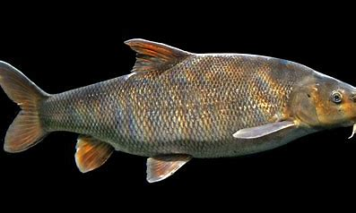
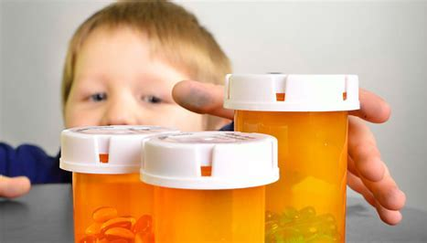
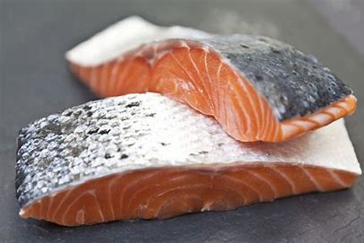
POISONz
Don’t get them confused
poisson
Don't consume it
It’s kinda bad

Slide 2
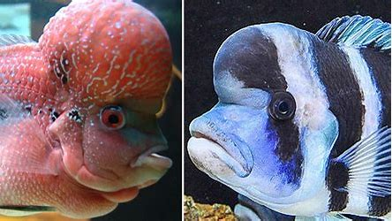
POISONS AND EARLY TOXICOLOGY
A poison is a substance that is capable of causing the illness or death of a living organism when introduced or absorbed. It’s involved in toxicology as that is the study of poisons, chemicals, and toxins for the purpose of investigation.
Early toxicology dates back as early as 50 000 BCE. Written records show that people were testing the natural chemical properties of plants, animals, insects and minerals from about 3000 BCE. Even famous figures in history like Cleopatra and Leonard da Vinci experimented with poisons.
Development of toxicology:
Poisons have been a common means of murder for thousands of years. They were often used as a ‘silent killer’ because some poisons leave few or no external traces, and their side effects – such as stomach cramps, vomiting, diarrhea or headaches – appear as regular symptoms for a host of other illnesses. This made it very difficult to detect when poison had been used to kill a person, or to determine if they could have ingested the poison by themselves, whether accidentally or on purpose.

Slide 3
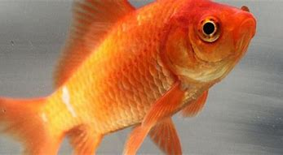
How to tell if someone has been poisoned
When alive, the symptoms of poisoning will depend on the type of poison and the amount taken in, but general things to look out for could be vomiting or stomach pains. Some poisons enlarge or constrict them, create drooling or dry out the mouth some produce an increased or decreased heart rate. Additional symptoms of poisoning include pain, slowed or increased breathing rate and hyperactivity.
When dead, some poisons display a difference in the tissue component of the host body. Carbon monoxide poisoning will leave the blood in a cherry red colour. In the case of carbon monoxide poisoning due to a fire incident, if there is no smoke or soot lining in the trachea, it is likely that the victim died before the fire. This is since breathing would have them inhale trace particles of soot and smoke in desperate gasps for air.

Slide 4
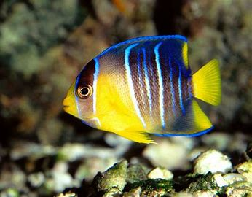
Common poisons
Many household products are poisonous and are used in suicide:
Pain medicine, antidepressants, cleaning substances and alcohols are all common poisons used by adults
If you drink bleach, it oxidizes or burns tissues in your mouth, esophagus, and stomach. It can also cause chest pain, lowered blood pressure, delirium, coma, and potentially death
Symptoms of arsenic poisoning may include:
red or swollen skin
skin changes, such as new warts or lesions
abdominal pain
nausea and vomiting
diarrhea
abnormal heart rhythm
muscle cramps
tingling of fingers and toes
Exposure to a large amount of cyanide by any route may cause these other health effects as well: Convulsions, Loss of consciousness, Low blood pressure, Lung injury, Respiratory failure leading to death, Slow heart rate

Slide 5
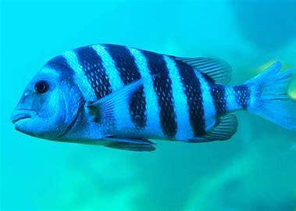
METHODS OF STUDYING POISONS
There are specific forms of poisons that can tell a lot about the purpose as to why they were used. For example
1. Solid Poisons
These poisons do not get absorbed easily into the blood. These should be dissolved in liquid to get absorbed. For example- Lead, Arsenic, Mercury etc.
2. Liquid Poisons
These poisons contain both organic and inorganic liquid. Organic liquids are more volatile than inorganic liquids.
3. Gaseous Poisons
These poisons are absorbed by inhalation such as carbon dioxide, carbon monoxide.

Slide 6
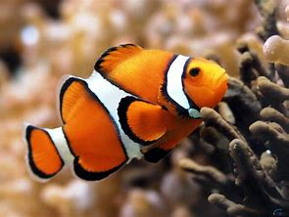
Angel of Death
Between 1993 and 1995, a nurse named Orville Lynn Majors was linked to 130 of the 147 deaths at the Intensive Care Unit of Vermillion County Hospital. Called “Angel of Death,” Nurse Majors was convicted in 1999 for injecting six patients with heart-stopping, lethal doses of epinephrine and potassium chloride. Although he is not officially blamed for 130 deaths, there is a great deal of suspicion surrounding these deaths.
His serial killing spree lasted for a couple of years in the mid-1990s, and the only reason his actions were brought to light was due to a routine study conducted by the hospital. The results of the study revealed that by 1994, the intensive care unit had a death rate of 120, despite the number being only 31 during years’ prior.

