Slide 1
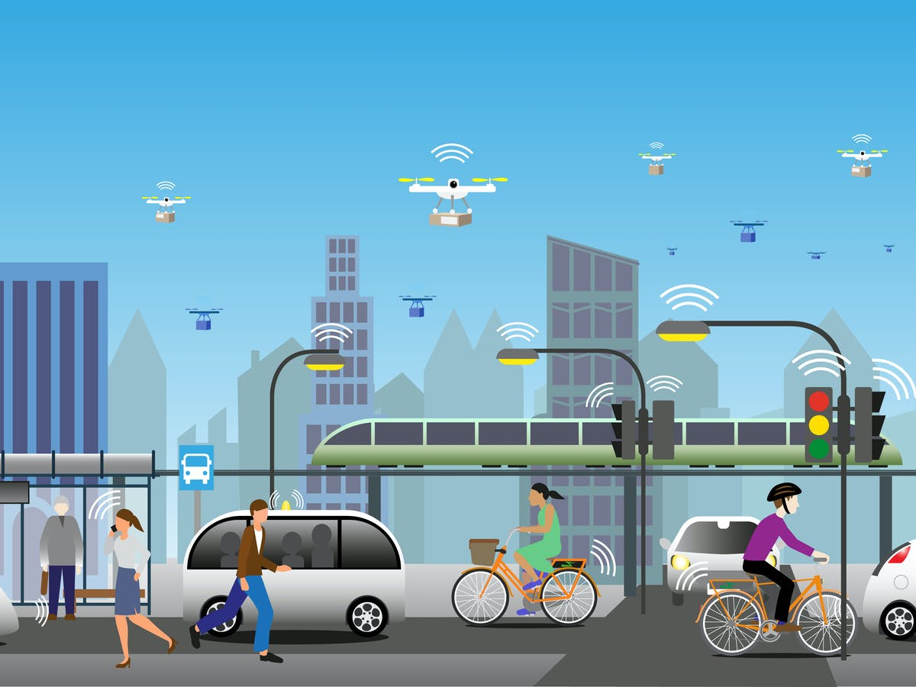
Learning Aim B
Potential advantages and disadvantages of travel options to access global destinations
B1 Different types of gateways and transport hubs and their facilities
AIR – Airports and Codes

Slide 2
Potential advantages and disadvantages of travel options to access global destinations
Global destinations have become more accessible via a network of different transport routes and providers.
There is now a wide range of travel and transport options available and each has their own advantages and disadvantages depending on a variety of factors, including customer needs.
International gateways and travel hubs such as airports and seaports enable tourists to access a variety of different travel routes to their destinations.
Some destinations are more difficult to get to than others , but for some visitors this may appeal to them as they are less likely to be mass tourist destinations – Can you give me some examples?

Slide 3

Your Experiences?
What is the worst journey or domestic trip you have experienced?
What made it so bad?
How could it have been improved?
“Camping in Dorset – it rained so much we were forced to come home”
“Flights to France cancelled due to computer technical, 14 hour drive instead to reach a family birthday party.”

Slide 4
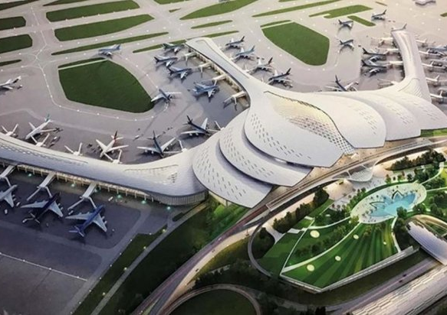
Gateways and Hubs?
What is the difference?
Gateway – A place where travellers enter of leave a country of destination, including airports, seaports, railway stations and coach and bus stations.
Hub – a central transport facility, such as an airport, from which other transport facilities operate, such as buses, coaches, trains and taxis.

Slide 5
Major emerging gateways and transport hubs and their facilities - Airports
Airports measure the number of international passengers that they receive, and these numbers can be used to identify which airports are the most important gateways and hubs.
Passengers may be using the airport directly to get somewhere or may be using it to transfer to another destination and will therefore require a range of facilities to pass the time away whilst waiting for their connecting flight.
Some cities also choose to develop themselves into stopover destinations to encourage passengers to visit the area. Can you give me any examples???

Slide 6
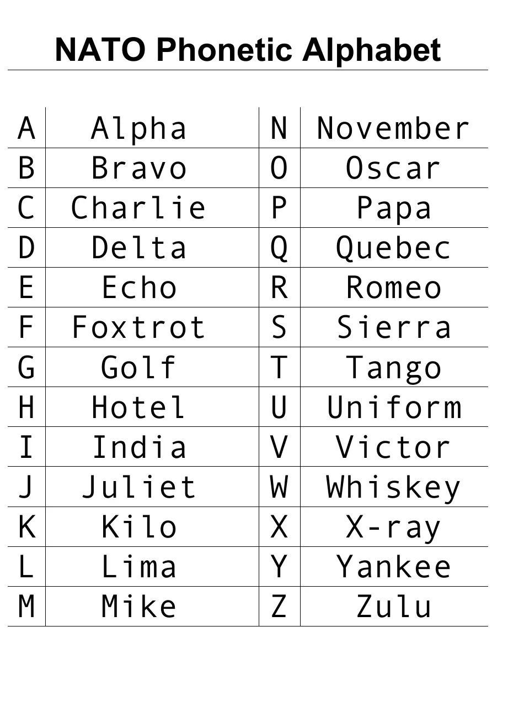
IATA Codes
Each airport has a three letter code known as its IATA Code. This code is unique so there can be no confusion about which airport is which, even if they share the same name. E.g. Manchester Airport in the UK has the IATA code of MAN, whereas Manchester Airport in Boston, USA is known as MHT.
When travel agents use IATA codes they usually use the phonetic alphabet. This is an important tool to know within the travel and tourism industry! Lets give it a go!

Slide 7
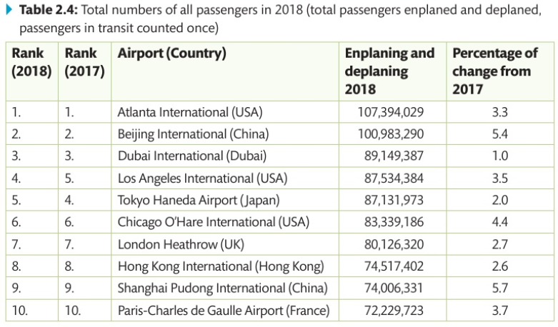
Activity - Where are the airports and their 3 letter codes?
Locate all the airports on the grid onto a world map, and identify their three letter code.
Identify the airports from the following codes: AMS, MAD, TOJ, LBG, CDG, ORY, IBZ, PMI, LMZ, AGP
https://www.world-airport-codes.com/

Slide 8
Airport Facilities
What facilities are provided at airports?
What type of passengers use facilities of an airport?
Using the grid on the next page, decide what type of airport facilities each of the customer types would need and want?
Tourists (including families, special needs, elderly, couples, education, VFR)
Business travellers
Stopover passenger
Non-travellers (e.g. airport staff)

Slide 9
Activity – Airport facilities
Type of Traveller | Airport facility needs
Tourists
Business travellers
Stop-over passengers
Transit passengers
Non travellers (airport staff)

Slide 10
Changi Airport Singapore
In the 2019 World Airport Awards, Changi Airport in Singapore was voted the world’s best airport for the 7th year.
The airport has been developed to such an extent that it is almost a destination itself, containing a cactus garden, an entertainment centre with cinema, Xbox Kinect room and even a hot tub. There is also a swimming pool on the roof!
Airport Guide | Singapore Changi Airport
53 Things to Do in Changi Airport, Singapore - Trevallog
How do you think the array of facilities at Changi Airport may encourage passengers to use the airport?
Where is Changi listed on the previous table. Has the airport moved up or down the rankings?
Where might you be going if you were travelling from the UK via Singapore? Give at least three examples of potential destinations…

Slide 11
Homework Task- Planning a flight itinerary
Choose one of these three routes to investigate:
1. LHR/SIN/DPS (Singapore Airlines) 2. LHR/CDG/JFK (Air France) 3. LHR/HKG/SYD (Cathay Pacific)
Route | Investigate
Departure time
Transfer Time (how long do you spend at the transit airport?)
Arrival Time (final destination)
Length of Journey
Facilities at departure airport
Facilities at transfer airport
Facilities at arrival airport

Slide 12
Key Terms
Gateway
Hub
IATA code
Direct flight
Indirect flight
ETA
ETD

