Slide 1
Learning Aim B Different types of gateways and transport hubs and their facilities
Rail, Road & Sea Travel

Slide 2
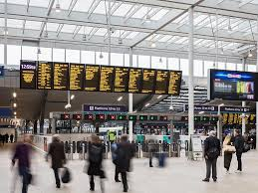
What is a rail terminal?

Slide 3
International rail terminals
Passengers choosing to travel by train also expect accessible connections and facilities. One example is the Eurostar service between UK and mainland Europe, which has important terminals at London St Pancras, Paris Gare Du Nord and Brussels Midi, as well as intermediate stations in Ashford and Ebbsfleet in Kent and Lille in France.
Eurostar also offers connecting tickets to more than 100 additional destinations in France, Germany and the Netherlands.
This make it a lot easier process for UK passengers as they can book their whole trip through Eurostar and get all the information they need without having to book with individual rail networks in each of the different countries.
What are the pros and cons of travelling with Eurostar?

Slide 4
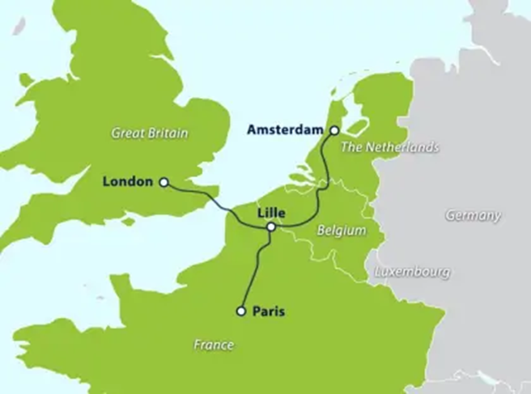
Facilities at a Rail Terminal
What facilities do you find at a rail terminal?

Slide 5
Eurostar, Le Shuttle and the Eurotunnel – What’s the difference?
What is the Chunnel?
The Channel Tunnel is an undersea tunnel linking southern England and northern France. It is operated by the company Getlink, who also run a railway shuttle (Le Shuttle) between Folkestone and Calais, carrying passengers in cars, vans and other vehicles.
Eurostar is a totally separate company running high-speed passenger services through the Channel Tunnel between London and a number of other European cities on the continent, including Paris, Brussels, Lille, Lyon, Avignon and Marseille.
https://www.eurostar.com/be-en/travel-info/the-channel-tunnel
The Channel Tunnel is 50.45 km long or 31.5 miles. That's the equivalent of 169 Eiffel Towers stacked on top of each other.
37.9 km (23.5 miles) of the Channel Tunnel is under the English Channel, making it the world's longest undersea tunnel.

Slide 6
Eurostar services and facilities?
What services, facilities and international rail connections are available when travelling by Eurostar from London St Pancras to Brussels and Paris?
Use the following link to help: https://www.eurostar.com/be-en

Slide 7
Road Travel
Road travel relates to vehicles using major and minor roads including motorways and road tunnels. It is most suitable for domestic tourism and shorter trips, but can also be used to make longer and international journeys.
Thanks to the Channel Tunnel and the Channel ports, it is easy for tourists travelling between the UK and the rest of Europe to make their journey by road.
Motorways in France and Spain are less congested than those in the UK, and therefore makes the journey through the country a lot quicker. You will however pay a Toll for the convenience.

Slide 8
What vehicles do we travel with?

Slide 9
Sea Travel
Travelling by sea can be a convenient option, especially if the distance to be travelled is very short. However seasickness can be a problem for some travellers, and some boats or ships cannot operate in bad weather.

Slide 10
What is the difference between a ferry and a cruise?
Ferry
Cruise

Slide 11
Sea ports
Most cruise companies operate international routes, with ships travelling between two or more countries. However some companies offer national cruises, such as sailing around the coast of a country.
Sea ports are the hubs that allow travellers to join ferry and cruise services. The world’s busiest cruise ports are in the USA, with Miami and Port Everglades (serves 11 different cruise lines) in Florida ranking the highest. For UK passengers, many choose a fly-cruise for joining a tropical cruise (e.g. fly to USA and then join a Caribbean cruise).
Many cruise operators now offer cruises originating from the UK. This avoids passengers having to take flights and ports will need to provide high quality facilities for these passengers.

Slide 12
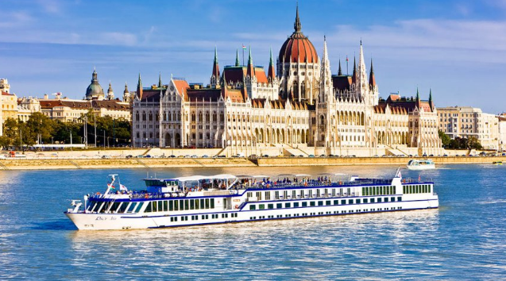
River Cruises
River cruises are another way of exploring a country or a region. This type of cruising is growing in popularity; passenger numbers from the UK grew by 21% in 2017. The River cruise is a popular way of exploring Egypt, with sightseeing cruises taking tourists up and down the Nile in order to visit famous historical sites such as the temples of Karnak and Luxor and magnificent Valley of the Kings.
Political unrest in recent years have seen Nile bookings decline, while cruises on the Rhine and Danube in Germany are gaining popularity. The Danube is the second longest river in Europe which begins in the Black Forest region of Germany and runs through ten countries (Germany, Austria, Slovakia, Hungary, Croatia, Serbia, Romania, Bulgaria, Moldova and the Ukraine).

Slide 13
National & Local Cruises
National cruises are organisations who offer cruises sailing around the coast of a country
Can you think of any examples?
Local cruises are often used as a way of providing tourists with an unusual or exciting way of seeing attractions.
Can you think of any examples?
Local cruises can also double as a form of transport from one destination to another, as crossing the border from Vietnam to Cambodia is made easier by travelling on an organised cruise along the Mekong Delta.

Slide 14
Transport Hubs
Integrated Transport Systems and Services
A transport hub is a place where passengers can move from one mode of transportation to another. E.G. many airports now provide options to take a rail, bus or light rail link to the nearest city centre and other transport hubs such as central railway stations and coach stations.

