Slide 1
Forensics
Research a Killer

Slide 2
Research a Killer!
Not too historical more recent cases
How they caught them

Slide 3
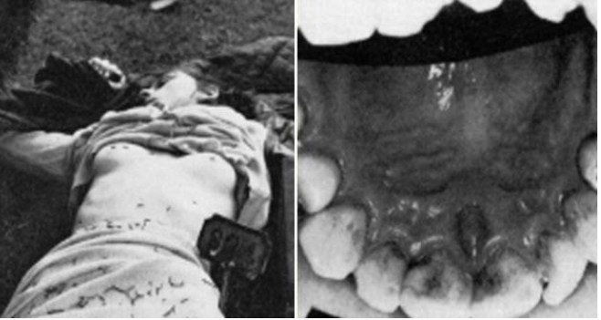
On August 7, 1967, 15-year-old Linda Peacock was found murdered in the Scottish town of Biggar. She had been beaten and strangled and had a bite mark on her right breast.
Authorities had a rich supply of potential suspects as the crime scene was near a school for juvenile convicts. Right off the bat, they had 29 persons of interest to investigate. They had to find a way to narrow down the field, so they turned to dental surgery lecturer and consultant Warren Harvey.
An initial set of teeth impressions from inmates and staff eliminated everyone but five.
A closer inspection singled out 17-year-old Gordon Hay.
His teeth suffered from cuspal maldevelopment which resulted in raised circular edges.
They matched small, circular contusions left on Linda’s breast.
However, if this was to be the evidence that convicted Hay, Harvey had to show that it was a unique or exceedingly rare dental defect.
He studied 350 boys aged 16 to 17 and examined over 1,000 canines. Harvey only found two teeth with similar pits and none that were on opposing sides of the same mouth. He spent five hours in the witness box, and the bite mark evidence was enough to convict Gordon Hay in a first for a murder case in the United Kingdom.[7]

Slide 4
Titles -5 slides
Murderer
History – childhood etc
How he/she murdered the victims
How they were caught using Forensics
How long sentence was or did they get the death sentence?
http://aboutforensics.co.uk/case-studies/

Slide 5
Some interesting cases but try and find your own
https://www.bbc.co.uk/news/uk-england-nottinghamshire-45561514
https://www.criminaljusticeprograms.com/articles/how-forensic-science-cracked-the-golden-state-killer-case/
https://www.forensicsciencedegree.org/how-forensics-finally-caught-up-with-the-green-river-killer/

Slide 6
The Murderer and what he/she did

Slide 7
History
What was their childhood like?
What happened when they were an adult?
Was there anything that tipped them over the edge?

Slide 8
How did they murder the victims/ dispose of the body/bodies

Slide 9
How Forensics helped them to be caught

Slide 10
How long sentence was or did they get the death sentence?

