Slide 1
History of Forensics
Have you been fooled by forensics on TV? | BBC Ideas – YouTube

Slide 2
Who am I?

Slide 3
What is forensics?
Forensic science is the application of scientific principles to questions of forensic (or legal) importance. Any branch of science may be of assistance in answering those questions, but of particular importance are:
biological science - DNA/ molecular biology, serology etc
chemistry - toxicology, paint analysis etc
physical evidence examination - toolmarks, ballistics etc
fire and explosion reconstructions/ interpretation etc
forensic specialties allied to forensic pathology (e.g. forensic entomology, anthropology, odontology, botany etc)
Read more: http://www.forensicmed.co.uk/science/forensic-science/

Slide 4
The Real Science of Forensics – YouTube
Early forensics and crime-solving chemists - Deborah Blum | TED-Ed

Slide 5
Quiz – what do you already know?

Slide 6
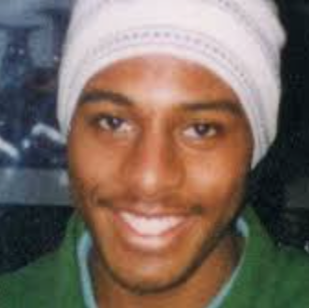
Forensic science in action
18-year-old teenager, Stephen Lawrence, was murdered by a gang of racist youths in Well Hall Road, Eltham, South London on 22nd April 1993. Two members of that gang, Gary Dobson and David Norris, were convcted of his murder on 3rd January 2012. Read more: http://www.forensicmed.co.uk/science/forensic-science/

Slide 7
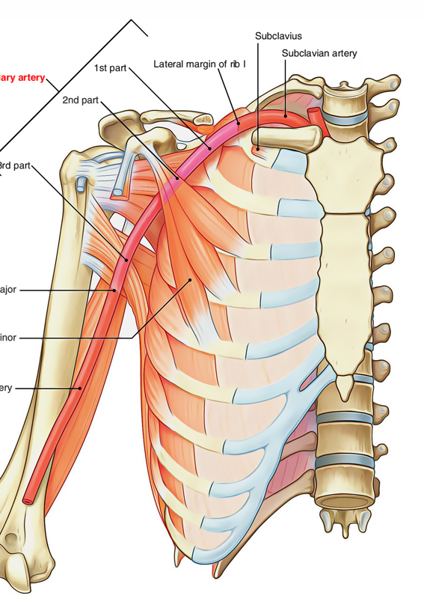
Stephen had been stabbed to a depth of about five inches on both sides of the front of his body to the chest and arm. Both stab wounds severed axillary arteries, and blood must literally have been pumping out of and into his body as he ran up the road to join his friend. In the words of Dr Shepherd, the pathologist, "It is surprising that he managed to get 130 yards with all the injuries he had, but also the fact that the deep penetrating wound of the right side caused the upper lobe to partially collapse his lung. It is therefore a testimony to Stephen's physical fitness that he was able to run the distance he did before collapsing". Read more: http://www.forensicmed.co.uk/science/forensic-science/

Slide 8
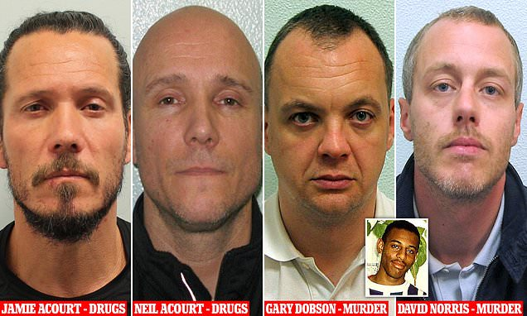
Suspects
It took 18 years for the family to secure convictions for the murder.
In January 2012, Gary Dobson and David Norris were found guilty of murder at the end of a six-week trial.

Slide 10
Research a Killer group work- groups of 3!
Not too historical more recent cases
Produce a powerpoint as I will use some of the slides in next weeks lesson when we look at Psycopaths
Research two killers
You have 45mins
You can leave the meeting and set up your chat – please include me!
Post your power point on the chat
Come back to a new meeting so we discuss serial killers!

Slide 11
Titles -5 slides
Murderer
History – childhood etc
How he/she murdered the victims
How they were caught using Forensics
How long sentence was or did they get the death sentence?
http://aboutforensics.co.uk/case-studies/

Slide 12
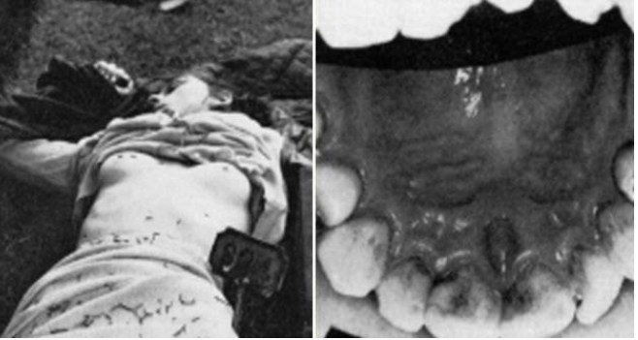
On August 7, 1967, 15-year-old Linda Peacock was found murdered in the Scottish town of Biggar. She had been beaten and strangled and had a bite mark on her right breast.
Authorities had a rich supply of potential suspects as the crime scene was near a school for juvenile convicts. Right off the bat, they had 29 persons of interest to investigate. They had to find a way to narrow down the field, so they turned to dental surgery lecturer and consultant Warren Harvey.
An initial set of teeth impressions from inmates and staff eliminated everyone but five.
A closer inspection singled out 17-year-old Gordon Hay.
His teeth suffered from cuspal maldevelopment which resulted in raised circular edges.
They matched small, circular contusions left on Linda’s breast.
However, if this was to be the evidence that convicted Hay, Harvey had to show that it was a unique or exceedingly rare dental defect.
He studied 350 boys aged 16 to 17 and examined over 1,000 canines. Harvey only found two teeth with similar pits and none that were on opposing sides of the same mouth. He spent five hours in the witness box, and the bite mark evidence was enough to convict Gordon Hay in a first for a murder case in the United Kingdom.[7]

Slide 13
Some interesting cases but try and find your own
https://www.bbc.co.uk/news/uk-england-nottinghamshire-45561514
https://www.criminaljusticeprograms.com/articles/how-forensic-science-cracked-the-golden-state-killer-case/
https://www.forensicsciencedegree.org/how-forensics-finally-caught-up-with-the-green-river-killer/

