Slide 1
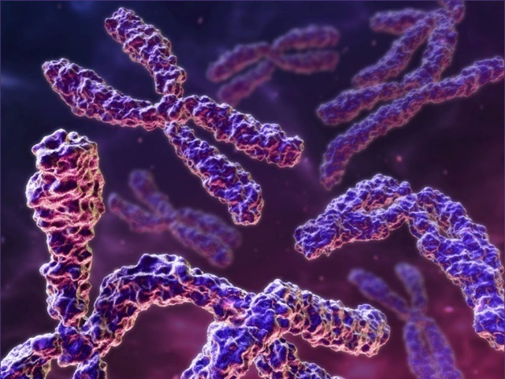
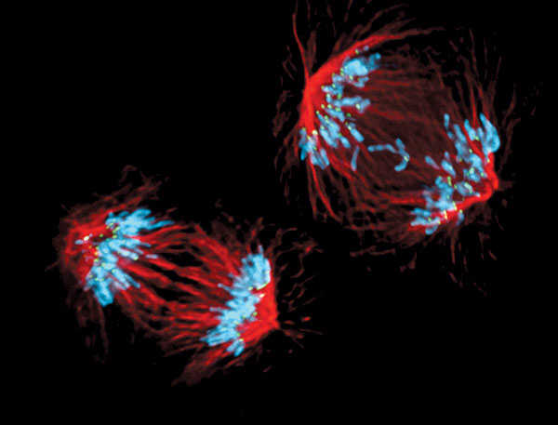
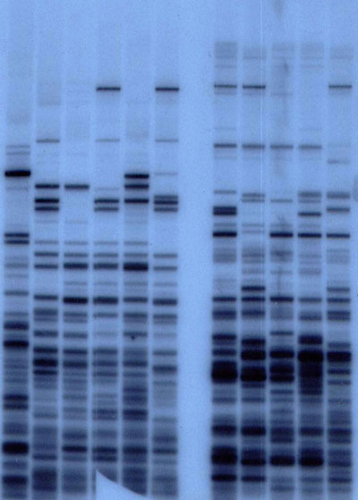
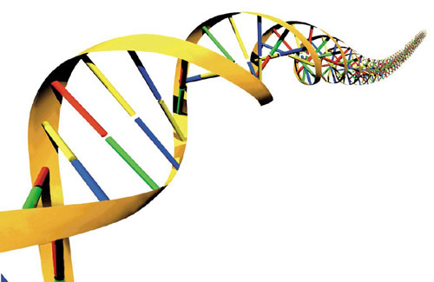
Genes and Variety
WJEC GCSE Science
Biology Module 1

Slide 2
What do you know about DNA???
MWB you have 5 mins

Slide 3
Fun Fact
If all of the DNA in your body was stretched out and put end to end, it would reach to the sun and back more than 600 times!

Slide 4
DNA
1-2 per cent of human DNA is coding DNA (GENES) and 98.5 per cent is non-coding DNA.
Genes are simply portions of the DNA that code the information required to make specific proteins.
The human body has approximately 20,000 genes
.

Slide 5
How much DNA do we share with………
Chimpanzee?
96%
Cat
90%
Fruit fly
62%
Banana
60%

Slide 6
How much of my DNA is the same as yours?
Whilst over 99.99% of human DNA is common between individuals, this minute variance is more than sufficient to allow comparative testing between subjects
A technique referred to as DNA testing, DNA typing, DNA evidence, or genetic fingerprinting

Slide 7
DNA extraction
https://www.youtube.com/watch?v=4h9y4_EMsL4

Slide 8
Extraction of DNA
Add 5g of salt and 5g of washing up liquid to the 50 ml beaker of water. Stir carefully to avoid too much froth forming – this is your extraction buffer.
Strawberries – add strawberries to zip lock bag and carefully add your extraction buffer.
Kiwi – gently mash with a fork before adding to zip lock bag. Add your extraction buffer.
Carefully squeeze out excess air from the bag and ensure it is sealed properly.
Using your hands gently squeeze the bag to mechanically break up the cells for a couple of minutes.
Leave to stand for 10 minutes.
Pour the bagged mixture through a sieve into a clean beaker.
Slightly tilting the beaker, use a pipette slowly add 3 – 5ml of the cold alcohol allowing it to run down the sides of the beaker.
The mixtures will separate and you should see a string-like layer form on the surface – this is your DNA!
The DNA can be lifted out using the cocktail stick.

Slide 9
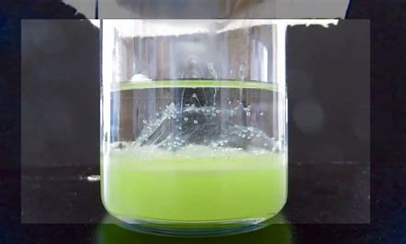

Slide 10
You can do this at home!
Just make sure the alcohol you use is 70% proof – ask your parents

Slide 11
How was genetic fingerprinting discovered?
Watch Part 1 of documentary
https://estream.godalming.ac.uk/View.aspx?id=16022~58~PtuPhmd3y9

Slide 12
Lesson 2
Finish documentary and discuss

Slide 13
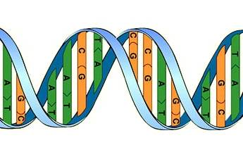
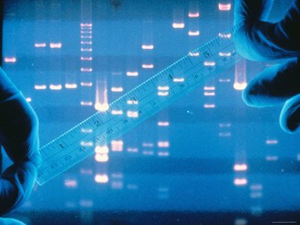
What is DNA fingerprinting?
The chemical structure of everyone's DNA is the same - the only difference is the order of the base pairs. There are so many millions of base pairs in each person's DNA that every person has a different sequence.
DNA fingerprinting uses differences in DNA sequences to identify a specific individual. It is also known as genetic fingerprinting or DNA profiling.

Slide 14
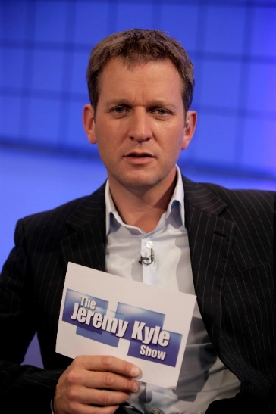
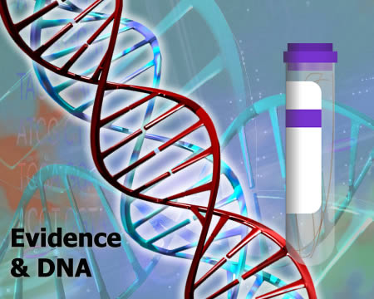
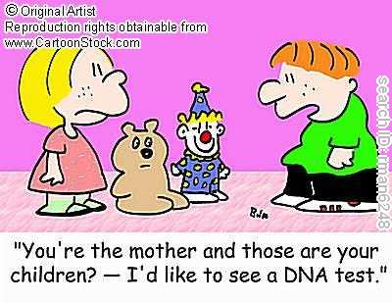
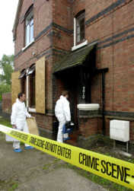
How is DNA fingerprinting used?
DNA fingerprinting is currently used for identifying paternity or maternity
DNA fingerprinting is also used for identifying criminals or victims of crime

Slide 15
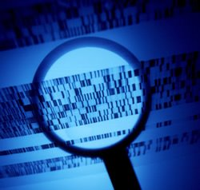
DNA Fingerprinting
1987 – Forensic scientist first used DNA profiling (genetic profiling) to solve a rape case. It was discovered in the UK by Alec Jefferies.
How does DNA fingerprinting work? - Naked Science Scrapbook - YouTube

Slide 16
What contains DNA?
Generally, DNA can be extracted from any of the biological samples.
Buccal smear,
saliva,
blood,
amniotic fluid,
skin,
hair,
body fluid and other tissue are the major types of the sample used for DNA fingerprinting.

Slide 17
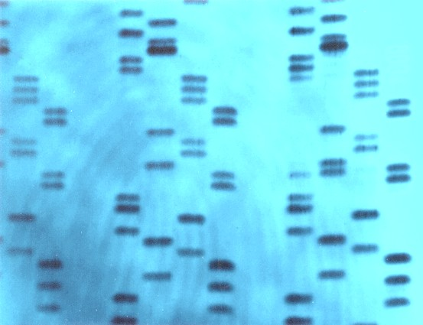
How it works
Only 0.1% of DNA (about 3 million bases) differs from one person to the next. These different regions are used to generate a DNA profile of an individual, using samples from blood, bone, hair, and other body tissues and products.
Enzymes are used to cut out specific sequences of DNA. The different lengths are then arranged in order of length using electrophoresis (RFLP)
Once the DNA sequences are ordered, they are labelled so that they show up when photographed. This produces the 'fingerprint' - a series of black lines corresponding to the DNA sequences present.

Slide 18
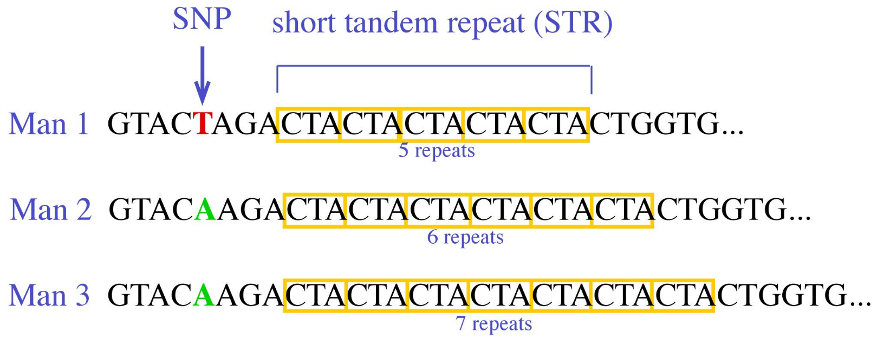
Short Tandem Repeats
New technique that is becoming more common than RFLP because it takes less time, less of a sample size, and is more exclusionary.
STRs are locations on the chromosome that repeats a specific sequence of two to ten base pairs.

Slide 19
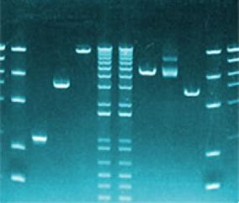
STR
Thousands of STR sites have been identified
They are located on almost every chromosome in the body
Easily amplified using a amplification technique known as PCR

Slide 20
STR
Forensic scientists scan 13 DNA regions that vary from person to person
They use the data to create a DNA profile of that individual
There is an extremely small chance that another person has the same DNA profile for a particular set of regions

Slide 21
STR
STR analysis is now the primary method for genetic profiling
In 1992 the Innocence Project at the Cardozo School of Law started using STR tests to free wrongfully convicted people from jail.
As of January 7th, 2014 312 have been exonerated
As of May 29th , 2014 316 have been exonerated

Slide 22
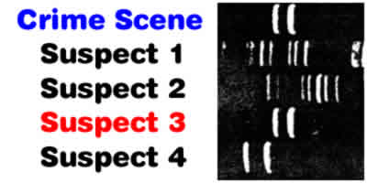
How it works
In criminal cases, DNA samples from crime-scene evidence and a suspect are compared. If the sample profiles don't match, the person did not contribute the DNA at the crime scene.
If the patterns match, the suspect may have contributed the evidence sample.
DNA from crime scenes also can be compared to profiles stored in a database.
DNA collected at the scene of a crime is compared with DNA samples collected from 4 possible suspects. The fragments from suspect 3 match those left at the scene of the crime, betraying the guilty party.

Slide 23
How do you compare parentage?

Slide 24
Activity 1
Here are six different DNA tests. Suppose these DNA tests are of a couple who are married and their possible children.
Which of the kids belong to both parents?
Which of the kids belong to only the mother?
Which of the kids belong to only the father?
Which of the kids belong to neither parent?

Slide 25
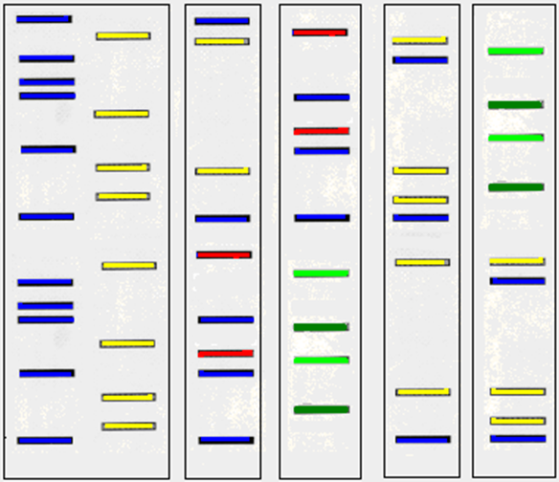
Mum Dad 1 2 3 4

Slide 26
Mum Dad 1 2 3 4
Mum Dad 1 2 3 4
Mum Dad 1 2 3 4
Mum Dad 1 2 3 4

Slide 27
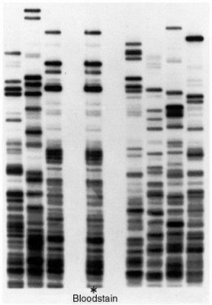
DNA fingerprint
Forensic comparison
Which sample matches the blood stain? Do the work sheet on chat
Sample A
Sample B

Slide 28
Activity sheet-

Slide 29
Teacher Answers

Slide 30
DNA evidence is not the be and end all
Houston Police department Crime Laboratory
Josiah Sutton accused of Kidnap and Rape 1998
Convicted Using DNA evidence for 25yrs
4 years later a private company re looked at the DNA evidence – he was not a match
2006 Donnie Young Confessed to the rape
Josiah Sutton - Innocence Project

Slide 32
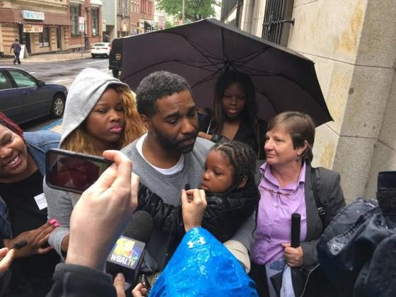
Forensics gone wrong: When DNA snares the innocent
Thanks to a series of advances it’s now possible to detect DNA at levels hundreds or even thousands of times lower than when DNA fingerprinting was developed in the 1980s.
Investigators can even collect “touch DNA” from fingerprints on, say, a glass or a doorknob. A mere 25 or 30 cells will sometimes suffice.
Can create false positives
A Baltimore man named Malcolm Jabbar Bryant has been exonerated and set free
spending 17 years in prison for a murder that new DNA evidence has finally shown
he did not commit. Malcom was arrested in 1998 when a ‘single eyewitness’ identified
him as the man who stabbed a 16-year-old girl named Toni Bullock to death
on November 20, 1998
Notes:
But Italian prosecutors also charged Knox and her boyfriend Raffaele Sollecito with murder. Traces of Sollecito’s DNA had been found on the clasp of a bra belonging to Kercher, suggesting that he had taken part in the sexual assault, while a knife in Sollecito’s kitchen drawer showed Knox’s DNA on the handle and Kercher’s DNA on the blade.
Hampikian reviewed the lab’s procedures and data for the defense team. He noted that the bra clasp hadn’t been collected until 46 days after the murder, and not until several crime scene investigators had picked it up, passed it around and then put it back down on the floor to photograph its position—all of which could have caused Sollecito's DNA to end up on the clasp. And although plenty of Knox’s DNA was on the knife handle (she had used it in cooking), the amount of DNA from Kercher on the blade was vanishingly small—less than half the amount the FBI considered valid for testing.
Hampikian's critique was signed by nine other prominent geneticists and made public. Meanwhile, he had his students mimic part of the investigation in Italy. They collected five soda cans from the office of BSU's dean of arts and sciences after lunch and put them in individual evidence bags. Then, without changing gloves, they put five newly bought knives into separate evidence bags. Like the Italians, Hampikian’s group looked for DNA at levels below the FBI-recommended minimum. They found DNA from a member of the dean’s staff on one of the knife blades. Yet that person had not touched or even been in the same room with the knives.

Slide 33
However
305 people wrongfully convicted of crimes have been exonerated due to DNA evidence.
DNA remains the same in all the body parts, tissue and cells in our body (except germ cell). Even, after the death of the individual, the DNA remains as well.
It can remain stable even after 1000 years.

Slide 34
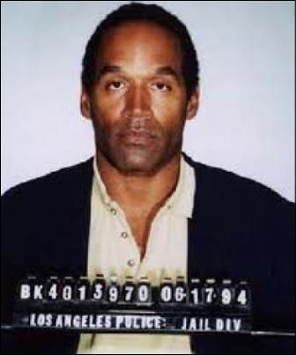
Famous Cases
In 1994 O.J Simpson was cleared of murder charges which relied heavily on DNA evidence.
The new technology, and the jury’s lack of confidence with it, formed a major part of the case.
This was later parodied in SouthPark as the Chewbacca Defence – it has become a technical term.
South Park - Chewbacca Defense – YouTube
Notes:
The Chewbacca Defence being a law tactic whereby the jury is presented with myriad facts or procedures they are unable to confidently understand the implications of – in the O.J Simpson case the jury was “bamboozled” and “blinded with science” in order to undermine their confidence in understanding DNA profiling.

Slide 35
Group work you have 20 mins
To find a case where DNA evidence helped to prove innocence
To find a case where DNA evidence was flawed and an innocent person was convicted

Slide 36
Gene Ownership – A National Database
Britain has the largest DNA database of its citizens in the world. It holds details of over 4 million people – 5.2% of the UK population
These include people who have been found guilty of a crime as well as those suspected of a crime but eventually cleared.
Should there be a database?
https://www.yourgenome.org/facts/what-is-the-uk-national-dna-database

Slide 37
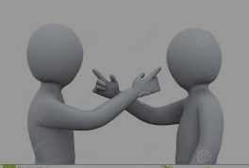
Activity
In pairs think of as many arguments in favour and against having a National database of DNA profiles and arguments against.

Slide 38
Arguments in favour
Each person's DNA is unique so, DNA evidence collected from a crime scene can implicate or eliminate a suspect (like fingerprints)
It also can analyse unidentified remains through comparisons with DNA from relatives
When evidence from one crime scenes are compared, there may be a link to the same perpetrator, so helping to solve crimes
If biological evidence from crime scenes is collected and stored properly, forensically valuable DNA, that may be decades old, could help solve an unsolved crime

Slide 39
Arguments against
It is possible for an innocent person’s DNA to be planted at a crime scene
An innocent person’s DNA may also be at a crime scene even though they weren’t involved in the crime
High cost to maintain and develop the database
It invades our right to privacy.
The data might get into the hands of commercial companies such as insurance, loan and employers. If it were used to identify that you had a genetic risk for a serious disease, could you find yourself refused life insurance, a loan, or even a job?
http://news.bbc.co.uk/1/hi/uk/7532856.stm

Slide 40
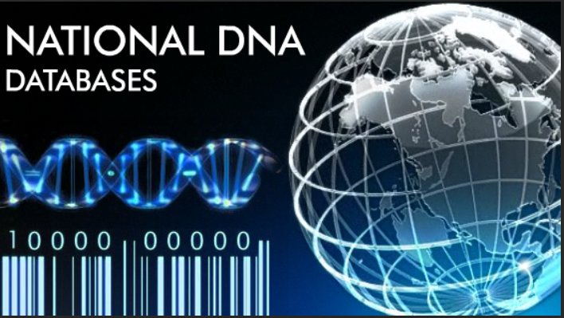
What use is a national database?
When it was first created in 1995, the UK National DNA Database only held records from convicted criminals or people awaiting trial.
The samples were then destroyed if the individual was later declared innocent.
However, over the years, the laws concerning the taking, use and storing of genetic information has changed.
As a result, the database rapidly expanded to include increasing numbers of innocent people and children, as well as the guilty.
By 2008, the police in England, Wales and Northern Ireland could take samples, without consent, from anyone arrested for all but the most minor offences. Unlike before, the samples and profiles were kept permanently.

Slide 41
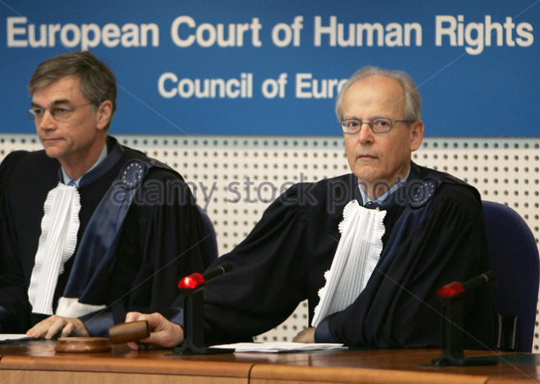
European Court of Human rights
In December 2008, the European Court of Human Rights made the decision that DNA from innocent people should not be kept on the database.
However, over the course of 2012 and 2013, the Protection of Freedoms Act ensured that 1,766,000 DNA profiles taken from innocent adults and children were deleted from the UK National DNA Database, along with 1,672,000 fingerprint records.
In addition to this, 6,800 convicted murderers and sex offenders, not previously on the database, have had DNA samples taken and the information added to the database.

Slide 42
The UK database
In 2013, the UK National DNA Database comprised (National DNA Database statistics):
4.8 million profiles (nearly 8 per cent of the UK's population)
80 per cent of profiles from men
76 per cent of profiles from white North European individuals
7 per cent of profiles from black individuals
5 per cent of profiles from Asian individuals
0.77 per cent of profiles from Middle Eastern individuals
73 per cent of profiles from individuals currently aged between 25 and 54
17 per cent of profiles taken from under 18s
14 per cent of profiles are replicated (more than one profile is held from the same individual)

Slide 43
Quizz – MWB A,B,C or D

Slide 44
Question 1- DNA fingerprinting was developed by?
Francis Crick
Khorrana
Alec Jeffrey
James Watson

Slide 45
Q2 – DNA finger printing relies on
Difference in patterns of genes between individuals
Difference in order of genes between individuals
Difference in Junk DNA between individuals
All of these

Slide 46
Q3 – The DNA fingerprint pattern of a child is
Exactly similar to both parents
100% similar to father’s DNA print
100% similar to mother’s DNA print
50% bands similar to father and the rest similar to mother

Slide 47
Q4 – A DNA profile is generated by
Separating DNA fragments by size
Separating out DNA fragments by their charge
Chopping up the DNA
Separates DNA fragments by weight

Slide 48
Q5 – The oldest sample a DNA profile was obtained from
Human origin 1000 years
700,000 year old horse
500,000 year old bacterium
Homo erectus 50,000 years to mother
Notes:
700, 000 year old horse

Slide 49
Q 6 Who’s guilty?
Suspect 1
Suspect 2
Suspect 3
Suspect 4

Slide 50
Q 7-How did OJ Simpson’s lawyer manage to refute the DNA evidence
The C3P0 Defence
The Luke Skywalker Defence
The Chewbacca Defence
The Leah Defence

Slide 51
DNA fingerprinting uses differences in DNA sequences to identify a specific individual.
http://estream.godalming.ac.uk/View.aspx?id=16022~58~PtuPhmd3y9
Upto 40 mins

Slide 52
What can you remember???
Finish programme
http://estream.godalming.ac.uk/View.aspx?id=16022~58~PtuPhmd3y9
From 40 mins

