Slide 1
Cooling curves

Slide 2
Measuring temperature
Which type of thermometer to use

Slide 3
Calibrating the thermometers
With ice
With boiling water
What should they read?

Slide 4
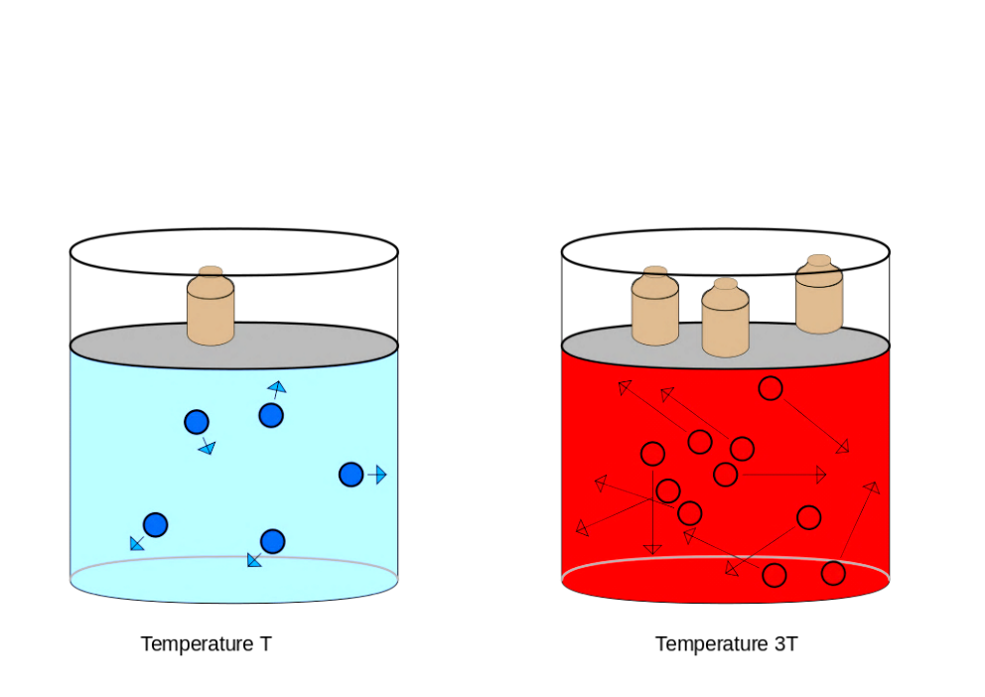
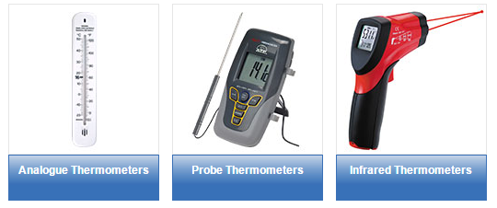
Accuracy of thermometers
Pressure – how high are we above sea level? The higher we are the less the pressure and the boiling points decrease
Are there any other types of thermometers which might be better?

Slide 5
Measuring something cooling
Heat it up
Put thermometer into it
Let it cool – in air or water?
Measuring the temperature every minute

Slide 6
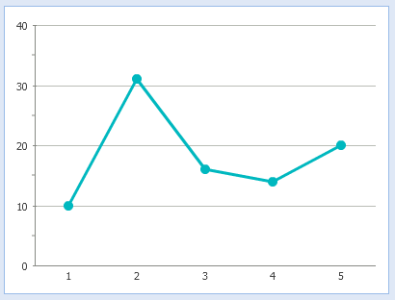
Plotting a graph
Temperature in °C
Time in seconds

Slide 7
What is happening when something cools and makes a solid?

Slide 8
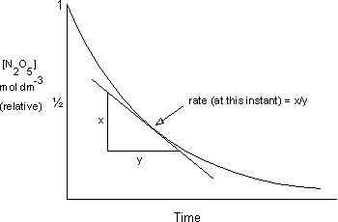
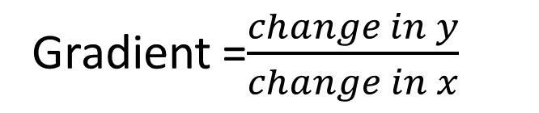
Measuring gradients
Gradient =$\frac{change in y}{change in x}$
y
x

Slide 9
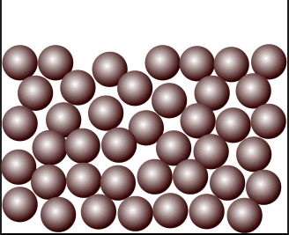
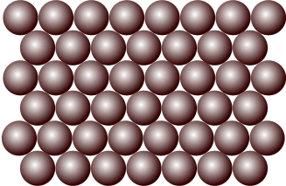
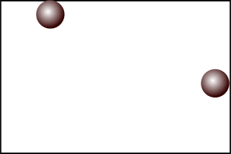
Changes of state
When a substance changes state that means something is happening to the intermolecular forces between the molecules – they are either breaking or being formed.
Solid
Liquid
Gas
Breaking intermolecular forces requires energy (you have to heat it up)
Making intermolecular forces gives out energy

Slide 10
Melting point determination
MP of 2-methylpropan-2-ol = 25-26°C
What is the class average?
How close are you to the actual melting point?
How close are you to the class average?

Slide 11

London Forces
Electrons are always in motion
This will always create a δ+ and δ- charge
INSTANTANEOUS dipole

Slide 12

London Forces
This instantaneous induced dipole then induces another dipole in the neighbouring atom
The more e⁻, the stronger the dipole will be
The longer the molecule the stronger the dipole
The less branching, the stronger the force

Slide 13
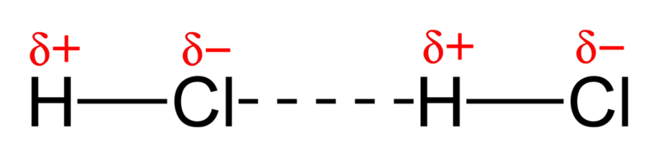

Permanent Dipole-Dipole
Molecules which are polar have a permanent dipole, when it interacts with another polar molecule it is called a permanent dipole-dipole force.
Stronger the dipole = stronger intermolecular force

Slide 14
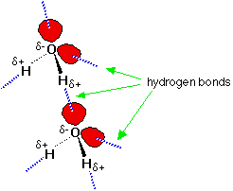
Hydrogen Bonding
NOF
FON
The 3 most electronegative elements
They usually have lone pairs
These lone pairs will bond with a hydrogen which is δ+
This gives a HYDROGEN BOND, it is almost the strength of a normal bond.

