Slide 1
Appraisals

Slide 2
What lab skills did you have before this year?
Pipetting?
Titrations?
Weighing solids – to how many dp?
Measuring temperature – what with?
What chemicals had you handled?
Personal Protective Equipment (PPE)?

Slide 3
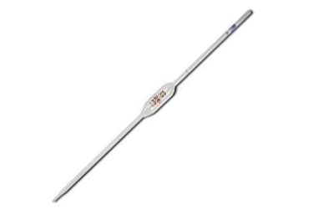
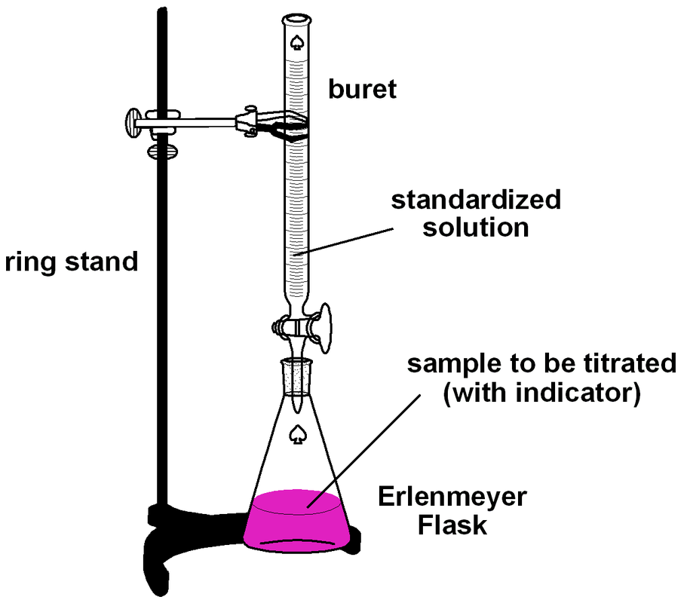
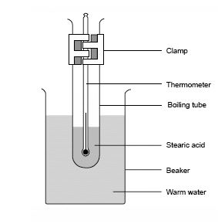
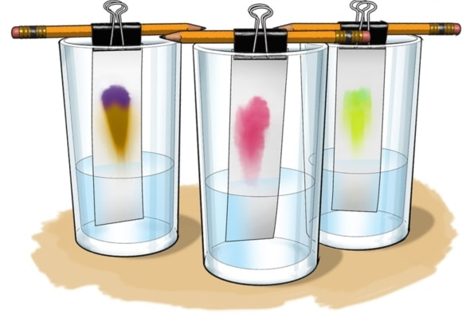
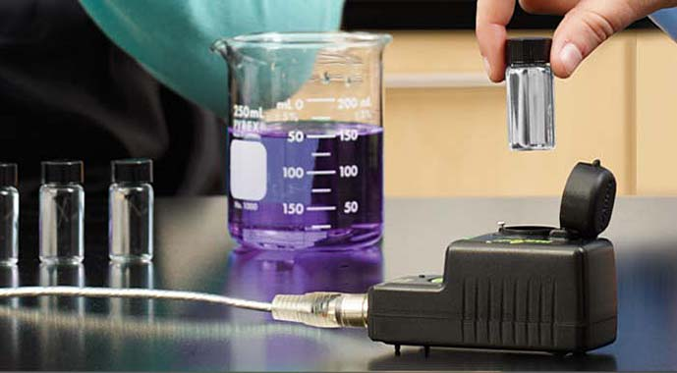
What skills have you learnt this year?

Slide 4
Skills this year, and any application to unit 1?
Moles calculations
Weighing to 2 dp
Standard solutions
Pipetting
Titration
Serial dilutions
Colourimetry
Cooling curves
Paper Chromatography
TLC
Rf values
Teamwork
Meeting deadlines
Report writing
Graphing, tangents and gradients
Excel spreadsheets
Timing
Resilience
Analysing results
Calibrating
Handling chemicals
Handling hot equipment
PPE

Slide 5
Strengths and weaknesses in each assignment
How close were to what you should have got?
What would you have done differently?

Slide 6
Responding to feedback
Has Brian or I ever suggested for you to do something differently?

Slide 7
Personal responsibility
Examples of skills developed and how they can be transferred
Working to appropriate standards and protocols
Accepting responsibility for the quality of own work
Applying safe working practices and behaviour
Taking responsibility for completing tasks and procedures as well as using judgements within defined parameters behaviour

Slide 8
Interpersonal skills
Giving and receiving effective feedback on your performance in relation to peers and your future progression goals
Behaviour for safe and effective working in science
Communicating and cooperating with others in the workplace

Slide 9
Professional practice
Recognising problems and applying appropriate scientific methods to identify causes and achieve solutions
Identifying, organising and using resources effectively to complete tasks
Maintaining and enhancing your competence.

Slide 10
Pass
Skills you had before
Skills you have learnt in unit 2
Skills to develop further
Discuss skills in general which you have learnt in each assignment
Explain which skills you have also used in unit 1 (or could use in further units)

Slide 11
Merit
Improvements you need to make and how you will achieve this

Slide 12
Distinction
Reflect on your strengths and weaknesses
Draw on feedback from peers, teacher, technician
Suggest what you could use these skills for in the future

Slide 13
Basic report outline
Skills learnt (pass)
  List of skills learnt and what skills you could learn in the future
What I need to improve upon (pass and merit)
How good I am compared to my peer group (merit)
What the teacher/technician says I need to improve upon (distinction)

