Slide 1
AQA
    A Level
      Computer Science
      Paper 2
Functional programming
  Unit 12
  OOP and functional programming

Slide 2
Objectives
Understand what is meant by a
programming paradigm
Define function type, domain and co-domain
Understand what is meant by a first-class object and how such an object may be used
Be able to evaluate simple functions
Use functional composition to combine two functions

Slide 3
Programming paradigms
A programming paradigm is a style of programming
Different types of problem need to be tackled in different ways:
  Calculating the forces that a new bridge need to withstand
  Finding your way out of a maze
  Translating from French into English
  Finding all the Skoda cars in the DVLA database with number plates beginning with AUH
Would you use a language like Python or VB.Net to solve all of these?

Slide 4


Ways of solving problems
There are many ways to catch a fish – and different situations require different “tools”

Slide 5

Procedural paradigm
This is the recipe approach to solving problems.
Ingredients can include variables
    Put teabag in mug
    While water_temp < 100
    Heat water
    Pour water in mug
    If white=yes then add milk
    If sugar=yes then
    For count=1 to how_many_sugars
    Add a spoonful of sugar

Slide 6
Object-oriented paradigm
This models the parts of the problem as objects with properties and methods
Here’s a Java fragment
  //add some milk
  myTea.addMilk(myCup);

Slide 7
Declarative paradigm
This paradigm states what needs to be done
Here’s an SQL fragment
  SELECT DrinkType, Milk, Num_Sugars
  FROM DrinkPreferences
  WHERE DrinkerName = Rob
Question (revision): what data type would be best for Milk?

Slide 8
Declarative
Question: what data type would be best for Milk?
Answer: Perhaps Boolean, for Yes or No; or maybe a string for “None”, “A little”, “Medium”, “A lot”. Or an integer to represent the range of 4 values
Others might also record Whole/SemiSkimmed/Skimmed/Goats/Soya
Those who are very particular might add the
volume in millilitres

Slide 9
Functional paradigm
This is the topic for today. It is a different approach to programming
A functional program describes a series of functions
Each function takes in some data as arguments and returns an output
Functional programming has a lot in common
with mathematics

Slide 10
Languages supporting different paradigms
Some programming languages support multiple paradigms:
  Python, VB and Delphi may be used to write a procedural or object-oriented program and have some support for functional programming
Other languages support a single paradigm:
  SQL and Prolog support the declarative paradigm
  Haskell supports the functional paradigm

Slide 11

Functional programming
Functional programming is not useful for procedures like making cups of tea
  We will explore a better use for it, when we look at Big Data

Slide 12
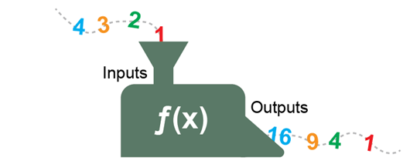
Functions
Functional programming has a lot in common
with mathematics
  Here’s a fragment of the Haskell language
  squareNumber x = x * x
  which a mathematician might write as
  f: A → B where f(x) = x²
  A function can be visualised as a number machine

Slide 13
Domain and co-domain
The domain is a set from which the function’s input values are chosen
The co-domain is a set from which the function’s output values are chosen
A function is a mapping from a set of inputs, called the domain, to a set of possible outputs, known as the co-domain
  For the function below, if the domain is the set of all integers from -10 to 10, what is the co-domain?
  squareNumber x = x * x

Slide 14
Domain and co-domain
  squareNumber x = x * x
  The domain is given as the set of integers
  from -10 to +10
  The co-domain is the set of non-negative integers
  The set that contains all possible output values of the function (i.e. the range) is {0, 1, 4, 9,…100}

Slide 15

Practical Haskell
Writing functions can be done with a text editor (e.g. Notepad) and the free GHC (Glasgow Haskell Compiler) for compiling your programs
  It’s at https://www.haskell.org/platform
  Here is a simple example:

Slide 16
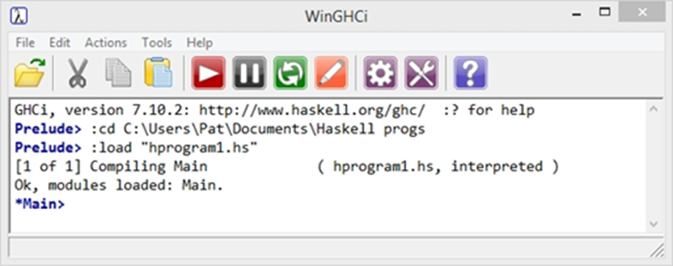
Starting Haskell
  Save this program as hprogram1.hs in a
  suitable folder
  In the Haskell window, use the File menu to navigate to your folder and load the file hprogram1.hs

Slide 17
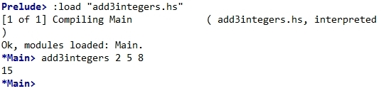
Starting Haskell
  The prompt changes to *Main>
  Run your program by typing
  add3integers 2 5 8

Slide 18
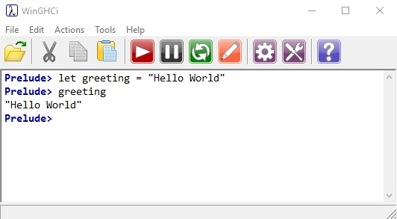
Worksheet 3
Do the questions in Task 1 of the worksheet

Slide 19
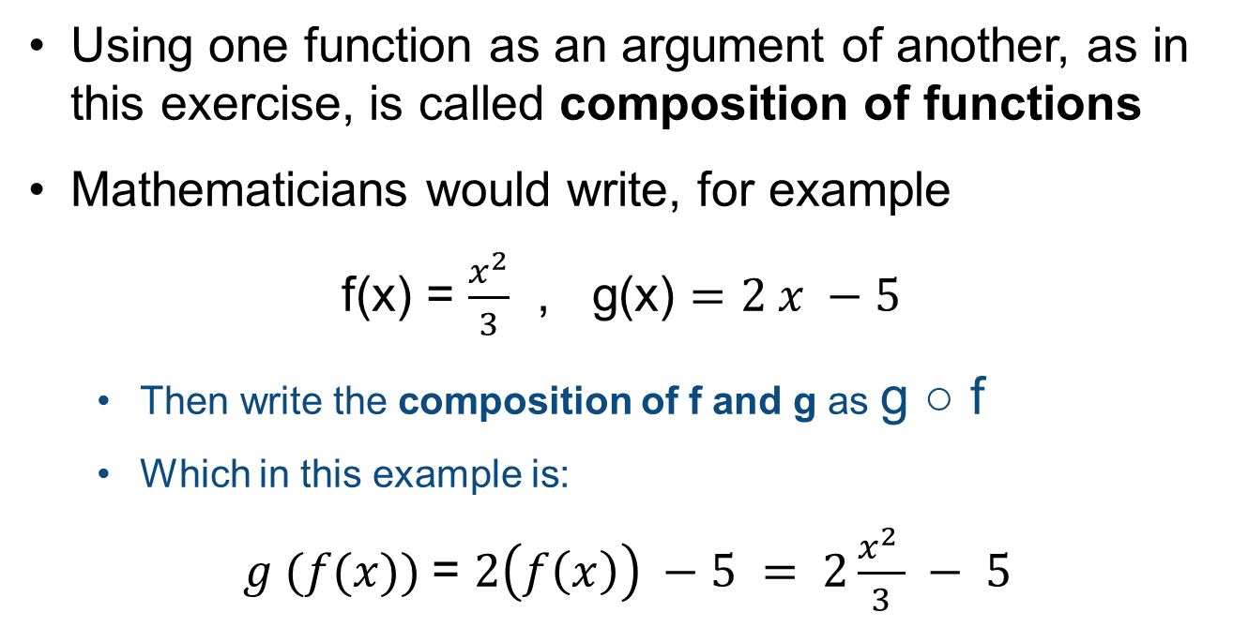
Composition of functions
Using one function as an argument of another, as in this exercise, is called composition of functions
Mathematicians would write, for example
f(x) = $\frac{x^{2}}{3}$ , g(x) $=2 x −5$
  Then write the composition of f and g as g ○ f
  Which in this example is:
$g (f(x))$= $2\left(f\left(x\right)\right) −5 = 2\frac{x^{2 }}{3} − 5$

Slide 20
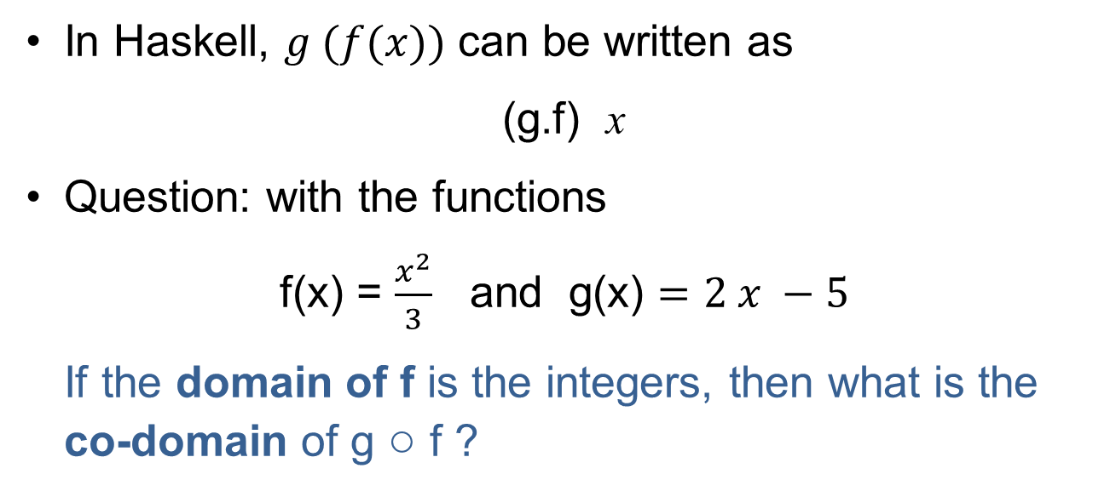
Combining functions
In Haskell, $g (f(x))$ can be written as
(g.f) x
Question: with the functions
f(x) = $\frac{x^{2}}{3}$ and g(x) $=2 x −5$
If the domain of f is the integers, then what is the co-domain of g ○ f ?

Slide 21
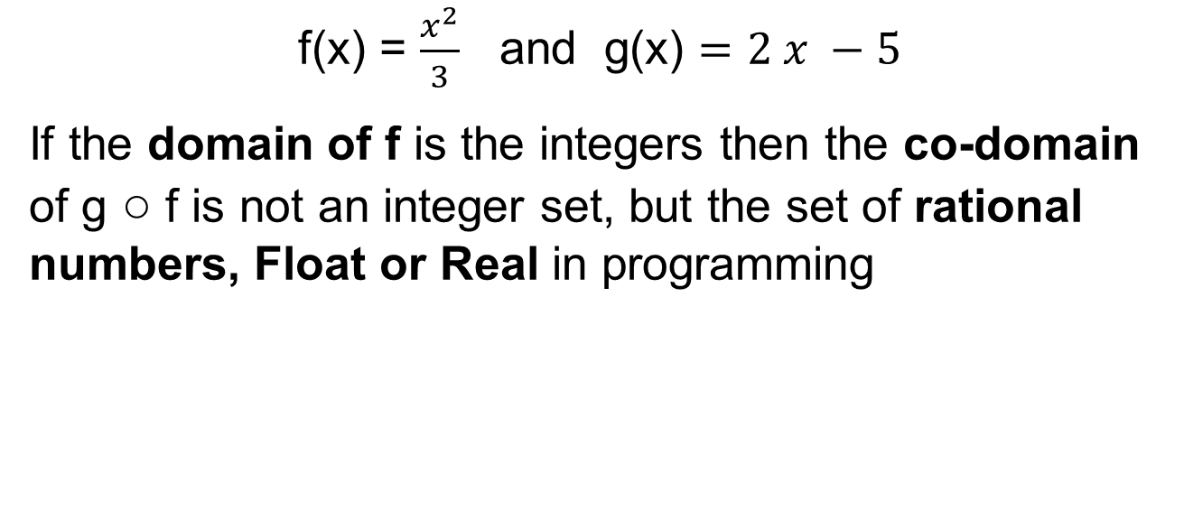
Answer
f(x) = $\frac{x^{2}}{3}$ and g(x) $=2 x −5$
If the domain of f is the integers then the co-domain of g ○ f is not an integer set, but the set of rational numbers, Float or Real in programming

Slide 22
Types and typeclases
Functional languages like Haskell use types such as
  Integer and Int e.g…. -5, -3, 0, 1,2,3 …
  Float e.g. 2.71828, 17.75….
  Bool True or False
  Char e.g. a, b, £
Typeclasses are sets of types
  Typeclass Num includes Integer, Int, Float, Double

Slide 23
Type variable
  Suppose we design a function
  sumOfTwo x y = x + y
  This function could work with different types perfectly well – adding integers, or floats, or a mixture, for example
  We can choose to give functions an explicit type declaration in Haskell, but it is not obligatory to do so

Slide 24
Function types
A function f has a function type
f: A → B
The function type is A → B where A is the argument type and B is the result type
  For example, the Haskell function isEqual below will return True if x and y are equal, False otherwise. (Note the equality operator == used here.)
  The type declaration is shown below, ahead of the function:
isEqual :: Int -> Int -> Bool
isEqual x y = x == y

Slide 25
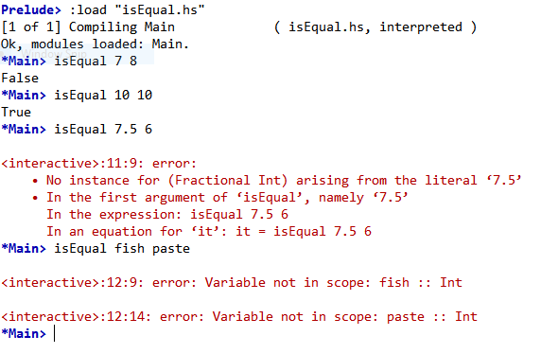
Testing
  Note that this function now works with Integers but gives errors if we use other input types
  The error messages help show what the problem is

Slide 26
Worksheet 3
Do the questions in Task 2 of the worksheet
Recall the syntax for a type statement:
  isEqual :: Int -> Int -> Bool
  isEqual x y = x == y
The input types are given first, followed by the output type
You cannot define types in interactive mode
  Instead, you need to enter a program including a type statement in a text editor, save it, then load and run it

Slide 27
First class objects
These are objects which may:
  appear in expressions
  be assigned to a variable
  be assigned as an argument
  be returned in a function call
From what you have seen so far, what first class objects have you met?

Slide 28
Answer
From what you have seen so far, the first class objects you have met include:
  Integers
  Floats
  Booleans
  Characters
  And …. Functions
  There are also Strings, which are lists of Characters

Slide 29
And the point is ??
Functional programming is not totally different from other paradigms, which also use functions
However, there are important differences, particularly in things which do not happen in functional programming

Slide 30
Statelessness
When you execute a procedural program such as Python or Pascal, the computer’s memory changes state as it goes along. You could execute the following statements, for example:
x = 5
x = x + 1
  In a functional programming language, the value of a variable cannot change
  Variables are said to be immutable, and the program is said to be stateless

Slide 31
Referential transparency
The only thing a function can do is calculate something and return a result, and it is said to have no side effects
A consequence of not being able to change the value of an object is that every time a function is called with the same parameters, e.g. x, y, z, it will always return the same result
A simple function can be proved to be correct, and then used to build more complex functions

Slide 32
Summary
A function maps values from a domain to
a co-domain
Functions use types such as Int, Float or Char
Functions use, and are, first-class objects
Functions can be combined
Variables are immutable; functional programming is stateless and has no side effects on data or programs

