Slide 1

Big Data
Notes:
1

Slide 2
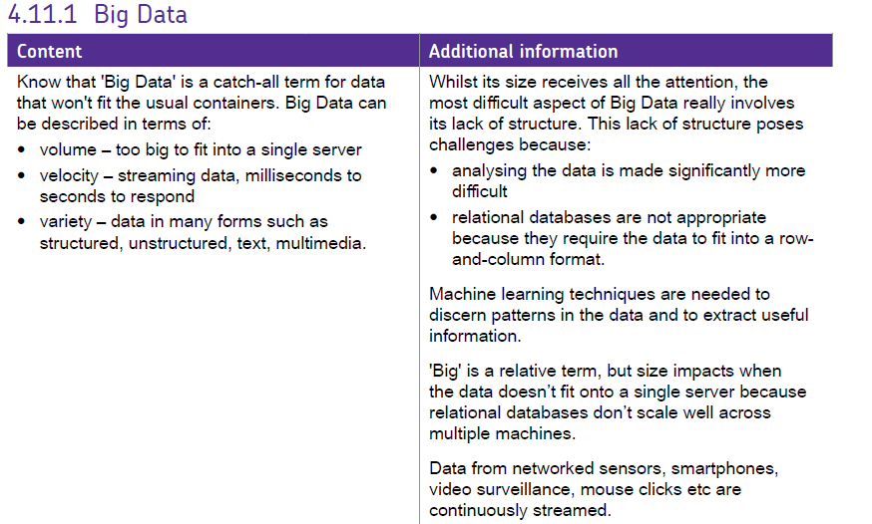
Spec has a LOT of detail!

Slide 3
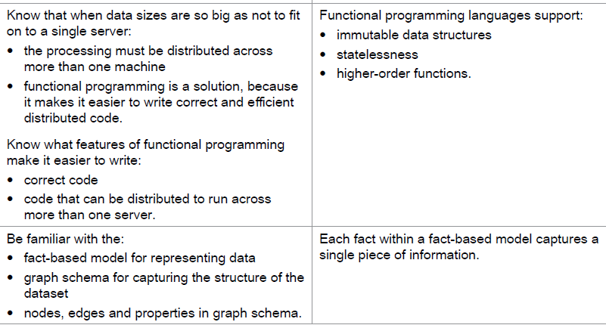
More Big Data specifics!

Slide 4
Objectives for today
Be able to identify Big Data sets
Describe what makes a set Big Data
Explain the 3V’s
https://www.youtube.com/watch?v=jDC3-QSiLB4

Slide 5
Big Data
‘Data that is difficult to collect, store or process within the conventional systems of statistical organizations. Either, their volume, velocity, structure or variety requires the adoption of new statistical software processing techniques and/or IT infrastructure to enable cost-effective insights to be made.’
(UNECE, 2013)

Slide 6
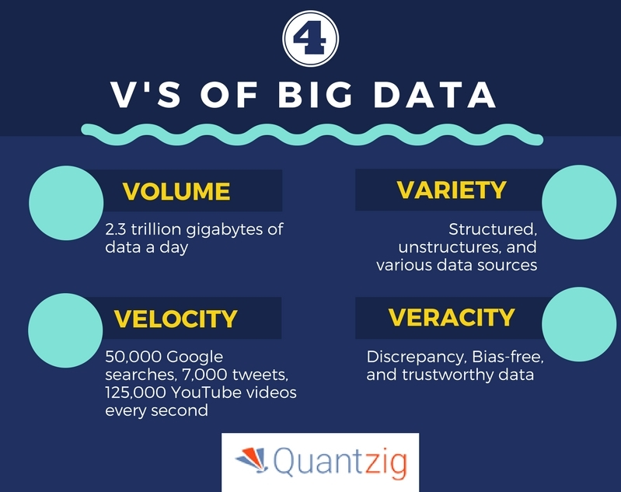
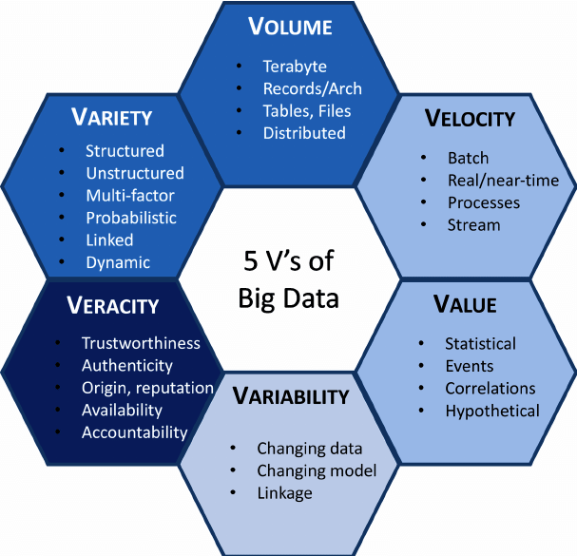

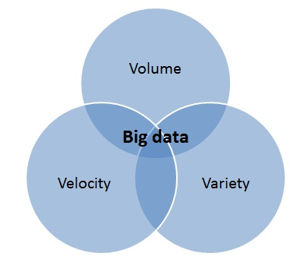
3 V’s
Volume | Velocity | Variety
The amount of data | The Rate of change of that data. How quickly the data requires processing | How changeable/ unpredictable

Slide 7











What are the sources of Big Data?
Social media: posts, pictures and videos
Purchase transaction records
Digital satellite images
Mobile phone GPS signals
Sensors gathering information: e.g. Climate, traffic etc.
High volume administrative
& transactional records

Slide 8

Velocity
  Estimate how many of the following per minute
Tweets
Google Searches
Hours of youTube Uploaded
Facebook Posts

Slide 9
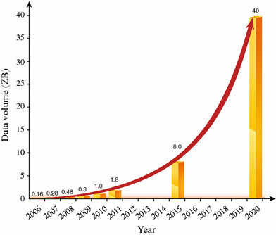
Volume

Slide 10

Variety
Unstructured
  Images
  Video
  Sound
  Free flowing text

Slide 11
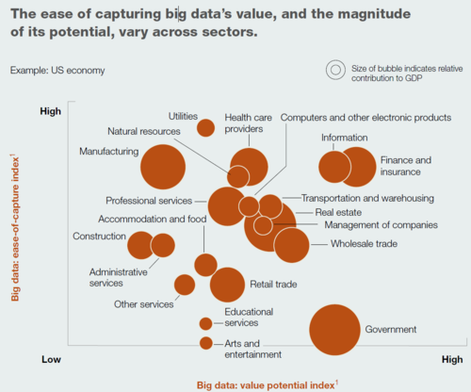
Notes:
11

Slide 12
Machine Learning
Neural Networks (
Build a model
Create training data sets
Train! Train! Train!
Test for known cases
Run the model… continue training

Slide 13
NOW: →25 mins!
Use Book/Spec.
  Note the Definitions!
Describe 3 Concrete examples of big data
  Why is it big data? (Use 3 V’s)
  What techniques could be used to process that data? (look up Machine Learning) Hadoop
  How is it stored?

Slide 14
Big Data and Official Statistics
Not just about replacing existing outputs
Produce entirely new outputs
Complement other sources:
  Filling in gaps
  Auxiliary variables for statistical models
  Quality assurance
Improve processes
Notes:
14

Slide 15
What is the ONS Big Data Project?
A project which aims to:
  Investigate the potential for big data in official statistics while understanding the challenges
  Establish an ONS policy and longer term strategy which incorporates ONS’s position within Government and internationally in this field
  Recommend next steps to support the strategy going forward
Through collaborative working/partnerships and practical pilots

Slide 16


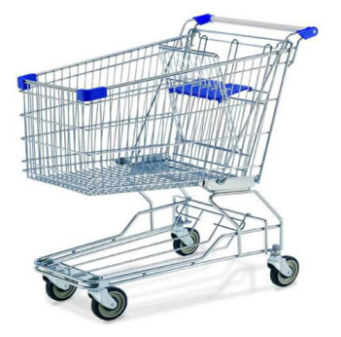

Big Data Project - pilots
Prices
Twitter
Smart-type meter
Mobile Phones
Notes:
16

Slide 17
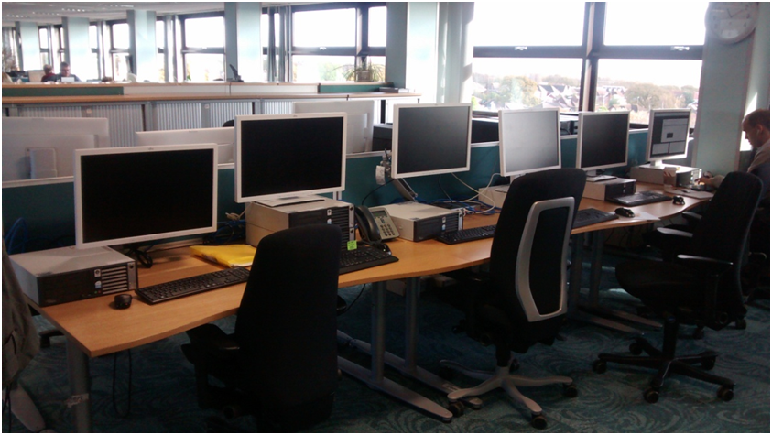
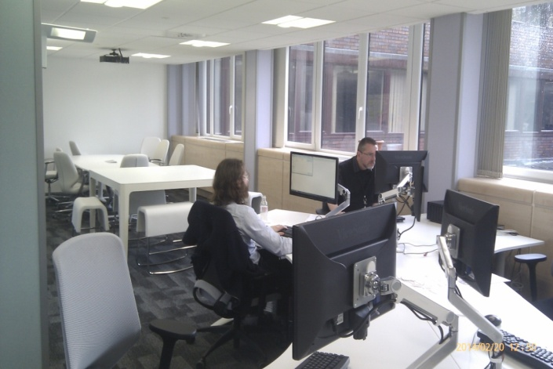
What are the labs?
Allows our staff to experiment with datasets and tools without compromising ONS security
Independent of ONS main systems
A “private cloud” – individual machines are pooled together to provide an integrated environment
Notes:
17

Slide 18
Pilot 1: Prices Project
Research Question: To investigate how we can scrape prices data from the internet and how this data could be used within price statistics
Potential for richer, more frequent and cheaper data collection
Focus on grocery prices from three on-line supermarkets
Collecting key descriptive information such as multibuy/size which can be used to address key research questions
Early analysis is providing useful insights
Notes:
18

Slide 19
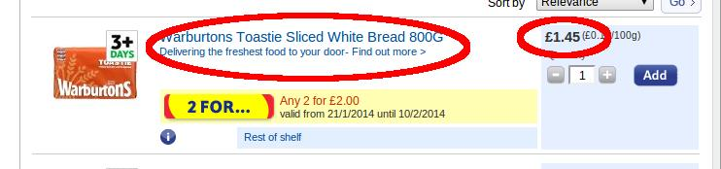
Price collection by webscraping
Web scrapers built and used to collect prices from three online supermarkets
6,500 quotes collected daily
35 CPI defined items
Collecting detailed information
Storing it in a NoSQL database (mongodb)
......
</div><div class="productLists" id="endFacets-1"><ul class="cf products line"><li id="p-254942348-3" class=" first"><div class="desc"><h3 class="inBasketInfoContainer"><a id="h-254942348" href="/groceries/Product/Details/?id=254942348" class="si_pl_254942348-title"><span class="image"><img src="http://img.tesco.com/Groceries/pi/121\5010044000121\IDShot_90x90.jpg" alt="" /><!----></span>Warburtons Toastie Sliced White Bread 800G</a></h3><p class="limitedLife"><a href="http://www.tesco.com/groceries/zones/default.aspx?name=quality-and-freshness">Delivering the freshest food to your door- Find out more &gt;</a></p><div class="descContent"><!----><div class="promo"><a href="/groceries/SpecialOffers/SpecialOfferDetail/Default.aspx?promoId=A31234788" title="All products available for this offer" id="flyout-254942348-promo-A31234788--pos" class="promoFlyout"><span class="promoImgBox"><img src="/</a></li></ul></div></div></div></div><div class="quantity"><div class="content addToBasket"><p class="price"><span class="linePrice">£1.45<!----></span><span class="linePriceAbbr"> (£0.18/100g)</span></p><h4 class="hide">Add to basket</h4><form method="post" id="fMultisearch-254942348"
.....
Notes:
19

Slide 20
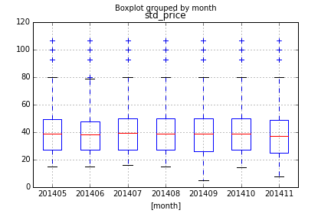
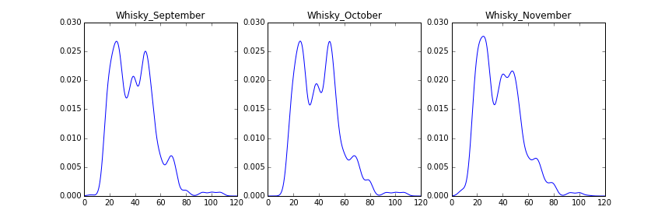
Exploratory data analysis
The data allows the investigation of price distributions at the lowest level
Findings, thus far:
  23% of items on discount
  Multibuy is common (around half of all discounts)
  Multimodal price distributions
  Produced some early experimental indices
Notes:
20

Slide 21
Experimental index
Notes:
21

Slide 22
Pilot 2: Twitter
Research Question: To investigate how to capture geo-located tweets from Twitter and how this data might provide insights into internal migration
7 months of geo-located tweets within Great Britain (about 80 million data points)
Research focused on methods for processing data to fit standard population definitions (e.g. usual residence)

Slide 23
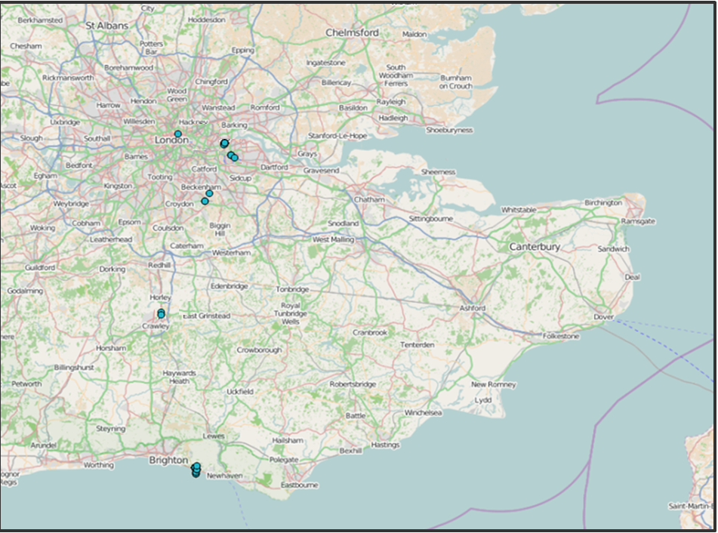
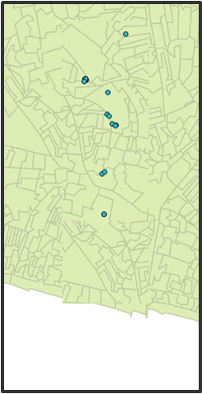
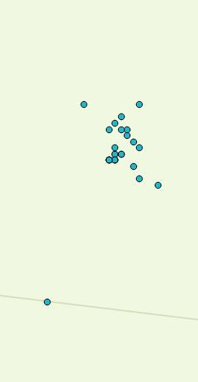
Lots of activity in different places but where does this person live?

Slide 24
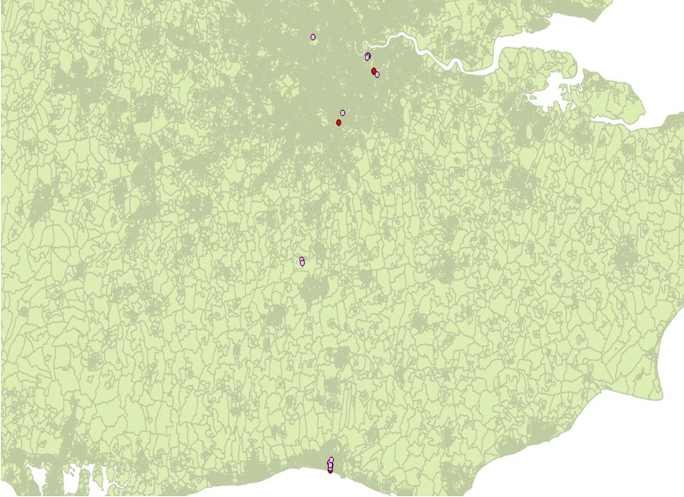
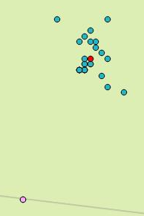
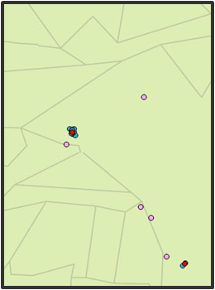
Cluster_id | Northing | Easting | Count | Type
60033_1 | 105?31 | 530?02 | 28 | Residential
60022_2 | 104?41 | 530?94 | 4 | Residential
60033_6 | 182?46 | 532?10 | 13 | Commercial
60033_13 | 104?56 | 531?17 | 3 | Commercial
60033_15 | 179?30 | 533?95 | 3 | Commercial
60033_21 | 165?47 | 532?51 | 3 | Commercial
Most likely lives here
Raw Data
Cluster Centroid
Noise

Slide 25
Time of day profiles by address type

Slide 26
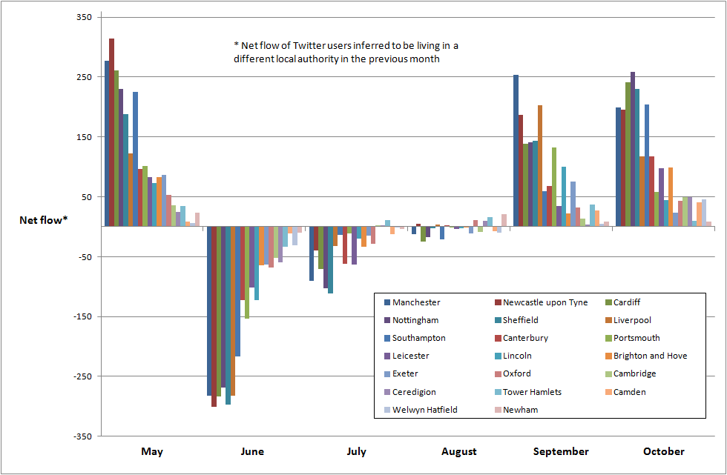
Use case: Student mobility

Slide 27
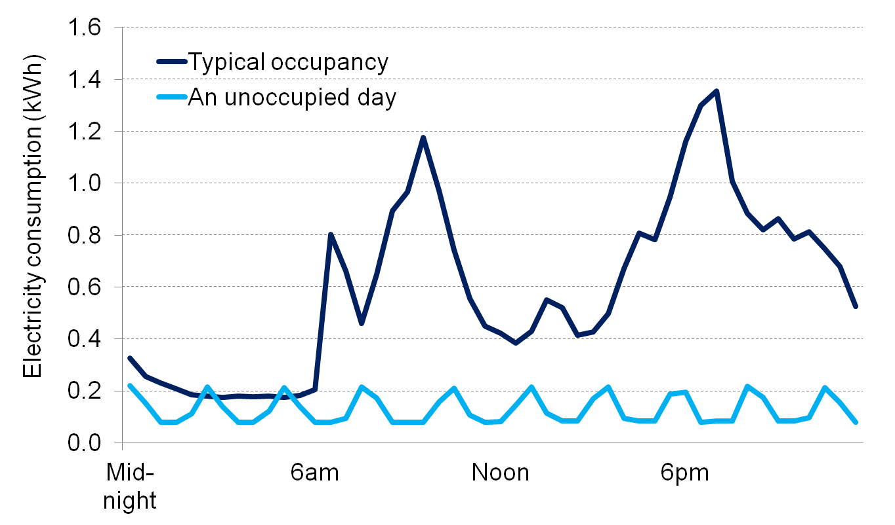
Pilot 3: Smart-type meter project
Notes:
27

Slide 28
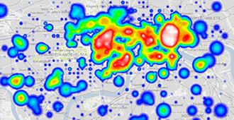
Pilot 4: Mobile Phones
Vodafone – commuter heat map of London

Slide 29






Partnerships
Partnerships
International
Cross-Government
Privacy groups
Academia
Private Sector

Slide 30
Emerging findings: Big Data in ONS
Benefits
Create efficiencies
Improve quality
Produce new or complimentary outputs
Improve operational processes
Respond to challenges/competition
Challenges
Technical
Statistical
Legal/ethical
Commercial
Capability
Starting to demonstrate tangible benefits and provide evidence that challenges can be overcome
But more long term work is needed to build on these initial findings
Notes:
30

Slide 31
Future work
Prioritisation of current and new pilots:
  Mobility and population estimates
  Intelligence on addresses
  Prices
  Economic statistics
  Public acceptability
Understanding and application of technologies
Future partnerships
Notes:
31

