Slide 1
UNIT 1 Investigating Practitioners’ Work
We don’t know when you will have to sit this exam – but you will have to at some point. We will sit a MOCK for Unit 1 towards the end of this Half Term.

Slide 3
LESSON 1 (wk 5)
Discussion about the theme
Beginning reflection on FRANTIC ASSEMBLY and their work LOVESONG in response to the theme

Slide 4
Remember. In advance of the written exam the exam board release A THEME – you will then use this theme to answer ACTIVITY 1 & ACTIVITY 2
A PRE RELEASED THEME

Slide 5
THE EXAM PAPER Reminder – how this all fits together …
Activity 1 40 minutes | Show what contextual factors are impacting the work of each company Reference one piece of work from each company to evidence this Understand the themes of both pieces of work | DV8 = To Be Straight With You FRANTIC = The Unreturning
Activity 2 70 minutes | Frantic Assembly – discuss the theme of one piece of work, and analyse 3 key moments interrogating the elements used | LOVESONG
Activity 3 70 minutes | Which company is better to headline a Festival? Using examples from their work, reach an opinion (the title of the Festival will be given in the exam) | DV8 reference Dead Dreams of Monochrome Men FRANTIC = Lovesong and Things I Know To Be True

Slide 6
FOR YOUR MOCK WE WILL USE LAST YEAR’S THEME …
Change of Direction

Slide 7
QUICK STARTER ACTIVITY
Note down what you think this THEME actually means.
How can you see this theme reflected in FRANTIC’S LOVESONG
We will pause for a second whilst you all write this down.

Slide 8
We will unmute someone to share
Note down what you think this THEME actually means.
How can you see this theme reflected in FRANTIC’S LOVESONG

Slide 9
THE COMING WEEKS
We will have a brief introduction to the key theme today beginning to relate it to the work of Frantic Assembly and LoveSong.
Over the coming weeks we will explore the work of both companies and focus you into the mock-exam in more detail DON’T PANIC OR WORRY YET.

Slide 10
YOU WILL COME BACK TO THIS EXAM AT SOME POINT …
At that point OUR EXPECTATION WILL BE that you can access all these notes / will have reflected on the teaching – and you will be ready just for a short spell of REVISION rather than direct teaching.

Slide 11
QUICK TASK NOW BUT ALSO TO FINISH …
Make a list of all the CHANGES OF DIRECTION that can be seen within LOVESONG
You can discuss this literally (in terms of movement)
In equal measure you can discuss this in a more abstract way

Slide 12
We will un mute. Make a list of all the CHANGES OF DIRECTION that can be seen within LOVESONG

Slide 14
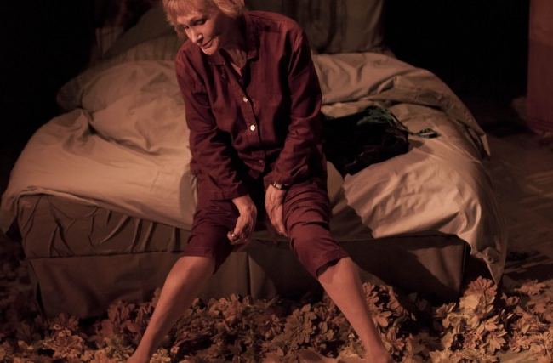
TYPE YOUR ANSWER IN THE CHAT BAR
THE BED
The bed has a centrality within the set design – sitting, dominating STAGE LEFT of the stage surrounded by rotting leaves. The season has changed.
WHY?
WHAT DOES IT CONOTE?
READ THE SIGNIFIER AND TELL ME THE SIGNIFIED

Slide 15
IN YOUR OWN TIME
Look again at the section in LOVE SONG – The Bed
GOL
UNIT 1
FRANTIC CLIPS
LOVE SONG 6
2.20 – 6.38

Slide 16
For now spend some time remembering that section
We will give you a couple of minutes to remember and then we will pick on individuals to remind us what happens during this section

Slide 17
LOVE SONG THE BED Describe and then read this section in the production

Slide 19
LOVE SONG: THE BED – Scene 10
One of you will be asked to answer question 1 another practitioner will be ask to answer question 2
Maggie begins in a fevered, fitful sleep
1. How do they show how her younger self (played by Leanne Rowe) comforts her older self?
The relationship between younger and older comes to a head on the bed with the two couples being connected through:
CONTACT WORK, SUPPORT WORK, UNISON, CANNON, EXTENSION
2. What is being communicated in this extract?

Slide 20
PERFORMANCE AND RELATIONSHIPS o pace o dynamics o timing o musicality o voice o movement o gesture o character o spatial awareness o performer to performer o contact work o performer to space o performer to audience o performer to accompaniment o placement and role of audience | PRODUCTION AND REPERTOIRE o text o choreography/direction o score/music o content o genre o style o set, staging and special effects o costume, hair and makeup o lighting and multimedia o sound
EACH ONE OF YOU …
Pick an element and be prepared to share HOW THAT ELEMENT IS USED IN THIS SECTION

Slide 21
Pick an element and be prepared to share HOW THAT ELEMENT IS USED IN THIS SECTION

Slide 22
PAUSE
Note down all the responses to the elements and this moment that have just been discussed.
Remember, in Activity 2 you wont know which 3 elements the exam will give you.

Slide 24
HOMEWORK
Ensure you revise and look again at a SCENE ANALYSIS for this moment from LOVESONG
You should have a FULL / COMPLETED scene analysis for this moment

Slide 25
Change of Direction
Now think about the key moment in relation to the theme for your Unit 1 mock exam.
The identified theme for your UNIT 1 mock exam

Slide 26
We will ask individuals to feedback
SHARE ….
How can you see this theme reflected in the key moment THE BED?

Slide 27
ACTIVITY 2
Remember. In ACTIVITY 2 you will be given 3 elements and you will have to analyse how they are used to communicate this key theme within LOVESONG
CHANGE OF DIRECTION

Slide 28
PAUSE
Note down all the responses to the given theme in relation to this key moment in LoveSong.

Slide 29
HOMEWORK
You know the key theme now. You can begin to think about all THE KEY MOMENTS we have looked at IN TBSWY, THE UNRETURNING AND LOVESONG and relate them back to the key theme.

Slide 30
EXAMPLE of a distinction Activity 2 on the theme of Power (not our theme or key moment but …)
A purple tinted light rises creating a fantastical, dream-like atmosphere and as this happens Clara decides to get out of bed. This light seemingly gives her the belief that she owns some sort of power which allows her to go against those who control her including Dr Dross and the matron, and furthermore convinces her that she has escaped the orphanage and is now in a world where she has the power to find and hold on to true love. For the audience, the unnatrual lighting enhances the idea that this is actually a façade and indicates that there is something unrealistic about the sudden power she has gained. At the end of the first section in the dream, the lighting reinforces Clara to believe she is powerful and important as she is left alone on the stage with a bright spotlight on her whilst she is praying/making a wish.

Slide 31
TASK
1. Write a paragraph about LIGHTING in THE BED key moment in relation to THE THEME OF CHANGE OF DIRECTION.
On your pad > ready to share if called upon.

Slide 32
We will un mute. To share your paragraph
LOVE SONG
THE BED

Slide 33
HOMEWORK
You could write another paragraph about LIGHTING in THE BED key moment in relation to THE THEME OF CHANGE OF DIRECTION
You could then continue this task utilising different elements for this key moment and this theme.

