Slide 1
LESSON 3 (wk 5)
Discussion about the theme
New ACTIVITY 1 reflection on Frantic’s THE UNRETURNING in response to the theme for our MOCK EXAM

Slide 3
For the next task you will need to type into the chat bar …

Slide 4
QUICK STARTER ACTIVITY
Just write a one or two word response that summarises THE UNRETURNING

Slide 5
DEVELOPMENT …
Pick someone else’s response … someone else’s summary
When asked, you will read out the summary, tell us who wrote it and then explain how the word links to the production (trying where possible to mention elements from THE OPENING which is our one key moment

Slide 6
FOR YOUR MOCK WE WILL USE LAST YEAR’S THEME …
Change of Direction

Slide 7
STARTER ACTIVITIES this is also something than can be completed …
Make a list of all the CHANGES OF DIRECTION that can be seen within THE UNRETURNING
You can discuss this literally (in terms of movement)
In equal measure you can discuss this in a more abstract way

Slide 8
We will un mute. Make a list of all the CHANGES OF DIRECTION that can be seen within THE UNRETURNING

Slide 9
IN YOUR OWN TIME
Look again at the trailer of THE UNRETURNING – remember this is THE OPENING and gives you enough to talk about for ACTIVITY 1 even if you haven’t seen the whole production
https://www.youtube.com/watch?v=PSP5NhBpIhM

Slide 10
For now spend some time remembering THE OPENING
We will give you a couple of minutes to remember and then we will pick on individuals to remind us what images are at play, what elements, what props, what costumes …

Slide 11
UNRETURNING THE OPENING Describe and then read this section in the production

Slide 13
Change of Direction
Think about the OPENING SECTION that you have seen from UNRETURNING and the work we have already covered on it…
For now, just make some quick notes about how you can apply the exam theme to it …
The theme for your UNIT 1 mock exam

Slide 14
Interrogate the links to the theme within this moment as a class
Change of Direction

Slide 15
PAUSE
Note down all the responses to the given theme in relation to this key moment in The Unreturning.

Slide 16
SOCIAL CULTURAL GEOGRAPHICAL ECONOMIC
MAKE A NOTE IN YOUR PAD …USE YOUR KNOWLEDGE OF THE PRODUCTION AND REFERENCING ANY KEY MOMENTS…
We will now try and link the theme CHANGE OF DIRECTION to the contextual factors/influences listed?
Be ready to share how these contextual factors impact THE UNRETURNING (this should be revision as we have covered this) and then say how that links to CHANGE OF DIRECTION

Slide 17
TYPE INTO THE CHAT BAR THE CONTEXT BELOW YOU WANT TO TALK ABOUT
We will then pick who will talk about THAT CONTEXT linking it to the exam theme of CHANGE OF DIRECTION
SOCIAL CULTURAL GEOGRAPHICAL ECONOMIC

Slide 19
PAUSE
ADD TO YOUR NOTES Note down all the responses to the given theme in relation to this key moment in The Unreturning.

Slide 20
EXAMPLE of a distinction Activity 1 on the theme of Power (not our theme or key moment but …)
Along with the scruffy costumes, the upbeat dancing and the happy facial expressions further reinforces that these folk people of Chile were oblivious to the extreme power that the military and Chilean police had over them, making them a vulnerable and easy target. Despite them being a minority, they still embodied significant amounts of power in comparison to the rest of the Chilean population, and used this to take advantage of the democracy.

Slide 21
TASK
1. Write a paragraph now about THE OPENING OF THE UNRETURNING in relation to the theme CHANGE OF DIRECTION
On your pad > ready to share if called upon.

Slide 22
We will un mute. To share your paragraph
THE UNRETURNING
THE OPENING

Slide 23
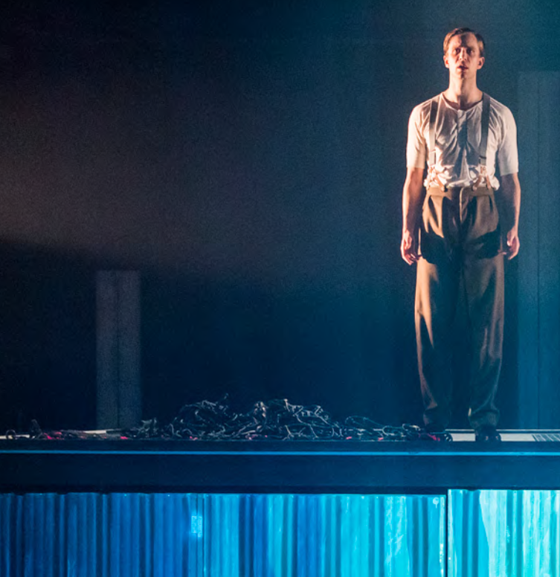
HOMEWORK
You could write another paragraph now discussing THE UNRETURNING in relation to CHANGE OF DIRECTION
Keep up to date with your Unit 1 work as you will be working on a MOCK UNIT 1 this half term.

