Slide 1
How To Be A Good Performer
A Short Presentation
By Gabriel Ryder

Slide 2
How can you tell that a performer is good at performing?
Character Variety and Being Immersive
Confidence and Focus
Being Adaptable

Slide 3
Equity
Protects Performers
Required
Costs

Slide 4
Headshots
Absolutely Necessary
Have very specific requirements
Blank Slate
Professional

Slide 5
Show Reel
Represents you as a performer
Highlights
Reference Appropriately

Slide 6
Harvard Referencing System
“I had to change trousers for this” 50 Shades of Green, By George Hatfield, on Page 52, Published in London by Class Action in 2016.
Hatfield, G. (2016) 50 Shades of Green. London: Class Action, P52
“I had to change trousers for this” (Hatfield, 2016)

Slide 7
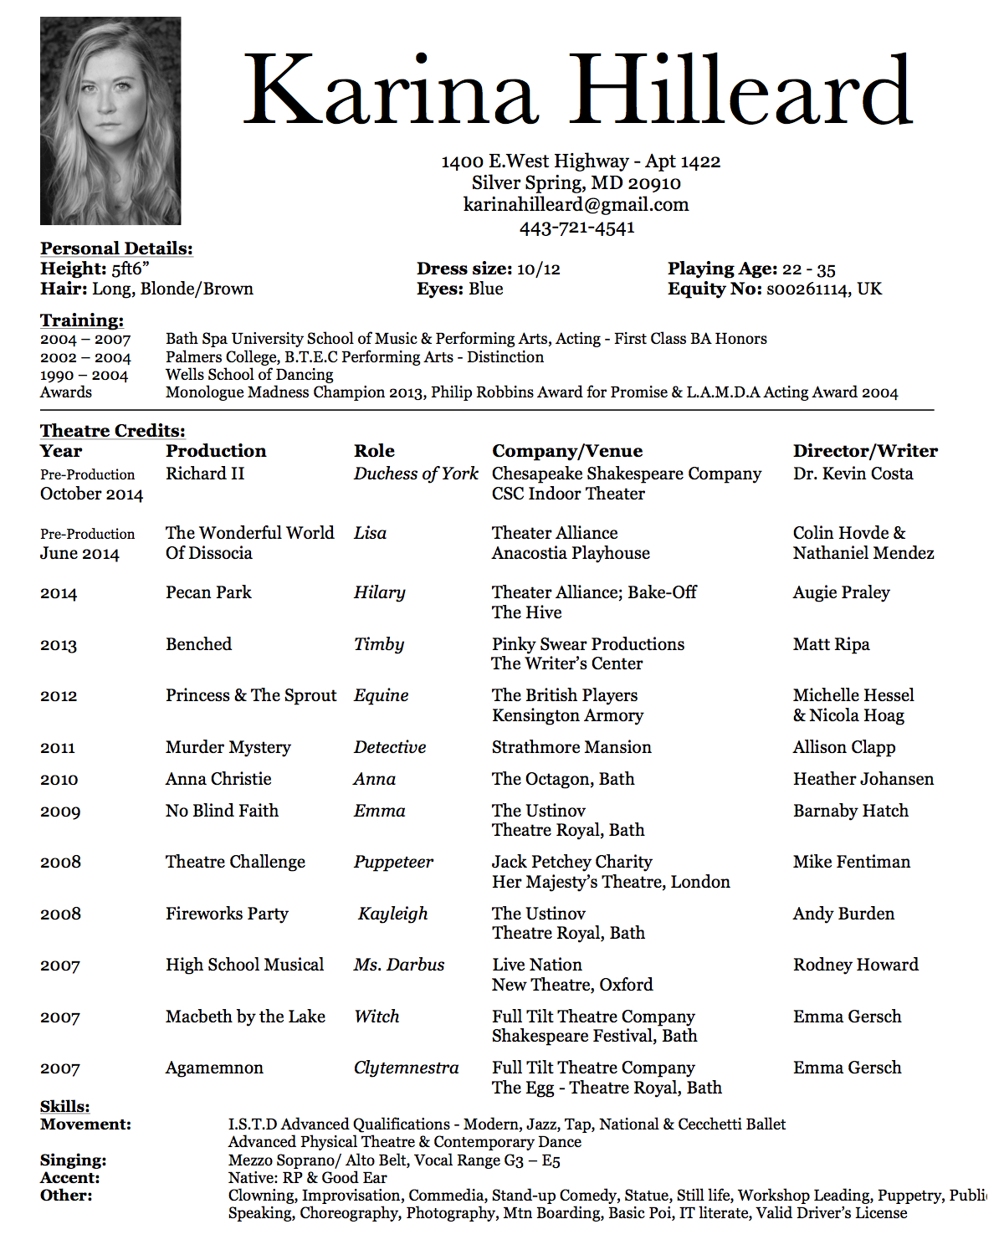
CV
Bibliography with
details and work
Lists with HRS

