Slide 1
What makes a good Performer?
Archie, Helen and Sakile

Slide 2
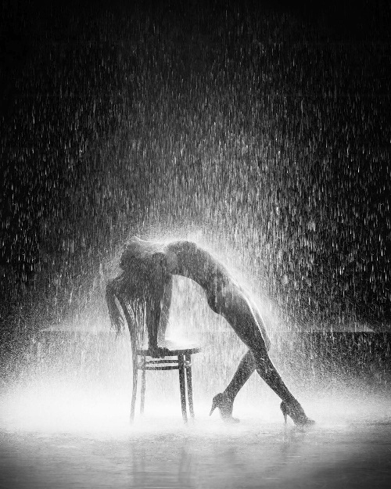
Key Elements:
Being confident BUT not arrogant
Having perseverance in everything you do
Determination is key to succeed
Reliable
Triple threat
Committed
Open minded
SOMEONE THAT TRIES

Slide 3
How do you know it’s good?
Captivation
Believability
Goose bumps
Understands the message
Excitement/butterflies
When it makes you feel something towards the play/characters.

Slide 4
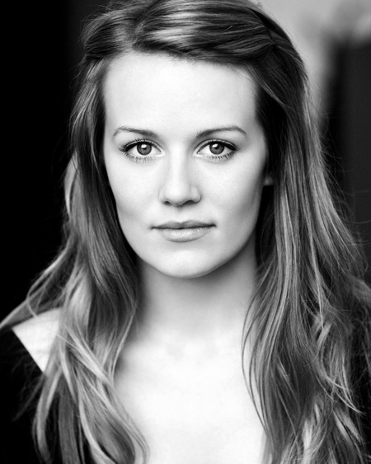
HEADSHOTS

Slide 5
CV

Slide 6
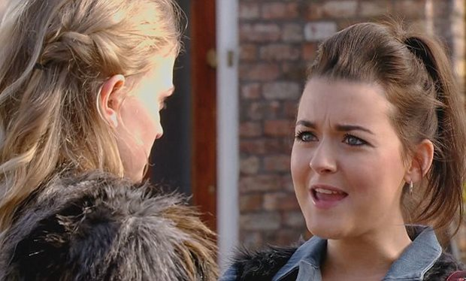
Show reels – what makes it good?
Titles and subtitles; production and company
Clearly show the difference between two different pieces of work
Don’t jumble up the order
Make sure the quality of filming and production is good
Choose the pieces where you are at your strongest. Eg saying lines.
https://www.youtube.com/watch?v=-PAFtrDi5Ys
Coronation Street
ITV

Slide 7
Drama/Dance schools -
RADA
Mountview
PPA
GSA
Brit school
Arts Ed
Birds
Laine
Italia Conti
LAMDA
Sylvia Young
East 15
URDANG

Slide 8
Harvard Reverencing System
Remember to use the Harvard Reverencing System in all of your work. Especially when using any quotations from books, websites or any source of information.
www.neilstoolbox/bibliography/creator
REMEMBER
Direct quotations are put in “double quotation marks.”
If you are writing direct quotations, you put the author and date.
The bibliography is pretty much always the same

Slide 9
Thank you!
Archie, Helen and Sakile

