Slide 1
What makes a good performer
By Charlotte Kirkham

Slide 2
Skills, qualities and attributes of a good performer
To be successful requires having the correct mind-set to able yourself to achieve your full potential. If you inhibit yourself mentally you will never be able to perform to the best of your ability.
“Performance is 10% physical and 90% mental.”
One of the biggest skills a performer needs is confidence. This means having a neutral opinion of their own skill set. You can’t come across over confident or shy in an audition or you’ll be seen as someone who is hard to work alongside.
Confidence links in with being versatile. You need to be open-minded to different ideas and therefore need the confidence in order to try something new. This will not only help you develop your personal skills but also your reputation as a performer will improve if you are seen as someone who is adaptable to all situations.
You must be dedicated. This is one of the hardest fields of work to succeed in and if you don’t have the drive or ambition you become unreliable. You have to be willing and committed to attend all rehearsals, auditions and jobs. You must have the determination to improve yourself and your performance.
Most importantly, above any other skill or attribute you must love the profession. This is going to play a part in every aspect of your life. You have to have the passion and commitment to put it above everything else in your life. You’re going to be faced with many hard decisions; it’s inevitable! But if you truly enjoy it and want to be a part of this it becomes worth it and something you’re willing to contribute your life's work to.

Slide 3
How do you know a performance is successful?
AUDIENCE REACTION: a good performance should make the audience feel something. It doesn’t necessarily have to be a good feeling or a bad one. But it should make you think. People react to different things in different ways, whether that’s physically or mentally. If the audience reacts, or is left thinking about the performance you know it’s been successful as you have clearly communicated ideas and presented a convincing character.
CAPTIVATION: as an audience member you should be drawn into the performance and interested in the piece. It should draw people in and make them want to watch on.
TEAMWORK: a performance takes the whole company to work together to create an affective performance. This requires being able to perform as a collective an have an understanding of how each person works in the group.
THE MESSAGE: underneath every performance there is a moral or a theme to be understood and interpreted. As a performer you’re job is to convey a message or a story. A successful performance means that audience members have the ability to gain an understanding or an interpretation of the work. They should at least be able to follow the events and conclude an opinion from what they see.

Slide 4
Headshots
At any audition you attend you will be asked to present a headshot. This is a photo of your face in a neutral position showing your features, dimensions and overall visual appearance.
There are a few guidelines to achieve a good headshot:
1. your face must be a neutral expression. This means no unusual funny faces to be pulled or playing a character. They want to see the raw material of your face. Make sure you present yourself looking well-groomed. It has to look like the best version of yourself to a certain extent. It can’t look like a glamour model shoot that you couldn’t recreate on a regular day to day basis but you should come across well presented.
2. as much as a neutral face is important the face needs to look alive and have energy in the eyes. It should show what you were to look like if you were stood in front of them.
3. having the headshot in black and white.
4. finally a professional headshot should use the correct dimensions. This can be measured by lining headshots up next to each other and the eye line of each person should match up. The dimensions of a headshot should be 8 by 10 inches.

Slide 5
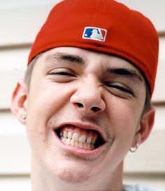
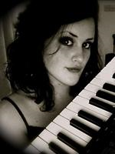
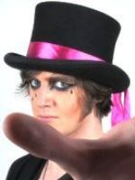
Examples of bad headshots
1. He is pulling a clearly ridiculous face.
2. You can’t see all features of his face due to his expression.
3. He is wearing a hat. This means that you can’t see what his hair looks like or the top half of his head.
4. It’s not in black and white.
The face is positioned at a strange angle.
There is a piano in the middle of the photo creating a distraction.
She’s wearing a very heavy eye make-up meaning we can’t see her natural appearance.
the dimensions are clearly wrong as you can see her face is not in the centre of the photo and the keyboard has taken up more space than her face.
This photo is a selfie. It has not been taken by a photographer.
His hand blocks out half the photo.
His make-up is ridiculous. There is far too much on his face you can’t see what he really looks like.
His hat is drawing huge attention from the photo.
His face is at a strange angle.
It’s not in black and white.
The dimensions are wrong for the photo.

Slide 6
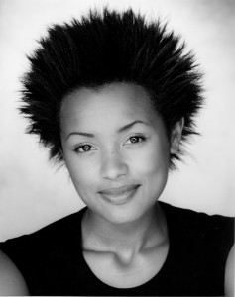
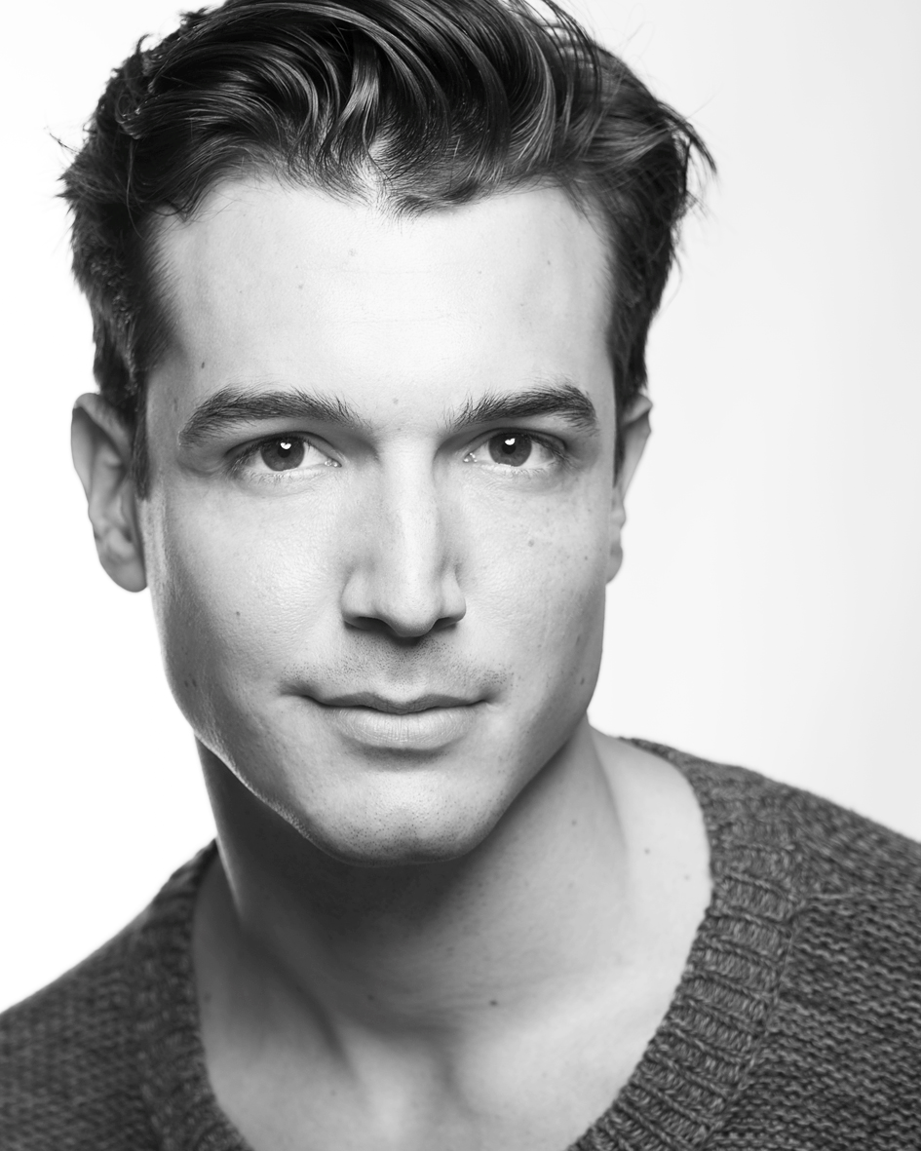
Examples of good headshots
1. Neutral facial expression.
2. Black and white.
3. Correct dimensions.
4. Shows them in their best version of themselves.
5. No heavy costume or make-up.
6. They both look energised.

Slide 7
show reels
A show reel is a collection of video footage of your previous work in television/film/theatre.
It needs to highlight the best of your abilities.
It should be focussed on yourself.
It needs to show your versatility as a performer.
There should be references to the show that the footage is from.
It needs to be presented clearly in an easily understandable format.
The quality of footage and your performance is key. Also the quality of the presentation. If it looks messily pieced together it will look like you can’t be bothered/don’t care enough or aren’t proud of your accomplishments.

Slide 8
equity
UK trade union for professional performers and working practitioners.
Nationally and internationally recognised for it’s work with helping performers.
Works with all areas of the entertainment industry.
Makes sure that those in the business are getting proper pay for their work.
Looks after performers and protects their pay and safety.
Many jobs will only pay if you are a part of Equity.
You have to have a membership which means paying a fee to be a part of it per annum.
It stops you from doing more than 48 hours of paid work per week.
You can lose your membership if you don’t do enough work in one year.
Government funded and overall ensures that performers are looked after properly.

