Slide 2
“In order to be a good actor, I'm a firm believer that you need to bring something to the table.”
(R. Lee Ermey, 1944)

Slide 5
- A photograph of an Actor/Actress. It is used to get work.
- 8 X 10 and BLACK AND WHITE!

Slide 6
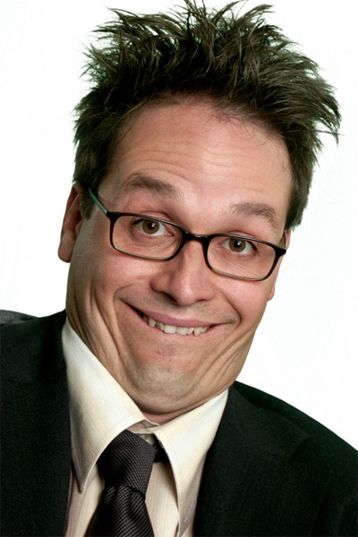
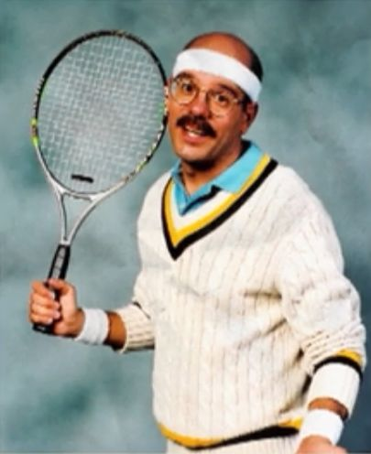
Good vs Bad

Slide 7
Resumes
What your resume should include:
Your name (in large BOLD letters)
Credits (the roles you’ve played)
Training (what course, qualification)
Mention special skills (Swimming? Horse riding? Driving?)

Slide 8
How Do I Get Paid?
The Actors' Equity Association (AEA), (known as ‘Equity’) is an American labour union representing the world of live theatrical performance, as opposed to film and television performance (which is represented by SAG-AFTRA).
Equity Minimum- £447.50 a week.

Slide 9
Thanks for Watching! x

