Slide 1
What Makes a Good Performer?
Performing Arts AS – Learning Aim A: Understand the Role & Skills of a Performer – Lesson 1

Slide 2
Journey
Over the next two lessons, we shall be looking at deconstructing the question; ‘What Makes a Good Performer?’ – whilst looking at the relevant Skills, Qualities and Attributes to a professional actor or dancer.
Looking at, Qualifications, Salary, Terms & Conditions, Life-style impact, Typical Working Day, rehearsal preparation, working skills application procedures and interrelationships.
Throughout these two lessons, you will need to write as much information as possible as it directly links to the structure of the Learning Aim A section of your coursework portfolio.

Slide 3
Today
We will be focussing on; Work, Lifestyle and Working Conditions.
We will go through specific information to help you write your coursework as well as providing you with links for further research and development to extend your learning.
I will briefly talk to you about referencing and how to reference your work correctly using the Harvard Referencing System.

Slide 4
Thinking Questions
In pairs/small groups, discuss the answers to the following question:
What MAKES A GOOD PERFORMER in your opinion?
When you watch work, how do you know it is good?
What sort of attributes does a performer need to have in order to perform successfully?
What kind of performer do you want to be? And how do you intend to ‘get there’?
WRITE THESE ANSWERS DOWN IN YOUR NOTES TO REFER TO LATER.

Slide 5
Thinking Questions
What are the key skills, qualities and attributes of a professional actor; explain in detail what these roles are and why they are key?
• Skills
• Qualities
• Attributes
In pairs/small groups, discuss the answer to this question and write it down in your notebooks – consider the 3 separate areas and try to answer (in detail) what these mean.

Slide 6
Thinking Questions
What (and why) are the key features of the role of a professional performer?
What is their work like (be specific about what role you are discussing)
What are their main duties and responsibilities?
What qualifications do you need?
What is the training route for this job?
What is the salary like for this role?
What are the terms and conditions?
How does this job impact on your life-style?
What is a typical working day for a professional performer?

Slide 7
COURSEWORK
The Key question of this are of your coursework is, when you watch professional work, how do you know it is good?
Your work needs to be developed with your personal feelings and analysis inputted throughout. We will look at how you ‘judge’ a good performer. REMEMBER – key terms should be embedded throughout!
https://collegegrad.com/careers/actors

Slide 8
DANCER

Slide 9
Requirements
ability in at least one form of dance
to have been dancing from a very young age
dance school training, like a degree or diploma
You could get a Dance and Drama Award (DaDA) to help with dance school fees.
You can also get performing experience by joining a local dance company.
Council for Dance Education and Training (CDET) has more information on training and becoming a dancer.

Slide 10
Overview
Dancers use movement, gesture and body language to portray a character, story, situation or abstract concept to an audience, usually to the accompaniment of music. This usually involves interpreting the work of a choreographer, although it may sometimes require improvisation.
As a dancer you can work in a variety of genres including classical ballet, modern stage dance, contemporary dance, street dance and African or Asian dance. You may perform to a live audience or take part in a recorded performance for television, film or music video.
Many dancers follow portfolio careers, combining performance with teaching, choreography or administrative work in a dance company.

Slide 11
Skills Required
You will need to demonstrate the following:
a thorough knowledge of dance and its related issues
physical fitness, stamina and perseverance
motivation and discipline
communication and interpersonal skills
creativity
resilience
confidence and self-belief
adaptability to the different disciplines of TV, film and theatre
the ability to work as part of a team
the ability to make contacts and promote current work.

Slide 12
Reflection
Think about your current skills as you are now on the course, how would you rate (out of 10) your required skill level at this state?
Are there any other skills you can think of that would be preferential to study this subject/become a professional performer?

Slide 13
What You’ll Do
You’ll usually follow a choreographer's steps, although you might also improvise movements. You’ll specialise in a form of dance, like:
classical ballet
contemporary dance
modern stage dance, like jazz, tap, and musical theatre
African or Asian dance
street dance
You’ll spend time: rehearsing, preparing for and going to auditions, going to dance classes, promoting yourself and finding work
You might combine performing with other activities like teaching, choreography, community dance, or arts administration.
You may be able to find work teaching other types of social dancing, like ballroom or line dancing, or entering professional competitions.

Slide 14
Responsibilities
Tasks vary from dancer to dancer, depending on the contract, but usually include combinations of the following:
preparing for and attending auditions and casting sessions
getting ready for performances, by rehearsing and exercising
performing to live audiences and for television, film and music video productions
studying and creating choreography
discussing and interpreting choreography
learning and using other skills such as singing and acting - many roles, for example in musical theatre, require a combination of performance skills
looking after costumes and equipment
taking care of the health and safety of others, which requires knowledge and observation of physiology and anatomy, as well as safe use of premises and equipment

Slide 15
Responsibilities
teaching dance, either privately or in the public sector
working in dance development and promotion, encouraging and enabling people, especially children, to become involved in dance and to understand and appreciate it
running workshops in the community, for example with groups of disabled people
undertaking administrative, promotional or stage management work, particularly in a small company or if setting up your own company
liaising with arts and dance organisations, theatres and other venues regarding funding and contracts.
Self-promotion is also a significant feature of the work. This can include sending out your CV or photographs and footage, delivering presentations, running workshops or attending auditions and meetings.

Slide 16
Salary
Your salary will depend on the amount of work you get and what you can charge. If you’re freelance, you’ll get paid a fee for each contract or performance.
The Independent Theatre Council (ITC) recommends that performers are paid at least £447 a week.
Equity also recommends rates of pay for performers and other professionals.
https://www.equity.org.uk/home/
https://www.itc-arts.org/

Slide 17
Salary
. This rate is applicable to rehearsal and performance weeks and is mostly used by dance companies that have received Arts Council funding or funding from other major bodies. Pay varies according to the type and size of theatre and performers may earn significantly more for film and television work.
An experienced dancer may earn £450 plus per week on short-term contracts. However, many dancers earn less than this and low pay is a feature throughout many parts of the industry. Pay can rise to £650 per week for a West End show and some performers will earn more.
Subsistence and accommodation payments are included in Equity contracts and some contracts may include royalties for recorded work. Membership of Equity includes accident and public liability insurance, plus many other benefits.
Payment and conditions for non-Equity work can be lower and some employers try to contract dancers for no payment at all.
Income figures are intended as a guide only.

Slide 18
Working Hours Patterns & Environment
Hours can be long and irregular. You’ll usually have classes and rehearsals during the day and performances in the evening.
You might perform in theatres, film or TV studios, nightclubs, hotels, halls and cruise ships.
The work is physically demanding and you’ll need to practise and keep yourself fit even when not performing.
You may need to spend long periods away from home if you’re touring.
How do these working environment/situations make you feel?
What are the implications of this sort of profession and lifestyle?

Slide 19
What To Expect
Many jobs are based in London but opportunities are also available with regional dance companies and organisations, as well as with touring companies.
Dancers are required to practise daily, even when not performing, and must be able to learn new steps and styles quickly.
A dancer's career can be short, rarely lasting beyond the age of 40. Injuries, especially to the feet, back and legs, can have an impact on the length of a performance career. Physical fitness and career planning are therefore crucial. Many dancers combine their dance role with teaching or administrative duties to make a living in dance.
Travel is usually associated with a dancer's career. This may involve touring the UK or overseas, or you may need to relocate to find work. If touring, you may spend long periods away from home.
There are a range of opportunities for employment abroad.

Slide 20
Qualifications
Most courses last three years and vary widely in style, content and aims, so do your research before applying.
For those who have successfully completed their training, most CDET-accredited schools also offer the Trinity College London Professional Performing Arts Diploma in Professional Dance (or Professional Musical Theatre) at levels 5 and 6. It is also possible to convert the level 6 Diploma into a full BA Hons Professional Practice in Arts from Middlesex University. The conversion course lasts a year and allows you to continue your professional activities while completing a professional portfolio and practice-based project.
There are a number of universities that also offer dance courses or degrees with an element of dance. For details, see the Universities and Colleges Admissions Service (UCAS). Check the content of courses before applying to make sure it meets your career needs.
A postgraduate or vocational course, while not essential, could be helpful in furthering your career once you have gained a few years' experience in the dance industry. See the CDET website for course details.
You must be willing to take direction and constructive criticism as well as contributing your own ideas and suggestions in collaboration with the director or choreographer.
More information on training to become a dancer, including possible sources of funding, is available in the Guide to Careers in Dance, produced by One Dance UK.

Slide 21
Employers
The dance economy employs around 30,000 people in the UK, with 2,500 working directly in performance. Typical employers include:
performing dance companies, including ballet, contemporary, street, Asian and African companies
clubs, cabarets and cruise ships, either in the UK or abroad
musical theatre, either in London's West End or on tour
community dance organisations.
Dancers sometimes set up their own companies, perhaps obtaining funding from one of the four Arts Councils:

Slide 22
Employers
Dancers will often combine performance with a range of other roles within the dance industry. Typical employers in the broader industry include:
private dance schools, who employ qualified dance teachers to teach a range of dance techniques at various levels, for social and recreational as well as vocational purposes
schools, further education colleges and higher education institutions (for those with relevant teaching qualifications)
local authorities, who sometimes employ people to promote dance throughout the authority - dancers will usually work on a peripatetic basis in schools across the area
the four Arts Councils and national and regional dance development bodies, who may employ dance officers.

Slide 23
Vacancies
Look for job vacancies at:
Article19
Dance Europe
Dance UK
Equity - job information service available to members, largely musical theatre and commercial dance.
London Dance - sign up to access details of vacancies.
Mandy.com
People Dancing - the foundation for community dance
The Stage - musical theatre, commercial dance and sometimes ballet.

Slide 24
Vacancies
You will need to take a creative and proactive approach to job seeking by networking and establishing contacts, as well as fostering links made through previous work, and attending classes and courses.
You may also need an agent to promote you and your work. Do your research and make sure you target agents that meet your career aspirations. Use networking opportunities to speak to agents or send a targeted email submission, invitation to showcases, show reels, etc.
Competition for jobs is fierce. It is important to get involved and to be persistent in seeking opportunities, auditioning for as many suitable roles as possible. The more styles of dance you have to offer (for example, tap, jazz, ballet, modern, ballroom, Spanish), the more likely you are to find work.

Slide 25
Professional Development
Training continues throughout a dancer's career, with even the most experienced dancers attending daily classes. Out-of-work dancers still need to continue to attend open classes in order to maintain and develop skills.
In order to increase your employability, you may also wish to gain further training and qualifications, particularly in other types of dance. Details of courses are available from CDET.
Information on training and networking opportunities in the independent sector are available from Dance UK. Taking singing or acting classes may also be useful in developing your range of skills and opening up new opportunities.
Dancers need to maintain a healthy body in order to keep fit and stay in work. The Healthier Dancer Programme (HDP) run by Dance UK provides advice, events and conferences on health, fitness and injury prevention.

Slide 26
Professional Development
Some dancers choose to train in areas related to dance in order to help boost their income and to develop a portfolio or second career. Popular areas include:
choreography
community theatre work
dance administration
dance teaching
notation.
Some dancers undertake further training to work in complementary therapies or to lead fitness classes such as yoga, pilates and the Alexander Technique. Another option is to become a personal trainer.
Short courses in IT and project management may be useful when seeking temporary work or work in dance administration and development.
For more information on training and career development opportunities, including possible sources of funding, see the Guide to Careers in Dance.

Slide 27
Career Prospects
There is no clearly defined career path for a dancer. Most will start their careers as dancers, or combine another aspect of dance with performance, and then move out of performance into a related area.
Many dancers progress into teaching, either in the private or the public sector. The CDET provides details of the range of dance teaching qualifications available. Many qualified dance teachers run their own courses and some large chains of health and fitness clubs offer franchises to run classes. Contracts are sometimes available to teach in leisure facilities, hotels or on cruise ships. Another option is to open a dance school or buy an existing one.
Some dancers go on to be dance captains and may then move into choreography (as an assistant choreographer and then choreographer) or work as dance notators. Others become dance administrators or work for dance development organisations such as Dance UK and People Dancing - the foundation for community dance.

Slide 28
Career Development
Another way to use your dance knowledge and experience is to write articles or review performances in the press. This is normally part-time, freelance work and tends to be part of a portfolio career alongside teaching or choreography. Short courses in dance writing are offered at festivals, or you could consider an MA in a related subject such as journalism.
Some dancers go on to become dance movement psychotherapists, which requires a relevant MA. This therapeutic process helps people address their problems or develop personally through dance and movement.
Some dancers move away into a totally unrelated profession. Career support and retraining services to dancers looking to make the transition from professional dancing to a new career are provided by Dancers' Career Development (DCD).

Slide 29
Links
http://www.thedcd.org.uk/
https://www.prospects.ac.uk/job-profiles/dance-movement-psychotherapist
http://www.danceuk.org/healthier-dancer-programme/
http://www.onedanceuk.org/wp-content/uploads/2017/02/Careers-Guide-Digital-version.pdf
http://www.onedanceuk.org/
http://www.cdet.org.uk/

Slide 30
ACTOR

Slide 31
Skills
good communication and listening skills
punctuality and reliability
the ability to interpret and analyse roles
the capacity to work well in teams
the ability to take instruction and criticism
confidence to network and follow up contacts
self-discipline and stamina to cope with long hours and learning lines
resilience and determination
additional skills - these may be required for some roles, such as the ability to sing, dance or play a musical instrument.

Slide 32
Requirements
If you have the desire to perform, determination to succeed and the ability to handle criticism, an acting career will offer you limitless possibilities
An actor communicates a character or situations to an audience through speech, body language and movement. This usually involves interpreting the work of a writer under the instruction and support of a director, although some work may require the actor to devise a character or improvise the reactions of a character to a situation.
Work varies enormously, from live stage performances of the classics and community theatre, to soap operas, radio work, television advertising and film parts. As well as providing entertainment, an actor's role may also involve education, training or therapy.

Slide 33
Responsibilities
job seek and network
liaise with an agent
prepare for and attend auditions
learn lines and rehearse
research or undertake activities to help prepare for a part
discuss interpretation and delivery with other members of the company and the director
perform for a live audience
perform in a studio or 'on location' for film, television, internet and radio broadcast

Slide 34
Responsibilities
do voice-overs for advertisements or record audiobooks
manage the performance area, costumes and props
undertake activities associated with touring, such as driving a van, 'get-ins' and 'get-outs' at theatres (i.e. setting up and dismantling the performance area)
liaise with venue managers and accommodation providers
keep records for company managers
work as a walk-on or extra for television or film.

Slide 35
Salary
Minimum wages are negotiated by Equity, the trade union for professional performers and other creative workers. Rates depend on the type of employment, location and number of performances.
Equity subscription rates are calculated according to the previous tax year's gross earnings from professional work. With special rates applied for students, children and long-service members.
An agent may be able to negotiate higher wages, taking a percentage of earnings as a fee. Securing an agent is itself a competitive process, involving networking and often inviting agents to see you perform, or sending them a 'showreel' of your TV or film work.
Very few people become wealthy through acting, although for some the rewards can be immense.
On average, actors spend about 80% of their working life 'resting' (i.e. not employed as an actor), so it's likely you'll need to have other ways of generating an income.

Slide 36
What to Expect
Actors usually work indoors in theatres or television studios, although some contracts will require actors to work outdoors, for example some film and television work and street theatre.
Actors are frequently self-employed for tax purposes. Not all employers pay National Insurance contributions. Many actors employ an accountant. Accurate record-keeping skills are essential.
The lifestyle implications are considerable. Time spent away from home is an inevitable part of the job. Disruption to home and social life may be unavoidable. Many actors leave the profession because of difficulties finding work.
Actors may find themselves working all over the UK and abroad. Auditions are usually held in London or other major cities and actors may be required to attend them at very short notice.
Once you have demonstrated you are professional and good to work with this may count in your favour, as recommendation by word of mouth is very common.

Slide 37
Qualifications
A degree or HND is not a formal requirement for a career in acting. However, you will most likely need to complete some form of study in media, performing or visual arts. Only a few actors are lucky enough to land acting jobs with no prior training; most will hone their craft over many years, often starting at a young age.
If you're a current student, of any discipline, you can gain acting experience through your university drama society. Skills developed in any other performing discipline, such as music, are also helpful.
Courses at specialist drama, dance or other performing arts schools tend to be very vocational and practical in nature.

Slide 38
Qualifications
Postgraduate study is not essential but may be a useful way of gaining more skills, experience and contacts. Entry is competitive and courses are intensive. A number of institutions offer a one-year MA/Postgraduate Diploma in Acting, or there are summer schools or short courses focusing on a particular element of acting, e.g. accent and dialogue coaching, stage combat and Shakespeare. Search for postgraduate courses in drama.
Details of accredited courses, assurance about training standards, advice on careers in the performing arts sector and advocacy are all provided by the Federation of Drama Schools. Fees and maintenance costs during study can be considerable and will vary significantly. Contact individual institutions for details.

Slide 39
Work Experience
There's no single route to becoming an actor. Experience is an important factor, as is talent, determination, hard work and luck.
Gain acting experience through your school, youth or community amateur dramatics group, or undertake work experience at a theatre or on one of the BBC Careers work placement schemes. Holiday camps and resorts offer good opportunities, working as an entertainer or tour operator. Signing up to an agency and securing small parts in television programmes or adverts, or working as an extra, can also be a great way into an acting career.

Slide 40
Employers
Repertory companies employ actors for a season, during which they perform in a number of different plays, each one usually running for a specified period.
Commercial theatre companies produce plays or musicals, often for long runs in London's West End or other locations, as well as tours.
Fringe theatre companies are small companies, sometimes employing only a few staff and may specialise in a niche area of theatre or performance, or focus on work from a specific era or by a particular playwright. Some aim to take performances to people who might not normally have access to larger productions. They perform in a variety of places, including venues such as community centres, church halls and public gardens. Some are run as cooperatives

Slide 41
Employers
Theatre in education (TiE) companies tour schools, using drama to educate children. Productions are often linked to the national curriculum and include workshops that focus on key learning points. Children's theatre companies with a less educational aim also tour schools and other venues to entertain children. An up-to-date Disclosure and Barring Service check may be required for actors looking to work in this area, and a teaching qualification and/or experience may be beneficial.
Youth theatres engage with young people in theatre activities, outside the formal education system.
Film, television and radio companies employ actors to work on particular productions. Contracts usually range from a day to several months or longer.
Actors may also be employed to appear in promotional or training videos, or to participate in corporate training events, where they might facilitate role-play activities for staff.
The internet is a growth area for acting, either through 'viral' marketing videos or extra online content related to films and TV programmes. Some video games include acting opportunities using 'motion capture' technology.
Museums, heritage organisations and tour companies sometimes employ actors as living history interpreters, which may involve role-playing a character from history and talking to visitors.

Slide 42
Employers
For an emerging actor, performing at showcases and major festivals such as the Edinburgh Fringe Festival can be highly valuable, as directors and casting agents tend to visit these events.
Agencies such as Uni-versalEXTRAS offer work as an extra.
You'll need to be proactive and establish a network of contacts, as few vacancies are advertised. Use directories such as the British Performing Arts Yearbook. The Knowledge provides information about organisations that are about to start casting roles in theatre, television and film.
Your CV, as an actor, is different to that for many other jobs. As well as a list of production credits and details of any special skills, such as languages, accents, musical instruments played, singing voice, horse riding or stage combat skills, it also includes a 'headshot,' a head and shoulders picture, usually in black and white, taken by an accredited photographer. Testimonials or professional recommendations may also be included

Slide 43
Professional Development
After you start work as an actor, it's unlikely that formal training leading to vocationally-related qualifications will be provided. Skills are developed on the job, through rehearsal and performance, as you move between contracts and this experience is evidenced on your CV. Sometimes you may need to learn a new skill for a role, such as a specific kind of dancing or circus skills, and the director may arrange for a teacher to train you for this.
You will most likely need to invest in your own career by paying for your own training. Learning other skills, such as singing and dancing, can increase your chances of success in landing roles.

Slide 44
Career Prospects
There is no standard career progression for an actor. You may spend your whole career moving from one acting contract to another, performing similar work without gaining extra responsibility or a significant increase in pay.
Success with one contract does not necessarily lead immediately to more work and you may move between theatre, radio, television and film. You must be prepared for the ups and downs and the lack of security, which is inherent in the profession.
Career progression may take the form of learning new skills, or in branching out into different areas of performance.
You may have the opportunity to move into other areas, such as theatre management, scriptwriting or directing; or even set up your own theatre or film and television production company.

Slide 45
Links
https://www.equity.org.uk/home/
https://www.prospects.ac.uk/postgraduate-courses-results?keyword=drama&featuredCourses=144,111381&size=20&page=0
http://www.federationofdramaschools.co.uk/
http://www.bbc.co.uk/careers/work-experience
http://www.universalextras.co.uk/
https://shop.rhinegold.co.uk/
https://www.actorscentre.co.uk/

Slide 46
Collaboration vs. Team Work
The end result of collaboration or teamwork is often the same. When a group collaborates, they are working together toward a shared goal. Everyone in the group has the same vision in mind (for example: to create a performance piece about bullying). The same applies to a group of students that works as a team, they too work together toward a shared goal. Everyone is committed to a single outcome: a performance piece about bullying.
Within a collaboration the group not only has to work together, they have to think together. The end product comes from the efforts of the group. This means collaborators are equal partners – there is no leader
https://www.theatrefolk.com/blog/collaboration-vs-teamwork-whats-the-difference/

Slide 47
Harvard Referencing System
Please have a look at the Harvard Referencing Video Cast on GoL under Performing Arts > Unit 2 > Learning Aim A.
We will revisit REFERENCING later on in the year when it comes to looking at the Unit 1 WRITTEN EXAM.
For now, use the VIDEO to be able to reference effectively in your coursework.
The following website links can also help;
http://www.harvardgenerator.com/references/website
http://www.citethisforme.com/

Slide 48
Plenary
I will email you all a grid which has some websites for you to look at to help support with further research – it is presented for you to be able to see which part of the coursework headings each link relates to.

Slide 49
What Makes a Good Performer?
Performing Arts AS – Learning Aim A: Understand the Role & Skills of a Performer – LESSON 2

Slide 50
Areas of Consideration
• CVs – what does it look like? What’s that layout?
• Personal Statements – what does it include?
• Application Forms – how to fill them in, what they require
• Auditions – preparation time, how do you get an audition?
• Portfolios of Work – presentation, relevancy
• Casting Agencies – how do they work?
• Head shots & Show Reel's – why are they important? How do you get one? What do they have to include?

Slide 51
How To Write a performer’s CV
A performer’s CV should be only one side of A4
Have a professional portfolio demonstrating your experience (posters, reviews etc) to take to an interview or to link to from a web site in your CV. If samples are requested, do follow instructions carefully – we will talk later in a bit more detail about a performer portfolio.
Be prepared to audition during an interview – choose your material (and clothes!) carefully.
The CV acts as a concise overview of you as a performer as well as enabling potential employers to be able to gain an understanding of who you are and what you can offer.

Slide 52
Performer’s CV
You need to include a photograph that is more than a passport photograph. Ideally, it should be a headshot – semi side on view, careful attention to lighting etc. It’s best to have this professionally produced. A 10”X 8” black and white photo (headshot) is required for most performing jobs.
Alongside the photo, there should be all of your personal contact details as well as the details of your agent (if you have one). Normally, any professional work would go through and agent and it’s almost impossible to gain successful and consistent work without one.
The other information that should be present next to your photograph should be either a SPOTLIGHT or EQUITY Number.

Slide 53

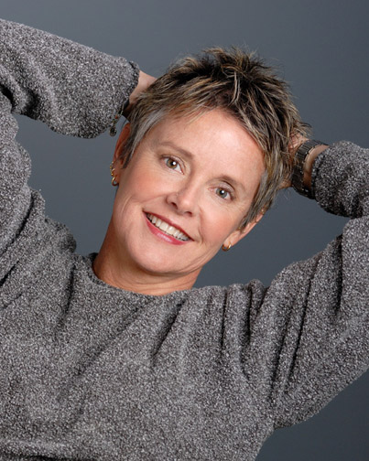
Headshots (BAD)

Slide 54

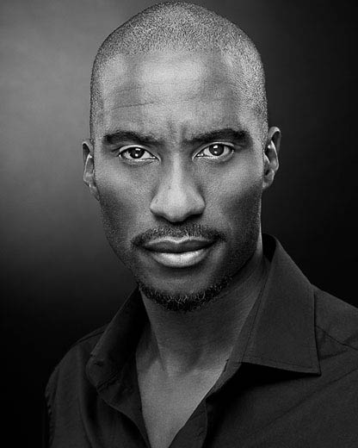
Headshots (GOOD)

Slide 55
Headshot Rules
Where at all possible, use a photographer recommended to you from a reliable source.
Make sure the photographer knows what discipline you are training to gain professional work in.
Make sure you have a range of colour and Black & White with a multitude of expressions.
Don’t POUT!!
Make sure the photographs are a TRUE representation of the way that you look – even if you think you/it is “UGLY” it doesn't’t matter. Often, peculiar looking people get work – GOOD NEWS FOR MOST OF THE PEOPLE IN HERE!

Slide 56
Spotlight
Spotlight is the photographic directory of all performers in the UK and is often the first place directors look when casting.
https://www.spotlight.com/join-us/performers
To join Spotlight, you need to pay AT LEAST £150 per year and, in terms of helping to improve your research, you should have a look at the website link above in order to show your development and improve your research within your written work on the course.

Slide 57
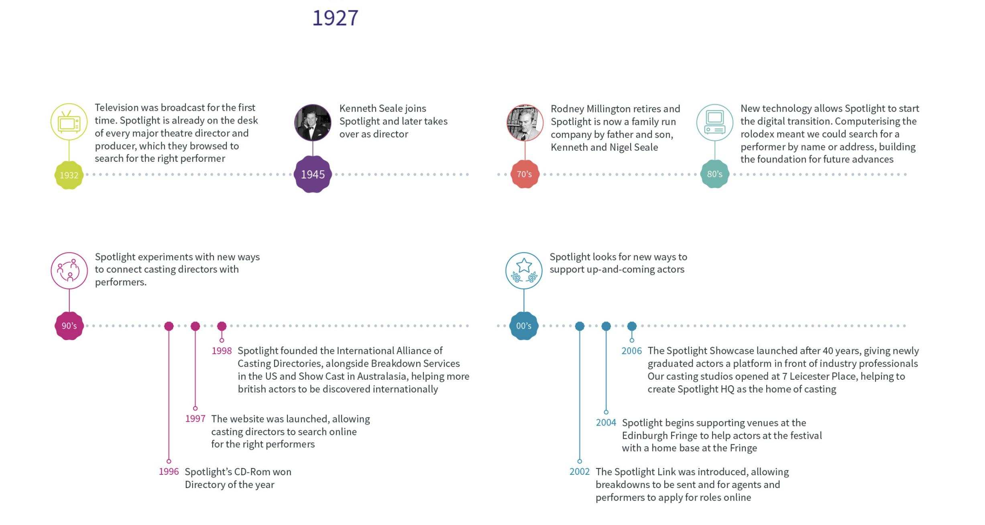
Spotlight

Slide 58
Equity
Equity is the UK trade union for professional performers and creative practitioners. As a leading industry organisation, Equity is known and respected nationally and internationally for the work we do with, and on behalf of, their members working across all areas of the entertainment industry.
https://www.equity.org.uk/about-us/
In terms of helping to improve your research, you should have a look at the website link above in order to show your development and improve your research within your written work on the course.

Slide 59
Performer’s CV
After you have filled out the appropriate personal details, you need to add;
Your height, build, hair colour and eye colour. Then, you need to talk about any accents you can perform OR, for dancers, all the styles of dance you are proficient in.
Singers need a brief profile to explain their style of singing: opera, musical theatre, popular, plus voice type: soprano, mezzo, baritone or bass. Specify what you want to do and why. Enthusiasm is very important. You can include a well produced & brief CD of your work or it can be linked from a website. These should be one or two minute samples of your best work. The first should be the best as this may be the only one listened to.

Slide 60
Performer’s CV
After this, should be a list of your skills. Things to include would be;
Full Driving Licence, BADC intermediate certificate in Stage Fighting, Horse Riding, Workshop Leader, Chorus Dancing, Skiing, Tennis, Scuba Diving, Computing
The extra skills that you posses can often be what sets you apart from other performers and it is CRUCIAL that you don’t lie on your CV as there are many stories of actors/dancers etc. saying that they could do something and it coming back to haunt them.
After this, any music skills – Singing: Soprano. Chorus and Solo Singing and any instruments that you play (including how good you are/what grade you have achieved).
Then you list your training, usually from Degree upwards. Only include short courses or relevant professional training.

Slide 61
Performer’s CV
CREDITS – this is the most important information you can include because it shows a casting director what work you have previously done. There is a specific way in which you lay this out which is universally adhered to as part of an acting CV.
List what experience you have: all the productions you have been in, usually divided into film and TV and theatre. Where you have performed: year, type, role, director/conductor and venue.
Break it down into specific genres and make sure you have all of the relevant information. This can be a mixture of student work, amateur work and professional work – just be wary of what to include. For example, if you performed in an AmDram show which received bad reviews from local press, maybe don’t include it as it could hinder your chances of gaining paid employment.

Slide 62
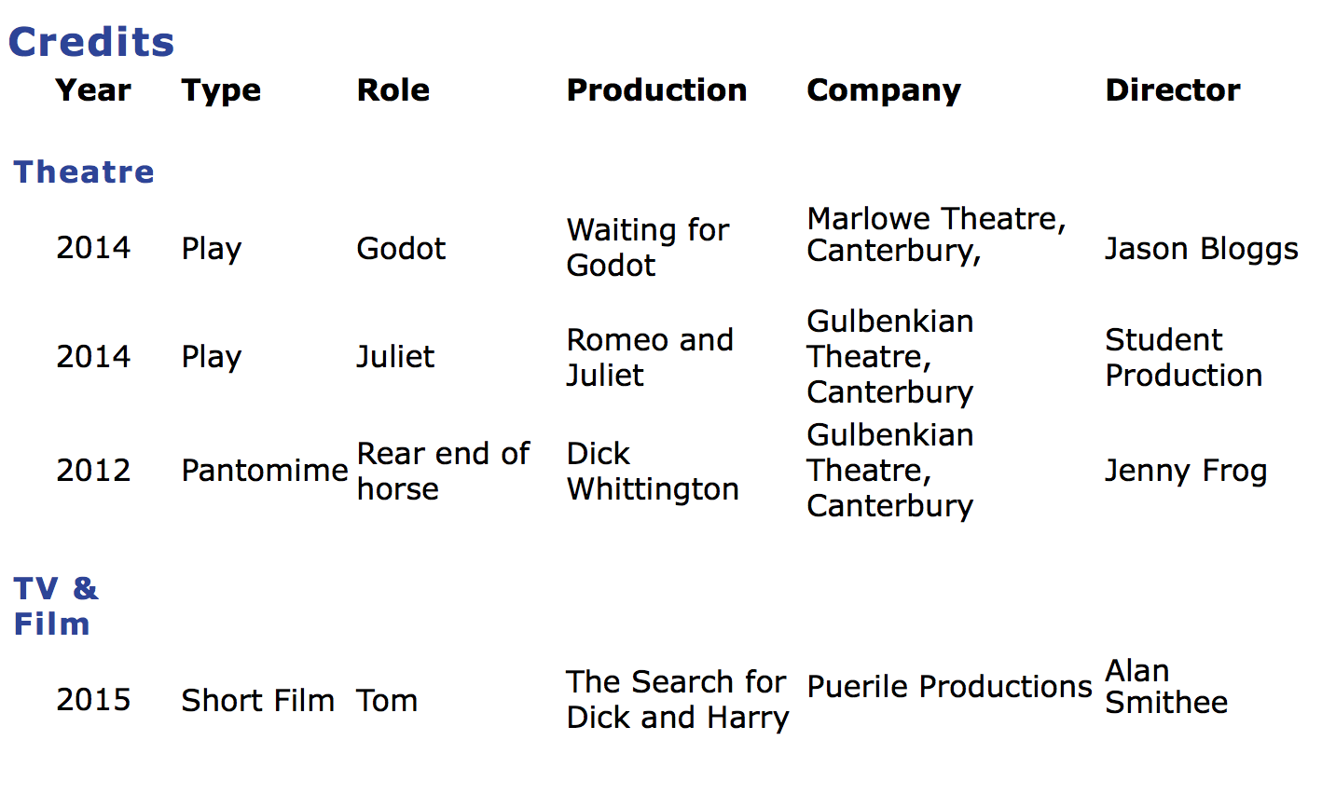

Slide 63

CV
Example

Slide 64
Personal Statements
Ultimately, you may not ever get a chance of giving a personal statement to a director in the professional world. However, depending on the job, you have to cater a statement towards the work that you are trying to get.
Make sure that you are keeping all relevant information and training up to date and included in your Statement.
Develop this depending on the job and make sure that you are catering to the requirements/specification of the person.
I will now show you how you can talk about this is your coursework…

Slide 65
Personal Statements
To PASS, you need to describe what a Personal Statement is.
A personal statement is a document which enables a performer to give an more specific overview of themselves and their achievements as well as giving a casting director a better understanding of their skills and personality.
To get a MERIT, you need to talk about how you would develop a statement and what they need to include.
In order to complete a successful Personal Statement, one has to give details about all aspects of their developments as a performer. You need to include any interpersonal and professional development as well as outlining what you hope to achieve if successful in achieving employment.

Slide 66
Personal Statements
To get a DISTINCTION, you need to explain how a PS sells a professional practitioner as well as justifying the importance.
A personal statement allows an employer to be able to gain a stronger understanding of an individual candidate. This is vitally important in such an overcrowded/over-saturated field of employment. A CV gives a performer the opportunity to be able to list in a concise manner the experience they have and the basic skills and employability options they offer. However, a professional practitioner who has a body of work and a range of experience cannot necessarily represent themselves with a CV alone. Having a personal statement allows a performer to be able to speak articulately about themselves and the opportunities they have participated in as well as their suitable to the post.

Slide 67
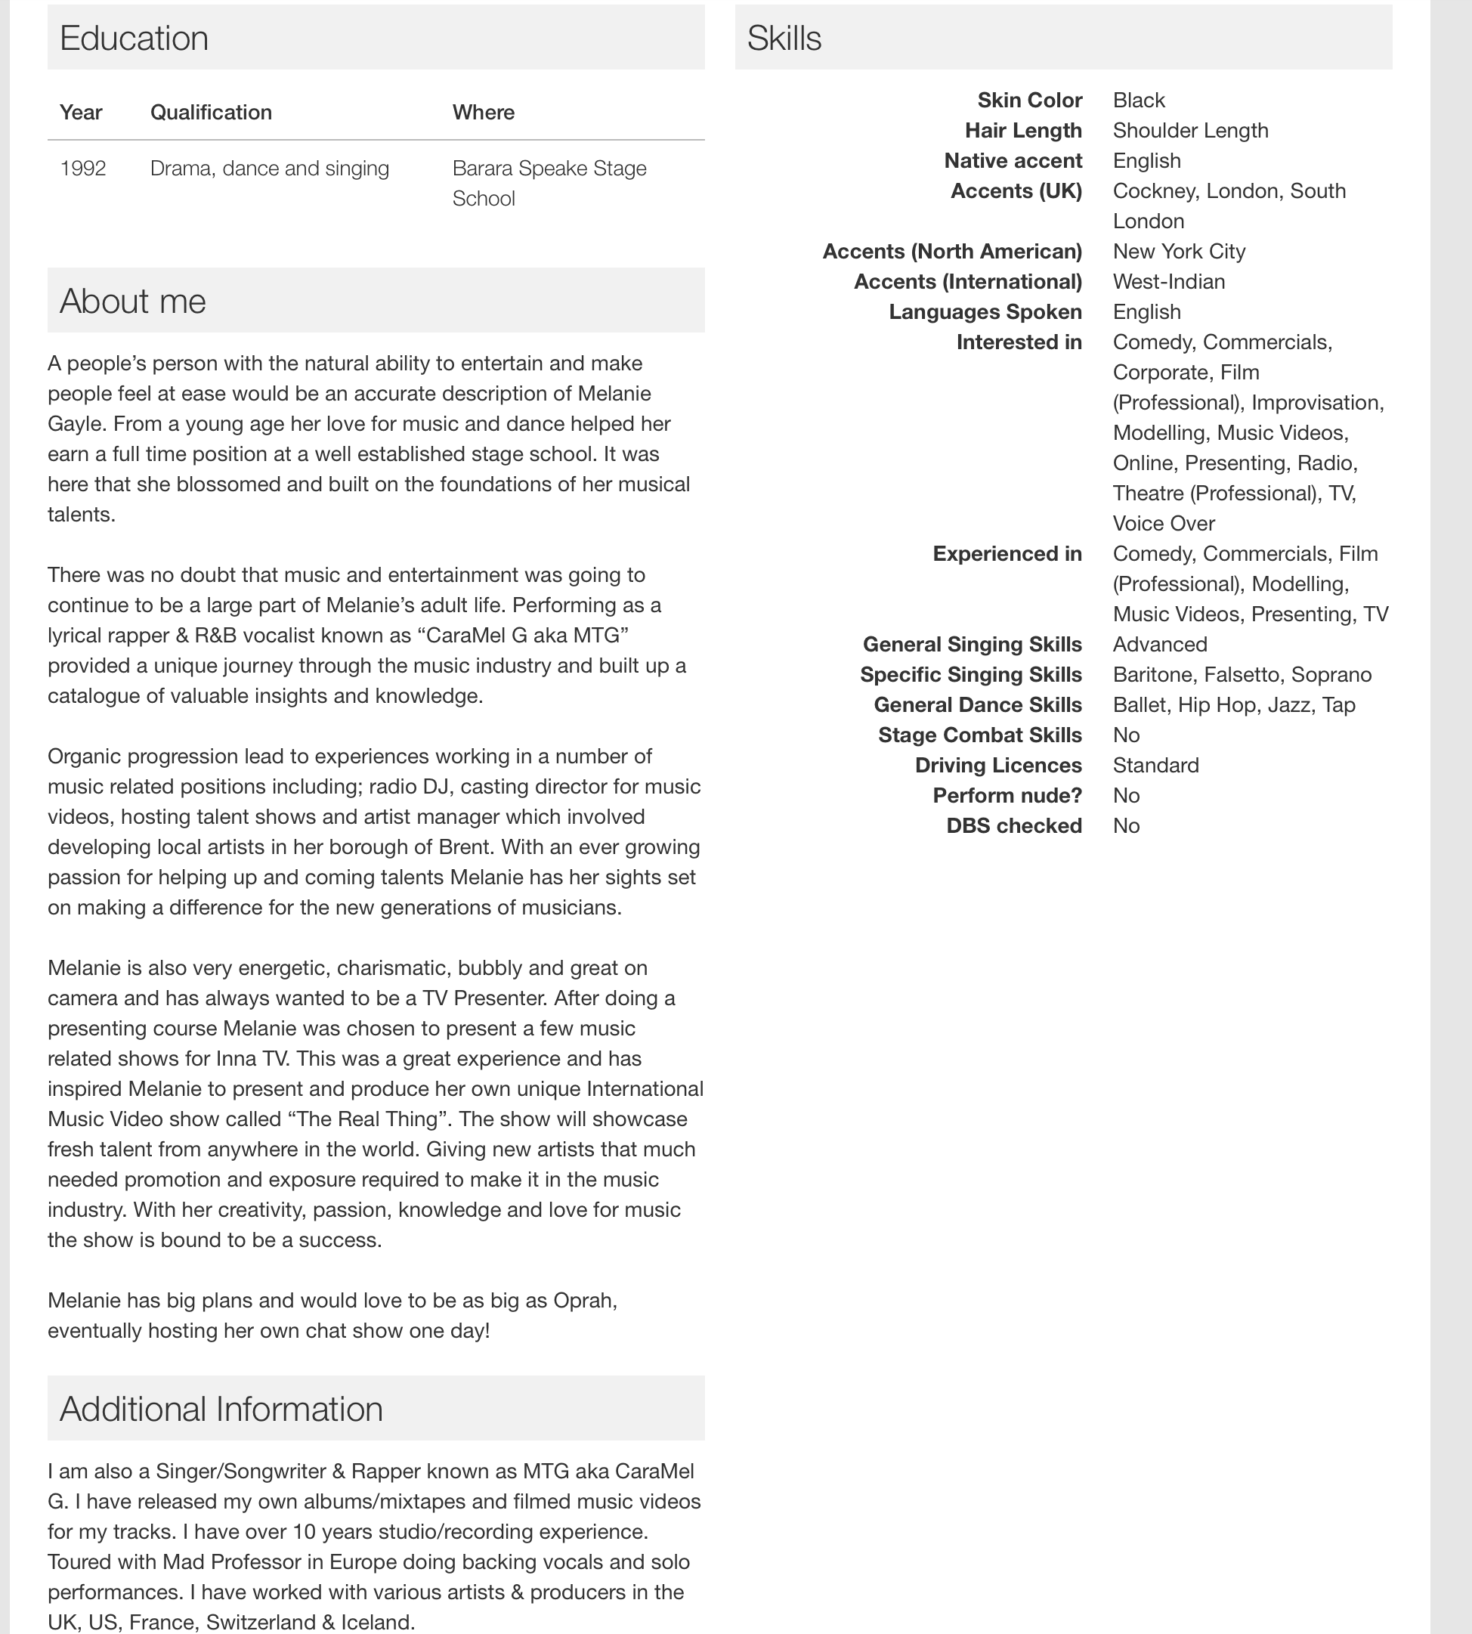
Casting Call Pro

Slide 68
Auditions
What separates professionals from wannabe talent show prodigies isn't inspiration. It's preparation and execution. Take control of your audition with these ten helpful tips to improve your skills.
REMEMBER – these are guidelines and every audition is totally different. You need to do as much research you can before the audition in order to successfully prepare you for your audition.

Slide 69
Auditions – Acting
1. Confidence. It sounds simple but it takes practice. Walk in the door with your held head high. Be wary of shuffling feet. You don't get sympathy points if you're nervous, not feeling well, or having a bad day. Leave it outside the door. You are being sized up the minute you walk in, so practice good posture and body language before you arrive. And don’t forget to smile – that's the lasting impression you want to leave.
2. Personality. Give a fair representation of yourself. Don’t give one-word answers when having a conversation with the casting director. Ask questions! The industry is looking for smart, curious actors.
3. Connection. As much as possible, try to connect with the material or choreography. Memorize the material or be familiar enough with it to maintain eye contact. Knowing the dialogue is important, but making a connection with the reader is what will make the scene natural and believable.

Slide 70
Auditions – Acting
4. Character. Know the character. Read the entire script beforehand to pick-up as many clues as possible. We know about a character by the following:
What he/she says about himself/herself
What other characters say about him/her
What the playwright or screenwriter says about him/her
5. Objective. Go underneath the dialogue. What does he/she want from the other characters? What is the character’s purpose in the scene/story?
6. Obstacle. What's in the way of the character getting what he/she wants? Acting is what happens to you as you TRY to get your objective met, in spite of the obstacle.
7. Opposites. Yelling isn't the only way to show hatred or anger. Sometimes being quiet as you make your point is a powerful display of emotion. Playing opposites is a much more interesting choice than the obvious.

Slide 71
Auditions - Acting
8. Love. Find the love in the scene. Even nasty characters should be likeable on some level. Find a moment in the scene where the love can show through.
9. Act. Acting means TO DO, not to talk. Find your actions and play them! (A wonderful resource is the book “Actions: The Actor’s Thesaurus” by Marina Caldarone & Maggie Lloyd-Williams.)
10. Variety. Feel the levels and dynamic in the scene. Don’t play one emotion. If the character is angry or tough, when might he/she show some vulnerability?
http://blog.stageagent.com/how-to-prepare-for-an-audition/ - this is a fantastic resource with detail about other ways to prepare for an audition.

Slide 72
Auditions – Dancing
1. Practice Regularly
Take dance classes in different styles consistently. During your classes, take your training seriously so that your technique is in peak form. Perform each combination in class to its fullest potential and take corrections in stride, employing them immediately. This will help condition your body and mind to the rigors of the audition world.
Know what style of dance you excel in, and then try something completely different. You never know when a choreographer is going to throw some ballet into a hip-hop routine these days. Versatility is a sought after quality in a dancer.
It also helps to take new classes regularly; that way you are continually testing your mental ability to pick up choreography quickly.

Slide 73
Auditions – Dancing
2. Gather Your Information
Be informed about what you are auditioning for. Are you auditioning for a Swan Lake role, or a music video backup dancer?
Learn as much as you can about the role or company you are auditioning for beforehand. Find out if there is a fee to audition and be sure to bring it with you. Then, find out if you need to bring or submit any documents. If the audition requires a resume and headshot, start to prepare the required documents.
Make sure your resume highlights your strengths and recent accomplishments, and includes your name and phone number. Also be sure to mention where you have trained, who you have studied with, and performance experience.
Your headshot should be a professional photograph. Some auditions may also require a full body photo. They may require you to apply and send this information in advance; others may want you to bring printed copies that they can keep.

Slide 74
Auditions – Dancing
3. Cross Train
Become a stronger dancer by cross training. Increase your cardio health through running, biking, or swimming. Lift weights to increase your strength for partner work. Do yoga or Pilates to stretch, strengthen your core, and focus your mind. Be patient to find what works for you.
This will help you get through a long audition. Cross training also keeps you in physically good shape, so that the judges are seeing your best self when you audition.
4. Be Healthy
Get plenty of sleep in the week and night prior to your audition. Maintain a plentiful and balanced diet. Focus on eating whole foods rather than processed foods as much as possible, especially the night before and day of the audition. Have a good, healthy, and filling meal the night before your audition, but don’t overdo it. Eat a light meal an hour or so prior to your audition. This is very important so that you can function to your highest ability when auditioning. Drink plenty of water regularly.
5. Dress Appropriately
Be smart about knowing what you are auditioning for. A ballet role is going to want to see you in leotard, tights, ballet slippers, or pointe shoes. A hip-hop role will allow you to express your personality through your outfit. If appropriate, wear something that helps you stand out in the crowd. Be edgy, but, keep it clean and neat. Inquire if you have any questions about the dress code. Bring the correct dance shoes as well.

Slide 75
Auditions – Dancing
6. Be Prepared for Anything
This may mean choreographing a short solo piece, participating in a group class, or performing an improvisation.
Find out if the audition will require a solo, and prepare by choreographing in advance. You can choreograph it yourself or have someone else choreograph it on you if you are more comfortable with that. Make sure your choreography suits the style of the audition and also shows off your technique and artistic ability. Practice your solo regularly. This also means to bring back up supplies such as hair bands, bobby pins, band-aids, extra water, other dance shoes, knee pads, or anything else you think you might need.
7. Arrive Early
Give yourself time to check-in and warm up. A good, thorough warm up is essential to any dancer being able to perform at their best. Take time to centre yourself, stretch, and move, even if they are giving you a warm up in the audition. This time will also help orient you to the studio space. If you start to feel nervous, take a few deep, slow breaths to calm yourself down.

Slide 76
Auditions – Dancing
8. Be Positive
Remain lighthearted and natural if you begin to feel nervous at all. Channel your nerves into enthusiasm for the choreography.
The more you can allow your talent to shine through your dancing ability, the closer you will be to landing the job! Be there for yourself and your desire for the job.
There is no need to compare yourself to others, so leave your judgment at the door. Be optimistic in the time leading up to the audition and bring that passion into the studio with you. Be yourself, relax, and have faith in your abilities.
When the time comes to audition, focus your mind on the present moment rather than what the results will be.
Auditioning is a skill that should be practiced often and will improve over time. Remember to learn what you can from both good and bad audition experiences. Remain hopeful in yourself and dedicated to your craft to continuing growing as a dancer and performer.

Slide 77
Portfolio
You need a portfolio to showcase your work and to help to demonstrate your skills to prospective employers. Nothing impresses more than a beautifully presented portfolio at an interview. But don't send it unless requested. Always bring it with you if you have an interview.
Go for quality, not quantity: employers will probably spend only a few minutes looking at your portfolio, especially at interview. Less can be more so select only your strongest work.
Put your portfolio on a web site if possible as it is so easy to access. You then simply need to provide the web link on your CV.
Make sure that the portfolio is carefully laid out and in the correct order.
All items need to be clear and easy to understand
A physical portfolio can include anything that is portable! Anything flat can be folded into a portfolio, but you are not restricted to things that can fit inside the portfolio! If an item is too large to take to the interview take high quality photos of it to show with close ups to elicit details.

Slide 78
Portfolio
A good portfolio would probably have most of the following;
An index of the contents
Your CV including your interests and any evidence of project management skills.
Your CV should give the impression that you think like a designer.
Perhaps a profile or personal statement
Your key achievements and skills
Examples of your work of course with good documentation.
Place the best and most relevant work first and start and finish with strong pieces of work.
Include a variety of examples of work you have done.
Your main example needs to reflect your strengths and your creative approach and flair.
Items that show your thought process and development of ideas are valuable: sequence of photos for example.
Production portfolios can also include budget sheets, idea pitches and marketing materials.

Slide 79

Portfolio

Slide 80
Portfolio – Other Examples
Blogs
A blog can sometimes be a compliment to your portfolio allowing you to keep potential employers right up to date with what you are doing. You can ask for comments from viewers on your latest work. Keep it professional!
Instagram
In the creative industries Instagram feeds are to some extent now replacing CVs and portfolios. Successful Instagram portfolios may also include information on your activities outside work as well as traditional material. Creative directors now often use Instagram to vet candidates as they can get a taste of your personality as well as your artistic skills.

Slide 81
Portfolio
A SHOWREEL gives a taster of your skills and can be placed on-line and/or on a DVD. Tell the viewer how long it will last in case they have limited time (or patience!).
https://www.youtube.com/watch?v=qMlqbdjDPPU – Vanessa Page
https://www.youtube.com/watch?v=NPJTr82NKXg - Adam Fray
Which one is better? Why is one better than the other? Who do you think will get more work based purely on a showreel?
https://www.youtube.com/watch?v=a4WEm4KxJPE - Rebecca Mansueto (DANCE)

Slide 82
Agent
Performers without agents tend to lack credibility in the eyes of potential employers. It’s not fair, but it’s a fact. However hard you work at getting to know potential employers, most agents have their fingers closer to the pulse, know what’s coming up, and simply have far more contacts than you can ever have. That’s their job.
Directors and casting directors rely on agents they trust to help in the filtering process of whom to interview. A good agent also understands contracts, knows the ‘going rates’ and has more clout to get money that’s owing.
Individual agents vary in the ways that they like to operate. There are those who like to maintain reasonably close personal relationships with their clients; others prefer to be more business-like. There are those who actively discourage clients from doing lower-paid theatre, preferring it if they wait around for a more lucrative television opportunity – even to the extent of not passing on an offer. (I discovered such an agent when my offer was turned down for someone who I knew - through a mutual friend - was available and wanted to do my production. I broke the rules and phoned her directly, and she sorted her agent out.) There are also those who are ‘here today and gone tomorrow’ – it’s a very mobile population.

Slide 83
Agent
There are all kinds of agency and agent listed in the ‘Agents & Personal Managers’ section of Contacts – around 600 (of which around a quarter don’t represent adult actors) the last time that I counted. (All those listed in Actors’ Yearbook do represent adult actors.) Roughly, the ones who primarily represent adult actors break down into the following types:
• The large and prestigious (several hundred clients) with lots of ‘names’. These agencies are staffed by a number of individual agents (often with assistants), and the focus can tend to be on their stars – sometimes ignoring their less well-known clients.
• The large (a few of whom are prestigious) who also represent models, presenters, etc. Once again, their focus can meander through their various specialisms.
• The large and less prestigious with smaller staffs, who rely on sheer numbers to keep them financially afloat – client promotion seems to be effected by sending out great wodges of CVs and photographs randomly in the hope that a few will land on the right desks.

Slide 84
Agent
• The medium-sized (around a hundred clients) who are often staffed by a couple of agents with minimal assistance – a few are very prestigious. The small (around a few dozen clients) who are usually run by a single person often working from home with a part-time assistant – I don’t know how some of these manage to make a living. The co-operatives who usually consist of around twenty members and are run by those members, sometimes with a full-time manager.
The important thing is that a good agent works hard at making contacts and makes sure that they are respected by those contacts. Just as the agent represents you, you represent your agent. Being an agent is, most of the time, as disheartening as being an actor – and it’s hard work, easily running into sixty or seventy hours a week. Agents putting clients up for things are putting themselves on the line. All directors and casting directors have blacklists of agents whose clients have messed them around too often, so good agents are very careful about how they select those they are going to represent. They have to feel that they can work with you at selling you effectively, just as directors have to feel that they can work with, and benefit from, you in a company.
Think carefully about which kind of agency might suit you in order to sort out who to target for representation.
From An Actor's Guide to Getting Work, Fifth Edition, Methuen Drama (Bloomsbury)

Slide 85
Interrelationships
This part of the coursework requires you to examine relationships between performer and choreographer or performer and director. You are evaluating the importance of the effectiveness of relationships as well as why this is important to be a successful performer. Think about the importance of being able to collaborate and work together. Choose either Choreographer or Director and use the links below to help.
Dancers - http://www.danceconsortium.com/features/interview/deborah-colker-the-choreographerdancer-relationship/
Actors - http://www.markwtravis.com/2012/06/the-actordirector-relationship/
Why are interrelationships important?

Slide 86
Plenary
Over these two lessons, you have been given all the information you could need in order to successfully complete LEARNING AIM A of your coursework.
These PowerPoints will be available online after this lesson for you to reference and have to help with the content of your coursework.
REMEMBER, these lessons are giving you a GUIDE as to what should be included – you need to complete your own research and add/develop to the ideas you have been given where applicable.
GOOD LUCK! – any questions, let me know and I’ll try and answer them for you.

