Slide 1
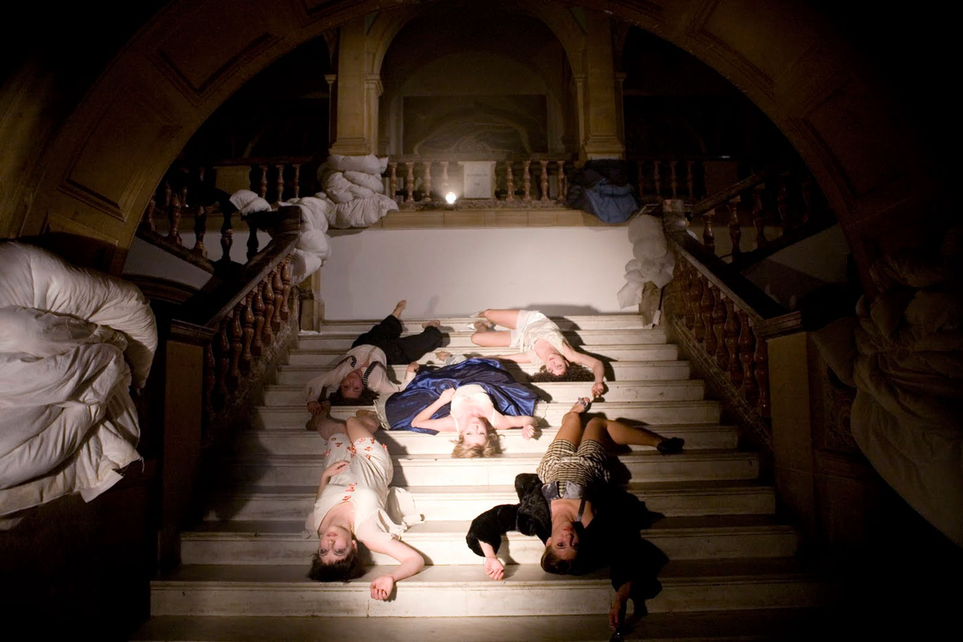
Dante or Die
Dante or Die

Slide 2
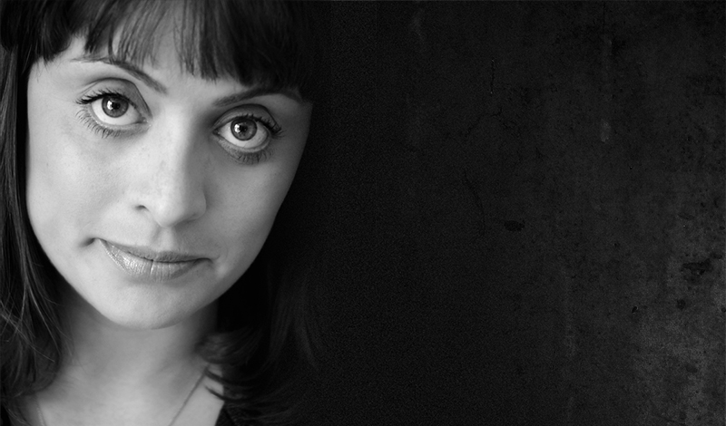
Daphna Attias
Co-Artistic Director of Dante or Die Theatre.
She has directed all of the company's work to date:
Take On Me, Handle With Care, I Do, La Fille à la Mode,
Side Effects, Caliper Boy, Clunk.
She is also Artistic Director of Peut-Être Theatre
Her work has been presented and performed nationally and internationally at venues such as Almeida Theatre,
Roundhouse, Royal Albert Hall, Brighton Festival, Southbank Centre, The Place, Royal Opera House, The Lowry,
Barnsley Civic, The Arc Stockton, The Egg Bath, Polka Theare, National Theatre's Watch This Space,
Drama Centre Singapore, Ziguzajg Festival Malta, Israel Festival for Children in Israel.

Slide 3
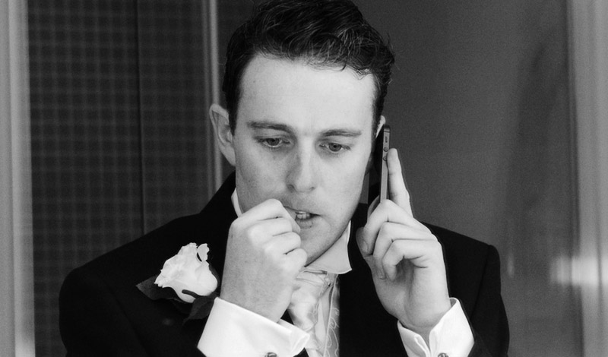
Terry O’Donnovan
A performer and director. As Co-Artistic Director of Dante or Die he has co-created all productions, performed in most, and co-directed La Fille à la Mode and Clunk.
He performs in Take On Me, Handle With Care, I Do, Caliper Boy and Side Effects.
Directing credits include On The Wire (Best Production, Irish Times Theatre Awards Nom; Wildebeest Theatre Co for Limerick City of Culture), The Secret Princess of Severndroog (Look Left Look Right commission for Greenwich & Docklands International Festival), Spin Cycle (Emergency Exit Arts), Our Dancing Feet and Home Fires (Inroads & Zap Arts).
In 2012 he co-founded TOOT to make Ten Out of Ten, an Ovalhouse commission toured throughout 2013 & 2014.

Slide 4
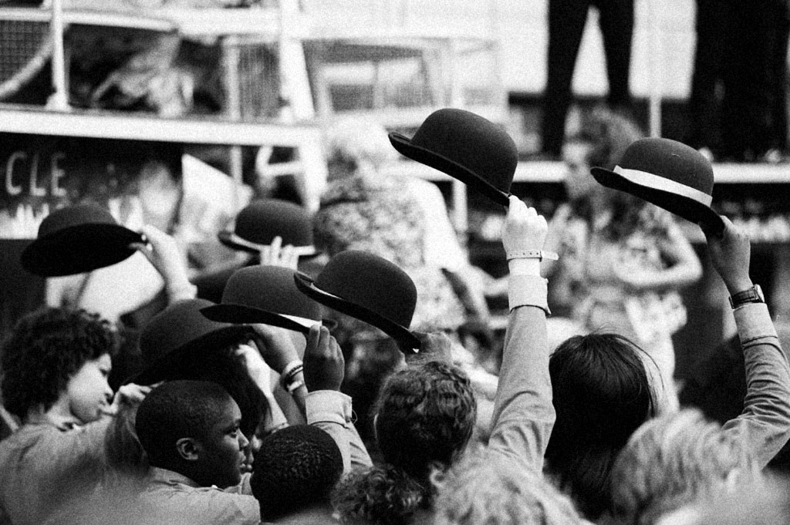
AMBITIOUS STRIKING CONTEMPORARY

Slide 5
PRODUCTIONS
User Not Found - Looking at your digital legacy and what will happen to your Facebook account when you die.
Take On Me - Looks at the 1980s and everything that makes this time iconic
Handle with care – A site specific performance about a womens life in self-storage

Slide 6
PRODUCTIONS
I Do – Site specific piece about 6 hotel rooms before a wedding.
Side Effects – Based around how intergenerational community works
Ski Lift – based and watched on a Ski lift, it is a unique and exciting dance and theatre piece.

Slide 7
Dante or Die focus on site specific and site sensitive productions
No one genre that they stick to as they believe any story can be entertaining if told right.
There target audience would be 16+ as they talk about the subjects which are relatable if you are slightly older and have some life experience.

Slide 8
THANK YOU

