Slide 1
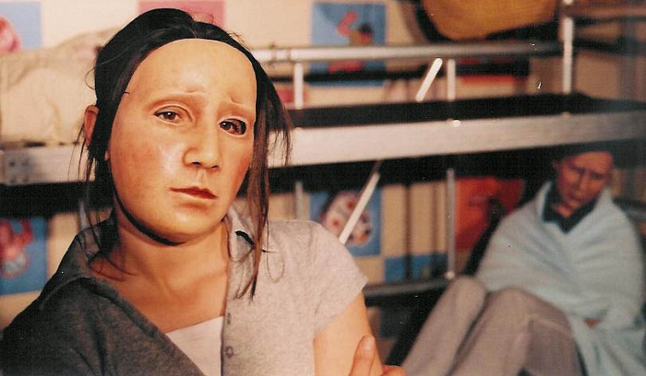
Geese theatre company
A theatre company that helps with Developing dynamic and interactive training solutions for professionals working within criminal justice and social welfare

Slide 2
When did the company start?
Geese Theatre Company was established in the UK by Clark Baim, in 1987. Clark had toured extensively in the USA with the original Geese Theatre USA, a touring company established in 1980 by John Bergman. Geese Theatre USA visited hundreds of prisons and paved the way for a great deal of innovative arts-based work in America. Although the two organisations have been separate since 1997 we owe a debt of gratitude to John for providing the foundations on which much of our current work is built.

Slide 3
TIMELINE OF WORK
10th June 1987 – Geese’s first rehearsal – University of Warwick
1987 – Geese delivers first ever performance at Rolfe Street Probation Centre, Smethwick, West Midlands
25th January 1989 – Geese host the national Arts and Crime Conference – a national conference on the role of the arts in crime prevention and reducing recidivism – including performances by Geese Theatre Company, Clean Break and Motionhouse, with a keynote address from Ian Benson, Chief Education Officer for HM Prison Service.
25th January 1994 – 40 minutes documentary 'Behind the Mask – a week in Risley prison with the Geese Theatre Company' was broadcast on BBC2
11th April 1996 – Geese co-host the Second European Conference on Theatre and Prisons at Manchester University with TiPP and the Unit for Arts and Offenders, with a keynote speech from Her Majesty’s Chief Inspector of Prisons, Judge Stephen Timmins
1998 – Geese win the first ever Interactive Learning BAFTA for a CD-Rom version of their prison performance Lifting the Weight
2001 – Geese awarded a Butler Trust Certificate for an innovative offending behavior programme in partnership with HMP Maidstone
2002 – first publication of the Geese Theatre Handbook by Waterside Press
2009 – Geese are awarded the Royal Society for Public Health’s Arts Award for their commitment to the mental well-being of offenders
2013 - Geese are awarded the Royal Society for Public Health Arts and Health Award for a second time

Slide 4
What do they do?
Geese Theatre Company is a team of theatre practitioners who present interactive theatre and facilitate drama-based group work, staff training and consultation for the probation service, prisons, young offender institutions, youth offending teams, secure hospitals and related agencies throughout the UK and abroad.

Slide 5
THEIR AIM / WHO THEY WORK WITH
The company work internationally with:
people in prison, on probation, or in mental health settings
young people who are seen to be at risk of offending and who have offended
professionals who work with these client group
The company’s mission is to:
To use drama and theatre practice to enable choice, responsibility and change amongst offenders and people at risk of offending in order to reduce crime and re-offending and create safer communities.

Slide 6
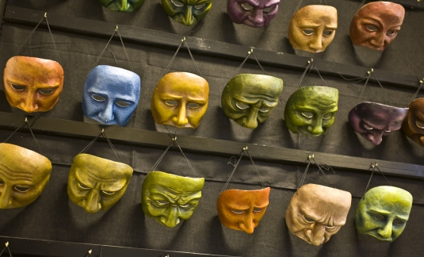
Why Masks?
Mask is one of the central metaphors in the company’s work and they use both full-faced and half masks.The company work with the notion that everyone wears 'masks', some as a habitual coping strategy, others more consciously. In the company’s performances and workshops, audiences are invited to ask characters to 'lift their mask' and can question them about the thoughts and feelings that inform their apparent attitude or behaviour.
They believe that this technique enables audiences to explore the distinctions between external presenting behaviours and internal experience and can prove to be incredibly motivating for audiences and group members. ( inner/outer thoughts.

Slide 7
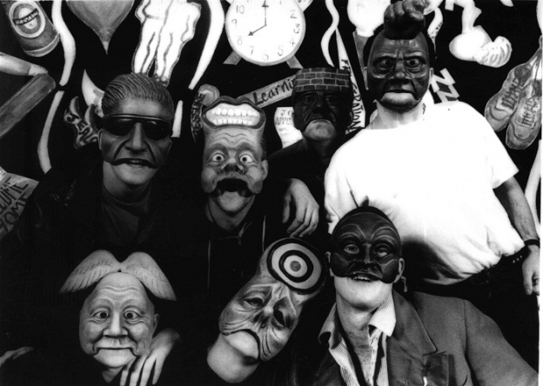
Their motif
“We believe that theatre performance and drama are powerful and effective tools for inviting individuals to examine their own behaviour and acting as a catalyst for promoting personal development and change.”

Slide 8
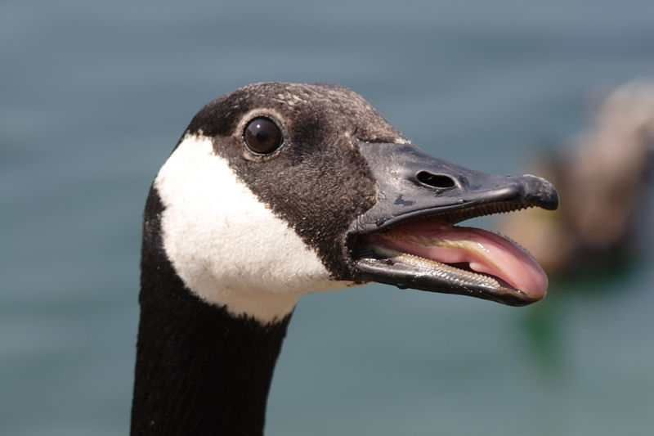
Their achievement and outcome
Since 1987 the company has worked in more than 150 custodial institutions, with over 250,000 offenders and people at risk, delivered training to over 20,000 people and performed at 750 criminal justice and social welfare conference events.

