Slide 1
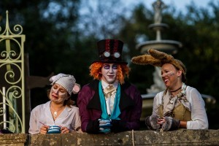
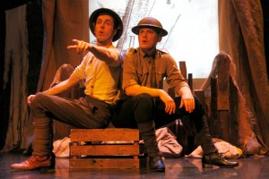
Scene Productions Theatre Company

Slide 2
Purpose Of The Company
Aim to create vibrant, fast-passed and immersive adaptions of classical texts
Devise creative physical theatre performances
Show how the use of masks, puppetry, movement, sound, text and tightly choreographed movement sequences

Slide 3
Themes Explored
The company was heavily inspired by WW1 with true stories for their performance of ‘For King And Country’
They like to dedicate themselves to exploring promenade style theatre
Re-imagining classic texts such as ‘Alice In Wonderland’
Real world conflicts throughout history such as WW1, WWII, Cold War, Afghanistan
Key emotional themes such as loss, conflict, world power, political oppositions and social relationships

Slide 4
Venues Performed In
They have performed at prestigious venues such as Ascot Racecourse and South Hill Park
The company also like to tour to smaller venues and schools to provide more interact performances and workshops to children and young adults such as their performance of ‘Metamorphosis’ in 2017

Slide 5
Target Audience
Workshops aim to improve and inspire children and young adults in education (Years 7-13)
Performances are opened to the whole public in hope they can inspire and educate people of moments in history as well as engage them into a world of creativity and a reformed reality in creative performances

Slide 6
Why is their work inspiring
The company is highly respected for its achievements such as their 2009 three week run of ‘The Other Side’ at the Edinburgh Fringe Festival exploring the Palestine/Israeli conflicts
Taking on such controversial conflicts that have affected many lives in detrimental manors is a bold but respected pathway for the theatre company
The experimentation of physical theatre in their pieces is extremely inspirational for devising performances and bringing use of masks, lighting and sound into your own rehearsals to see what could work

Slide 7
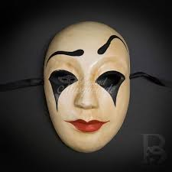
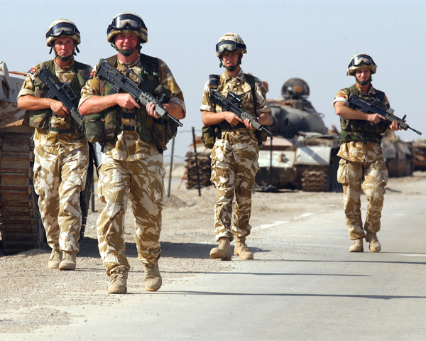
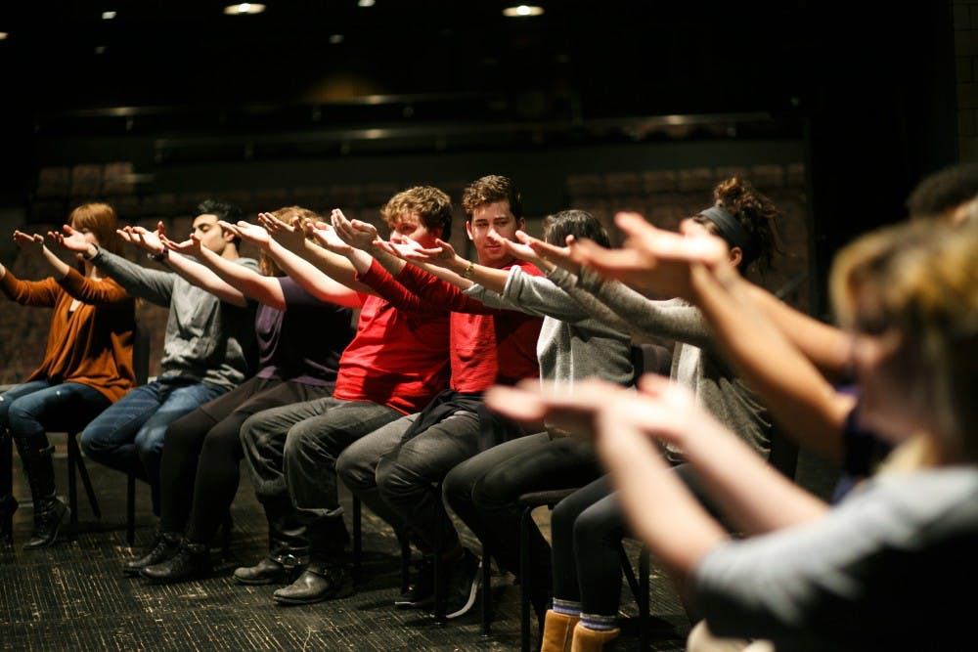
Aspects Of Performance For Our Community Theatre
Experimentation with props and masks
Use of music and sound effects
Taking on real world issues – global or local
Interactive with the audience/clients

Slide 8
The Boring Bits
Scene Productions is a local physical theatre company based in Yateley, founded in 2004 by Artistic Directors Kelly Taylor-Smith & Katharine who met at the Guildford School of Acting in 2002
Their work includes a strong focus on learning and the company lead a variety of workshops offering students and adults the chance to re-discover theatre in fresh, bold and imaginative ways. The company also offer work experience to students and collaborate and participate in workshops with other theatre companies to continually learn and progress themselves

Slide 9
Company Members
Kelly Taylor-Smith – Company Director
Ron Price
Gavin Robertson
Matthew Springett
Mark Rush
Sarah Hope Morrissey
Danny Bright
Joanne Major - Set design and construction

Slide 10
Current Workshops

