Slide 1
Scene productions
By aimee jn

Slide 2
What is the purpose of focus of the theatre company?
The company creates vibrant, fast-paced and immersive adaptations of classical texts as well as their own devised work.
Their unique physical style combines mask, puppetry, movement, sound, text and tightly choreographed movement sequences.

Slide 3
Past productions
Oh What a Lovely War
A Christmas Carol
Woyzeck
The Fall of The House of Usher

Slide 4
Current productions
Alice in wonderland
Metamorphosis
For king and Country

Slide 5
What venues do they perform in?
As a touring theatre company they are very flexible and have worked in many different spaces such as halls, drama studios and theatres.
They create a performance piece and tour around to different theatres and schools to an audience that best suits their piece.

Slide 6
Who are their target audience?
Their target audience varies dependant on the piece. For example some performances are aimed towards children in schools and some are aimed to the older generation about things that effected them in their generation.

Slide 7
Workshops?
We also offer In house residency – Where an actor/actors can come into your school (for days, weeks or a term) and work along side your students in class, giving them inspiration, and a chance to see a professional actor working.
Summer courses- 1 WEEK PHYSICAL THEATRE COURSE AGES 11-14 – £150
1 WEEK PHYSICAL THEATRE COURSE AGES 15-18 – £150
School workshops- 1-3 hour sessions which give students the confidence and practical tools required for creating their own theatre. These workshops can be opened up to both GCSE and A-Level students. 2-4 Hour Brecht Master Class.

Slide 8
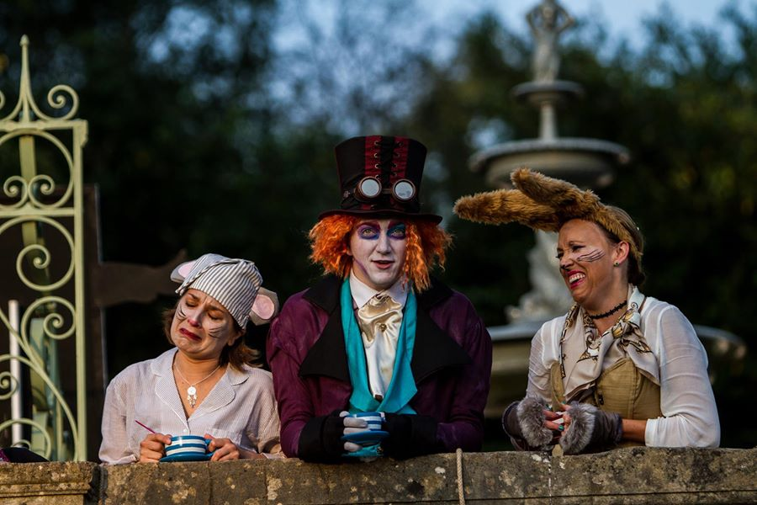
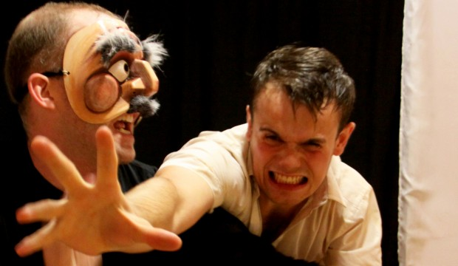
THE END.

