Slide 1
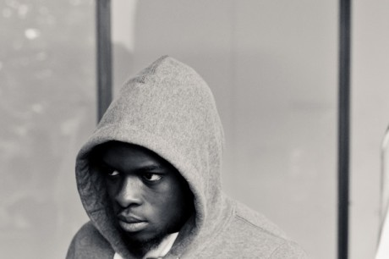
By Molly and Tiff

Slide 2
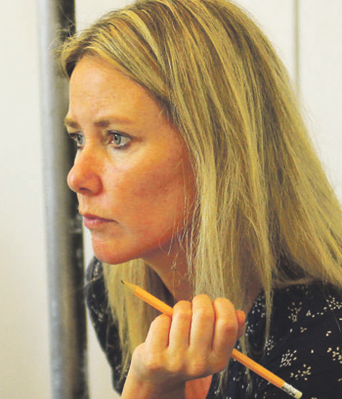
ESTHER BAKER
Artistic Director
Esther co-founded Synergy in 2000 having received a Butler Trust Development Award. She directs Synergy’s productions and has also worked for at the National Theatre Studio, Young Vic, Royal Court Theatre and in the West End.

Slide 3
Synergy’s work impacts
120 prisoners/ex-prisoners
300 young people at risk of offending
Audiences of 3,500 (including 2,500 young people) per year
Over 1,100 prisoners/ex-prisoners and 1,800 young people have participated in projects reaching audiences of over 24,000

Slide 4
Synergy’s work includes
26 productions with prisoners and ex-prisoners
10 touring productions for young people
30 projects for young people
3 national prison script writing competitions
40 playwriting courses
50 rehearsed readings
2 radio projects
And a short film

Slide 5
Synergy’s Young People’s Programme

