Slide 1
Theatre exchange
By Spike and Toby

Slide 2
The history of Theatre Exchange
Theatre exchange, previously part of Thorndike exchange, now known as Leatherhead Theatre, has been active since 1989.
It was established as its own theatre company thanks to the co-artistic director of Thorndike, a man known as Andrew Pullen.

Slide 3
Andrew Pullen
Andrew was co-artistic director of the Thorndike Exchange, a youth and community theatre company, working from the Thorndike Theatre in Leatherhead before establishing Theatre Exchange as an independent theatre company in its own right. With Theatre Exchange, Andrew developed many theatre experiences for a whole range of educational environments from primary school students to the field of disability arts.

Slide 4
Andrew Pullen
Andrew was co-artistic director of the Thorndike Exchange, a youth and community theatre company, working from the Thorndike Theatre in Leatherhead before establishing Theatre Exchange as an independent theatre company in its own right. With Theatre Exchange, Andrew developed many theatre experiences for a whole range of educational environments from primary school students to the field of disability arts.

Slide 5
What is Theatre Exchange?
Theatre Exchange is a theatre company based in the South East that specialises in producing educational, community-centric and cultural theatre.
They dedicate themselves to producing theatre for those who don’t have access to the creative arts in their local area, with particular emphasis on rural communities.

Slide 6
What themes do they explore in their shows?
Some of the shows they are/have performed/performing are/is:
‘Moonbrella’ – An umbrella goes to the moon and a boy goes to save the brolly. Themes: friendship and bravery.
‘Our Junes Wedding’ starring Ava’s mum – Transforms the audience from strangers into a group of friends and family attending a wedding. Themes: Family and friends, love.

Slide 7
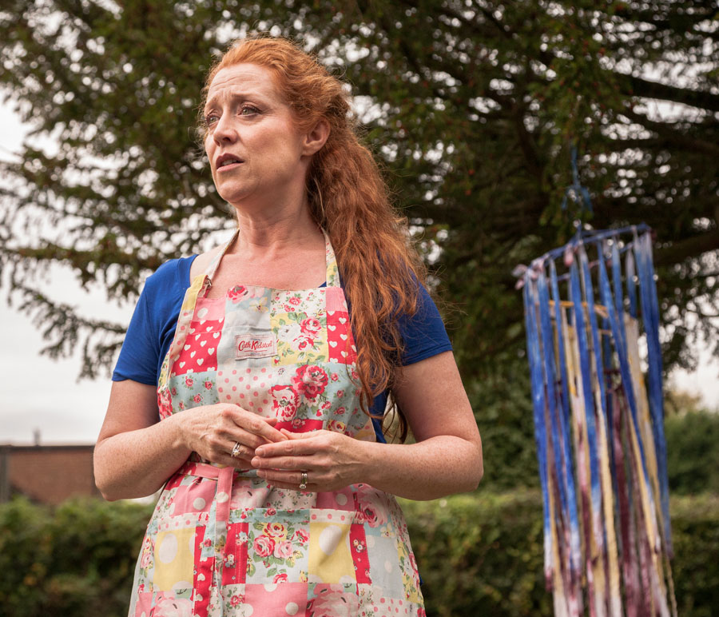
This is Ava’s mum in ‘Our June’s Wedding’

Slide 8
What venues do Theatre Exchange use?
Theatre Exchange aim to perform in a variety of venues, this includes:
Local theatres
Leisure centres
Infant schools
Community centres
Churches
Arts centres

Slide 9
What are their target audience?
Theatre exchange targets the audience, this includes primarily children.
Their age can range from anywhere between 18 months and 16 years.

Slide 10
How they inspire us
Theatre Exchange is an inspiration to us because of their contribution to communities with a lack of access to the arts.
They also specifically target children as their audience, educating them in a more fun and engaging way.

Slide 11
What ideas from Theatre Exchange would we consider in our own community theatre?
Theatre Exchange in their current performance of ‘Moonbrella’ are utilising the use of songs, sounds and signing, which we think would be something that we should also utilise in our own community theatre in order to make our performance more engaging to the audience.
They also involve the audience a lot, making it more engaging for the audience, so we shall also plan to do that.

