Slide 1
3.1.3.2: Sources of energy at the coast
Learning Objectives
To understand tides and the energy they generate
To understand ocean currents
Key words:
Destructive
Constructive
Swash
Backwash
Rip currents
Wave refraction
Neap tide
Spring tide
Concept Checker:
What are tides and currents?
What role do tides and currents play in the development of coastal landforms and landscapes?

Slide 2
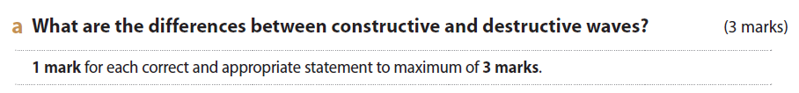
Recap from last lesson…..
On mini whiteboards
What are the characteristics of high energy coastlines?
What are the characteristics of low energy coastlines?

Slide 3
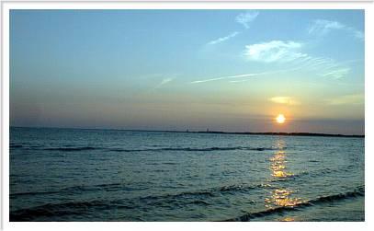
Tides
What are tides and what causes them?
Tides are the periodic rise and fall in the level of the sea.
They are caused by the gravitational pull of the sun and moon, although the moon has much the greatest influence because it is nearer.

Slide 4
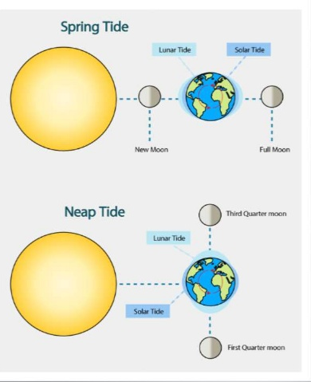
As the moon orbits the Earth, the high tide follows it. Twice in a lunar month (28 days), when the moon, sun and Earth are in a straight line, the tide-raising force is strongest. This produces the highest monthly tidal range or spring tide.
Also twice a month, the moon and sun are positioned at 90° (perpendicular) to each other in relation to the Earth. This alignment gives the lowest monthly tidal range, or neap tides. At this time high and low tides are between 10 to 30% lower than the average.
https://www.youtube.com/watch?v=6IyRE9azhwQ

Slide 5
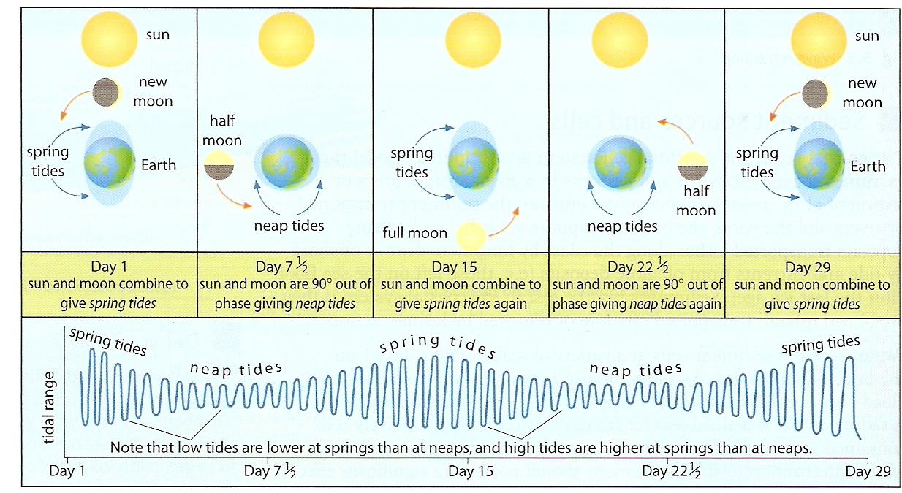

Slide 6
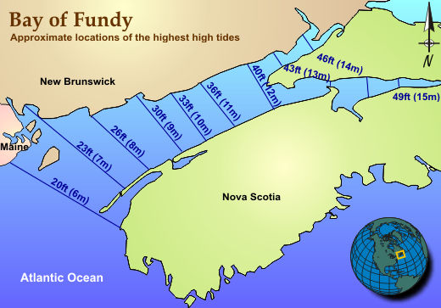
Tidal ranges
Some coasts have a larger tidal range than others.
Micro-tidal ranges are under 2 metres
Meso-tidal ranges are 2–4 metres
Macro-tidal ranges are over 4 metres.
The Bay of Fundy, Nova Scotia has the highest tidal range in the world.
Watch this video clip and explain why this is the case.
https://www.youtube.com/watch?v=l85Dk9LpIEs

Slide 7
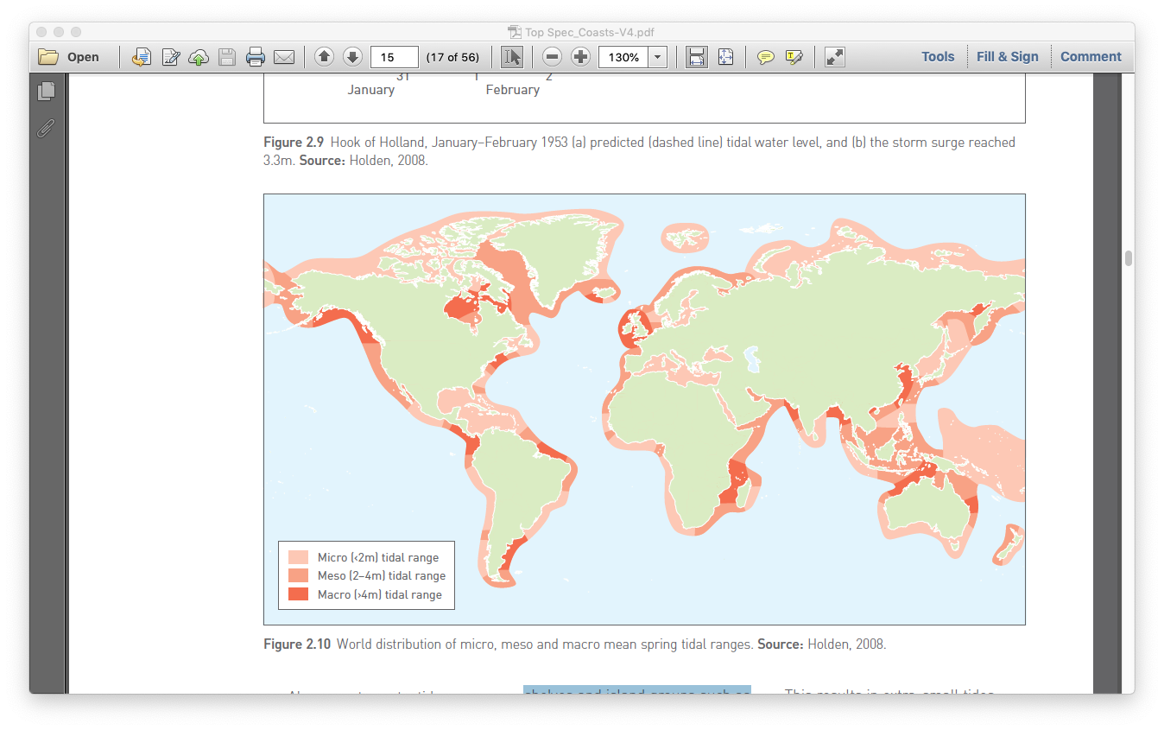
Tidal ranges around the world
Figure 1: World distribution of micro, meso and macro mean spring tidal ranges
Notes:
Source of Figure 1: Top Spec Geography: Coasts (2018) by Gerd Masselink and Debbie Milton, Geographical Association. P. 15

Slide 8
Tidal ranges around the world
Activities
Find the location of the Bay of Fundy on this map.
Describe the location of macro-tidal ranges on this map.
Estimate the percentage of coastlines that are macro-tidal.
Figure 2: World distribution of micro, meso and macro spring tidal ranges.
Notes:
Source of Figure 2: Top Spec Geography: Coasts (2018) by Gerd Masselink and Debbie Milton, Geographical Association.

Slide 9
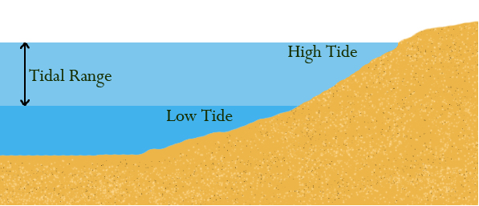
How does tide and wave influence coastal processes?
1) Destructive waves:
A small tidal range means that as destructive waves break on a shoreline their wave energy is concentrated.
A large tidal range means the zone of wave attack moves up and down: wave energy is more dispersed as the tide ebbs and flows.
Constructive waves:
A small tidal range results in deposition being concentrated on a narrow zone of the shore.
With a large tidal range the zone of deposition is more dispersed.
2) Tidal range affects the length of time that the littoral zone (the narrow zone between the high and low water mark) is exposed to subaerial weathering.
3) The speed of incoming and outgoing tides has an important scouring effect on the coastline as strong currents can be generated.
Annotate the diagram to show how the tide influences coastal processes

Slide 10
What modifies the pattern of tides?
The regular pattern of tides is significantly modified by
  The morphology (shape) of the seabed
  2) The proximity of land masses
  3) The impact of the spinning forces of the Earth (Coriolis force)
  The Coriolis has no direct effect on the tide. However, it has on the main oceanic currents and those influence the tides.

Slide 11
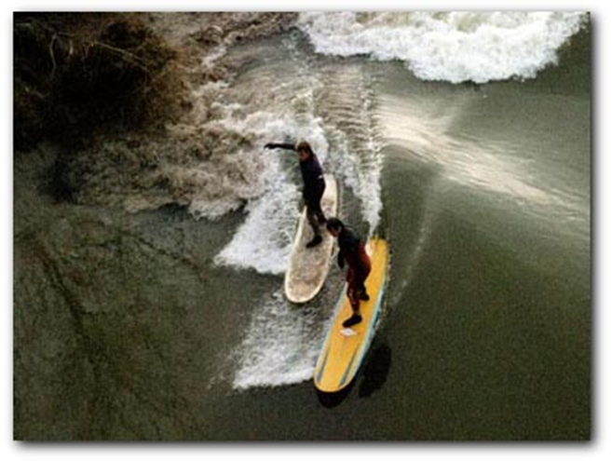
The shape of the coast influences the tidal range:
Funnelled coast e.g. Severn Estuary – as the tide advances it is concentrated in the ever-narrowing space. This causes its height to rise rapidly producing a tidal bore. Along the River Severn this is referred to as the Severn Bore and is a wave of up to 1m in height traveling at a speed of 30 km per hour.
River Severn, Bristol:
https://www.youtube.com/watch?v=O8TeguB3BYo

Slide 12
Tidal Surges
Tidal, or storm surges are occasions when meteorological conditions give rise to strong winds which can produce much higher water levels than those at high tide.
This particularly affects the North Sea and the Holderness Coast (our major case study)
Sea level can rise by about 1cm for every 1millibar drop in pressure
Strong winds drive waves ahead of the storm, pushing the sea water towards the coastline.
The shape of North Sea can lead to funnelling
When storm surges combine with spring tides the effects are intensified
https://www.youtube.com/watch?v=YSlQXN2fB1g
BBC report:

Slide 13
Storms of 2014

Slide 14
Currents
The term current refers to the permanent or seasonal movement of surface water in the seas and oceans. There are 4 currents you need to know about:-
Tidal currents
Longshore currents (also referred to as littoral drift)
Rip currents
Upwelling
Small currents have less energy, so they only move finer sediments.
Large currents have more energy: they can move bigger materials.

Slide 15
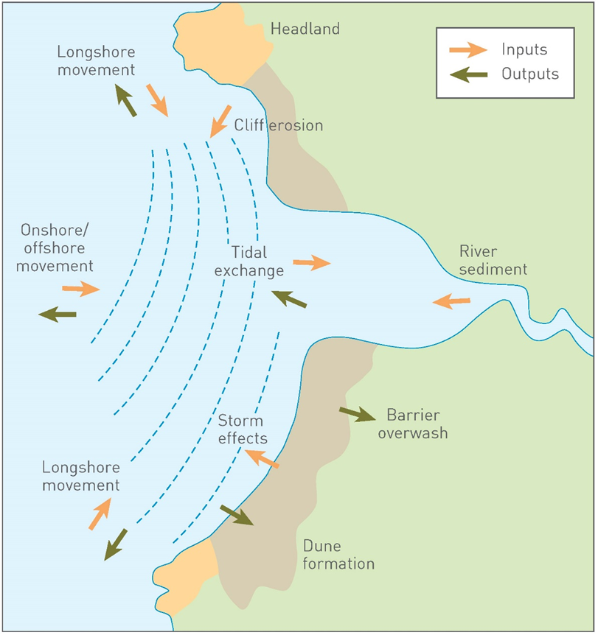
Tidal currents
Ebb currents: currents that move away from the land.
Flow (or flood) currents: currents that move towards the land.
1) What influence do you think the ebb and flow of currents will have on sediment transfer?
2) How might tidal exchange be influenced by spring and neap tides?

Slide 16
Longshore currents
On your mini-whiteboards quickly sketch an annotated diagram to show the process of longshore drift.
How important a role do you think that longshore drift has on the formation of coastal landscapes?
Have you included the following annotations?
Direction of wind and wave
Swash and backwash
Direction of longshore drift
Have you drawn the path of the sediment being transported correctly?
Copy your diagram into your handout

Slide 17
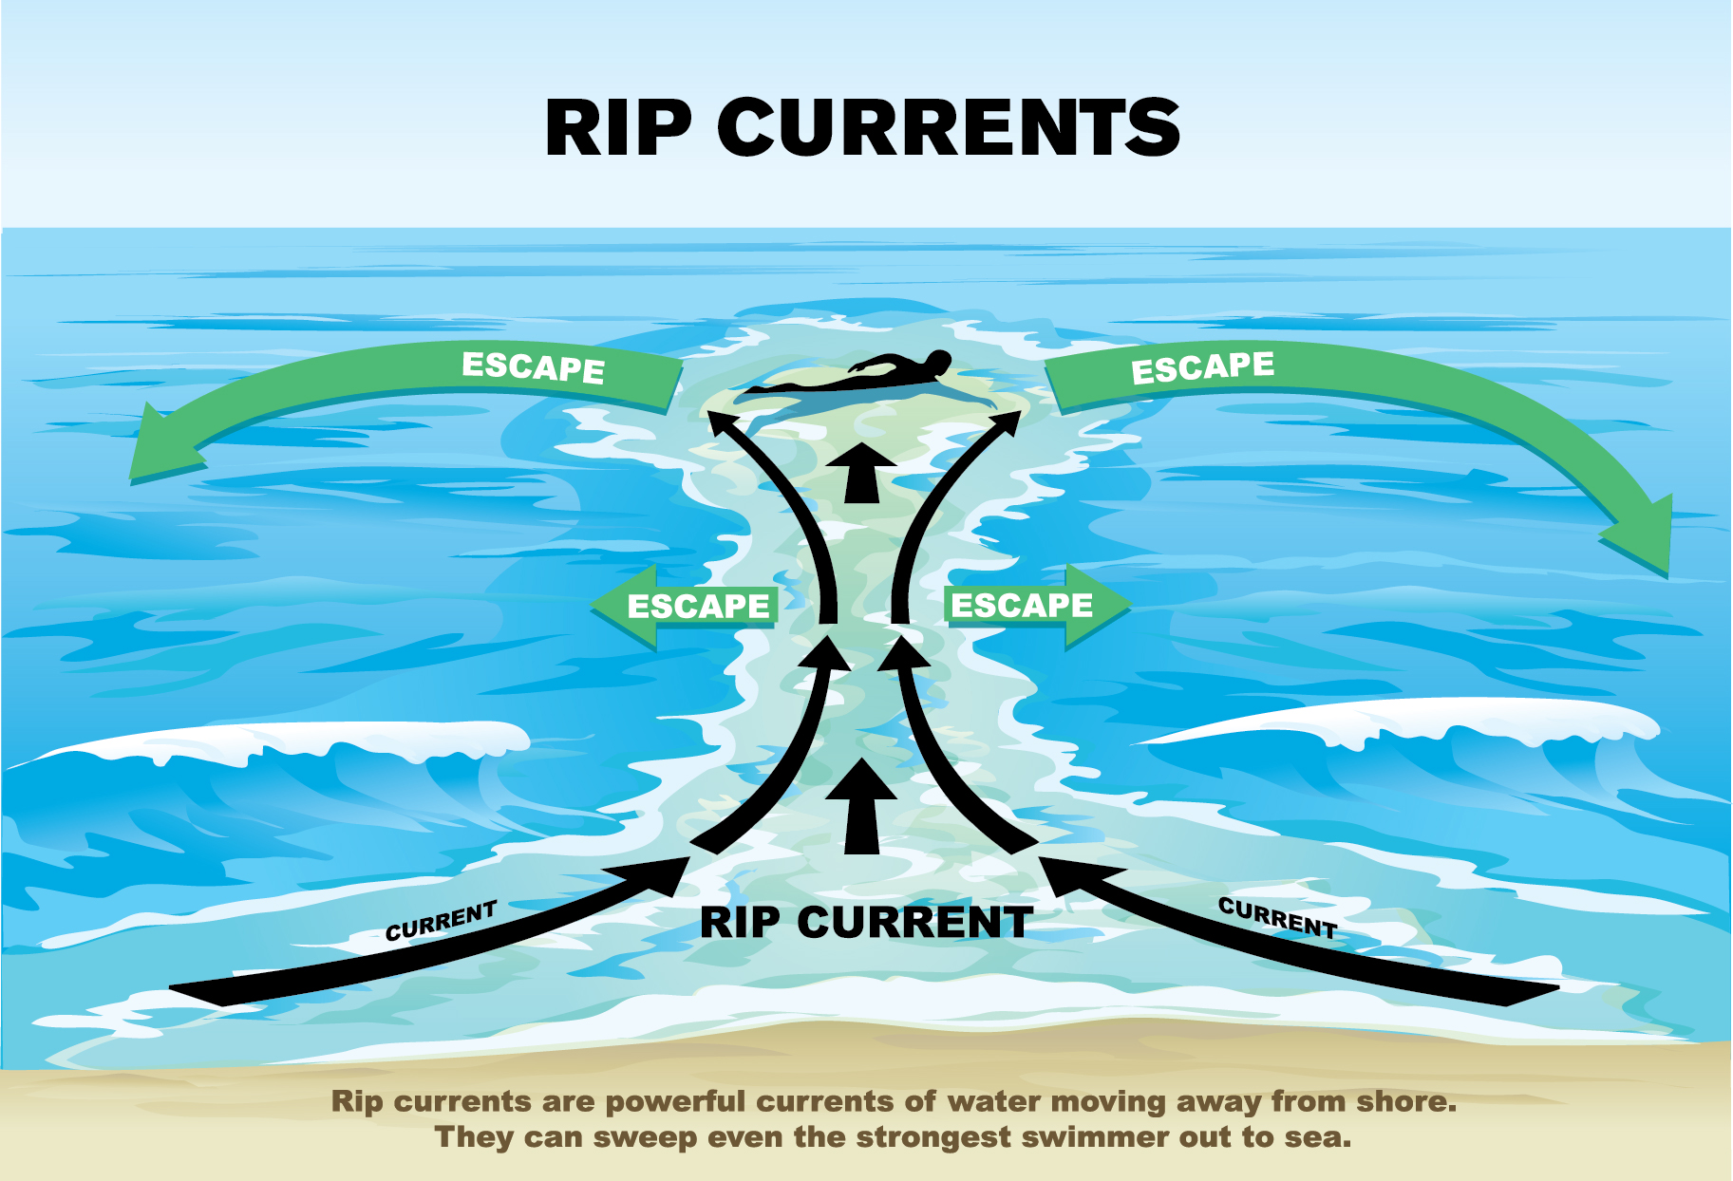
Rip Currents
These are strong currents moving away from the shoreline.
What impact do you think rip currents will have on the sea bed?
https://www.bbc.co.uk/news/av/world-asia-25559412/how-rip-currents-work

Slide 18
Upwelling is the movement of cold water from deep in the ocean towards the surface. The more dense cold water replaces the warmer surface water. These currents form part of the pattern of global ocean circulation currents
What do you notice about the pattern of ocean currents? What do you think causes this?

Slide 19
The 3 sources of energy that we have studied are:-
Wind
Waves
Tides and currents
In pairs/groups you need to rank their importance as factors shaping the coastline. Justify your rankings.

Slide 20
Question
Evaluate the role of tides and currents in the development of coastal landforms and landscapes (9 marks)
Evaluate is a key command word and requires you to give some kind of measure/worth as to the role that it has. You also need to consider whether there are other factors which are more important.
Introduction – define what landforms and landscapes are (give some examples)
Main body
Paragraph 1 – What are tides and currents? How do they shape the landscape? Do you think they play a large role in the development of coastal landforms and landscapes?
Paragraph 2 – What other factors play a role in the development of coastal landforms and landscapes? Do you think they play a greater role?
Conclusion – Overall sentence evaluating – what is your overall judgement?

Slide 21
