Slide 1
Flip Learning – Sea Level Change
Read the tutor 2 u study notes and:
  Define Eustatic sea level change
  Define Isostatic sea level change
  Summarise how tectonics can impact on sea level
  Make a brief time line of historic sea level changes

Slide 2
3.1.3.3c: Sea Level Change
Learning Objectives
To understand the causes and impacts of sea level change (eustatic, isostatic and tectonic)
To identify the major changes in sea level over the last 10,000 years
To understand the origin and development of landforms of emergence and submergence
The understand the nature & impact of recent & predicted climate change on coasts
Key words:
Eustatic
Isostatic
Tectonic
Emergence
Submergence
Rias
Fjords
Dalmatian coasts
Concept Checker:
The concept of sea level change in the context of the coast and synoptic links to water and carbon
The concept of sea level change due to tectonic activity
The concept of climate change

Slide 3
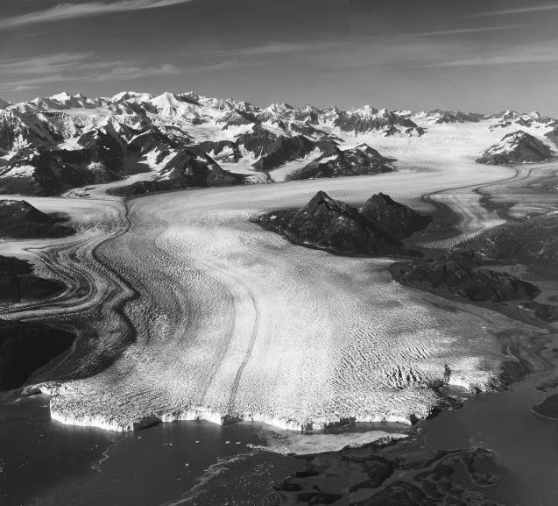
Sea Level Change

Slide 4
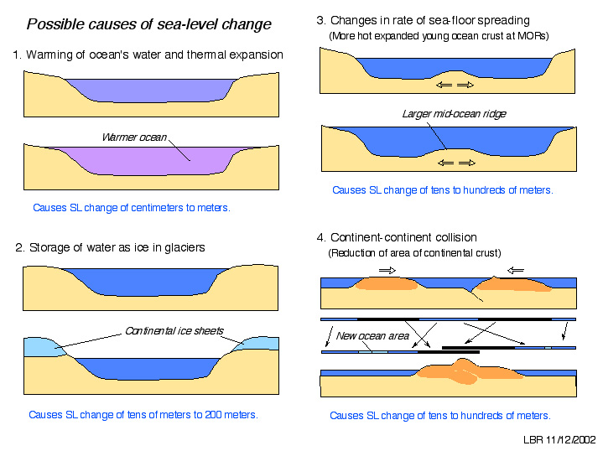
Causes of Sea-level change

Slide 5
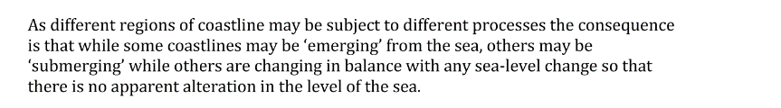
Relative levels of sea and land are affected by:
TYPE OF CHANGE (EUSTATIC, ISOSTATIC OR TECTONIC) | POSSIBLE CAUSES | SCALE AND TEMPORAL CHANGE
Eustatic (affects global sea levels) | Thermal expansion Melting ice Tectonic movements | Global sea levels change: short, medium and very long-term
Isostatic (affects local sea levels – certain coasts) | Melting of glaciers (freshwater held as ice sheets on land) | Localised sea level changes as land rises and falls. Medium term
Tectonic (can affect global & local sea level) | Tectonic plate movement – spreading and collision, sudden uplift and downthrusts | Short term – rapid changes to areas affected

Slide 6
Tectonic changes
Past tectonic activity has had a direct impact on some coasts across the world, as well as sea levels.
Examples:-
Indonesia - Boxing Day 2004 (Oxford p136)
Tohuku earthquake (Cambridge p87)

Slide 8

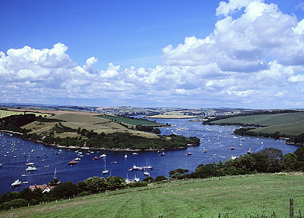
Sea level change
Sea level can change with respect to the land, and
Land level can change with respect to the sea.
Global changes in sea level are called eustatic changes and local changes in land level are called isostatic changes.
What might cause eustatic readjustment?
This occurs when there are worldwide changes in sea level e.g. during the ice age there was a global fall in sea level because more water was being stored as ice.
When the ice sheets melted, there was a global rise in sea level.
As a consequence of global warming sea level are rising again due to thermal expansion and melting ice caps.
Eustatic changes occur in the short, medium and very long term.
Eustatic rise in sea level caused the flooding of the lower parts of river valleys to form rias. They are common in the SW UK
https://www.youtube.com/watch?v=d3jF6H9mqJ4

Slide 9
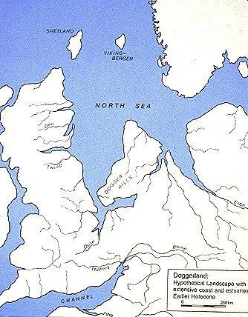
Eustatic changes
Past eustatic changes - During the last ice age the UK was joined to the rest of Europe. Sea levels have risen by 120m since the end of the last ice age 10,000 years ago.
Future eustatic changes -
The Antarctic ice shelf is 4km thick in places. If it melts then global sea levels will rise by approximately 50m.
The warming of oceans leads to thermal expansion – the same given mass of ocean occupies a greater volume the higher the temperature. The impact of this ranges from a couple of centimetres to several metres.

Slide 10
Eustatic Sea Level Change
Changes in the amount of water
Operates on a global scale
Often associated with periods of glaciation:
  Water locked up as ice / snow = less liquid water in oceans = sea level falls
  Ice melts = water now as liquid = sea level rise
In reality, the situation is highly complex!
Think about the additional impact of global warming
https://www.youtube.com/watch?v=lDZWWcAfn-c Melting ice – impact on sea level change

Slide 11
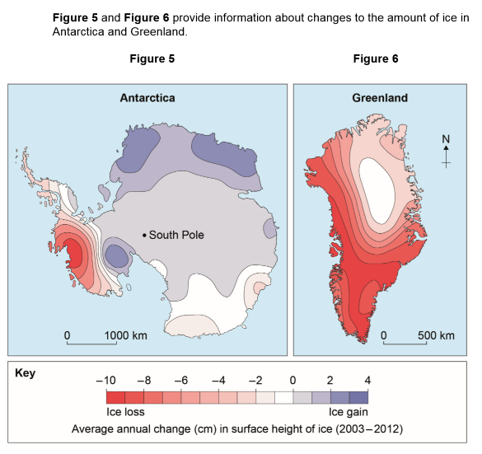

Slide 12
Isostatic Sea Level Change
Changes to the level of the land due to rebound or subsidence
Ice on the land is very heavy – land may actually sink relative to the sea during a glacial period
When ice melts & weight is removed, land SLOWLY rises and recovers (isostatic recovery), causing a relative fall in sea level
Isostatic change tends to be much slower than eustatic change
In the UK, isostatic change is still taking place after the end of the last glacial period some 10, 000 years ago
Isostatic change operate on a local scale – e.g. In the UK, the SE is sinking whilst the NW is rising!

Slide 13
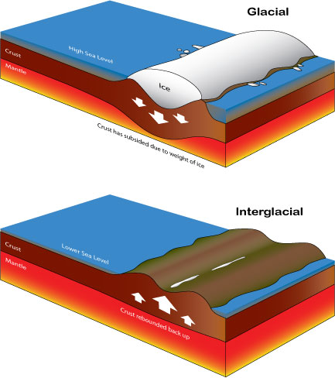
What has happened to the earth’s crust when covered by ice?
What happens when the ice melts?

Slide 14
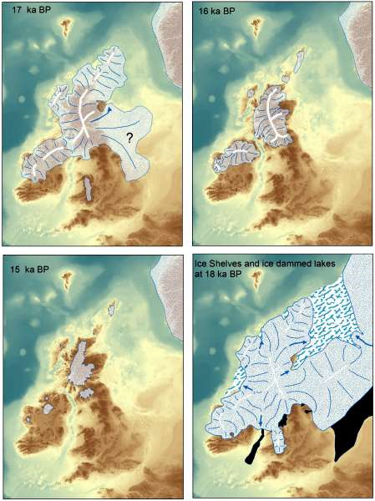
Isostatic Changes
Isostatic change operates on a more localised scale than eustatic change.
The sheer weight of ice sheets can have the effect of lowering the land’s surface by depressing the crust into the viscous mantle. When ice sheets melt, the land can ‘bounce back’ up, a process known as isostatic adjustment or recovery

Slide 15
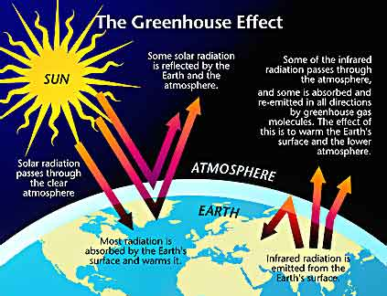
Global Warming
Carbon dioxide & other gases in the atmosphere stop some of the radiation from the Earth’s surface escaping into space. They absorb & emit energy back towards the surface; this is termed the greenhouse gas effect.

Slide 16
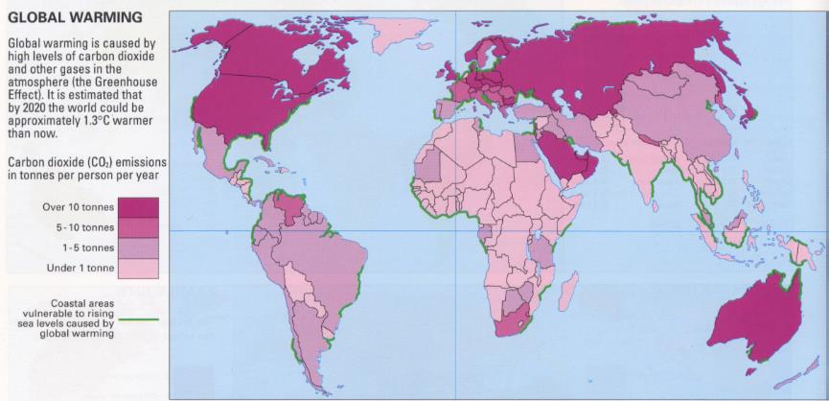
Accelerated Global Warming
Due to increased CO2 emissions through the burning of fossil fuels and deforestation.

Slide 17
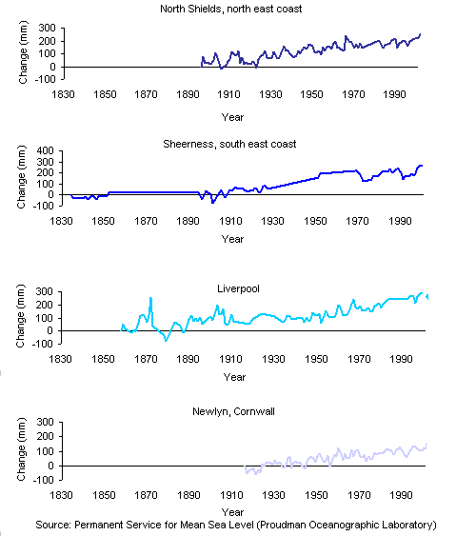
Sea level rise in the UK
1-2mm per year – some reports suggest this is partly down to global warming & research is being carried out to investigate this claim
http://www.reading.ac.uk/archaeology/research/neolithicsteppingstones/_/Sea.html
A more significant effect of GW could be an increase in storminess – impacting on rates of coastal erosion & sediment transfer

Slide 18
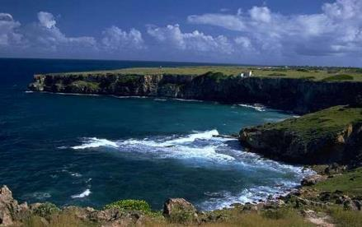
Sea level change - Landforms
Landforms that are created by rising sea levels are known as submergent as they have been ‘submerged’ by the water.
Those that been created as a result of rising out of the water are known as emergent landforms. These are often recognisable as they are just like present day coastal landforms e.g. caves, beaches and wave cut platforms but are now stranded well above the waterline. They are known as relict features as the processes that created them are no longer at work.
A marine platform in the West Indies
https://www.youtube.com/watch?v=p_AUkB9EGBo Marine Terrace

Slide 19

Marine Platform
Santa Cruz, California, West coast of Scotland
Raised beaches
Isle of Arran, West coast of Scotland
Landforms of Emergence
Relict cliffs
Sea level change – eustatic and isostatic change, Coastlines of submergence and emergence and associated landforms. Impact of present and predicted sea level increase
Fjords
Milford Sound - New Zealand, Coastline of Norway
Landforms of Submergence
Rias
Salcombe- Devon
Dalmation Coasts
Croatia

Slide 20
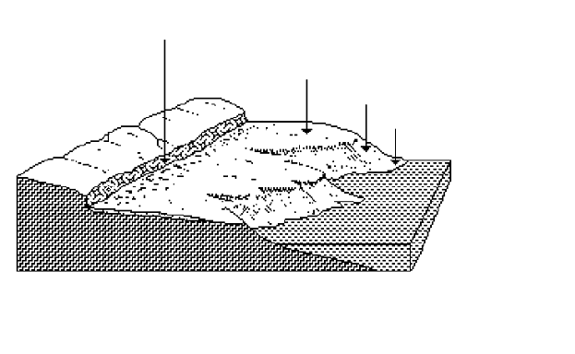
Sea level change - Emergent landforms
Former cliff line
Raised beach
Present-day cliffs
Present-day beach
Many of these features can be found on the Isle of Arran, W. Scotland. They can be as a result of eustatic or isostatic changes. Scotland is rebounding upwards. The ice sheet that covered it during the last ice caused it to sink but it is recovering at a few centimetres a year. This has the effect of sea level falling on a local scale.
Notes:
Source; www.geographyhigh.connectfree.co.uk/s3glacgeoghighpostglacland.html

Slide 21
Sea level change - Emergent landforms

Slide 22
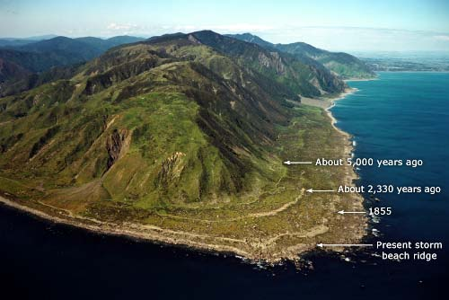

Slide 23
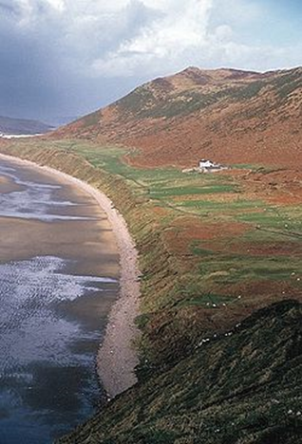
Raised beach and relict cliffs
Arran Islands

Slide 24
Research Tasks – Emergent landforms
Using the textbook and resources on the next slide in this PowerPoint (see Godalming Online):
In pairs, devise a virtual online field trip (use PPT or word) that focuses on ‘Isostatic change in the UK landscape’. Use Google maps and an internet search to identify the best UK locations to see and photograph:
  raised beaches
  relic cliffs
  any other evidence of isostatic change

Slide 25
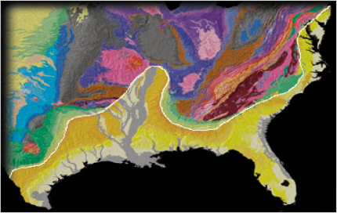
Sources of info (videos and useful links – see Godalming Online):
Summary of causes of sea level change: good images to explain change and sea levels through recent geological time
Video animation of sea level change around the British Isles in the last 12,000 years – plays in QuickTime
Summary of coastline features with good diagrams and images– including emergent and submergent features
Short video about fjords
National Geographic encyclopedia entry on fjords
Open University video on forming fjords
Information on raised beaches/marine terraces.
WizScience video on marine terraces
The Geological Society information on the raised beach at Loch Tarbert
Emergent coastlines form as a result of a (relative) fall in sea level. This may be as a result of greater ice storage, but in today's context they form as a result of isostatic recovery. Isotatic recovery creates a range of abandoned or reliccoastal landforms that formed at the point in time aand space that they were at the coastal margin. They now stand some distance away from the marine zone. These landforms include, raised beaches and wave-cut platforms, relict cliffs with typical cliff features and coastal plains. A good place location to observe these coastal features is is in Western Scotland.

Slide 26
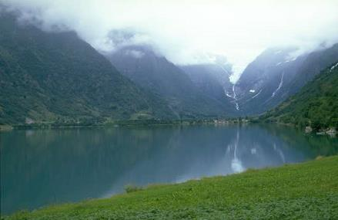
Sea level change – Submergent landforms
Steep valley sides
Classic ‘U’ shape
Rounded head of valley
What evidence is there that this fiord was a former glacial valley, now flooded by eustatic sea level rise?
Relatively narrow but deep valley
https://www.youtube.com/watch?v=U_2DtNLnc0M Fjords

Slide 27
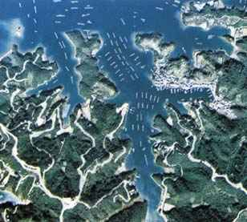
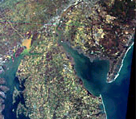
Rias
What is a ria ?
A deep, sunken river valley drowned by the sea.

Slide 28
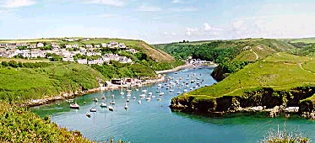
They form funnel-shaped branching inlets, decreasing in depth and width inland.
This is Solva in Pembrokeshire.

Slide 29
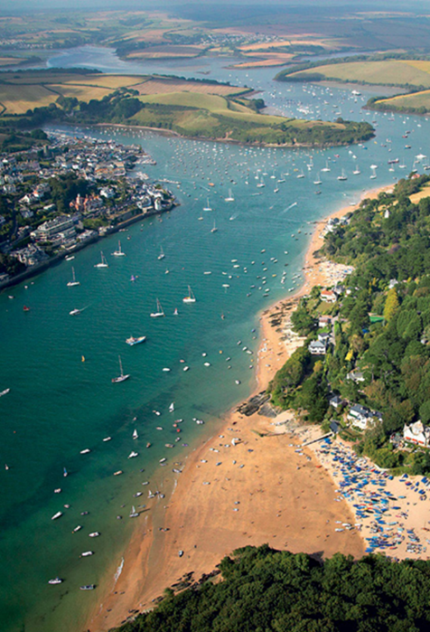
Ria
Salcombe in Devon

Slide 30
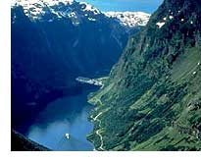
Fjords
Narrow, lengthened and very steep marine Gulf, which results from
the invasion by the sea of a U-shaped valley dug by a glacier.

Slide 31
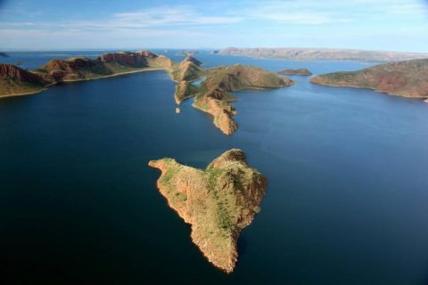
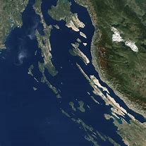
Dalmatian
•The Dalmatian coasts result by submergence of mountain ridges with alternating crests and troughs which run parallel to the sea coast.
•The Dalmatian coast of Yugoslavia is a typical example.

Slide 32
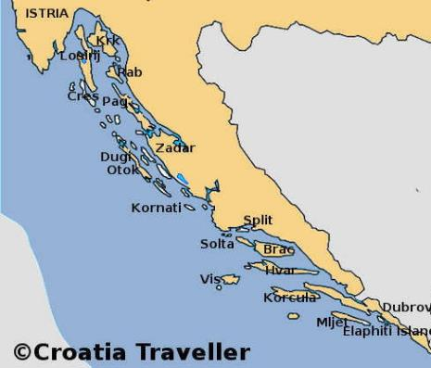
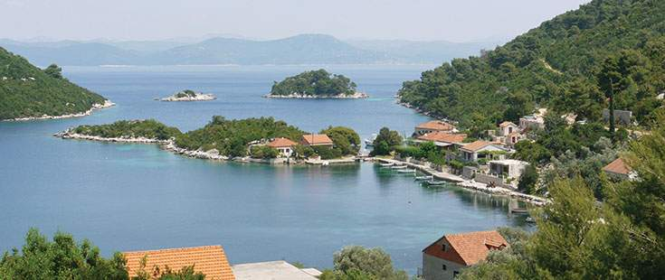
Dalmatian Coast, Croatia

Slide 33
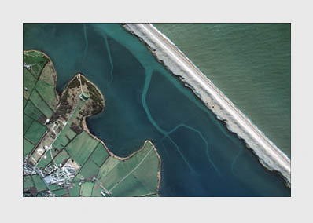
Barrier Beaches
Shingle beaches such as Slapton Sands and Chesil Beach were pushed ashore during a transgression.
As the sea level rose, the horizontal progress of the sea across the dry shelf would have swept the sediments before it, a process called bulldozerisation.

Slide 34
Homework Task
Read the Geofile GF600 SLC landforms.pdf
Complete the questions 1 to 3 on the Geofile 600.
Resources:
  Use the Oxford textbook, pages 135, 137-138 and Hodder textbook pages 112-116 to help you.
  https://www.slideshare.net/6thformmatt/submergent-and-emergent-coastlines
  https://www.kerboodle.com/system/images/W1siZiIsIjIwMTYvMDgvMjUvMDkvMjAvNDIvNjAvODMwOTIxX0dGNzU2X1NURC5wZGYiXV0/830921_GF756_STD.pdf
You should type up detailed answers and bring them to next lesson. See next slide for advice on question 2.
Extension – SLC Task Checker.ppt – complete the questions

Slide 35
Submergent features | Emergent features
Rias Fjords Dalmation Coast | Raised beaches Relict cliffs Marine platform
For question 2, cover the above landforms and include:-
An explanation of what they are and how they are formed
A diagram or series of diagrams to show their formation and photos
An example from around the world
Hodder textbook p113-115 (good diagrams)
Oxford p137-139
https://www.slideshare.net/6thformmatt/submergent-and-emergent-coastlines
https://www.kerboodle.com/system/images/W1siZiIsIjIwMTYvMDgvMjUvMDkvMjAvNDIvNjAvODMwOTIxX0dGNzU2X1NURC5wZGYiXV0/830921_GF756_STD.pdf

