Slide 1
Holderness Coastline -Local (UK)case study
Aims
To be able to identify the processes, landscapes and management

Slide 2
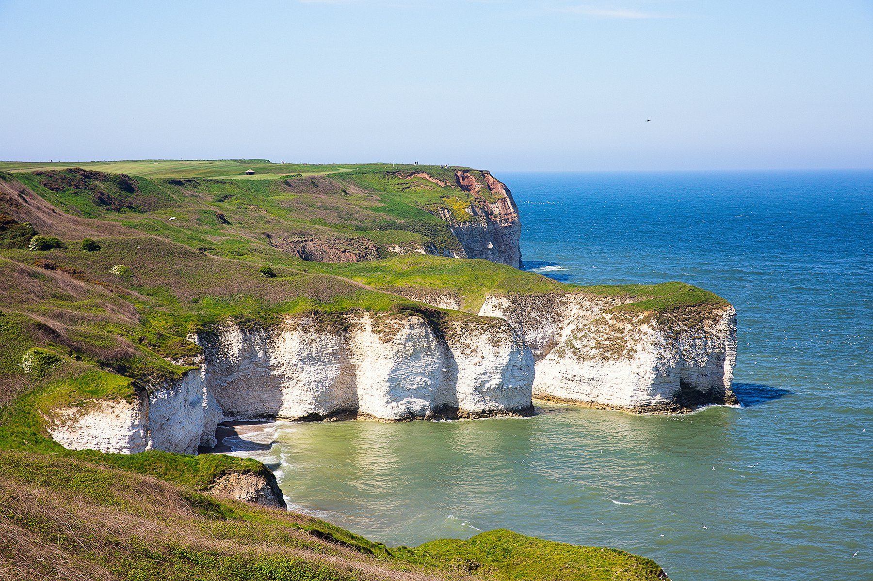
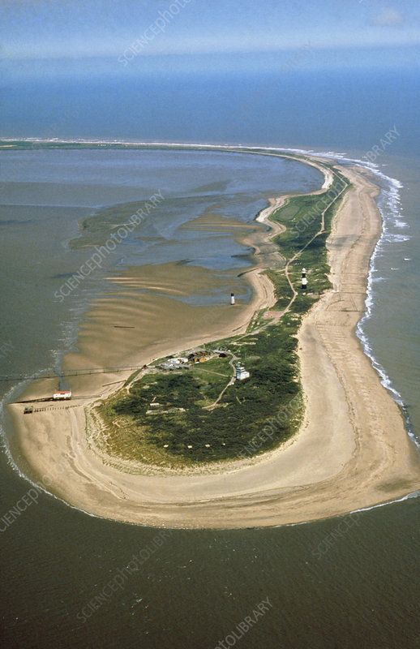
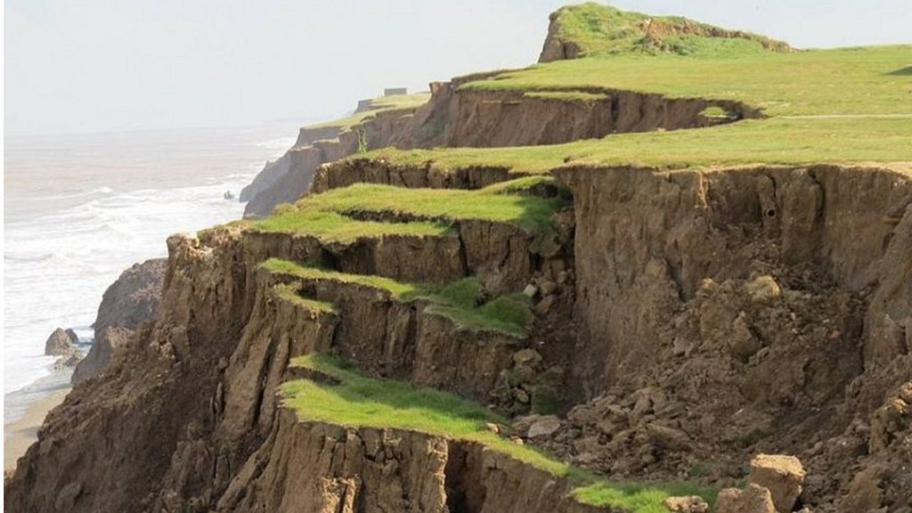
You need to know about the different landscapes and landforms found along the Holderness Coast and the processes operating within them.

Slide 3
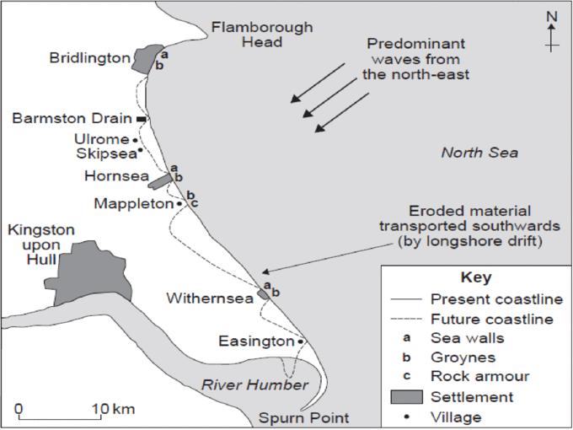
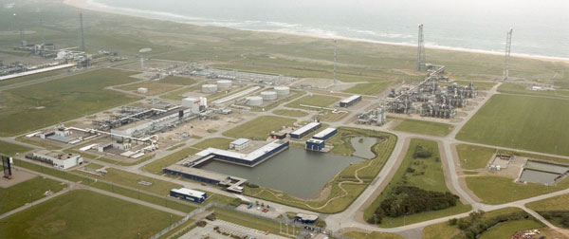
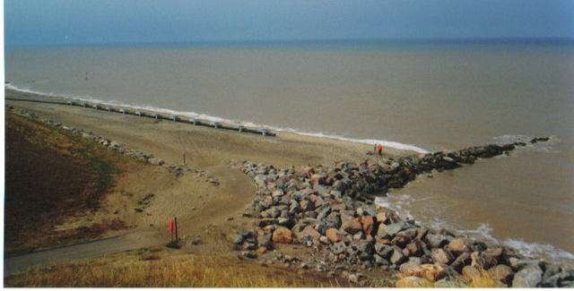
You need to know about the different forms of coastal management found along the Holderness Coast and the impact that they have on the processes and people.
Special focus needs to be on Mappleton

Slide 4
Watch the following video clip and answer the questions on the sheet.
The Holderness Coastline – estream http://estream.godalming.ac.uk/View.aspx?ID=4586~4x~8zS48MtV

Slide 5
The Physical Processes and Landscapes – The Holderness Coast
Resources to use:-
Oxford textbook p144-146, Tutor 2 U resources on Holderness and the information from the video clip
Draw a blank outline of the Holderness coastline on a A3 piece of paper (p144 Oxford has a clear map)
Annotate your map with information on the following:-
Geology (Lithology and rock structure)
Processes operating on the coastline – include erosion, transportation, deposition, weathering and mass movement
Landforms found along the coast
Include information of the different temporal factors – e.g. which landform was formed 75 million years ago etc

Slide 6
Coastal Management – The Holderness Coast
Resources to use:-
Oxford textbook p144-146, Tutor 2 U resources on Holderness and the information from the video clip
Draw a blank outline of the Holderness coastline on a A3 piece of paper (p144 Oxford has a clear map)
Annotate your map with information on the following:-
The coastal management strategies at the following places:-
Bridlington, Hornsea, Withernsea, Easington and Mappleton
You will need to add additional detail for Mappleton as it could be used as one specific management scheme
Don’t forget to include information on the SMPs for this section of the coastline.
Include information on the impact coastal defences are having on the Humber Estuary

Slide 7
Analyse the need for, and evaluate the success of, a coastal management scheme you have studied. (20 marks)
P1 - Intro – introduce the scheme – what have they done? (AO1)
P2 – Why have they needed a scheme? – Physical and human reasons (A01)
P3 – What are the successes? Remember to evaluate (A02) – judge how
successful – case study evidence needed
P4 – Why might the scheme not be successful? – evaluate (AO2)
P5 – Overall conclusion – your judgement – how successful – why?

