Slide 1
Changing Places
The Nature and Importance of Places – Part 1
Learning Objectives
To examine the concept of place and the importance of place in human life and experience
To identify how insider and outsider perspectives on place differ
To identify categories of place: near and far, experienced and media places
Concept Checker:
How humans perceive, engage with and form attachments to places
How place-meanings are bound up with different identities, perspectives and experiences
Why people may feel like insiders or outsiders
How our understanding of near and distant places is influenced
How our understanding of experienced places and media places is different
Key words:
Perceive
Perception
Insider
Outsider
Topophilia
Topophibia

Slide 2
What is place?
A location (GPS)?
Somewhere that can be mapped?
Somewhere ‘concrete’ – that has a name and can be seen?
A locale (setting) where every day activities take place?
A sense of place – a subjective (personal) and emotional attachment to a place and its meaning?
Somewhere associated with human behaviour, history or culture?

Slide 3
Definition of place
Place is location plus meaning
Without meaning it is just a space

Slide 4
Location
Where a place is, for example, the co-ordinates on a map
Sense of place
This refers to the subjective and emotional attachment people have to a place. This may be completely different when looked at from another’s perspective
Locale
Locale, unlike location, takes into account the effect people have on their setting. In terms of locale, a place is shaped by the people, cultures and customs within it.
The different aspects of place

Slide 5
On mini whiteboards – write down 5 words to describe Godalming as a place.
Share and compare with the group. Divide the words into those who are from Godalming and those that are from elsewhere.
Why do people’s sense of place differ?

Slide 6
How might the information gained in the induction task influence sense of place?
What sense of place does the following information from the induction task give of Godalming?
Nomis statistics
Datashine maps
Case study research notes

Slide 7
Different places
Examine the following images
  How and why might people’s sense of place of these places vary?

Slide 8
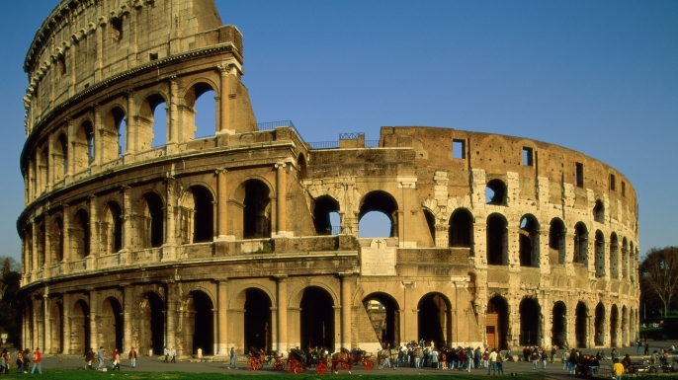

Slide 9


Slide 10


Slide 11
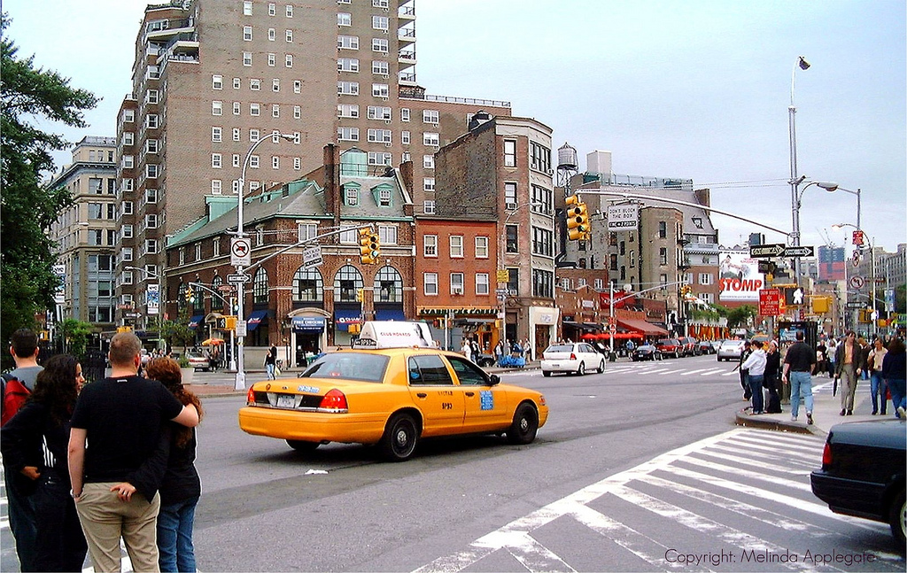

Slide 12
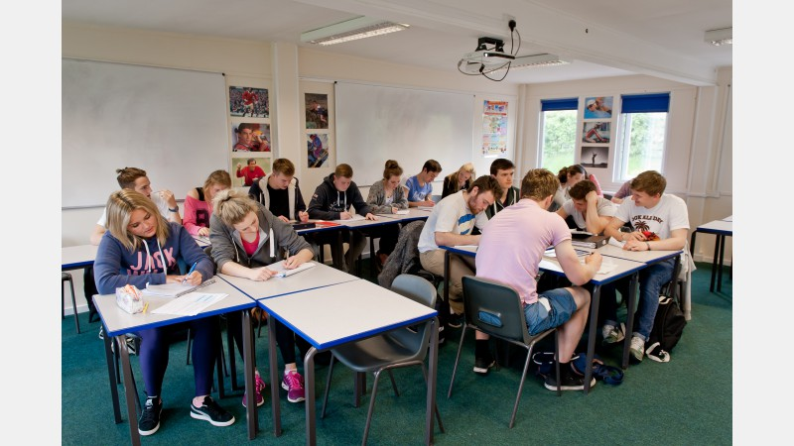

Slide 13
What influences how people view a place?
Age
Religious beliefs
Moral attitudes
Family history
Ethnicity
Education

Slide 14
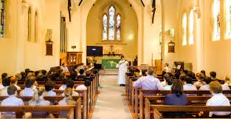
Concept of place and conflict

Slide 15
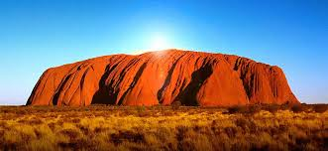

Slide 16
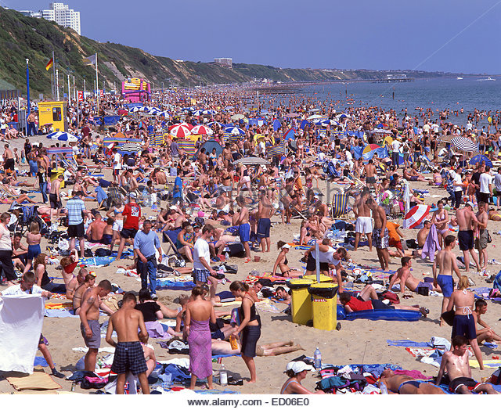

Slide 17
How might different concepts of place lead to conflict?
In pairs/groups come up with a list of possible conflicts – think of the previous images shown

Slide 18
The depth of feeling (attachment) we have for a place is influenced by the depth of our knowledge and understanding of it – this attachment increases with age, as we learn more about our home.
Our attachment to a place is also influenced by the quality or intensity of experience we have there. The more enjoyable or safe the experience then the greater the attachment.
How is your sense of place for where you live different to a place where you have been on holiday?

Slide 19
Topophilia and Topophibia
Topophilia: a strong sense of place or love of particular places
Topophibia: a fear or dread of certain places
Some places may evoke mixed feelings e.g. a visit to Auschwitz concentration camp. Which other places can you think of?

Slide 20
Insiders and outsiders
Our sense of place can be so strong that it can be a central part of our identity
Sense of place can vary in scale so that we can feel identity from own home village/town/city to nation/continent
What makes people feel like they are outsiders in a place?
List as many ideas as you can as to why some people may not feel that they ‘belong’ in a place

Slide 21
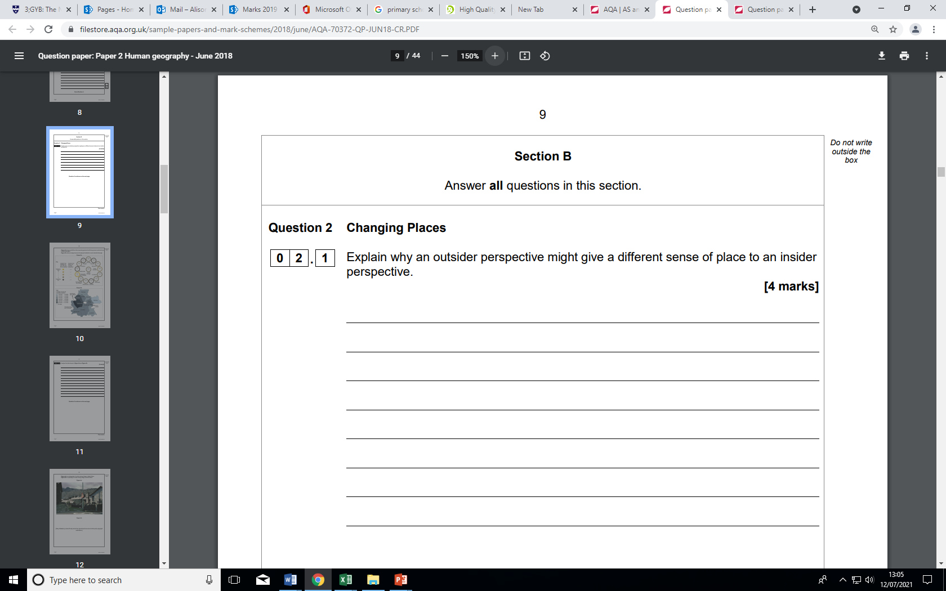

Slide 22
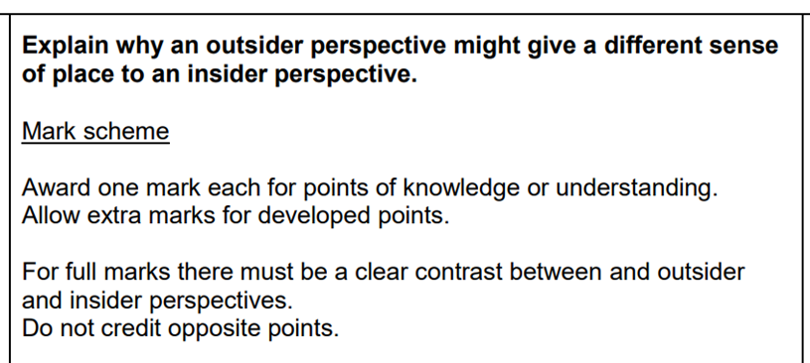
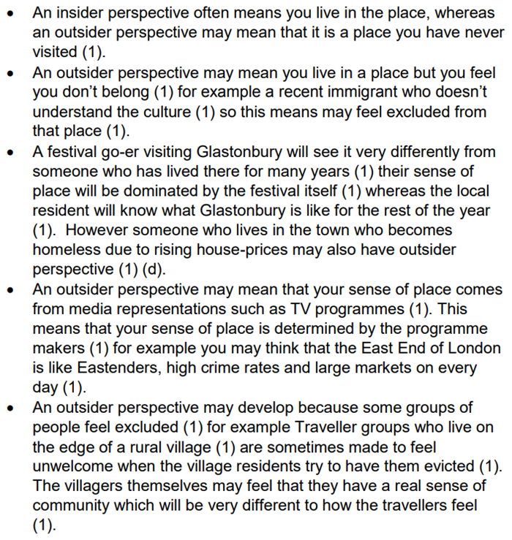

Slide 23
Our perspective of place can change over time
An area of town may be busy and feel safe during the day and deserted and threatening at night
Task:
Can you think of other examples where perceptions of place have changed over time?

Slide 24
Near and Far
The terms ‘near’ and ‘far’ can have 2 potential meanings when it comes to place. They could refer to:
1) The geographical distance between places
2) The emotional connection with a particular place and how comfortable a person feels within that place
Some places can feel more familiar than others. ‘Geographically near’ places do not automatically foster identities of familiarity and belonging and that in these days of globalised culture, travel and media far-off places are not automatically strange, uncomfortable or different.
Think of an example for this ………………

Slide 25
Near and Far
The concept of near and far often leads to a ‘them and us’ attitude
This can sometimes lead to perceived differences that lead to racist attitudes
Racist ideologies have been used to justify atrocities committed in wars and by colonial powers, including the British e.g. British in India
Can you think of any ways in which we, in the UK, compare ourselves to others? Are these comparisons fair/accurate?

Slide 26
Experienced Place and Media Places
Experienced places are those places that a person has spent time in.
Media places are those that the person has only read about or seen on film.
People travel more today than in the past and therefore have more real life experiences of places. People have a greater emotional attachment to places that they have experienced.
When in a place all the senses are stimulated – smell, taste, sight, hearing and so a greater understanding of a place is gained. Experience turns undifferentiated space into place

Slide 27
Media Place
Complete a spider diagram of all the types of media which influence our sense of space
For each of them – evaluate their strength and weaknesses in establishing a sense of place
If we go on a virtual field trip on the World Wide Web, is the sense of place (place meaning) we gain less valid than if we had visited in person?

Slide 28
Newspapers
Television
Radio
Online reviews
Brochures
Film
Apps
Satnav and interactive maps
Advertisements
Social media

Slide 29
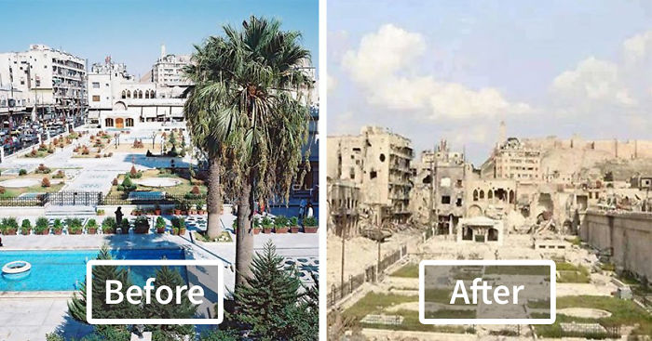
Research and find some contrasting media images of the same place.
Find some articles on places that have differing views – think about reviews on places visited.
Aleppo - Syria

Slide 30
Exam style question:
How might sense of place vary between individuals and over time? (6 marks)
You will need to give examples in your answer as evidence.

Slide 31
FLIP learning – find out what is meant by the following:-
Clone town
Glocalisation – McDonalds
Bristol pound

