Slide 1
Godalming Fieldtrip Preparation Work

Slide 2
Thursday 2nd December
Time in Godalming Microclimate session time
3M2 12.30- 3.30 12.30 – 1.30
Friday 3rd December
Time in Godalming Microclimate session time
3G1 10.45 – 13.45 10.45 – 11.45
3M3 10.45 – 13.45 11.45 – 12.45
3E1 12.30 – 15.30 12.45 – 13.45
3M1 12.30 – 15.30 13.45 – 14.45
3C1 13.00 – 16.00 14.45 – 15.45
Meeting point:-
Outside Fat Face
You will be required to sign in with a teacher at the start of your fieldwork session and at the end.
You will also need to ensure that you turn up on time in your groups for your microclimate session so that equipment can be issued to you.

Slide 3
Purpose of trip
To explore a range of data collection techniques that could be used to answer the following potential investigation titles:-
To what extent is Godalming a ‘Placeless Town’?
How globally connected is Godalming town centre?
How does the microclimate of Godalming change?
(How does the land use and environmental quality vary between towns x and y)

Slide 4
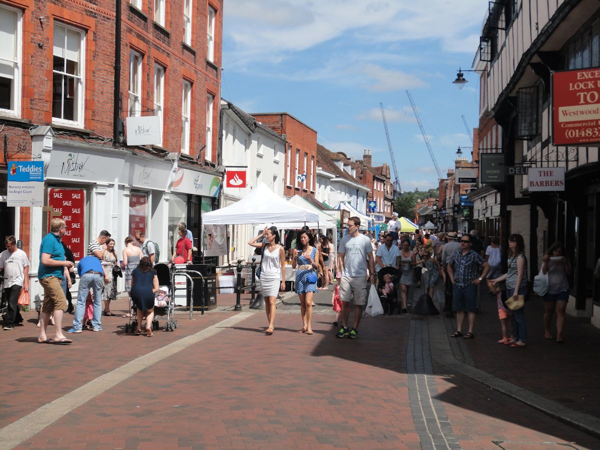
To what extent is Godalming a ‘Placeless Town’?
How could we test this?
How could we test this?

Slide 5
To what extent is Godalming a ‘Placeless Town’?
Clone town survey
Photographs to show any features which might represent the identity of Godalming
Questionnaires – asking individuals a series of questions as to how they feel about Godalming and if they think that it has an individual character
Street questionnaires would normally be carried out but due to COVID we do not think that it would be appropriate/safe. (It may be possible to do this on the Guildford fieldtrip)
How else could you get the questionnaires completed?

Slide 6
Clone town survey
  Where do you think you will start your survey? What will you need to consider?

Slide 7
Questionnaires
What sort of questions can you ask?
  Closed questions – those that you answer with a yes or no. e.g. Do you live in Godalming?
  Questions with a choice on answers. e.g. Why have you come to Godalming today? Shopping, work, appointment or other
  Questions that allow people to rate their opinion on a scale. e.g. on a scale of 1 to 5 with 5 being high and 1 being low, how would you rate the schools in Godalming?
  Open questions – What 3 words would you use to describe Godalming?
How useful are the above questions in answering our question:
To what extent is Godalming a ‘Placeless Town’?
In pairs come up with a range of questions which will help you investigate the question. These questions are the ones that you will use on the day.

Slide 8
Think about who you want to ask and what you need to know about them.
You may need to make sure that you ask people who live in Godalming and not tourists. You could ask if they live in Godalming in the questionnaire.
You may wish to check you get a range of ages to see how people’s opinions differ. How might you ask people’s ages without offending them?
What sampling technique will you use?
Where will you conduct the questionnaire?
How many questions and how many questionnaires to complete? People will not want to spend too long answering questions so make it quick and easy to complete
How many questionnaires to complete? You need a decent number of questionnaire so that your research is detailed enough. (At least 25-50 is a good number – the more the better)

Slide 9
Be polite…and smile
Explain briefly what you are doing. (Most people will be willing to stop for school/college kids so use that!)
Wear your college lanyard and make sure that it is visible
Be willing to accept the “no I’m very busy”, and do not been offended when you are rejected

Slide 10
Respondent | Resident of Godalming (yes/no) | Age range category | Reason for visit | Education rating | Words used to describe Godalming
1
2
3
4
5
6
7
8
9
10
Design a recording sheet for your responses

Slide 11
The Chi Squared Test is a statistical test that is often carried out at the start of an intended geographical investigation.
We may have noticed a pattern, distribution or anomaly in a feature of the human or physical world and have a hunch that ‘something is going on’ to produce it.
The Chi Squared Test tells us whether our ‘hunch’ is statistically significant – i.e. that – yes, we have noticed a valid geographical phenomenon that deserves further investigation as part of a geographical enquiry. Alternatively, it can indicate that what we think is a ‘phenomenon’ is actually just a random variation in the feature we’ve noticed, and doesn’t deserve further investigation or research.
So it’s a test to indicate: ‘There’s something valid going on here – investigate it further and work out what it is and what’s causing it’, or ‘Don’t waste your time – it’s just ‘chance’ or ‘random events’ that you’re seeing – move on and give your time to studying some other aspect of geography.
I have a hunch that the students in this room prefer marmite to jam or peanut butter.
I am going to test this hunch to see if it is statistically significant. If it is, I will then investigate it further.
With chi squared tests we come up with a null hypothesis.
What do you think this could be for this example?
There is not/no ……………..

Slide 12
Type of spread | Observed | Expected | (0-E) | (O-E)²
Marmite
Peanut butter
Jam
 |  |  | Ʃ(O-E)² | _____

Slide 13
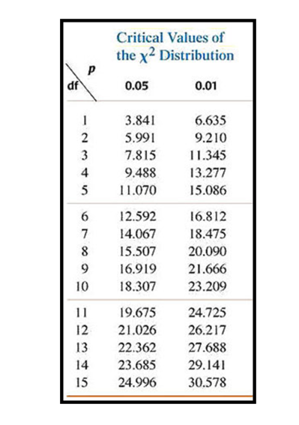
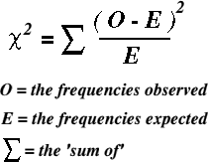
The ‘Degrees of Freedom’ (df) is usually calculated as n-1 (number of data sets minus 1) which in this example is
3 (types of spread) -1 = 2. So we use the df 2 row to look up our ‘Critical Value’.
If our result is larger than the Critical Value – we have got a valid result in our data that lets us reject the null hypothesis and accept our original hypothesis. It our result is smaller than the Critical Value, we have to accept the null hypothesis – that there is no key geographical process observable in this data set.

Slide 14
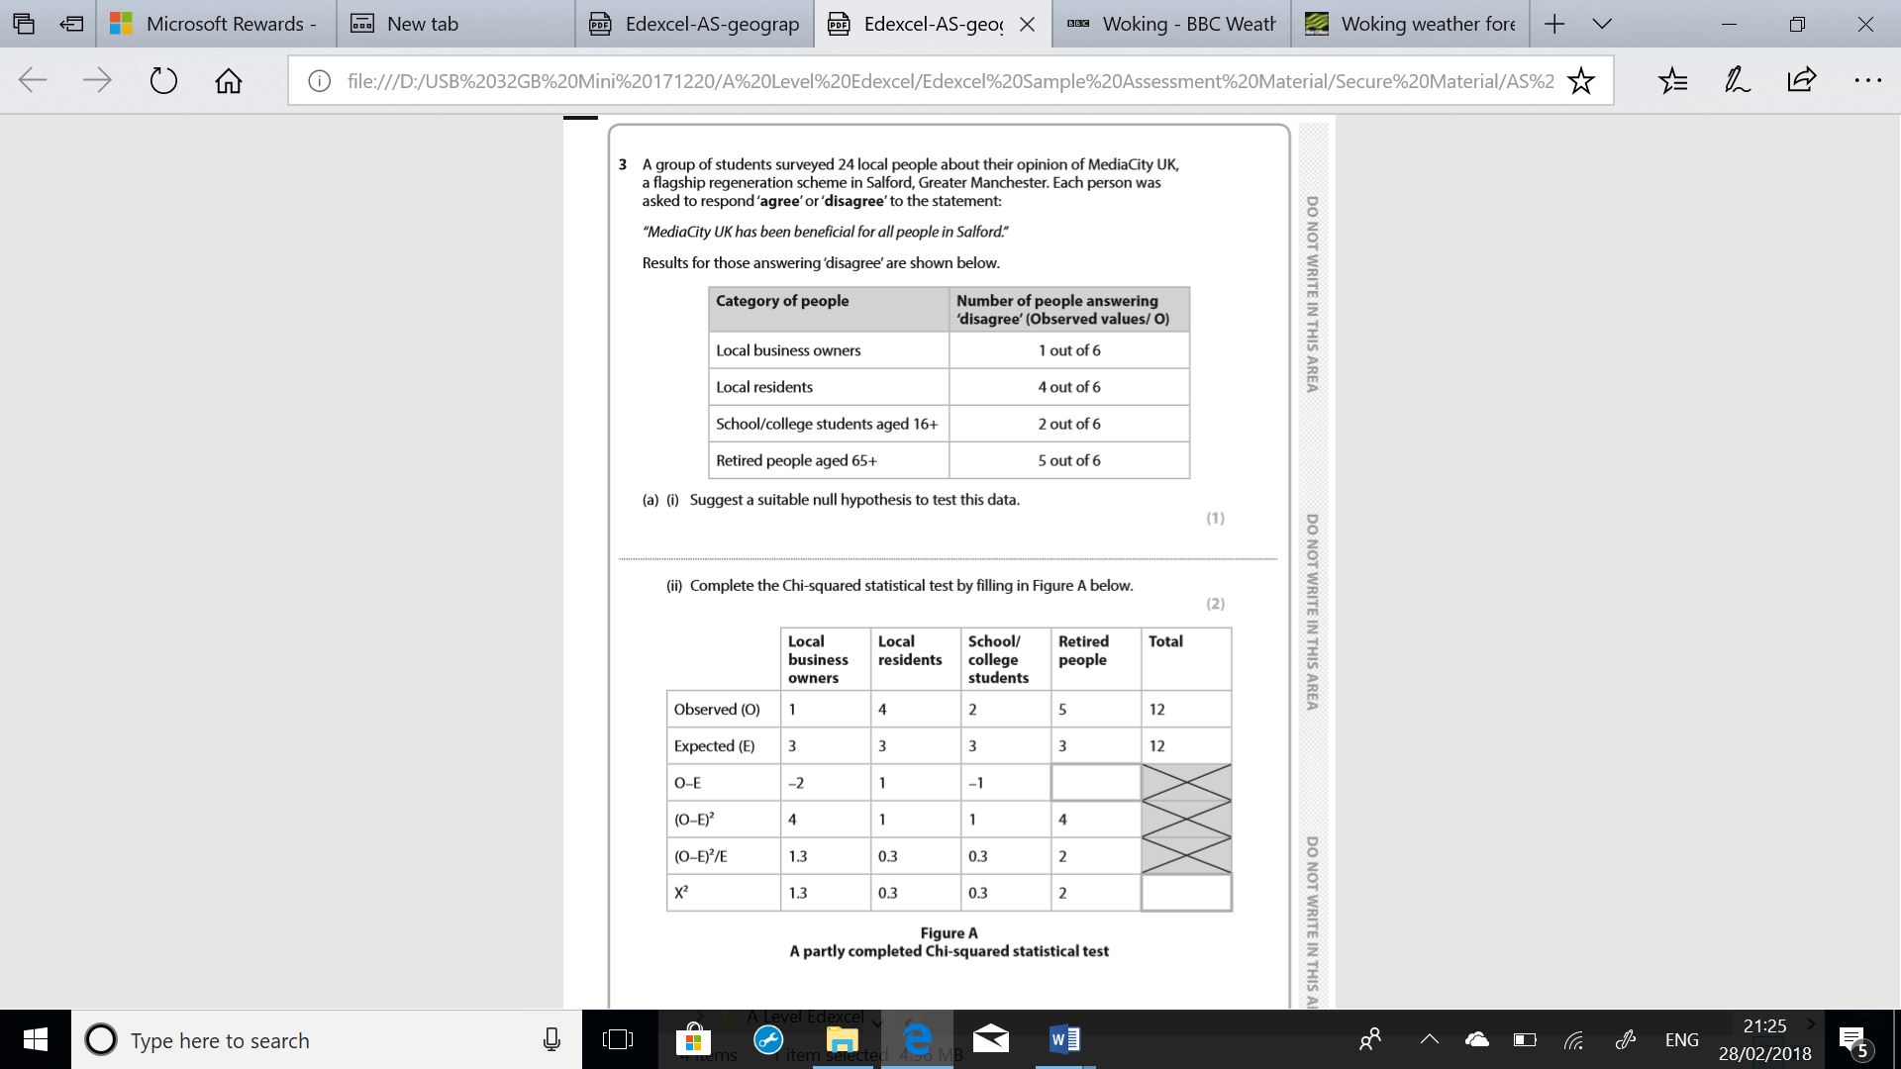
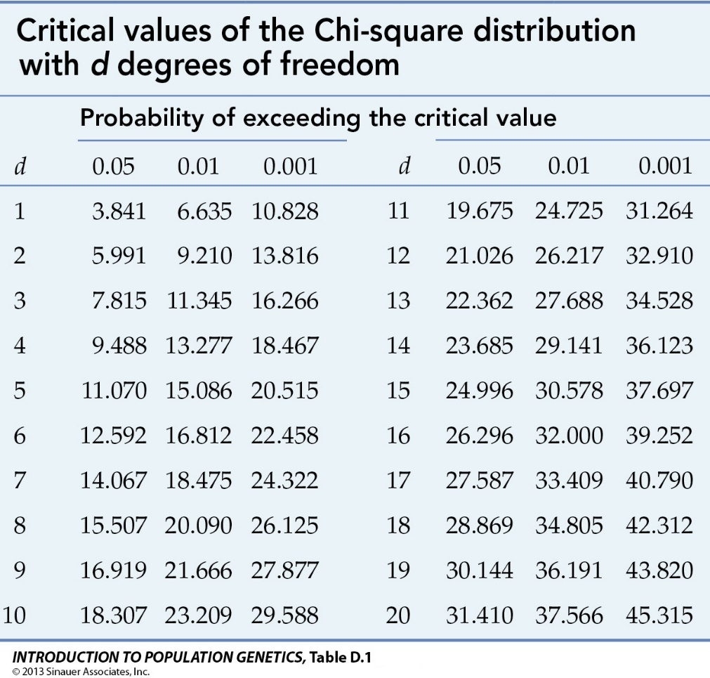

Slide 15
Look back at the questions on your questionnaire.
Have you a question that will give you data to do a chi squared test? If not add one.

Slide 16
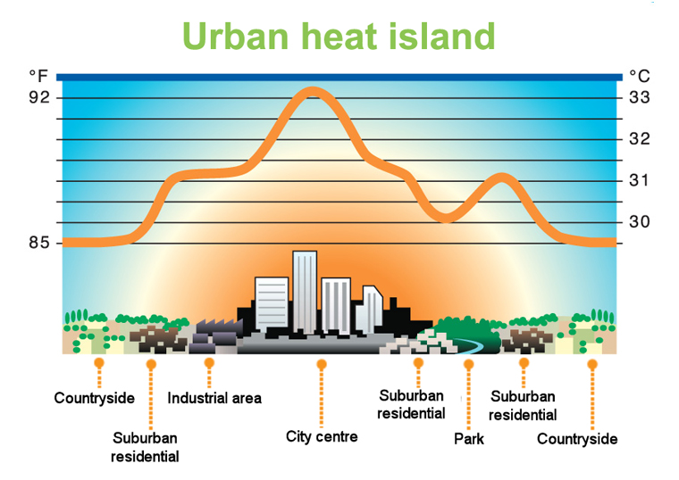
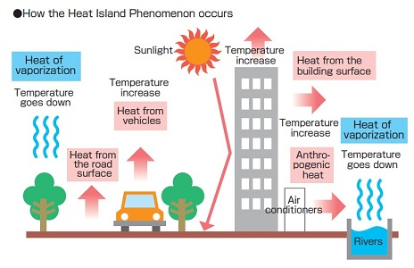
Does Godalming have on urban heat island?
Hypothesis to test:
Temperature will decrease as you move further from the town centre

Slide 17
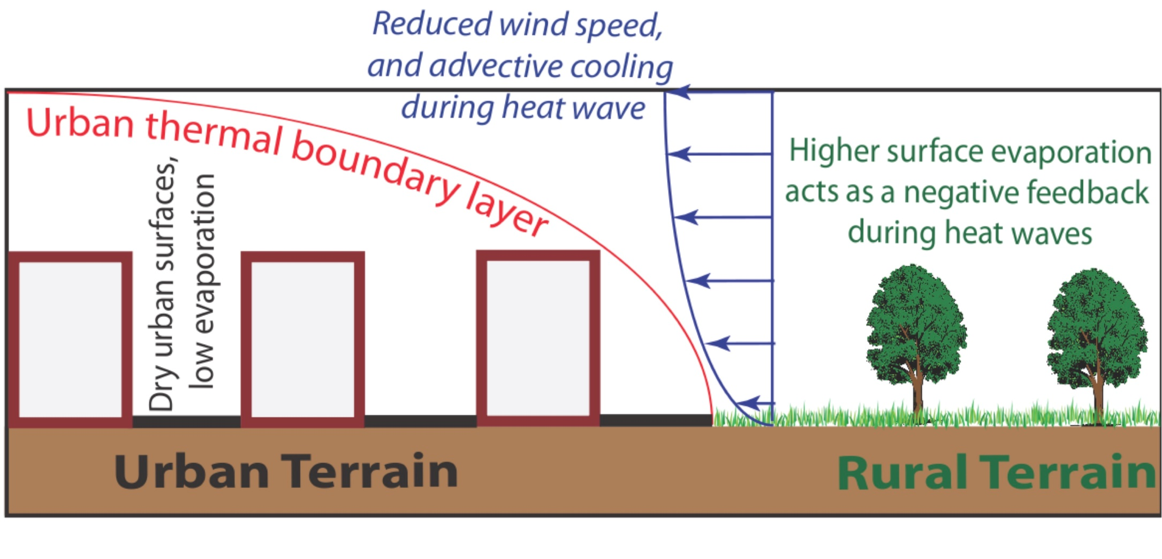
Hypothesis to test:
Humidity will increase as you move further from the town centre

Slide 18
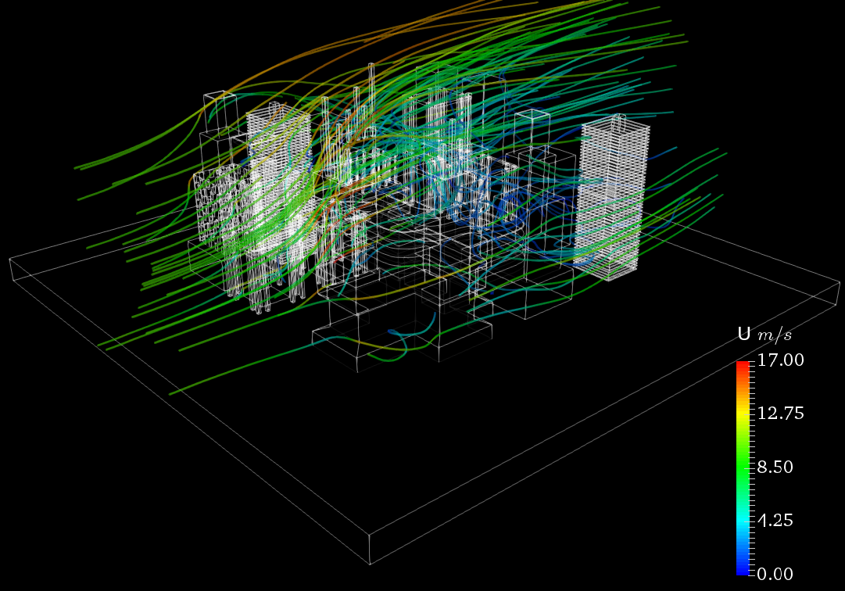
Hypothesis to test:
Wind speed will increase as you move further from the town centre

Slide 19
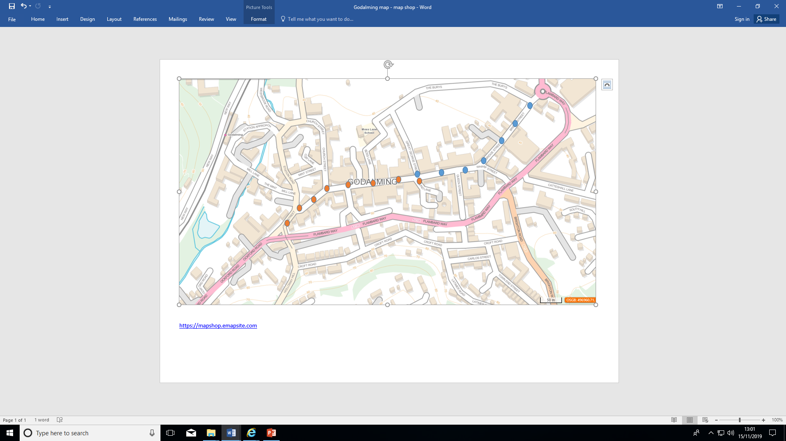
Your group will either be assigned the transect going west (orange dots) or the transect going east (blue dots). You will recording temperature, humidity, wind speed (mph), wind direction and whether the sample point is in the sun and shade every 50m.
Surface type is also another factor that could be recorded but we are not going to record it on this occasion as we will be walking along the high street and the surface type is likely to be similar throughout the transect.

Slide 20
Distance from starting point – corner of Great George Street (WEST) | Temperature °C | Humidity % | Wind speed (mph) | Wind direction | Sun/shade | Surface type
0 |  |  |  |  |  | Not applicable for this transect. We are walking down a high street and so the surface type will not vary. However, it may be something to record if different surfaces e.g. grass were encountered. Surface type
50m
100m
150m
200m
250m
Distance from starting point – corner of Great George Street (EAST) | Temperature | Humidity | Wind speed | Wind direction | Sun/shade
0
50m
100m
150m
200m
250m
300m
Recording table

Slide 21
How globally connected is Godalming town centre?
What is globalisation?
  A process by which national economies, societies and cultures have become increasingly integrated through the global network of trade, communication, transportation and immigration.
What evidence do you think there is of globalisation in Godalming?

Slide 22
Data collection tasks:
International business survey
International product survey
Mapping evidence that represent Godalming’s links with the wider world (blank map provided)
Photos evidencing globalisation (make sure that you map the location of your photo on the blank map)

Slide 23
International business survey
Start at one end the High Street and record the first 50 shops that you pass from wherever you start. As you walk along the High Street fill in the form in the booklet and note whether the company is owned by an International brand or not. You may need to google this or go in and ask. At the end you will have a list of different businesses and whether they tend to be global brands or not. You could then calculate the ratio or proportion of local/national versus international businesses.

Slide 24
International product survey
Name of shop | Products found and where grown/made
Choose 5 different shops in Godalming (make sure that they are not all the same e.g. food shops). Try to do this systematically e.g. every 5th shop. Randomly select 5 items from each shop and record where the product was made or grown. This can then be plotted on a map. Make sure that you record the name of the shop

Slide 25
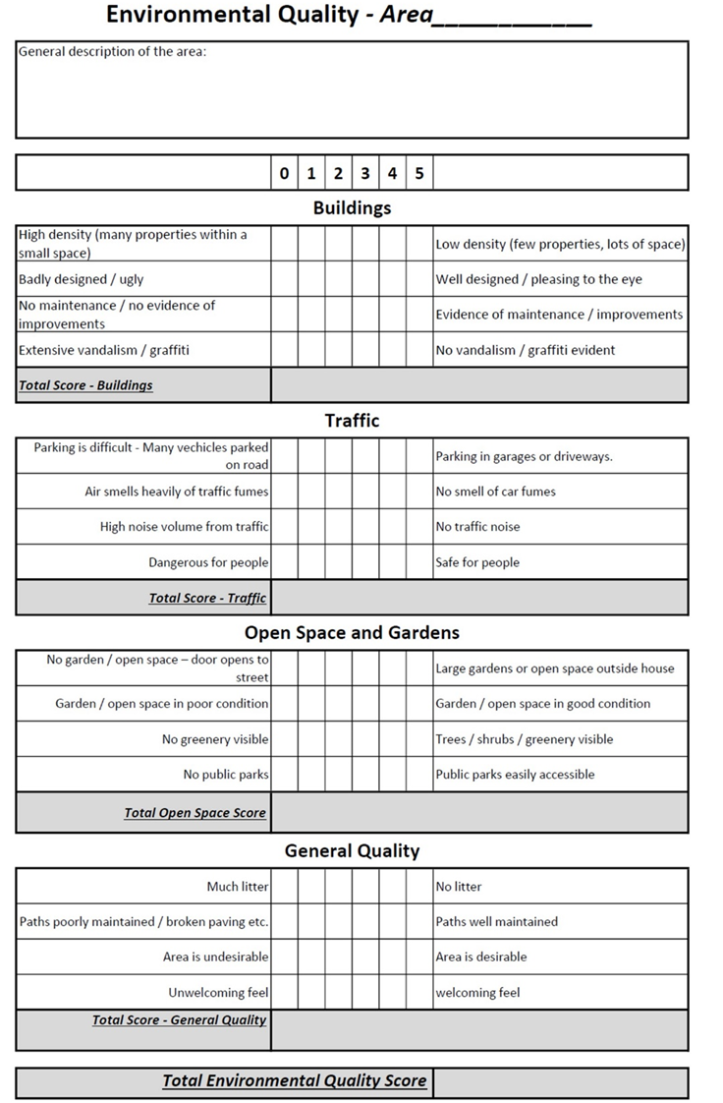
An environmental quality survey uses an observer’s judgements to assess environmental quality against a range of indicators. Often they work on a sliding scale of quality (like 1 to 5) to represent less good to good. Alternatively you can use a Bi-polar scale (like -5 to +5) to indicate a negative assessment through to a positive assessment, with 0 representing neither good or bad.
As it is based on personal judgements the data collected using environmental quality surveys is subjective. Benchmarking the scoring between different observers will help reduce this subjectivity.
Sampling for environmental quality surveys within a study:
Either an overall judgement of an area – walk around the whole Output Area and then complete the survey as a summary
Or at a number of points within the area – which may be selected using a random, systematic or stratified sample
Choose 2 locations to complete environmental quality surveys in Godalming town centre. Use the map in this booklet and google maps/satellite images to find some contrasting locations.

Slide 26
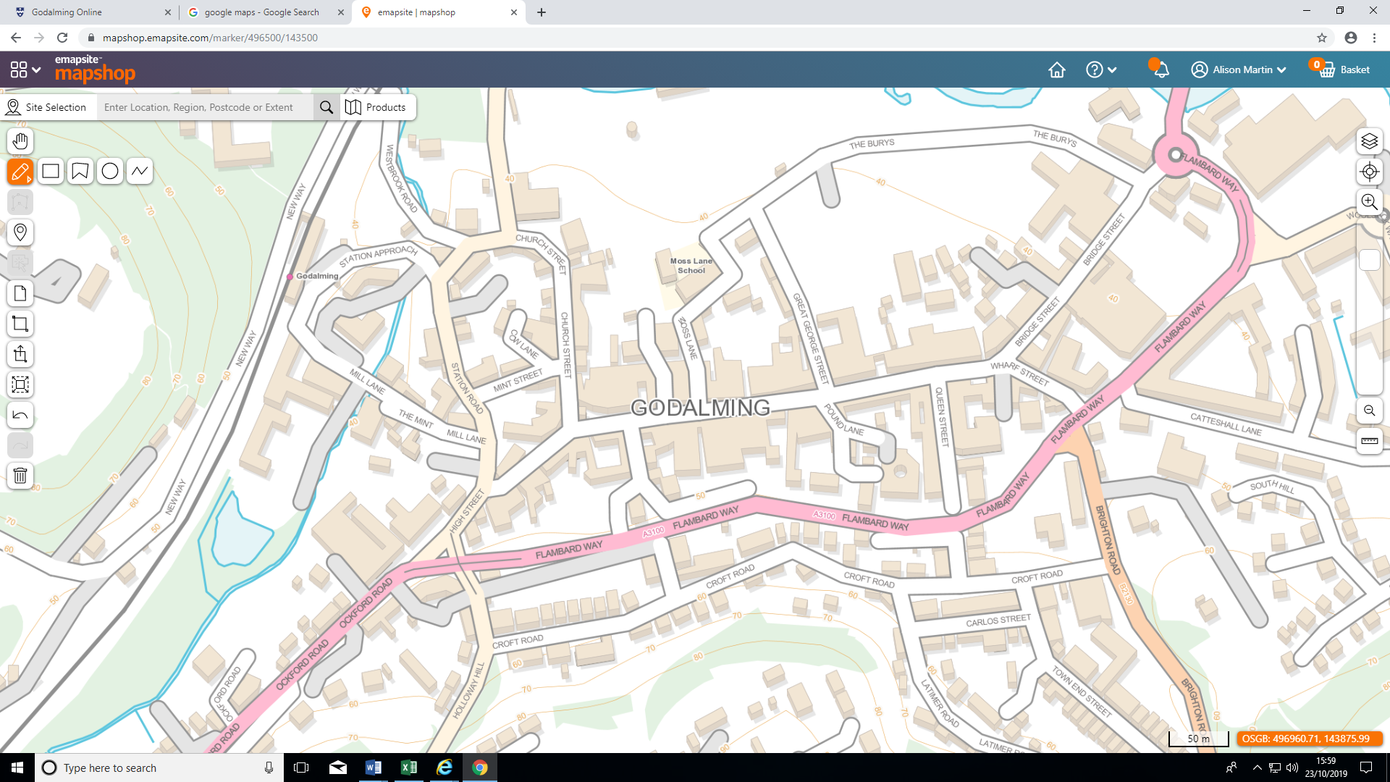

Slide 27
Ethical dimensions
Be ethical
When planning your fieldwork you need to consider the ethical implications that your fieldwork might have. These considerations then need to be included in your write-up.
You will need to ensure that you minimise the harm that your investigation may have upon the environment and the people in it.
P63-64 in the coursework workbook contains further information on ethical dimensions to fieldwork
Create a mind map of the ethical dimensions which need to be considered when on your fieldtrip to Godalming.
How might these ethical dimensions differ to when you went on the fieldtrip to the Witterings?

