Slide 1
Godalming Fieldwork Follow-up
Aims
To be able to understand what needs to be included in an NEA introduction and method.
Our focus for this follow-up task
Mark allocation
Introduction and preliminary research 10 marks
Methods of field investigation 15 marks
Methods of critical analysis 20 marks
Conclusions, evaluation and presentation 15 marks

Slide 2
Choose one of the following investigation titles:
To what extent is Godalming a ‘Placeless Town’?
How globally connected is Godalming town centre?
How does the microclimate of Godalming change?
Complete an introduction and method for your chosen title. You will need to come up with some sub-questions/hypotheses that you want to ask/test. You will also need to complete a bibliography listing the books/websites/articles you have used in your introduction and reference in the text where you have used direct quotes. This is explained on one of the following slide.
What is a hypothesis? An idea or explanation that you can then test through study and experimentation e.g. people in Godalming think it is like any other town in the UK.

Slide 3
Area 1. Introduction and preliminary research - 10 marks
A research question(s) is effectively identified and is completely referenced to the specification with a suitable comment as to how it is relevant.
You may have broken your key question down into specific key questions or hypothesis.
Well-supported by thorough use of relevant literature sources and fully referenced within the text and a bibliography.
You have included clear maps to show where your study area is located. Maps should be labelled/annotated or referred to in your text.
Your maps each have a source, title, scale and north arrow.
You have linked your question to geographical theory (i.e. the type of information you would find in a text book and online sources). This may be a model, concept, idea or geographical theory.
You have included a literature review table at the end of your introduction and have referenced any data/information you have gained from secondary sources.
Criteria | Marks awarded | What the examiner is looking for?
Introduction and preliminary research | 10 marks | The area assess your ability to: Define the research questions on which your field investigation is built Research relevant literature sources and understand and write up the theoretical or comparative context of your study.

Slide 4
Link to the specification:-
https://filestore.aqa.org.uk/resources/geography/specifications/AQA-7037-SP-2016.PDF
Or simply type in Geography AQA A level specification
Example as to how to reference a title to the exam board specification:
I have chosen to investigate the effect that coastal processes have on East Head Spit. This corresponds with 3.1.3.2 in the specification. Coastal processes of erosion, transportation and deposition. Sediment sources and cells and depositional landforms.

Slide 5
How to reference your work
You must acknowledge anything that is not your original thoughts, ideas or words. If this is not the case, you could be accused of plagiarism. Your NEA will be run through plagiarism software before submitting.
In-text citation (written within the main body of your investigation)
(Leatherwood, 2001)
In the bibliography at the back of the investigation –
Leatherwood, S. (2001) Whales, dolphins, and porpoises of the western North
Atlantic. U.S. Dept. of Commerce. Report number: 63.
You need to include the author/editor, the year of publication, the title, any organisation and any report number (if there is one)

Slide 6
How to use the referencing tool in word
Open a word document
Type something that you have copied from a book/article/website
Click on the reference tab and insert citation and then click on new source.
Complete as many of the fields as you can (some may not be relevant) and click OK.
When you have completed all the citations you can click on the bibliography tab and it will automatically create a bibliography at the end of your document

Slide 7
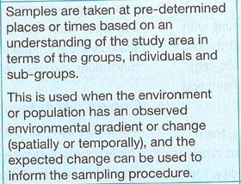
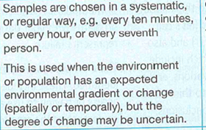
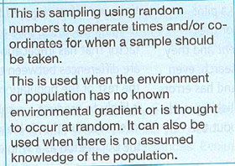
Sampling strategies
Random, stratified or systematic?

Slide 8
Sampling strategies
https://www.rgs.org/schools/teaching-resources/sampling-techniques/
Click on the link above and use the information on p48 of the Coursework workbook to complete the sampling techniques handout
You need to establish which image matches which sampling technique, briefly explain what the technique is and the advantages and disadvantages of using it.
There is also pragmatic sampling – this is when, for practical reasons, you chose to question those who look more approachable. You are more likely to use this form of sampling when doing questionnaires on the street. Why is this?

Slide 9
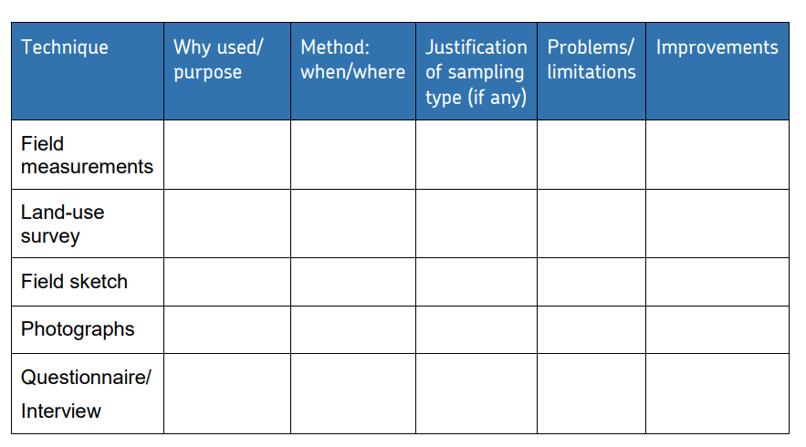
Area 2. Methods of field investigation - 15 marks
You have included methods of primary data collection.
You have included sources of secondary data collection.
Every type of data collection links very closely to your coursework question. If it doesn’t, change the method!
You have explained in detail exactly how you will collect each type of data.
You have said whether each type of data collection is stratified, systematic, random or pragmatic and why you selected this method.
You have said how much data you will collect (frequency and repetition), when you will collect it and referred to any collection methods requiring timing.
You have been specific on the timing of your data collection (time of day, date, season etc.)
You have justified your choice of study sites, making clear reference to your question.
You have a detailed paragraph referring to the ethics of collecting accurate and fair data.
You have identified problems, limitations and improvements for your data collections methods.
You have made a clear point to explain why you think your data is as accurate as it can be (evaluation will come in later).
You have mapped and labelled individual data collection sites
Methods of field investigation | 15 marks | This area assesses your ability to: Plan and justify the practical approach you take to data collection in the field, including frequency/timing of observation, sampling and data collection approaches Show that you have a practical knowledge and understanding of field methodologies appropriate to your investigation Put into practice your chosen methodologies to collect good quality data/information which is relevant to the topic you are investigating.

Slide 10
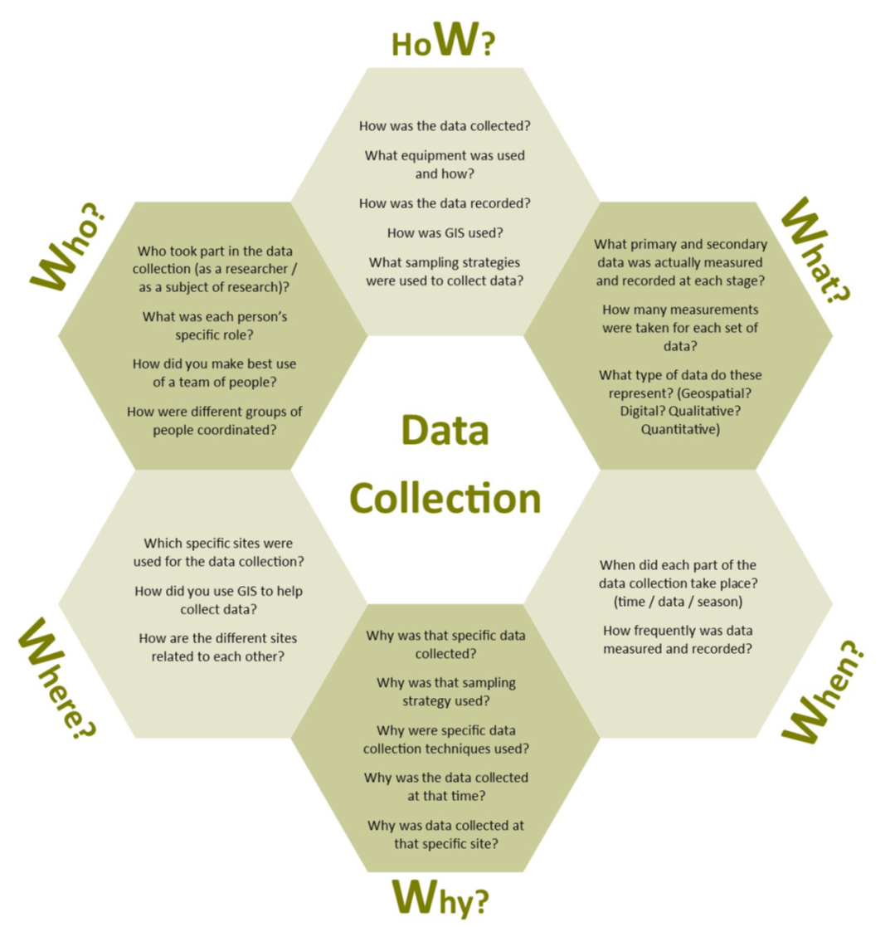
Don’t forget the ethical dimensions you needed to consider!

Slide 11
Example of a method write up of one technique. This was taken from the following NEA example published on the AQA website.
https://filestore.aqa.org.uk/resources/geography/AQA-70373-NEA-C.PDF
Pebble data I collected this data because I wanted to see how the size of the pebbles, and also the shape, varied along Chesil Beach. This would be useful as it would help to support the theory that there are two directions of longshore drift along the coast here and that this has resulted in sorting of the pebbles. I wanted to use random sampling to ensure that I got a good representative sample of pebbles from the beach and to stop me simply choosing the ones that I thought looked nice. I laid two tape measures down with 10m sections making two axes. I then used a table of random numbers to give me pairs of random numbers. I used the two tapes like a graph and if the numbers were 2 and 5 I would go to 2 metres along one tape, 5 metres along the other and where the two distances met would take a pebble from the beach for the sample. I repeated this 50 times. With each pebble, I measure the longest length (a axis) using the callipers – this was a quantitative method and told me how big the pebbles were. I also classified the pebble based on its shape- using the 6 categories from angular to well rounded. This was more of a qualitative method as it was based on my opinion of the shape of the pebble. The group a pebble was put into might vary depending on who was carrying out the fieldwork. If I were to extend the project I might also want to think about taking samples of pebbles from different areas of the beach – such as the foreshore or the back of the beach. I could also measure the A, B and C axes and do more calculations on the shape of the pebbles and their degree of roundness.
TASK – complete a method write up for a technique that you have collected information for on the Godalming fieldtrip.

