Slide 1
ArcGIS Introduction and pre-work
Aims
To explore how ArcGIS can be used to collect data in the field and create maps and other forms of data presentation
To introduce further ideas for possible investigations and data collection techniques

Slide 2
You will be receiving an important email from ArcGIS (Esri for schools) inviting you to join the Godalming College ArcGIS account. Please make sure that your inboxes are not full and that you do not accidently delete it.
You will be given a user name and be asked to change your password. Please do so as soon as possible as you will need to access the account in the preparation lessons for the Guildford fieldtrip.

Slide 3
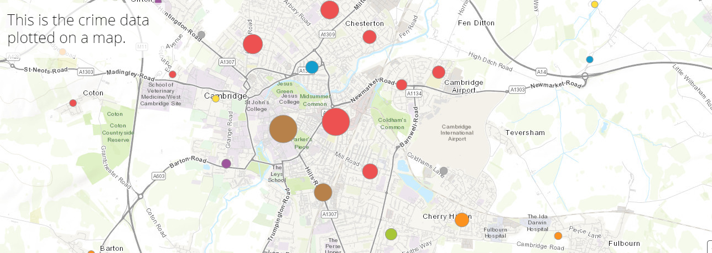
How can you use ArcGIS for your NEA?
https://esriukeducation.maps.arcgis.com/apps/Cascade/index.html?appid=40de01dad0344ead98d1a306e5240d95
All sorts of information could be mapped in this way e.g. pedestrian/traffic counts, environmental quality scores, housing decay surveys

Slide 4
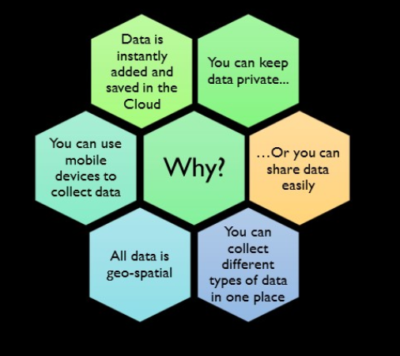

Slide 5
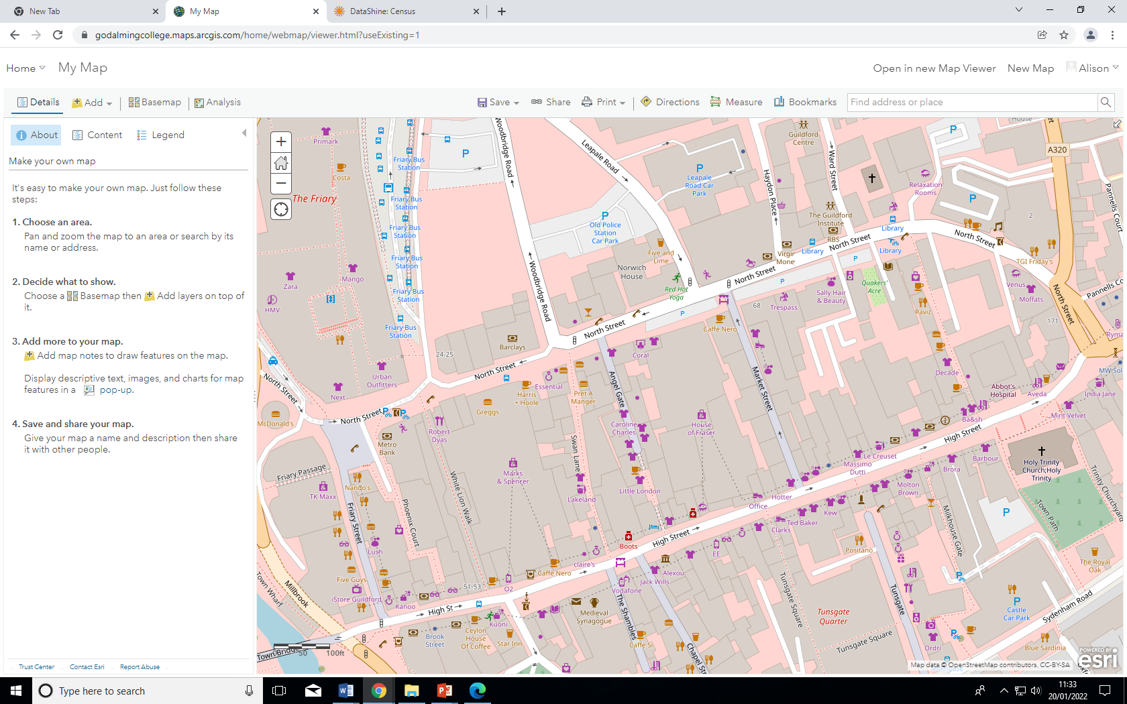
The maps
Go into Maps on ArcGIS. Either zoom into an area or type in the name or postcode.
Explore the different maps/images that you can get using the different basemaps.

Slide 6
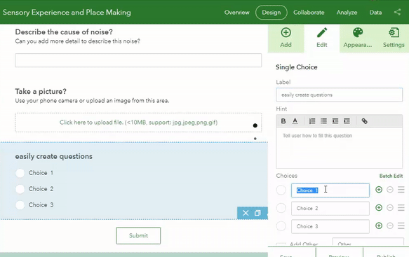
Survey 123 form
You will be creating surveys like this one that you will then try out in Guildford

Slide 7
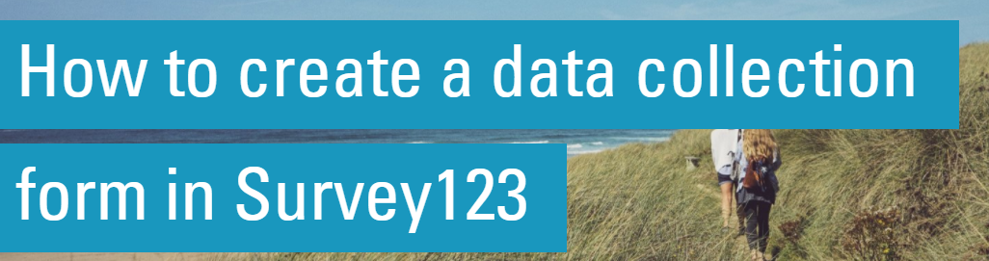
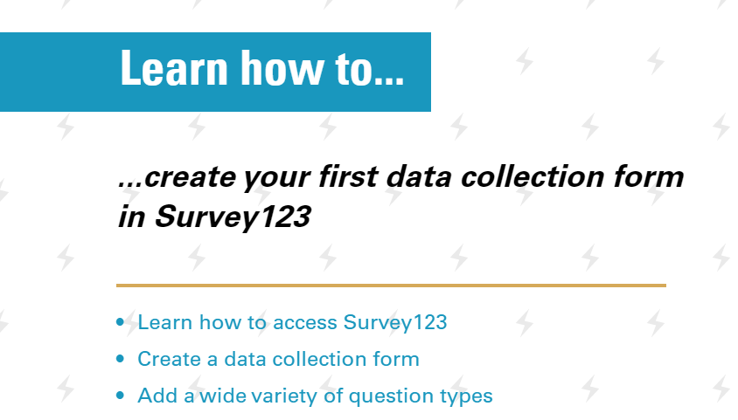

Slide 8
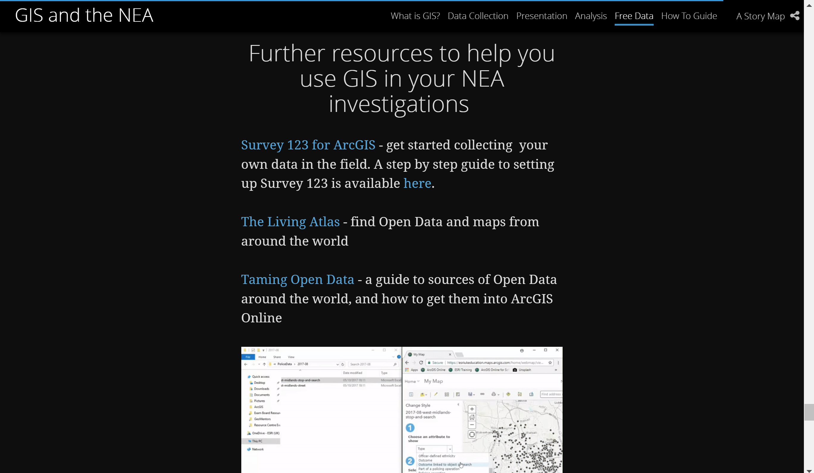
Click on the link below, scroll down and find the Survey123 – step by step guide
https://esriukeducation.maps.arcgis.com/apps/Cascade/index.html?appid=40de01dad0344ead98d1a306e5240d95

Slide 9
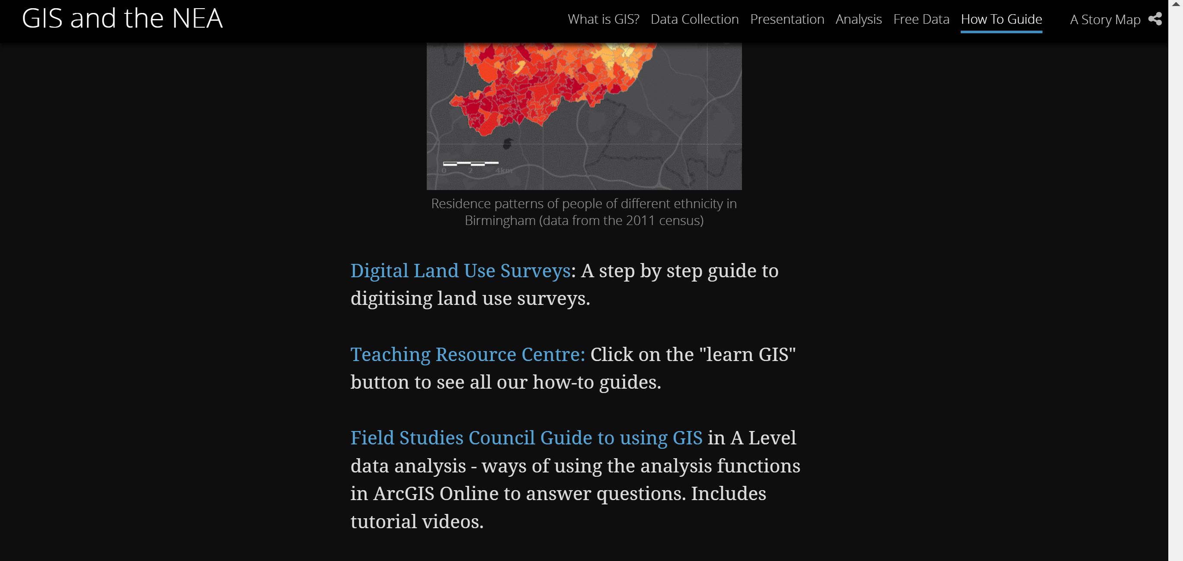
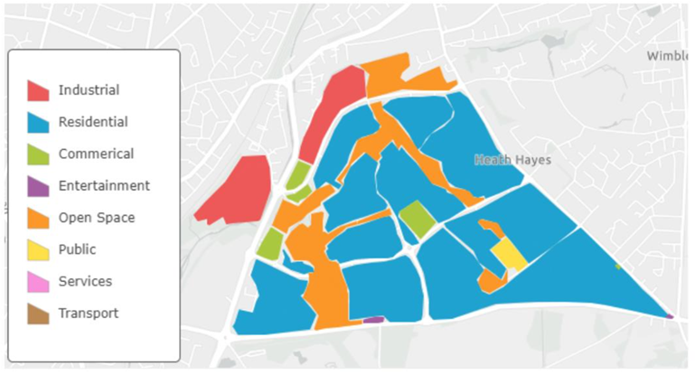
https://esriukeducation.maps.arcgis.com/apps/Cascade/index.html?appid=40de01dad0344ead98d1a306e5240d95
Use the above link to learn how to create a land use map.
://services.arcgis.com/XSeYKQzfXnEgju9o/arcgis/rest/services/Landuse_New_Masters/FeatureServerTh

Slide 10
Pre-work
The Guildford Preparation PowerPoint can be found on GoL in the Independent Investigation Folder. Click on Guildford folder to locate it.
Digital land use survey
https://esriukeducation.maps.arcgis.com/apps/Cascade/index.html?appid=40de01dad0344ead98d1a306e5240d95
Go to analysis and find the instructions.
Look through the powerpoint and clink on the links provided. I recommend that you print out the instructions sheet and keep it safe for future reference. (The instruction sheets have also been put in the Independent Investigation folder in case the links do not open on your system)
Try out the techniques shown using a base map of Guildford. It does not matter which categories you use as it is just an opportunity to play around with the software. Print out a copy of the map you have created. You will need to sign into your ArcGIS account to do this.
3) Use the measure tool in maps to measure the area of a place and also the distance from the centre of Guildford (High Street) to Pewley Hill
Surveys123 forms
https://esriukeducation.maps.arcgis.com/apps/Cascade/index.html?appid=40de01dad0344ead98d1a306e5240d95
Go to analysis and find the instructions.
1) Create a Survey123 form with at least 3 different styles of questions and including the option of taking a photograph. These questions can relate to the area (road) you live on e.g. number of cars on drive, how well maintained a property is etc. Download the app onto your phone and collect the data. Once back on a computer explore the presentation function and create a map and a graph of your fieldwork. Print off and submit/bring to the lesson.

