Slide 1

Changing Places exam question practice
May 2019 paper

Slide 2
Water and carbon – structure of the exam
1 x 4 marks | AO1
2 x 6 marks | AO3 AO1 2 marks AO2 4 marks
1 x 20 marks | AO1 10 marks AO2 10 marks

Slide 3
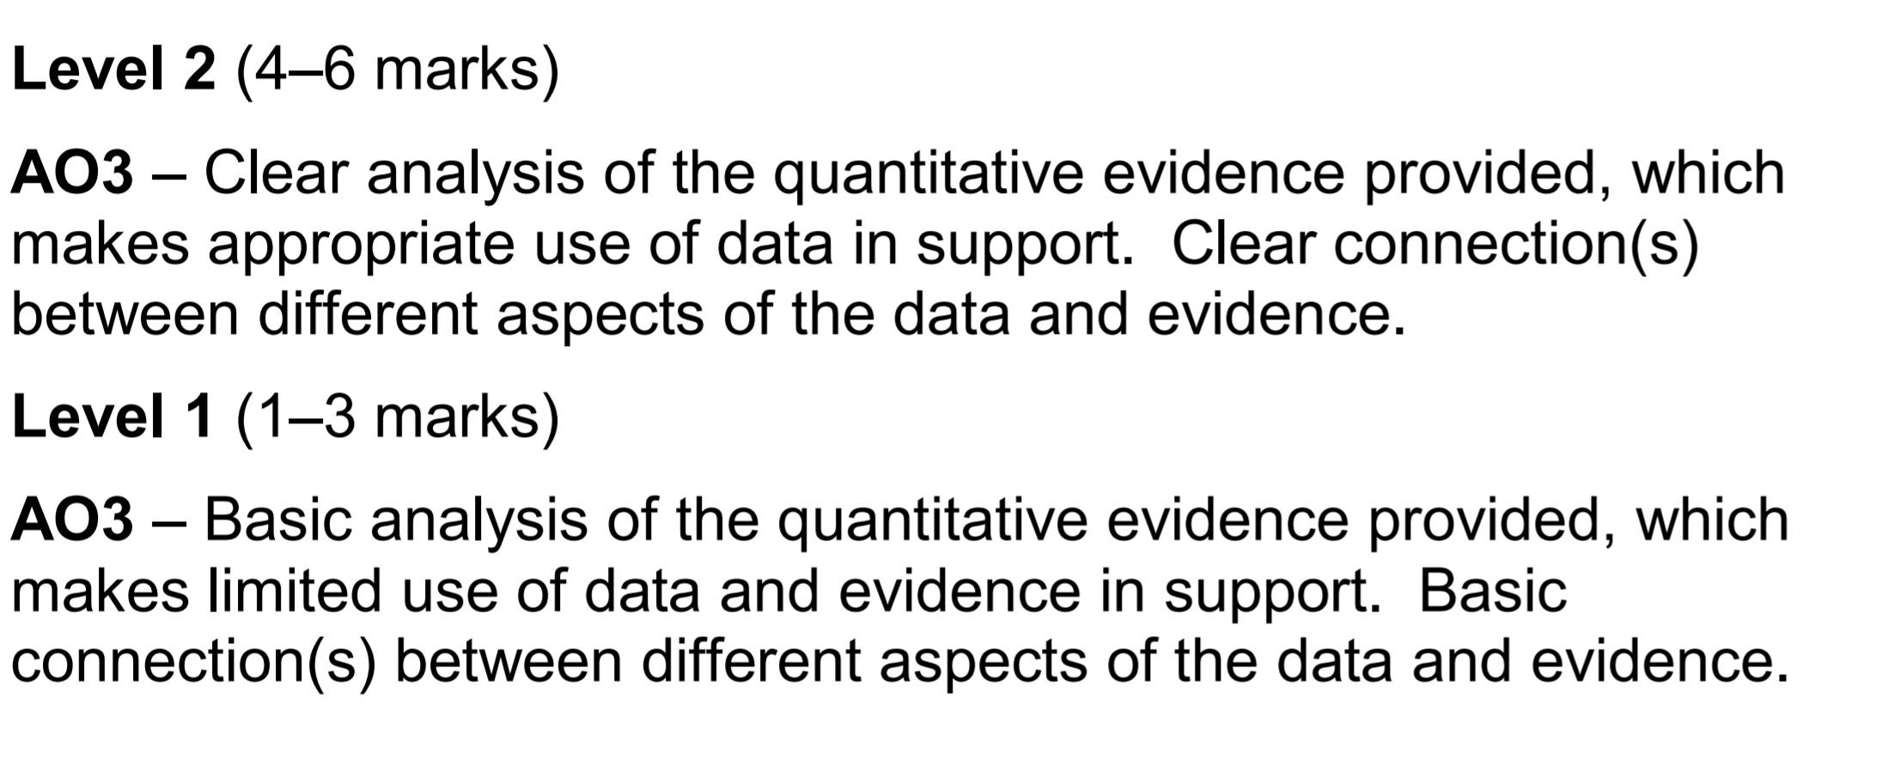
Analyse Question – Generic mark scheme

Slide 4
6 mark assess – generic mark scheme

Slide 5
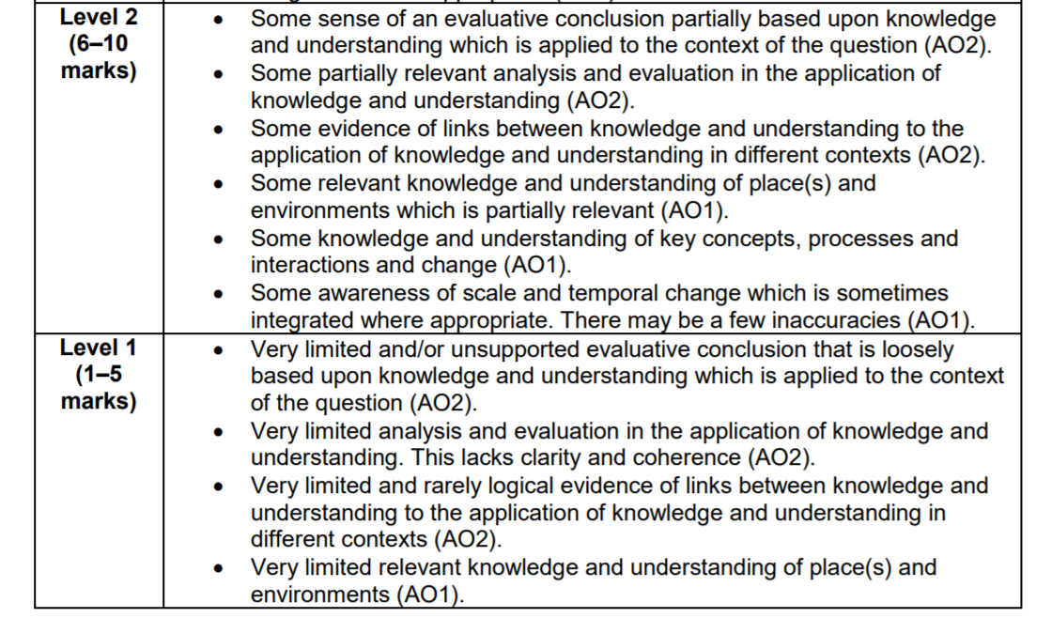
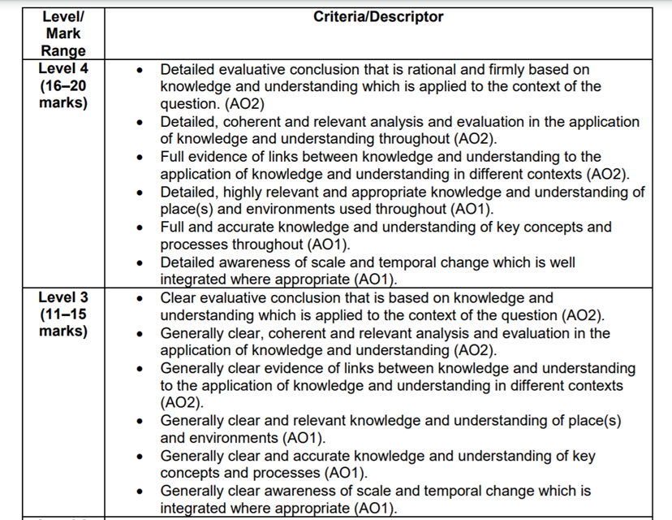
20 mark essay – Generic mark scheme

Slide 6
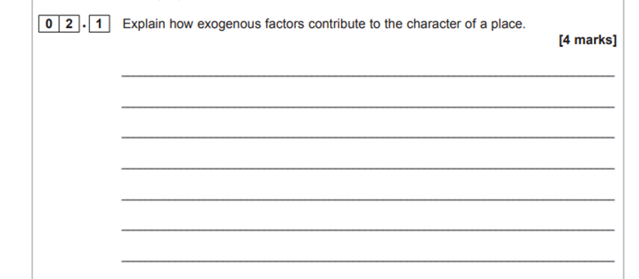

Slide 7
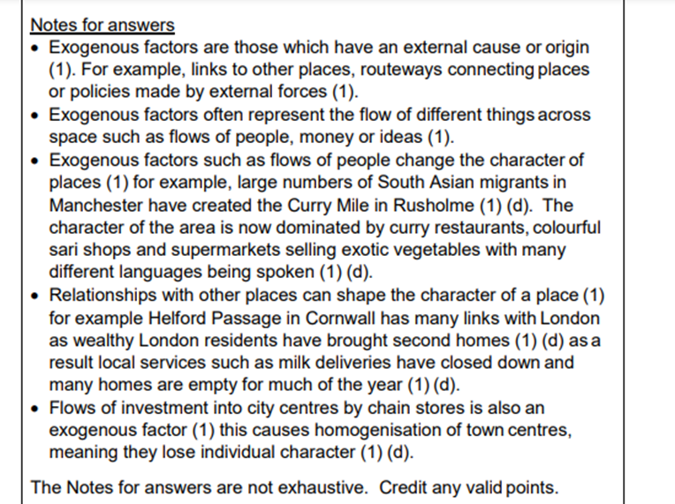

Slide 8
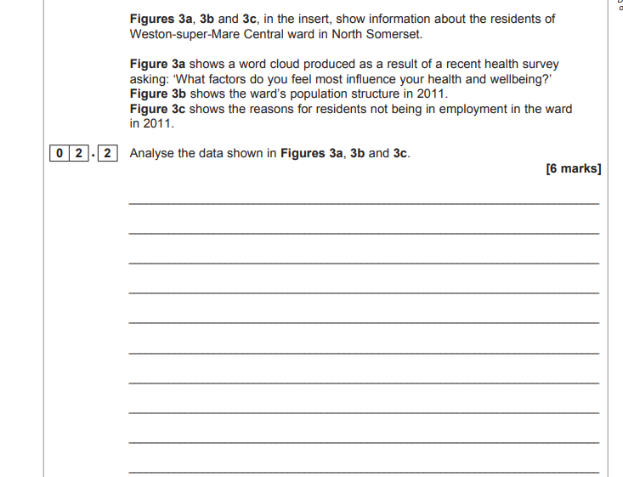

Slide 9
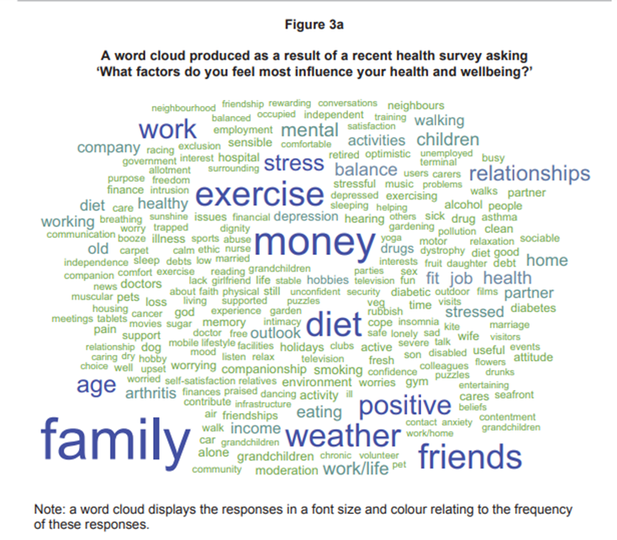
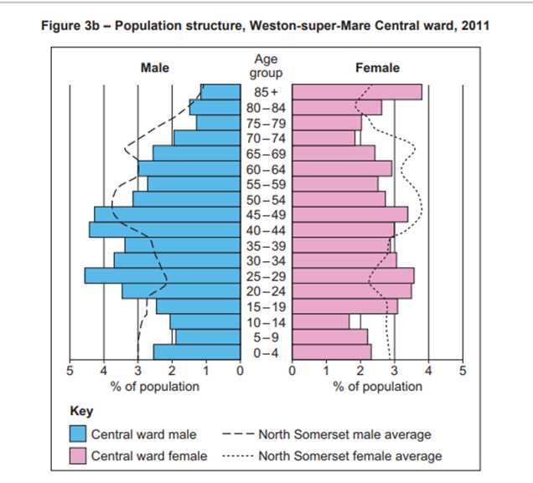
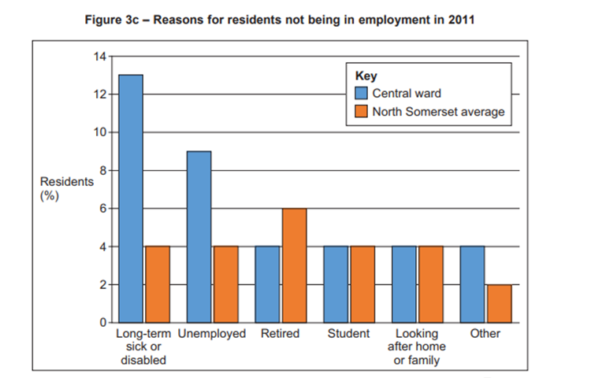

Slide 10
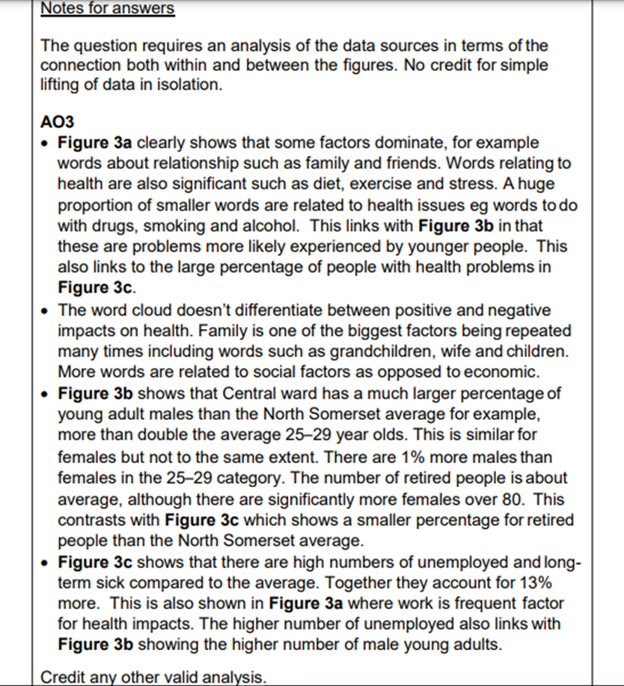

Slide 11
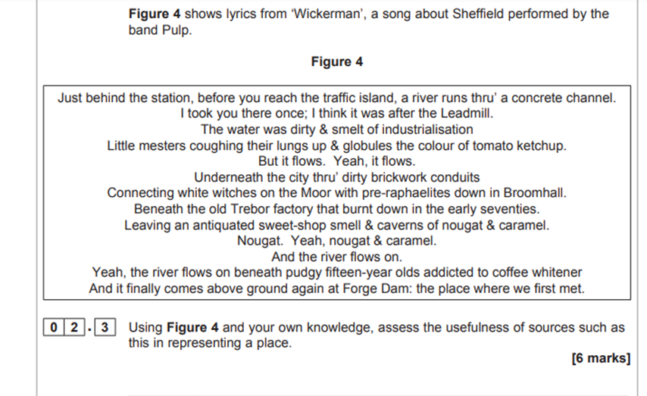

Slide 12
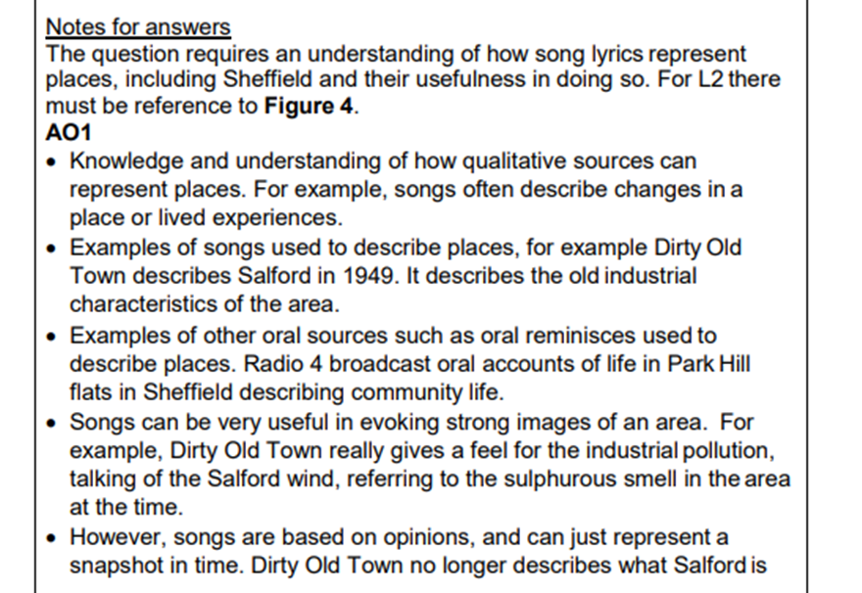
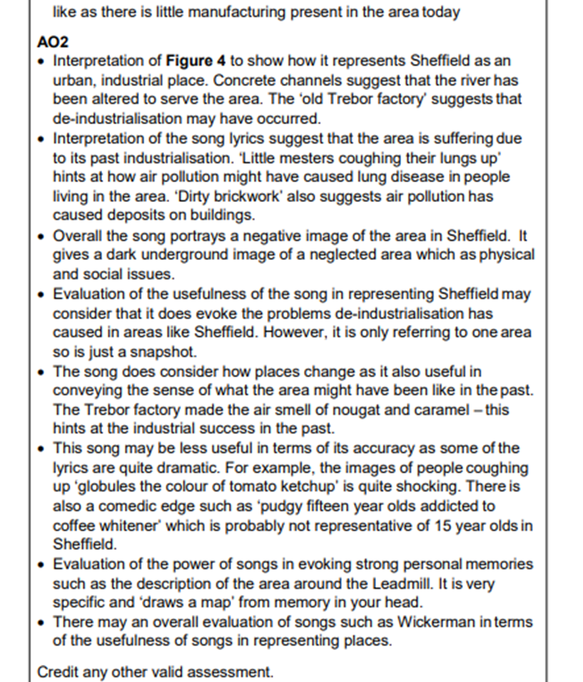

Slide 13


Slide 14
