Slide 1
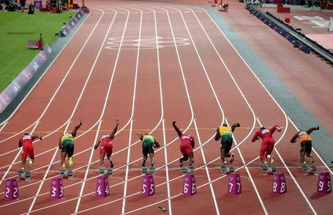
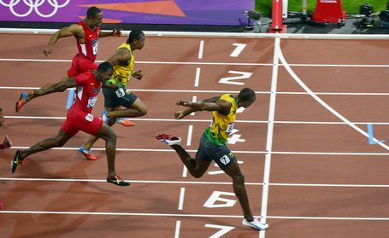
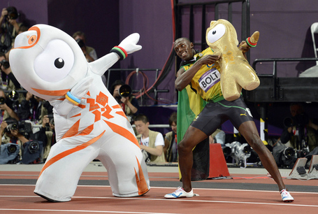
Reaction Time
From the onset of the stimulus to the initiation of the response
Movement Time
From the initiation of the response to the completion of the movement
Response Time
From the onset of the stimulus to the completion of the movement
Or
Reaction time + Movement Time

Slide 3
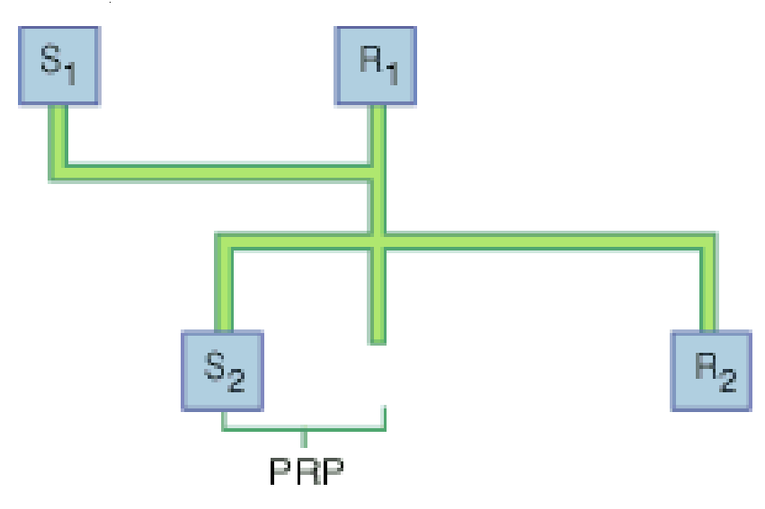

Slide 6
Explain the Psychological Refractory Period [4]
Define reaction, movement and response time [3]
What is the relationship between the three components above?[1]
Explain, using practical examples, Hicks Law. [2]

