Slide 1
Best way to use Extrinsic Motivation
Use positive reinforcement / not punishment
Continuous reinforcement good at cognitive stage
Intermittent is usually better through associative to autonomous phase
Immediate is usually best
Reward successful approximations in first stage (trial and error remember)
Reward performance (not just outcome – Bonney’s swimming badges)
Reward effort

Slide 2
Dangers of Extrinsic Motivation
Extrinsic may lead to loss of intrinsic motivation
Become dependent on extrinsic motivation
Excessive extrinsic motivation eventually loses its effect
Failure to achieve extrinsic reward may lead to loss of motivation;
Too much pressure, which may lead to cheating

Slide 3
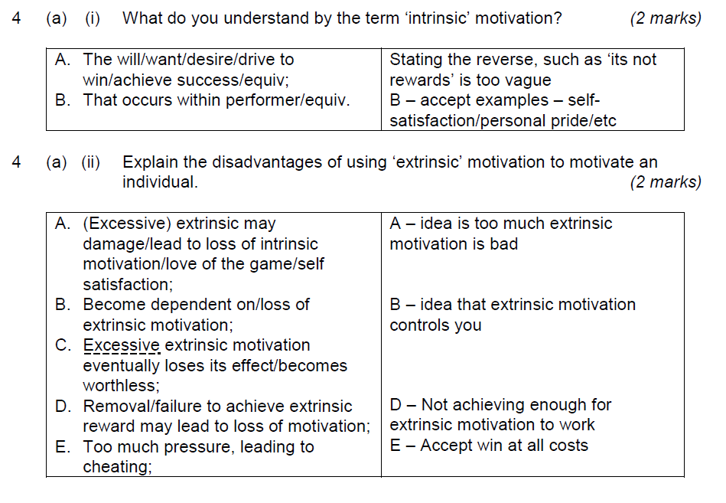
May 2011

Slide 4
