Slide 1
4 marks

Slide 4



Jan 13
3 marks
3 marks

Slide 5
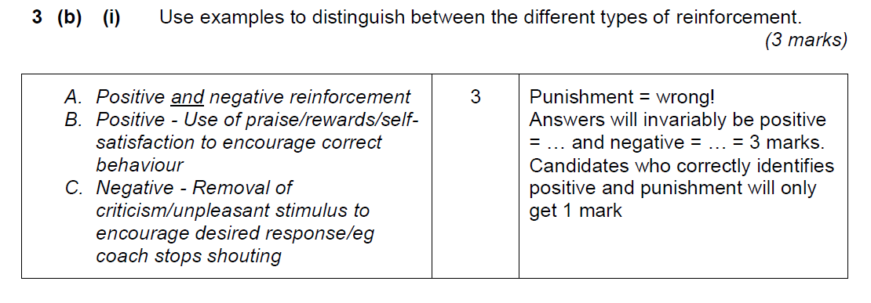
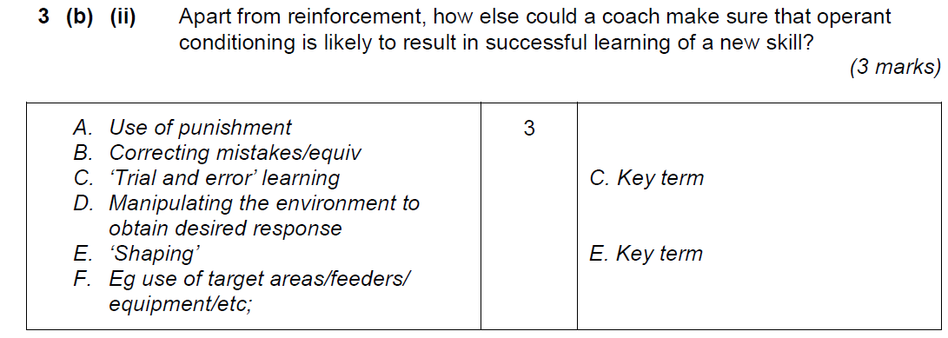

Slide 7
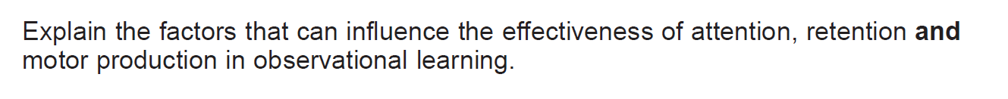
Jan 13
4 marks
Jan 12
3 marks

Slide 8
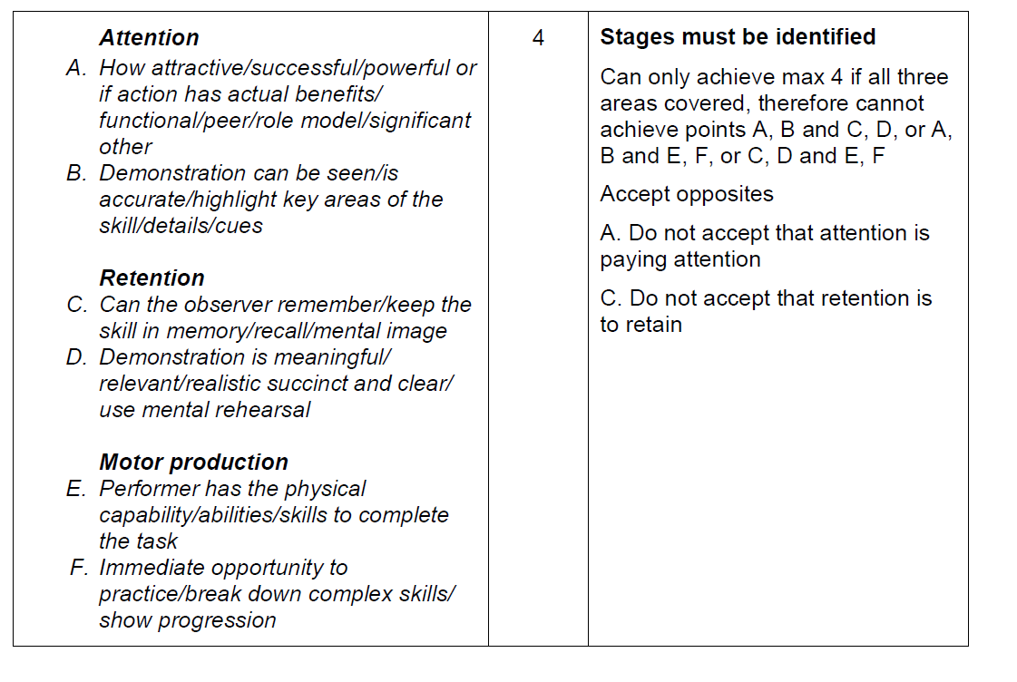
Jan 13

Slide 9
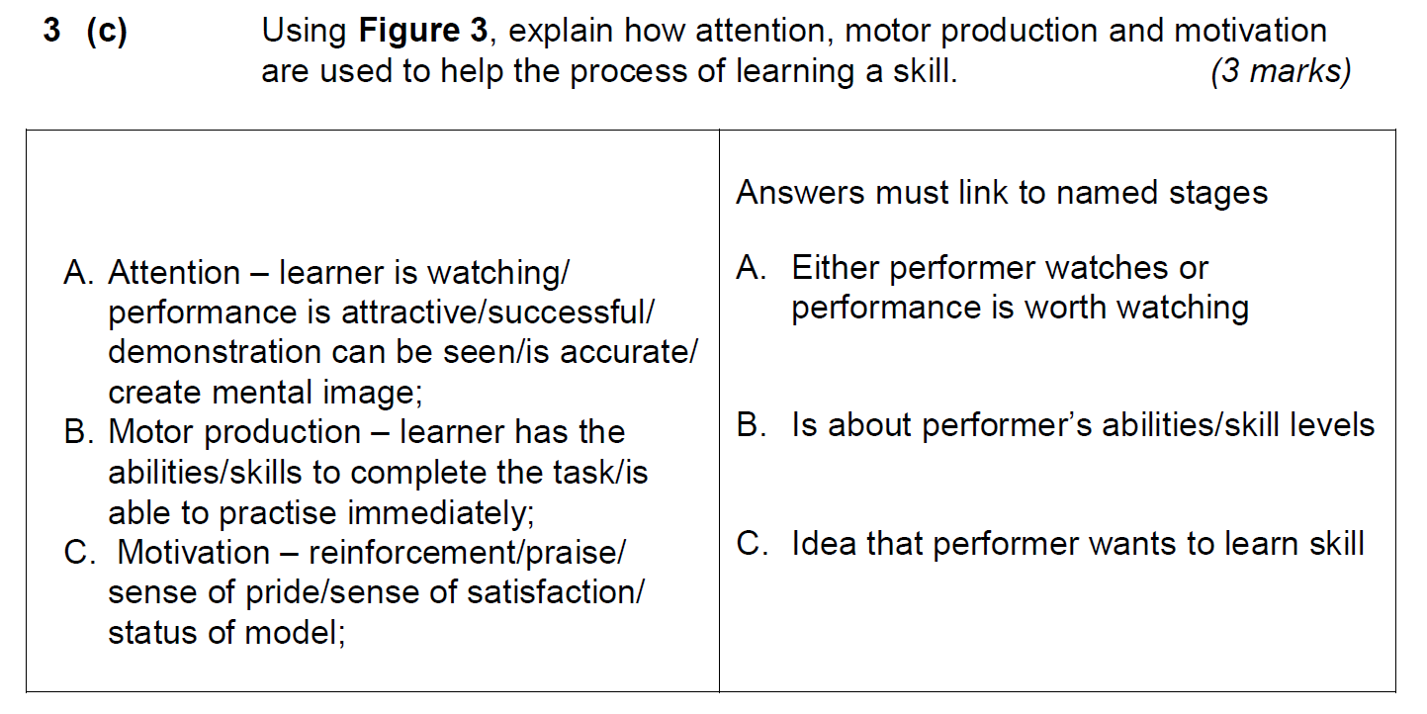

Slide 11
May 14

