Slide 1
Transfer of Learning
“Practically all learning is based on transfer”
Refers to the relationship between two skills and is important because one skill can facilitate or impede the learning and performance of another.

Slide 2
Positive Transfer
Occurs when one skill helps the learning and performance of another e.g. throwing helps the racquet arm action in tennis serving

Slide 3
Negative Transfer
Occurs when one skill impedes the learning and performance of another e.g. wrist actions in tennis and badminton.

Slide 4
Promoting Transfer
Coach makes performer aware of transfer potential / highlight elements of skill that are similar
Identify elements that may hinder learning
Ensure original task is well learnt / practiced
Planned progression in teaching of skills
Make practice sessions realistic / relevant to the competitive environment eg practicing against opposition etc
Eliminate bad habits
Performer is well motivated / confident.

Slide 5
Proactive Transfer
Occurs when a previously learned skill influence the learning and performance of new skills either positively or negatively.

Slide 6
Retroactive Transfer
Occurs when new skills influence the learning and performance of old skills either positively or negatively.

Slide 7
Bilateral Transfer
Is the ability of a predominantly right footed / handed player to perform a skill using the left foot / hand of the body. Eg. a footballer being able to pass with both feet. They may be stronger on the right, but many aspects of the skill transfer to the other side.

Slide 8
Zero Transfer
No relationship between two skills e.g. front crawl swimming and basketball shooting. Sometimes known as neutral transfer.

Slide 9
Jun 09 Question
1. Positive transfer (of learning)/develop schema
2. Make performer aware of transfer potential/highlight elements of skill that are similar
3. Ensure original task is well learnt/practiced
4. Planned progression/part learning of skill/break skill down
5. Make practice sessions realistic/relevant/same movements
6. Eliminate bad habits
7. Practicing on trampoline is safer/reduce risk of injury
8. Repeated practice more possible – aids reinforcement
9. Only use if performer is well motivated / confident / avoid tedium

Slide 10
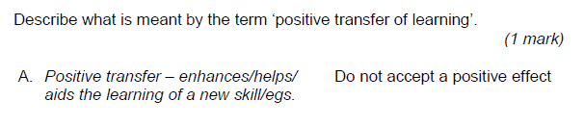
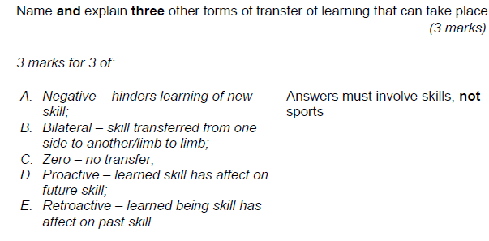

Slide 11
