Slide 1
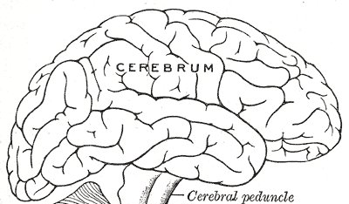
A Level Physical Education
Chemoreceptors
Proprioreceptors
Baroreceptors
In muscles, aorta and carotid artery detect lower ppO₂, increase ppCO₂, lower pH
In the joints and muscles detect movement
In the aorta and carotid artery detect decreased blood pressure
Cardiac Control Centre
+
-
SA Node
Acceleratory nerve
Vagus nerve
Sympathetic Nervous System
Parasympathetic Nervous System

Slide 2
A Level Physical Education

