Slide 1
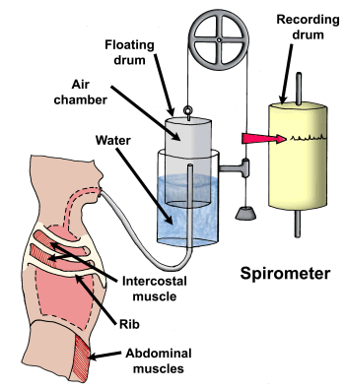
Lung volumes - spirometer
5
Anatomy

Slide 2
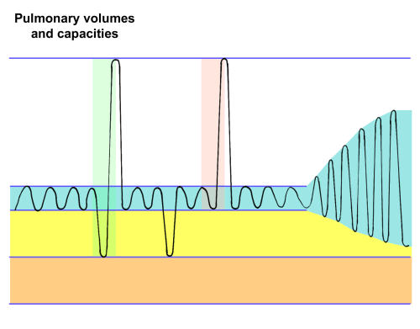
Spirometer trace
5
Anatomy

Slide 3
Lung volumes
5
Anatomy
Tidal volume
Amount of air moving in and out during normal breathing
Expiratory reserve volume
Amount of air that can be forcibly expired after a normal breath
Inspiratory reserve volume
Amount of air that can be forcibly inspired after a normal breath
Maximum amount of air that can be expired after a maximal inspiration
Vital capacity
Amount of air left in the lungs after breathing out
Residual volume

Slide 4
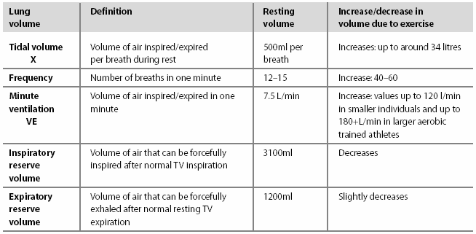
Answers…
5
Anatomy

Slide 5
Lung volumes
5
Anatomy
VC = TV + ERV + IRV
Minute ventilation = TV x breathing rate
During exercise TV increases, taking air from ERV and IRV

Slide 6
Mechanics of breathing – 5 key steps…
5
Anatomy
The mechanics of respiration are easier to learn and understand by linking the five key steps:-
  Muscles actively contract or passively relax to cause…
  Movement of the ribs and sternum and abdomen which causes…
  Thoracic cavity volume to either increase or decrease, which in turn causes…
  Lung air pressure to either increase or decrease which causes…
  Inspiration or expiration – air breathed in or out

Slide 7
2 Minute task: Think of a phrase using the words beginning with the letters M.M.T.L.I.
5
Anatomy
You can use this to help you remember the mechanics of respiration.

Slide 8

Mechanics of
Respiration at Rest
5
Anatomy
Inspiration
Expiration
1. Diaphragm & External Intercostals Actively Contract
2. Diaphragm flatten, ribs/sternum move up and out
3. Thoracic cavity volume increases.
4. Lung air pressure decreases below pressure outside
5. Air rushes into lungs
M
M
T
L
I
1. Diaphragm & External Intercostals Passively Relax.
2. Diaphragm pushed up, ribs/sternum move in and down
3. Thoracic cavity volume decreases
4. Lung air pressure increases above pressure outside.
5. Air rushes out of lungs.

Slide 9
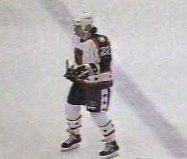
Mechanics
During Exercise
5
Anatomy
Inspiration
Expiration
1. Diaphragm, External Intercostals, Sternocleidomastoid, Pectoralis minor contract.
2. Diaphragm flattens with more force + Increased lift of ribs and sternum
3. Increased thoracic cavity volume
4. Lower air pressure in lungs
5. More air rushes into lungs
1. Diaphragm relaxes, External Intercostals relax, Internal Intercostals contract, Abdominals contract.
2. Diaphragm pushed up harder with more force. Ribs/sternum pulled in and down.
3. Greater decrease in thoracic cavity volume
4. Higher air pressure in lungs
5. More air pushed out of the lungs.

Slide 10
Tackle these….
5
Anatomy
1. Label the spirometer trace on the board [3]
2. Which muscles contract to increase lung pressure causing fast expiration of breath during exercise? [3]
3. Define Tidal Volume and give an average resting value and an exercise value [3]
4. List 3 features of the lungs that make them ideally suited for effective gaseous exchange [3]
Total marks / 12

Slide 11
Tackle these
Name any 2 inspiratory muscles and any 2 expiratory muscles [4]
Define the terms partial pressure and diffusion gradient. [2]
Explain how O2 diffusion gradients get steeper during exercise [2].
Where do the following occur:
Internal respiration
External respiration [2]

Slide 12
Gaseous exchange
Oxygen required for energy production in muscles
Need to transport oxygen from air via lungs and blood to muscles
Carbon dioxide produced as waste product of energy formation in muscles
Need to transport CO₂ from muscles via blood and lungs to air

Slide 13
Alveolar gas exchange
This is termed 4. respiration
The
1. of
2. is higher in pulmonary capillaries than alveolus and therefore diffuses from blood into alveolus
alveolus
3. partial pressure is higher in alveolus than pulmonary capillaries and therefore diffuses from alveolus into blood
pO₂ = 100
pCO₂ = 32
blood
pO₂ = 40
pCO₂ = 46
During exercise the O2 5. gets steeper due to 6. partial pressure of oxygen in the 7. .

Slide 14
Diffusion
7
Anatomy
Process by which substances move
from and area of higher concentration to an area of lower concentration

Slide 15
Diffusion works
7
Anatomy
Thin alveolar and capillary membranes
Short distance between alveolus and capillary
Large differences in concentration (partial pressures)
Large contact surface area
Blood flows slowly – cells in single file

Slide 16
Transport of oxygen in blood
7
Anatomy
97% of oxygen enters red blood cells in oxyhaemoglobin
3% in plasma

Slide 17
Transport of CO2 in blood
7
Anatomy
In blood plasma
As carbaminohaemoglobin
As carbonic acid

Slide 18
Saturation of haemoglobin
7
Anatomy
When lots of oxygen available – all haemoglobin carries oxygen – haemoglobin fully saturated
When not much oxygen around – oxyhaemoglobin splits – releasing oxygen into muscles

Slide 19
Forming oxyhaemoglobin
7
Anatomy
Oxygenated blood to muscles
In lungs – lots of oxygen – Hb becomes fully saturated with O₂
In muscles – less O₂ – oxygen leaves Hb (dissociates)

Slide 20
During exercise
7
Anatomy
Temperature in muscle increases
More CO₂ produced
Both these increase amount of oxygen released into muscles

Slide 21
Forming oxyhaemoglobin
7
Anatomy
During exercise
Oxygenated blood to muscles
In lungs – lots of oxygen – Hb becomes fully saturated with O₂
In working muscles – higher temperature and more CO₂ – more oxygen leaves Hb (dissociates)

Slide 22
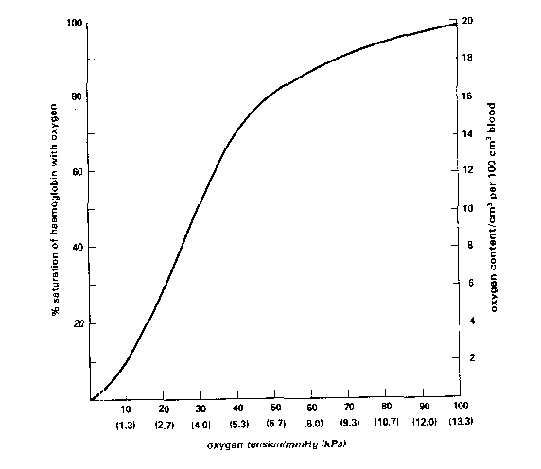
Oxyhaemoglobin Dissociation Curve
Amount O₂ released
Bohr shift
Increased O₂ released
muscles
lungs

Slide 23
Tackle these!
1. List 4 factors that increase the amount of oxy-haemoglobin dissociation at the muscles during exercise. [4]
2. Which way does the oxy-haemoglobin dissociation curve shift during exercise? What is this shift called? [2]
3. What is Myoglobin? [1]
4. What happens to the depth and rate of breathing during exercise? [2]
5. State 3 factors that increase the efficiency of diffusion at the lungs [3]

Slide 24
4. Lower PH/ More acidity
More carbon dioxide will lower the pH in the body. A drop in pH will cause oxygen to dissociate from haemoglobin more readily (Bohr effect)
Increased Temperature
When blood and muscle temperature increases during exercise oxygen will dissociate from haemoglobin more readily
2. Partial pressure of oxygen decreases
As the level of oxygen decreases in the muscle (thus increasing the oxygen diffusion gradient) oxygen will dissociate from haemoglobin in the blood capillaries to the muscles more readily
3. Partial pressure of carbon dioxide increases
As the level of carbon dioxide rises during exercise oxygen will dissociate quicker from haemoglobin

Slide 25
Extraction of oxygen
7
Anatomy
Lots of oxygen-rich blood delivered to muscles
Need for muscle to remove this blood
Difference between oxygen content of artery approaching muscle and vein leaving muscle - concept of a-VO₂ diff
During exercise a-VO₂ diff increases

Slide 26
a-vO₂ diff.
7
Anatomy
Artery carrying O₂ to muscle
Vein carrying O₂ away from muscle
Difference in oxygen concentrations between artery and vein = a-vO₂ diff.

Slide 27
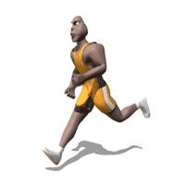
Oxygen into muscles
7
Anatomy
Oxygen combines with pigment - myoglobin
An oxygen store
Used in aerobic processes to make energy
In the form of ATP

Slide 28
Effects of training
7
Anatomy
More blood – haemoglobin – better O₂ transport – improved stamina
More capillaries to muscles/lungs
  Higher a-vO₂ diff
  More efficient lung exchange
No change in lung volumes

