Slide 1
Using examples from sport, describe the use of video analysis programmes in qualitative and quantitative research. [4]
 | Quantitative research | Qualitative research
Descriptions [2]
Sporting examples of video research [2]
used to collect factual/numerical data/objective data
used to collect descriptive information/subjective data
Eg Netball coaches can use video analysis to generate pass completion percentages/ or equiv.
Eg Football coaches use video analysis to show movements of defenders and inform coaching decisions/opinions/ strategy about what formation to use/ or equiv.

Slide 2
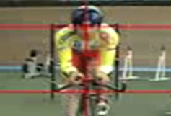
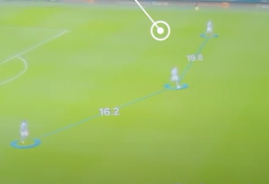
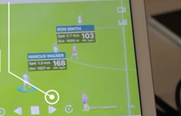
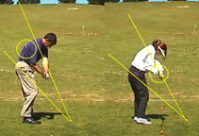
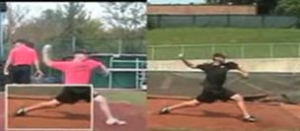
Function of sport analytics | Sport/situation | Name of programme/ tool | Explanation how the programme can be used to achieve the function
Prevention of injury [1]
Game analysis [1]
Monitor fitness for performance [1]
Skill and technique development [1]
Talent ID/scouting [1]
Cycling
Dartfish - Horizontal and vertical tool
Eg This tool shows if your spine is out of alignment when in the saddle. If this was not identified it could lead to chronic/overuse back injury and muscle imbalance.
Football
Spiideo – team tracking tool
Eg This tool tracks the movements of the defence showing the distance between the players. This can indicate that the wing-backs are playing too wide and leaving the central players exposed to 1 v 1 situations.
Football
Spiideo – Activity tracker
Eg This tool tracks the speed, distance and acceleration of individual players indicating levels of fatigue in the final stages of a match. This could lead to extra fitness sessions for some players.
Golf
Silicon coach - Measurement tool
Eg This tool uses lines to show the desired angle of joint movement allowing the coach to highlight errors and pinpoint which joint falls out of the desired position and when. This can then be used to feedback to the performer.
Baseball trials
Dartfish – Side-by-side comparison tool
Eg This tool can be used to directly compare the potential of two closely matched throwing techniques. If repeated it can show which pitcher is more consistent and therefore deserving of squad selection.

