Slide 1
Vicarious Experience
Verbal Persuasion
Emotional Arousal
Performance Accomplishments
Confidence
Performance

Slide 2
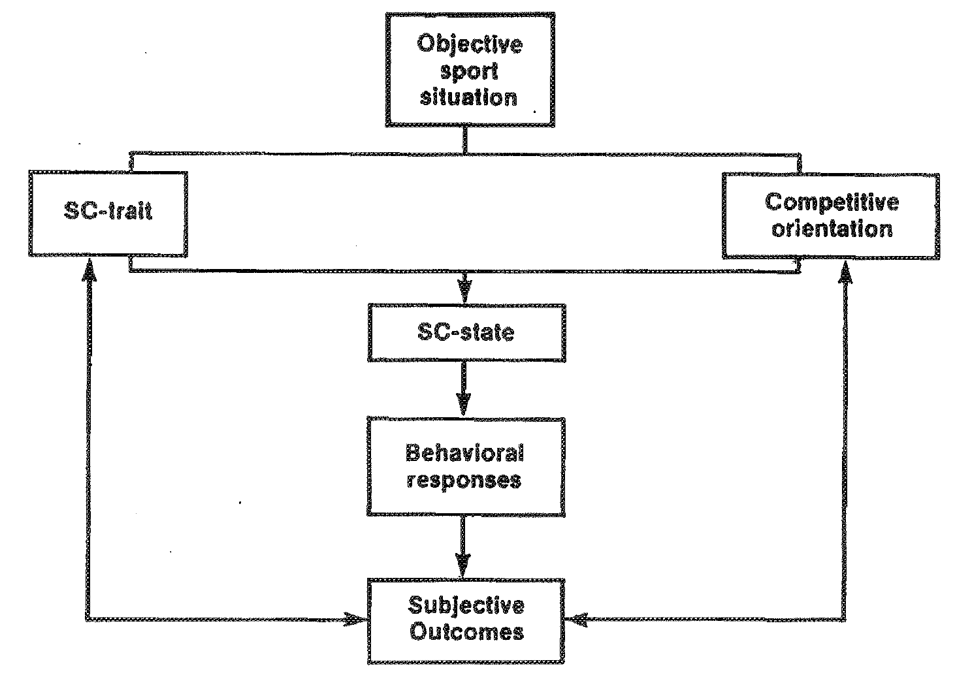

Slide 3
Trait Sports Confidence
Is innate and a natural disposition.
It is relatively stable.
Different to general confidence- how?
Trait sports confidence is concerned with how a performer rates their own ability to perform across a wide range of sports.

Slide 4
State Sports Confidence
State sports confidence can be developed through learning.
It can be changed.
State confidence is concerned with how a performer rates their own ability to perform at one specific moment.

Slide 5
Competitive Orientation
The extent that an individual is prepared to compete.
Whether an individual strives to achieve a PERFORMANCE GOAL or an OUTCOME GOAL.

Slide 6
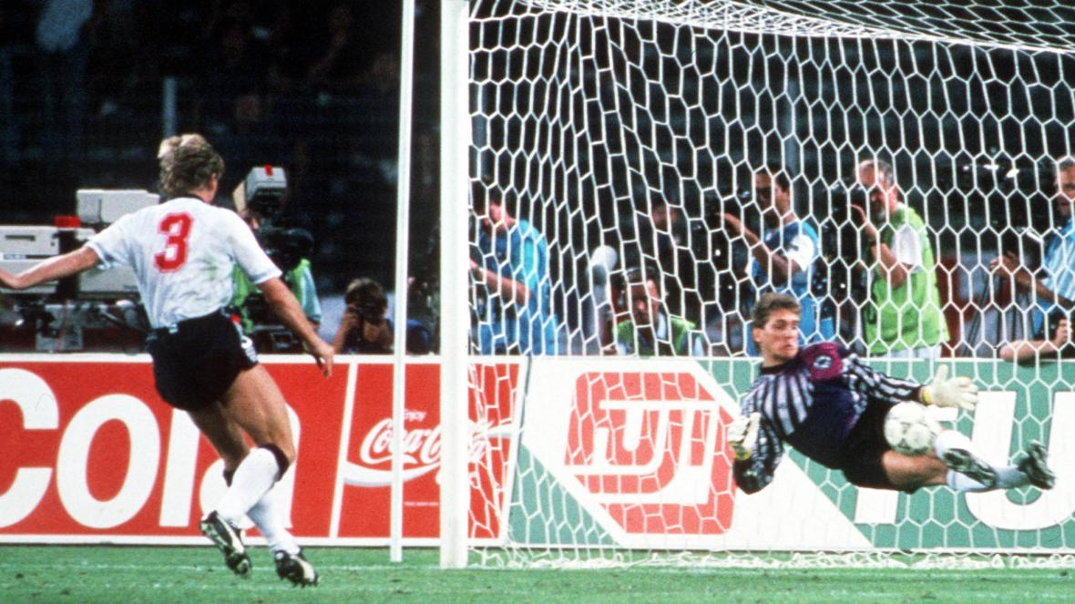
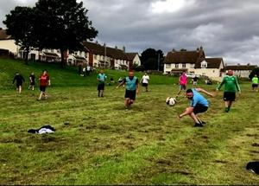
Objective Sports Situation
The type of skill that is to be performed.
The situation that the skill is to be performed in- i.e. High/Low pressure.

Slide 7
Subjective Outcomes
The extent to which the athlete perceives the performance has been successful is termed the SUBJECTIVE OUTCOME.
An outcome perceived to be good will increase trait sport confidence and competitiveness.
An outcome deemed to be poor will decrease trait sport confidence and competitiveness.
State Confidence will also decrease.
It can also change the competitive orientation

Slide 9
Effects of Variation in Levels of Trait Sports Confidence
Decrease in SC Trait and Competitiveness… | Increase in SC Trait and Competitiveness…
Depress SC State | Elevate SC State
Reduce Self-Efficacy | Increase Self-Efficacy
Make the performer less confident | Make the performer more confident
Avoidance Behaviours | Approach Behaviours

Slide 10
How do we improve SC State?
Mastery of Skill: When a skill has been acquired and the performer perceives that progress has been made.
Styling: Confidence will increase if the performer can demonstrate the skill to significant others.
Physical and Mental Preparation: Increases the likelihood of a successful performer.
Social Reinforcement: Praise and approval by significant others, within strong team cohesion situation, will raise confidence.
Effective Leadership: Promotes confidence within team members.
Environmental Comfort: People who lack self confidence will be helped if the working conditions are suitable i.e. novices should not be too closely observed- elite performers at home?

Slide 11
Evaluation of Model

