Slide 1
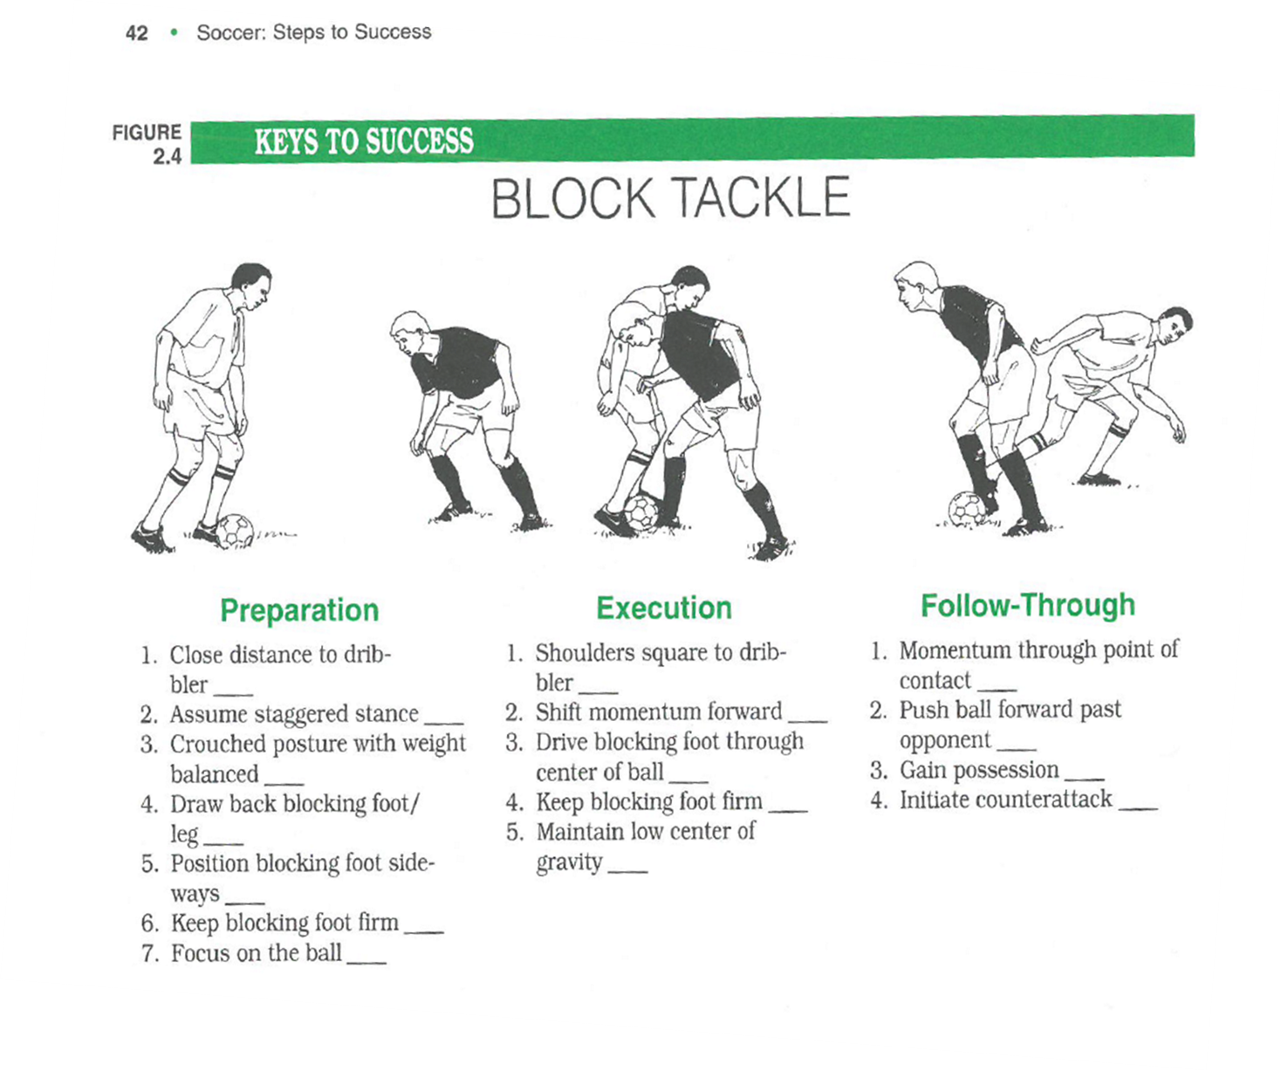
Tasks for today
Find the specification for your PE assessment sport on Godalming online.
Print the pages that relate to your sport only – you don’t need to the whole document!
You will notice that your sport is split into three assessment areas (1, 2 & 3). This is how we will assess you for practical worth 15% of the course. The written coursework is also worth 15%. But in the coursework you only have to write about assessment areas 2 & 3.
3. Choose one of the skills listed under Assessment area 2 for your sport. This might be one that you consider yourself to be weak at performing. Find a breakdown of this skill into parts and print it off.
4. Now consider your own weaknesses in performing this skill and list them in your A3 planning sheet. You get zero credit for writing about your strengths so if there are parts of the skill that you think you are good at then do not write about them or you could consider your self in relation to the best performers in the world (in which case you will be weaker in that part of the skill, at least sometimes (e.g. when you get fatigued).
5. In A3 planning sheet: For each of your weak points, give a written explanation of the perfect way to do the skill.
6. In A3 planning sheet : For each of your weak points, give a written explanation of how this affects your performance as a whole.

Slide 2
FB - Block Tackle
Lead foot sometimes raised on approach
Feet square-on
Body weight on front foot
Not tight enough
Stay on both feet
‘jockey’ position (side-on) your
weight on your back-foot.
Pressure on the ball player – ‘touch tight’
Difficult to change direction if the dribbler turns. This means I have to ground / overstretch to make the block.
More steps required to recover if the player beats me
Over-commit to tackle. Momentum takes me forward = foul.
Opponent able to get head up and cross/ play a pass under no pressure

Slide 3
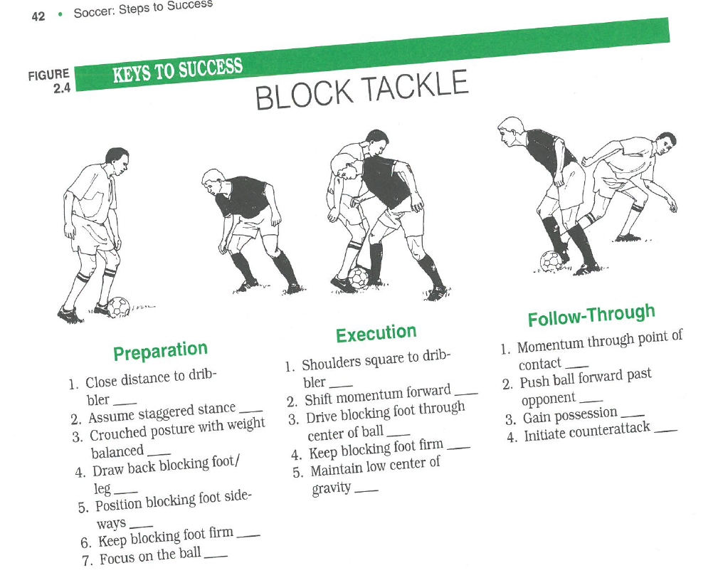

Slide 4
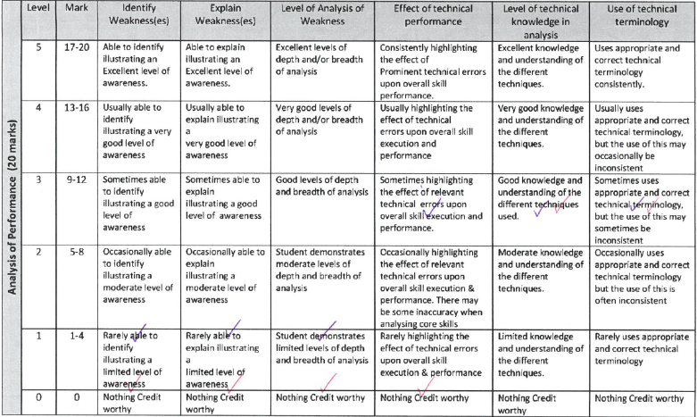

Slide 5
FB - Block Tackle
Lead foot sometimes raised on approach
Feet square-on
Body weight on front foot
Not tight enough
Stay on both feet
‘jockey’ position (side-on) your
weight on your back-foot.
Pressure on the ball player – ‘touch tight’
Difficult to change direction if the dribbler turns. This means I have to ground / overstretch to make the block.
More steps required to recover if the player beats me
Over-commit to tackle. Momentum takes me forward = foul.
Opponent able to get head up and cross/ play a pass under no pressure

Slide 6
How will this look when I write in full?
Technical error – raising one foot off ground in ready position
It is important to stay on both feet as you approach the ball-carrier. You may avoid the need to tackle at all by standing the opponent up and showing them into an area where you want them but you can only do this by standing up. In anticipating the block I often approach the player with my front foot raised slightly to make the tackle. This is ineffective because the player can predict my movements and change direction accordingly. This leaves me unbalanced, with only one foot on the ground and I am unable to contact the ball from my fixed position. If the opponent has protected the ball well this means that I cant make contact without lunging and making contact which leaves me on the ground. This could lead to an overload situation or a free-kick could be awarded if I make contact with the player. In each case, an attempt on goal for the opposing team is the outcome.

Slide 7
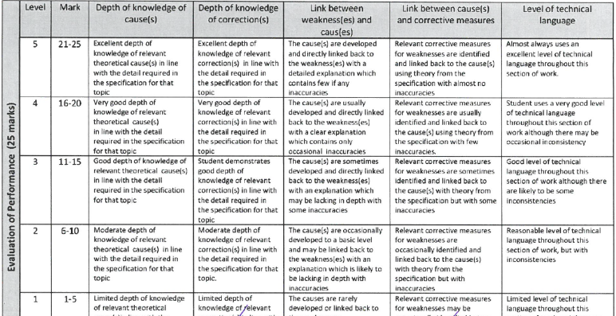

Slide 8
Common faults!
Analysis:
Lack of detail – don’t just focus on major joints/actions. Consider minor points also, finger placements, foot position etc
Tactical information – in AA2 you are only given credit for technical analysis (physical position of the body). Avoid descriptions of errors in judgement, decision-making, timing, anticipation unless there is a technical error that causes this.
Evaluation:
For your main technical error clearly give a theory cause that is on the specification. (ie not ‘fatigue’, ‘lack of core strength’ etc)
Only do one corrective measure for the one main technical error.

Slide 9
AA2 Evaluation section
/25 marks
Explain the theory cause of your main technical error
Explain one theory correction of your main technical error
Link the correction to the cause

Slide 10
FB - Block Tackle
Lead foot sometimes raised on approach
Feet square-on
Body weight on front foot
Not tight enough
Stay on both feet
‘jockey’ position (side-on) your
weight on your back-foot.
Pressure on the ball player – ‘touch tight’
Difficult to change direction if the dribbler turns. This means I have to ground / overstretch to make the block.
More steps required to recover if the player beats me
Over-commit to tackle. Momentum takes me forward = foul.
Opponent able to get head up and cross/ play a pass under no pressure

Slide 11
Which theory areas are good to use?
Learning theories (Bandura’s, Operant conditioning, Insight)
Information processing
Fibre types
Schema theory
Movement analysis
Training methods (linked to energy system)

Slide 12
Which theory areas are bad to use?
Anything socio-cultural!
Areas that are small (eg balance/stability) will not allow you to show as much analytical detail.

Slide 13
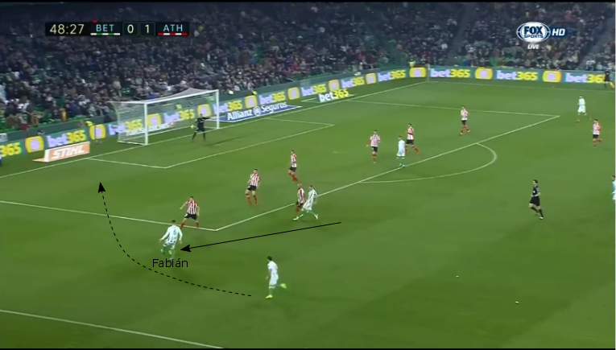
AA3 (Tactics)
Identify the area of weakness
“My main area of weakness is making supporting runs from left-back.
This is an over-lapping, attacking run from left back position to support out left-winger.
The opportunity for this commonly arises on counter-attacks. Their right winger is out of position. Our left winger has drawn their right-back in to a 1 v 1 situation.
I am required to make a supporting run to create an overload (2v1).
Our left winger will either a) play me in behind their defensive line or b) use me as a decoy and cut inside”.

Slide 14
AA3 (Tactics)
Explain the area of weakness
“I have other tactical weaknesses (e.g. decision-making over whether to jockey or tackle) but I have chosen this as my main area of tactical weakness because:
In our formation (4-3-3) there is a reliance on the attacking full-backs to provide supporting runs. Without these the formation doesn’t work.
Our left-winger is predominantly right-footed. This means he cuts inside a lot. Being left-footed, I am therefore the best provider or crosses from wide-left.
Our team concedes few goals but also doesn’t score many.
My poor supporting runs so far this season has resulted in few chances created for the team. We tend to attack down the right side”.

Slide 15
I make the run too late
Left-winger has to slow down to delay the pass – dispossessed?
Make the run early so the striker can play the pass whilst running at speed
Starting position too narrow (10 yards in from touchline)
Compresses area for the defence. I can be tracked by their CDM/CM)
Stay wide – makes the space bigger.
I over-lap on the inside
(under-lapping)
Means I turn my back to the ball. Harder to receive.
Overlap on the outside = easier to receive
Failure to communicate
Left-winger doesn’t know when to pass/ has to look over shoulder
“Hold! hold…
release”
Get caught offside
Curve run – open body shape so can see the line to stay onside
Run too straight
Not able to scan the box. Blind cross often cleared for corner.
Head down
Head up to aid decision of where to cross

