Slide 1
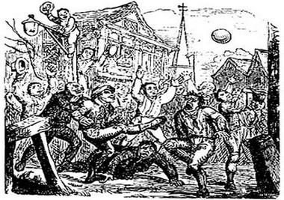
1
Sport & Society
Sport & Society
Part 1: Pre-industrial Society

Slide 2
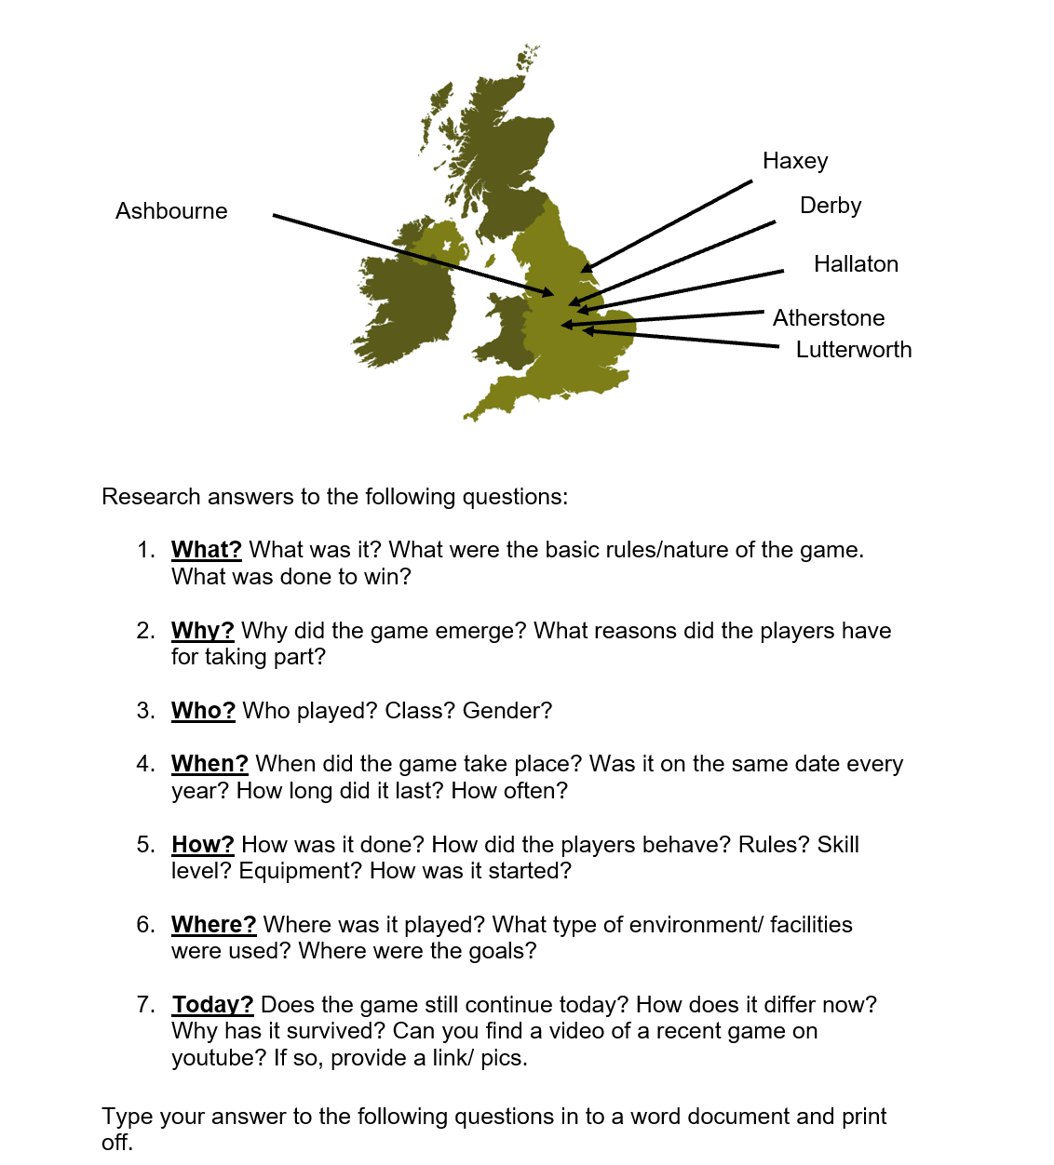
1
Sport & Society

Slide 3
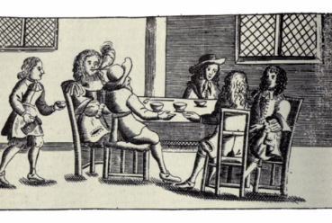
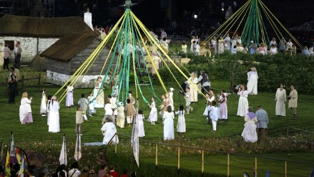
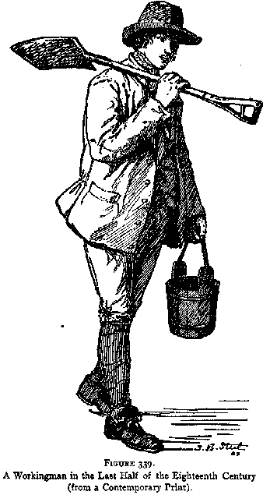
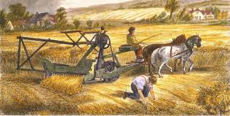
Pre-industrial Society
(Pre-1780)
1
Sport & Society
Local
Two-tier class (feudal) system
Limited communications (village customs unchanged for centuries e.g. folk games, fairs & wakes
Limited Transport (by foot for most or horse and carriage for wealthy), runners employed as messengers
Upper-class – nobility and wealthy landowners. Public school education for boys. Privileged.
Lower-class – poor land workers. Poor health and living conditions.
Widespread illiteracy
Rural
Countryside
Agricultural work
Harsh Lifestyle
Little compulsory education means most peasants can not read/write
Hard labour and few rights. Life is cheap.

Slide 4
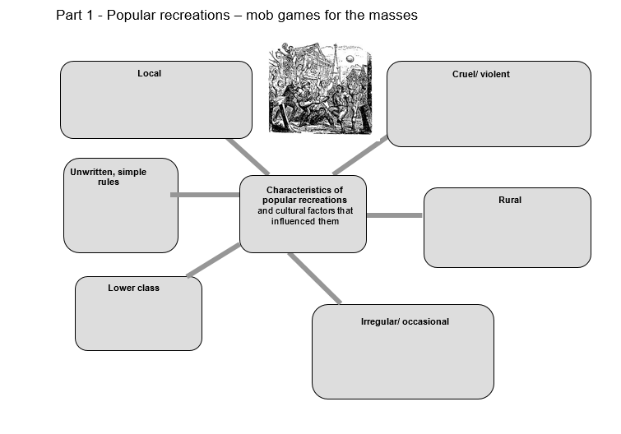
1
Sport & Society
Lack of transport/
communications
Harshness of life – uncivilised release of pent-up aggression
Widespread Illiteracy
Work and life in countryside. Prior to industrial revolution
Class division
The poor had limited leisure time

Slide 5
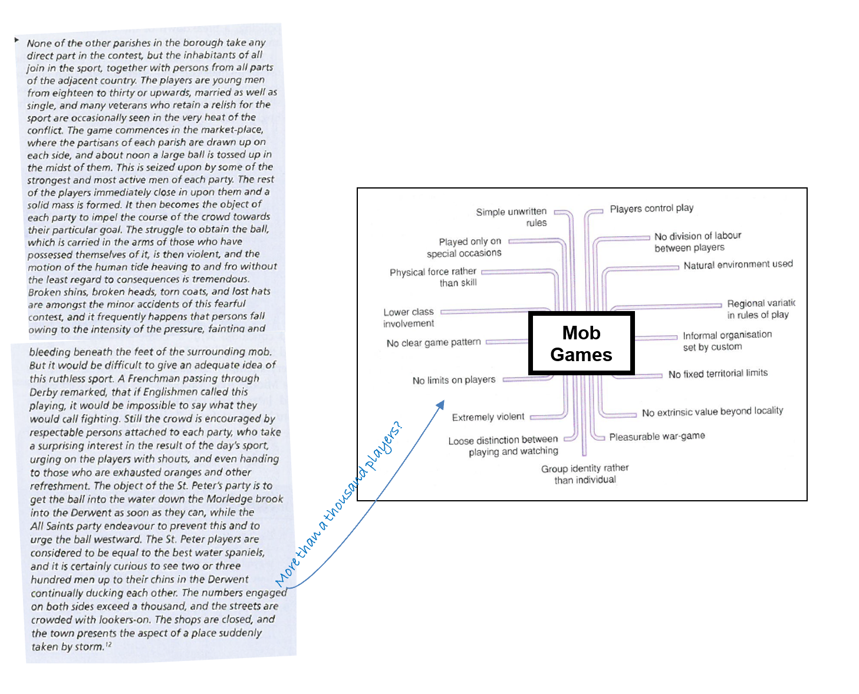
1
Sport & Society

Slide 6

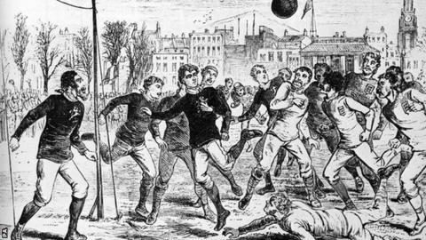
1
Sport & Society
(Pre-1780)
(1780 - 1900)
Popular recreations
Natural (pre-industrial)
Involved brute force
Part of an ancient feudal right to recreation, claimed by all branches of the rural community.
Simple, unwritten rules
No division between players and spectators
Occasional
Rational recreations
Skilful involving fair play & etiquette
Complex written rules/tactics
Purpose built facilities
Administrated and codified
Spectators as well as participants
Regular
Kits/positions

Slide 7
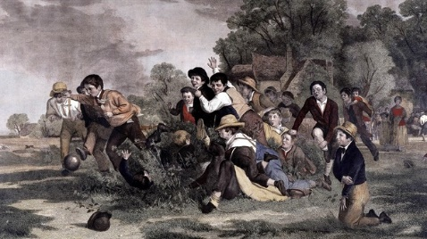
Mob Football
1
Sport & Society
(Pre-1780)
What
A popular recreation
E.g. The Ashbourne Shrovetide Match
Who
Predominantly lower class men – agricultural labourers
Where
Mostly rural villages
Some towns also.
Why
For local pride – traditional/ritual importance, for wagers, to settle disputes, release aggression, often part of festivals,
When
Annual/occasional
Religious holy days
How
Brute force over skill,
Simple,
unwritten rules (passed by word-of-mouth),
Often no division of labour/ positions,
limited organisation,
no referee,
little division between players and spectators
Key term: Popular recreations = simple, pre-industrial games for the masses

Slide 8
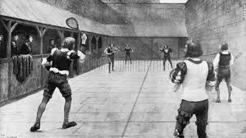
Real Tennis
2
Sport & Society
(Pre-1780)
What
Perhaps an early form of Rational Recreation?
A sophisticated racket/net game.
Who
Only aristocracy - males
Why
Social status – show of wealth, to prove yourself as a gentleman, a chance to wager – excitement,
Where
Purpose-built courts at elite public schools and universities. Also built at homes of Nobility and wealthy merchants.
How
High demand on skill-level and strategy,
Complexity (written rules, tactics, scoring, terminology)
Purpose-built facilities, specific equipment
Clear division between players and spectators – usually no more than a doubles game
Fixed territorial limits of the court
Highly structured
When
Played regularly in upper-class leisure time.

Slide 9
Pre-Industrial Britain
(Pre-1780)
1
Sport & Society
Feudal society (2 –class system)
Minimal communications/media
Agricultural and cottage industry
Village, Market & Country town life (plus London)
Little free time
Harsh society with law and order problems
Limited transport – pre-railways
Widespread illiteracy – Limited education for the lower class

Slide 10
Link to lower class? | Mob football characteristics | Real Tennis Characteristics | Link to upper class?
 | Unskilled/ brute force
 | Simple/ natural
 | No spectators/ ‘all in’
 | Unstructured
 | Simple / unwritten rules
 | Cruel / violent
Manual labourers
Defence against invaders
Tactical game with
skills and techniques
Had time to practice
Needed to learn tactics for role in war
Access to countryside
Purpose-built courts
Courts at public school/ university/home
All men compelled to play for local pride and to show virility, release aggression
Usually singles not more than a doubles game/ Gallery for spectators
Participation important to prove status as a gentleman
Ladies not expected to play
Important way to do business/ politics
Mob rule – no fixed boundaries/
no one in authority/loose
time limits
Clearly defined
boundaries, equipment
Expensive, purpose built courts at home
Learned scoring as boys
Easily afford the equipment
Men Illiterate so learn rules by word-of-mouth
Complex scoring system & rules – often in French
High levels of education and practice
Reflects the harshness of peasant life
Strict etiquette (conduct & dress code)
Need to maintain gentlemanly status

Slide 11
Popular Recreations
2
Sport & Society
Ashbourne mob football match
http://www.youtube.com/watch?v=5uV1zrZFzZo&feature=related
Haxey Hood Game
https://www.youtube.com/watch?gl=GB&v=7Su4XASv-Bo&hl=en-GB

Slide 12
Re-Cap Quiz
2
Sport & Society
Describe three characteristics of pre-industrial (pre-1790) British society [3]
Give three factors which limited lower-class participation in sports in pre-industrial Britain [3]
Name a surviving pre-industrial mob game [1]and state 3 features common to all mob games [3]
What part did the gentry play in the traditional mob game? [2]
Two-tier class system
Rural
Local
-Lack of leisure time/time off on holidays only
-Lack of transport
-Widespread illiteracy
-Harsh lifestyle/working conditions
- Suppression by church/upper class
Violence
Unlimited number of players
Unwritten/simple rules
Lower class involvement
- Hallaton Bottle/Ashbourne Match/ Haxey Hood
Gave permission for it to take place
Attended as spectators
Often started the event/gave the award

Slide 13
Essay: Most sports were rationalised in post-industrial Britain. Explain why pre-industrial Real Tennis might be thought of as an early Rational recreation and give reasons why Real tennis was not played by the lower classes in pre-industrial society. [8]
Level | Marks | Description
4 | 7-8 | Knowledge of relevant characteristics of Rational recreation is consistently accurate and well detailed. Application of breadth or depth of knowledge is clearly evident. Reasoning is coherently and consistently made between relevant pre-industrial factors and their impact upon barriers to lower class participation in Real Tennis. Relevant terminology is consistently used. The answer almost always demonstrates substantiated reasoning, clarity, structure and focus.
3 | 5-6 | Knowledge of relevant characteristics of Rational recreation is usually accurate and detailed. Application of breadth or depth of knowledge is often evident. Reasoning is often made between relevant pre-industrial factors and their impact upon barriers to lower class participation in Real Tennis, usually with coherence. Relevant terminology is often used. The answer usually demonstrates substantiated reasoning, clarity, structure and focus.
2 | 3-4 | Knowledge of relevant characteristics of Rational recreation is sometimes accurate with some detail. Application of breadth or depth of knowledge is sometimes evident. Reasoning is sometimes made between relevant pre-industrial factors and their impact upon barriers to lower class participation in Real Tennis, but this may lack coherence. Relevant terminology is sometimes used. The answer occasionally demonstrates substantiated reasoning, but may lack clarity, structure and focus.
1 | 1-2 | Knowledge of relevant characteristics of Rational recreation may be limited. Application of breadth or depth of knowledge may be limited or not evident. There may be little or no reasoning between relevant pre-industrial factors and their impact upon barriers to lower class participation in Real Tennis. Relevant terminology is occasionally used. The answer may lack substantiated reasoning, clarity, structure and focus.
 | 0 | No relevant content.

Slide 14
AO1 – Knowledge of Rational Recreations. (2 marks)
Played regularly/often/fixtures/leagues/nationally based
Written rules/codification
Standards of behaviour/etiquette/civilised/fair play/sportsmanship
Highly structured/set times/boundaries/officials/kit/equipment
Skill based/refined/complex/tactics/developed
Limited number of players
AO2 – Reasons for pre-industrial Real Tennis as a Rational Recreation. (3 marks)
Upper class able to play regularly in leisure time
Real tennis had sophisticated/complex written rules/national structure
Etiquette designed for the nobility e.g. dress code
Game control dictated by regulations not players
Skill important in Real Tennis/no physical violence/a range of different game strategies
Players separated from spectators in Real Tennis/usually not more than pairs
AO3 – Reasons for exclusion of lower class from Real Tennis. (3 marks)
Brought over from France where it was a nobles’ game/important for upper class status within social order
Lower class illiterate/unable to follow very sophisticated rules
Not able to access/afford purpose-built facilities
Etiquette designed for the nobility/lower class did not have/know the appropriate etiquette/behaviour
Court control/punishments if lesser people played
Lower class had limited access to/ could not afford specialist equipment used.
Lower class did not have the appropriate dress code
Real tennis had its own language which lower class did not understand
Lower class had little free time or energy to play/free time on holidays only
2
Sport & Society

