Slide 1
A-level PE Paper 2 Content
Sports Development

Slide 2
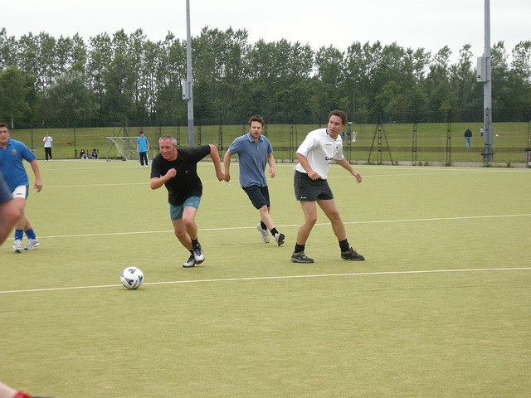
Characteristics of Physical Recreation
1
Modified facilities/
equipment
Low levels of organisation
Less serious commitment/ training
Flexible rules/ space/time
Low levels of competition
Usually self-regulated
(no refs)
Low skill

Slide 3
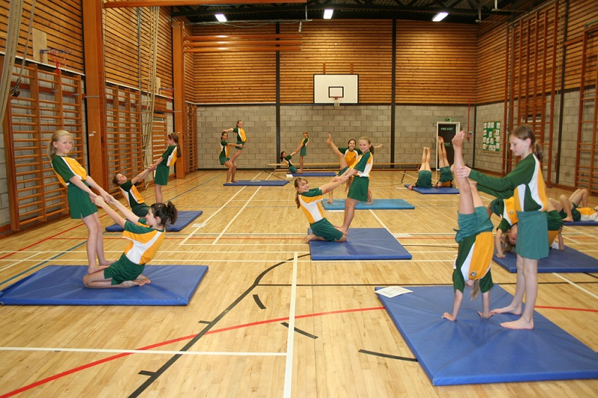
Characteristics of Physical Education
Specialist facilities/
equipment
Skill learning/health & Fitness
2
National curriculum
Personal/ social development
Structure – time/space/rules.
Qualified teacher
Compulsory – for all
Pre-planned

Slide 4
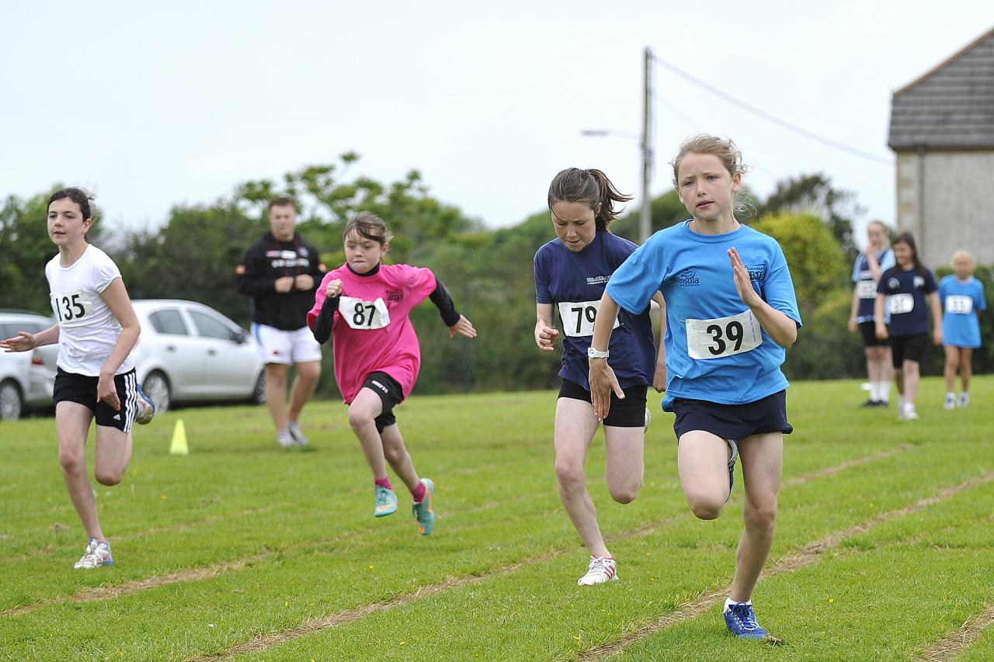
Characteristics of School Sport
Specialist facilities/
equipment
3
Extra-curricular
(e.g. after-school)
Competitive
Voluntary
(not compulsory)
Structured Time/space/rules.
Selective
(for chosen few)
Coaching
Officiated
Organised

Slide 5
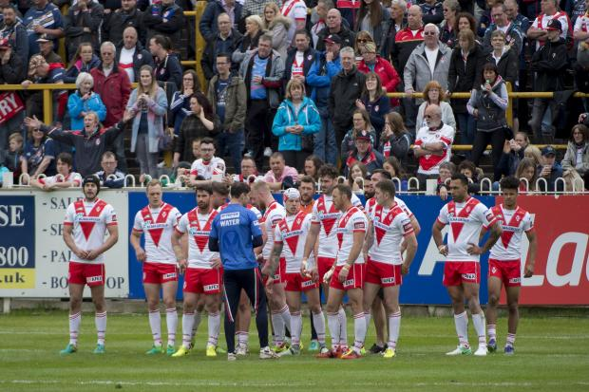
Rules externally enforced by officials.
Can be amateur (intrinsic rewards) or professional (extrinsic rewards)
4
Competitive - Winning taken seriously
Spectators/entertainment
Pre-planned strategies/tactics
Highly structured – time/space/rules.
Coaching/Training/specialisation/trials/selective
Characteristics of Sport
Sophisticated facilities and equipment
Skilful/refined skills
Administration/Organisation – clubs/NGB’s

Slide 6



Functions
5
For individuals
For society
Socialising
Reduced crime and social disorder
Realise full potential
Increased worker productivity
Extrinsic rewards
Stress relief
Community integration
Skills
Medals & National Pride
Confidence
Jobs & Economic
Professional career?
Reduced strain on NHS
Qualifications
More skilled population
Health & fitness

Slide 7
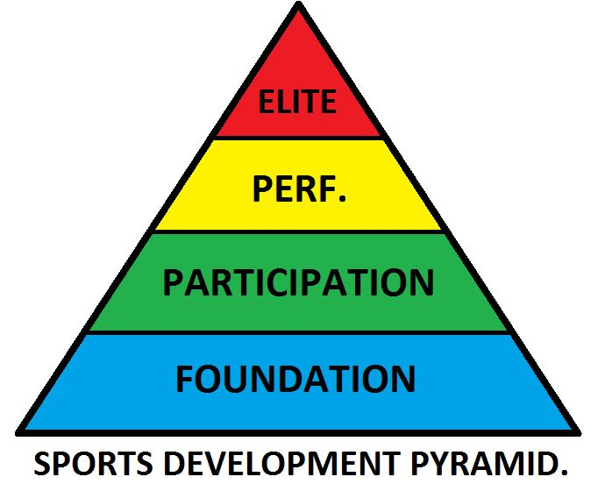
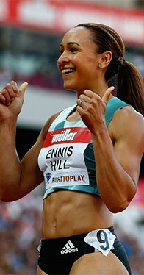
Sporting development continuum
6
E.g. National/International standards
E.g. Commitment to improve/ county level
E.g. More regular club level
E.g. School PE programs
Elite competition
Family/ peer support
Tough-mindedness
Motivation
Somatotype
Specialist facilities
Self-sacrifice
Personal factors required
Social and cultural factors required
World-class coaching/ training
Confidence
Skill
Natural ability
Sports medicine
Funding/ sponsorship
Sport Science support

Slide 8











NGBs
Talent
pathway
7
Identify performers for World Class Pathway funding
A growth in participation in the 14-25 age range & across the adult population
NGBs are responsible for the overall development of the whole sport
A growth in high quality talent development
Appoint Performance Directors
A growth in participation by people who have disabilities
Train high level coaches in their sport
Get more people to the elite level
Produce Whole Sport Plan
Sets targets
Developmental training squads/structured competitions
Highlights resources/funding needed
Run centres of excellence
Funding depends on success of plan

Slide 9

Oversees work of EIS
Distributes Lottery funding for elite performer development
8
Podium
Funding for most likely medal winners at next Olympics
Co-ordinates widespread Talent ID programs with EIS – includes physiological testing
Roles
UK SPORT provides strategic support to elite sports and sports performers.
World Class Performance Pathway
Development
Funding those with realistic Olympic medal winning capabilities next 4 – 6 years
Gold Events Series - programme to attract top quality sporting events to UK
Talent
Funding the identification and development of athletes who are 8 years from an Olympic medal
Ethically fair drug free sport promoted (e.g. 100% ME!)
Shares in best coaching practice from around the world

Slide 10
9
Top quality coaches
Top quality facilities to train in
Research & Innovation
Athlete zone
UK Institutes of Sport (e.g. English Institute of Sport) provides practical support to elite athletes
Sports medicine support - physiotherapy/soft tissue therapy
Elite level training squads – regional or satellite centres/hubs
Sports science support - biomechanics/ strength and conditioning/ psychology/talent identification/physiology/performance analysis/nutrition
Performance lifestyle support/advice

