Slide 1
Ethics

Slide 2
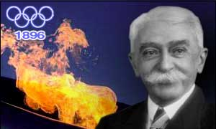
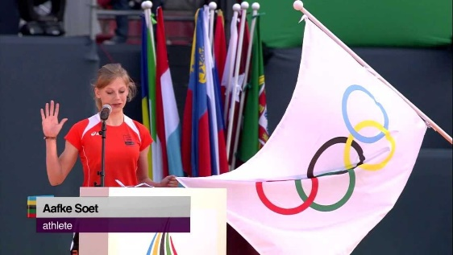
1
Ethics
Written by Pierre de Coubertin.
First taken at summer Olympics 1920
Taken at opening ceremony by one athlete and one judge as representatives
Olympic Oath
Is it still relevant?
http://www.youtube.com/watch?v=7mq1ioqiWEo&feature=related
‘In the name of all competitors I promise that we shall take part in these Olympic Games, respecting and abiding by the rules which govern them, committing ourselves to a sport without doping and without drugs’
https://www.youtube.com/watch?v=TEfBSfN_Ah8

Slide 3
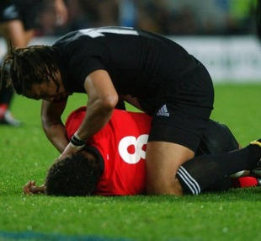
Sportsmanship
1
Ethics
Conforming to the written rules and the unwritten rules (spirit and etiquette of the game)
Involves a ‘spirit of fair play’,
Some sports still have a very strong association with sportsmanship e.g. Golf
attempting to gain an advantage by stretching the rules to their “absolute limit”
(Eg time wasting in football)
Gamesmanship
http://www.youtube.com/watch?v=uVVprhNV550

Slide 4
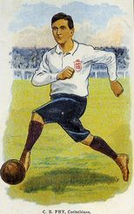
Amateurism =
Playing sport for the love of it, for no monetary gain.
1
Ethics

Slide 5
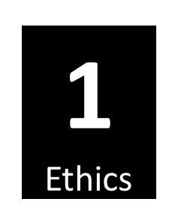
The Win Ethic
Where winning is all that matters in sport
Due to the rewards for winning being so high and livelihoods being at stake
Also called ‘win-at-all-cost’.
Linked to professionalism
A cause of gamesmanship, cheating & corruption
Leads to breakdown of Sportsmanship

Slide 6
Sportsmanship can be encouraged
(and Gamesmanship discouraged)
Use of positive role models (e.g. 100% ME and ethically fair, drug free sport)
1
Ethics
Use of technology to improve officials decision making e.g. video umpire
http://www.ukad.org.uk/athletes/
Rule changes
Give harsher punishments for negative actions in sport e.g. fines/bans
Fair play charters/ campaigns (e.g. Respect via FA)

Slide 7
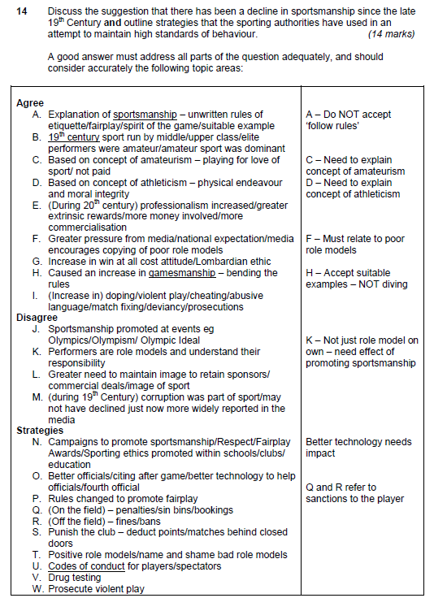

Slide 8
Agree
A. Explanation of sportsmanship – unwritten rules of
etiquette/fairplay/spirit of the game/suitable example
B. 19th century sport run by middle/upper class/elite
performers were amateur/amateur sport was dominant
C. Based on concept of amateurism – playing for love of
sport/ not paid
D. Based on concept of athleticism – physical endeavour and moral integrity
E. (During 20th century) professionalism increased/greater extrinsic rewards/more money involved/more commercialisation
F. Greater pressure from media/national expectation/media encourages copying of poor role models
G. Increase in win at all cost attitude/Lombardian ethic
H. Caused an increase in gamesmanship – bending the
rules
I. (Increase in) doping/violent play/cheating/abusive
language/match fixing/deviancy/prosecutions
Disagree
J. Sportsmanship promoted at events eg Olympics/Olympism/ Olympic Ideal
K. Performers are role models and understand their responsibility
L. Greater need to maintain image to retain sponsors/ commercial deals/image of sport
M. (during 19th Century) corruption was part of sport/may
not have declined just now more widely reported in the
media

Slide 9
Strategies
N. Campaigns to promote sportsmanship/Respect/Fair play
Awards/Sporting ethics promoted within schools/clubs/
education
O. Better officials/citing after game/better technology to help
officials/fourth official
P. Rules changed to promote fair play
Q. (On the field) – penalties/sin bins/bookings
R. (Off the field) – fines/bans
S. Punish the club – deduct points/matches behind closed
doors
T. Positive role models/name and shame bad role models
U. Codes of conduct for players/spectators
V. Drug testing
W. Prosecute violent play

Slide 10
Forms of Deviance
1
Ethics
Positive
Negative
This would be classed as “over conformity” to the sports ethic so they did not let anybody down (eg over train/perform when injured). In other aspects of life we would not encourage someone to cause further damage to his or her health.
Includes drug-taking, violence or accepting a bribe to lose a game. Often the motivation is to “win at all costs” which encourages performers lacking moral restraint to act against the norms of society.

Slide 11
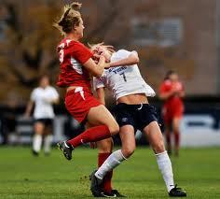
http://www.youtube.com/watch?v=PJiRQsyrBoI

Slide 12
Causes of player violence
2
Ethics
Crowd behaviour (i.e. Eric Cantona (1995), Patrice Evra (2017)
Conflict within the team
Importance of winning- extrinsic rewards/local derby/Frustration at losing
Provocation by opposition (i.e. verbal sledging/ late challenge leads to retaliation)
Perceived unfairness of decisions/ poor refereeing
Conflict within the individual/ inability to deal with emotional intensity

Slide 13
2
Ethics
Religion, e.g. Celtic v Rangers
Poor officiating
Too much alcohol
Taunts by rival fans
Poor crowd control by police
Causes of spectator violence
Violence by players on the pitch reflected in crowd
Diminished responsibility by individuals when in a large group (i.e. a football crowd)
Pre-match media hype
Your team are losing
Ritual importance of the event
e.g. a ‘local derby

Slide 14
Re-cap quiz!
Define positive deviance and give an example from sport [2]
2. Define negative deviance and give an example from sport [2]
3. Identify 4 causes of player violence [4]
4. Identify 4 causes of spectator violence [4]
Positive = over conformity to norms/values/ethics of society/sport e.g. training when injured or equ.
Negative = acting against the norms/values/ethics of society/sport e.g. drug taking
Provocation / importance of outcome / coach pressure / frustration / Refereeing decisions / crowd behaviour / inability to control arousal/ conflict within the team
ALCOHOL / Hooliganism / Religion or Nationality / Diminished responsibility / Poor player behaviour / Importance of game / Taunts by rival fans / Poor officiating

Slide 15
Why should player violence be discouraged?
2
Ethics
It is cheating/blatantly infringing agreed sporting codes
Poor image /less sponsorship for a sport/negative role models for youngsters
It can cause serious injury/ retaliation
It is against the law and increasingly punished with legal action
http://www.youtube.com/watch?v=_SFCnzf1-5U
http://www.youtube.com/watch?v=eha1IdQkz-k
http://www.youtube.com/watch?v=ypPMMvc33FY

Slide 16
Strategies to prevent player violence
2
Ethics
Use of video technology to assess/adjudicate on violence by performers
More authority for officials
Educate performers to instil an ethos of fair play into them; FA Respect campaign from 2008/09 season
Punish violence more severely (e.g. penalty tries/ longer bans)

Slide 17
The Y-word
http://www.youtube.com/watch?v=RIvJC1_hKt8

Slide 18
2
Ethics
CCTV around stadiums
Tougher deterrents/bans/ fines from matches/ imprisonment for offenders
Police intelligence/liaison by police in different areas of the country
Strategies to prevent crowd violence
Ban/ control of alcohol sales e.g. via earlier kick-off times
Removal of terraces/ all-seater stadiums as in Premiership/fan segregation
Promotion of football as family entertainment/ responsible media reporting

Slide 19
Re-cap quiz
Give 3 negative implications of player violence [3]
Give 3 strategies to prevent player violence [3]
Give 3 causes of spectator violence [3]
Give 3 strategies to prevent spectator
violence [3]
Poor role modelling
Injury
Negative image/PR for the sport/drop in participation
Loss of sponsorship/earnings
Cheating/against the law of sport/break down of sportsmanship
In-game punishments – Sin bin, Red card
After-game punishments – ban, fine, prosecution
Use of CCTV
Better officiating/rule changes
NGB campaigns/education e.g. FA Respect campaign
Alcohol
Racism/Religious or national difference
Importance of game/derby match
Losing/ poor performance
Provocation
Organised hooligan groups
Violence by players copied
Media hype
Poor policing/stadia
Poor officiating
Mob mentality
Changes to stadia – all-seater/ family entertainment
Segregation
Control alcohol – e.g. early kick-off times
Punish the clubs – e.g. bans
Better policing/ larger numbers/ more intelligence
CCTV

Slide 20
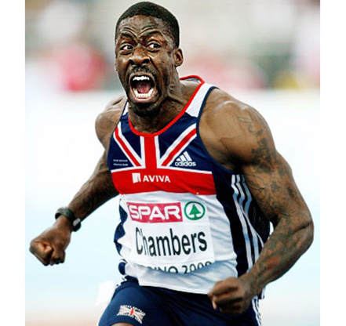
Reasons why athletes take performance enhancing drugs
Social Reasons | Extrinsic rewards are worth the risk to be famous (Win-at-all-cost culture)
 | Pressure to win from coaches, peers, media, sponsors, and self (win ethic)
 | Drugs easily accessible/lack of effective deterrents Belief that ‘everyone else is doing it’
Psycho-logical reasons | Steady nerves (e.g. beta blockers)
 | Increase aggression (e.g. anabolic steroids) Stimulants increase confidence
http://www.youtube.com/watch?v=sMdrlztBPJs

Slide 21
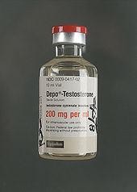
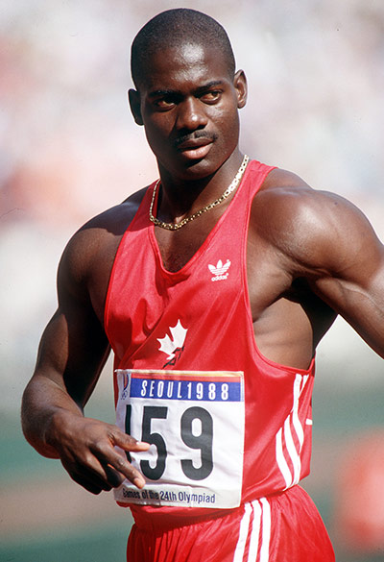
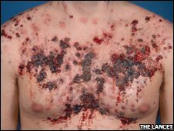
Anabolic Steroids
https://www.youtube.com/watch?v=3YZQBo4BBFI
What are they?
Artificially produced hormones –
mimic the effects of testosterone
Benefits:
Promote muscle repair/growth, strength and lean body weight
Which athletes?
Power athletes such as sprinters
Negative side-effects:
Acne and behaviour changes such as aggression, paranoia and mood swings
Liver damage, heart and immune system problems.

Slide 22
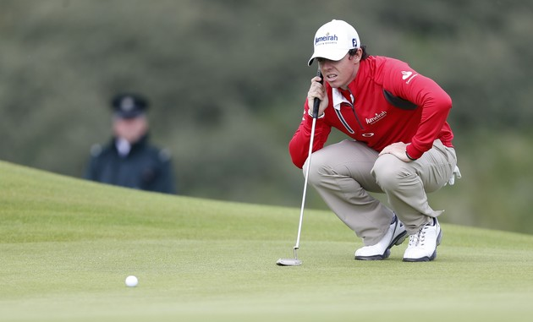
Beta Blockers
What are they?
Drugs that interfere with /weaken the effects of stress hormones.
Benefits:
Can improve accuracy in precision sports through steadying the nerves and reducing anxiety
Which athletes use them?
E.g. Snooker players, golfers
Negative effects:
Tiredness due to low blood pressure and slower heart rate which will affect aerobic capacity

Slide 23
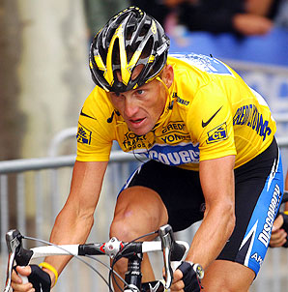
EPO
What are they?
Erythropoietin = A natural hormone produced by the kidneys to increase red blood cells. Now it can be artificially manufactured to cause an increase in haemoglobin levels.
Benefits:
An increase in the oxygen carrying capacity of the body can lead to an
increase in the amount of work performed.
Which athletes use them?
Endurance performers who need effective oxygen transport
Negative effects:
Can result in blood clotting, a stroke and in a few cases death.

Slide 24
Consequences if caught e.g. shame/ban/lose medals/loss of earnings
Negative role model for children/It gives a negative image to certain sports (e.g. cycling)
It is illegal
Arguments
Against
Drugs
It’s unfair/immoral – against Olympic oath (Sport should be about natural talent)
Health risks and possible death (e.g. addiction, heart disorders)

Slide 25
Strategies to prevent drug use in sport
Campaigns/education programmes for coaches and athletes encouraging ethically fair drug free sport (e.g. 100% Me!);use of positive role models.
Random and out of competition testing/increase investment in testing
Better co-ordination between organisations (e.g. WADA/UK Sport/NGBs)
Stricter punishments and life bans/removal of lottery funding if test positive

Slide 26
Problems in eradicating drugs in sport
Difficulty defining a drug as compared to supplement or medicine. Leads to accidental use.
Difficulty in successful testing/masking agents/new drugs developed, keeping one step ahead of the scientist
Difficulty for WADA co-ordinating with different organisations e.g. NGBs
Different countries and different sports have different PED lists/ rules (e.g. Football’s resistance to accepting the “whereabouts” rule)
Difficulty in access/getting to athletes during training, particularly when at training camps abroad
Cost of widespread testing/legal aspects can lead to resources being spent defending a “case” against a sports organisation/governing body
http://www.youtube.com/watch?v=X0bVxEvW6vc

Slide 27
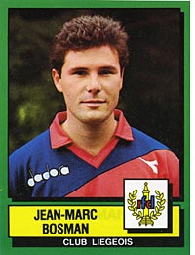
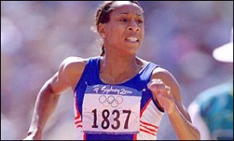
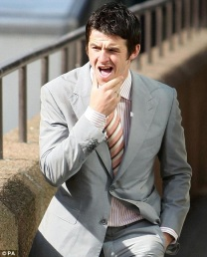
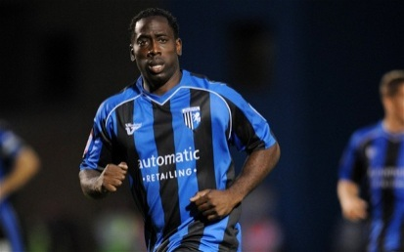
The law protects performers
Employment rights
Ensure freedom of contract
E.G.
Bosman-ruling
Jean-Marc Bosman was a player for Liege in Belgium whose contract had expired in 1990. He wanted to change teams and move to Dunkerque, a French team. However, Dunkerque refused to meet his Belgian club's transfer fee demand, so Liège refused to let him go.
In the meantime, Bosman's wages were reduced as he was no longer a first-team player. He took his case to the European Court of Justice and sued for restraint of trade.
Drug testing
The performer has a right to appeal
against NGB/BOA sanctions
E.G.
Diane Modahl won appeal against ban
http://www.youtube.com/watch?v=ZWmxuW2DbHs
Violence on the field of play
Can lead to compensation claims/ legal actions
E.G.
Joey Barton charged for assault on team-mate
Health & safety legislation
Safe playing environment & duty of care
E.G.
Mark McGammon
sues Gillingham
Equal opportunities legislation
Discrimination in workplace
http://www.youtube.com/watch?v=GOWcdChSnDA
http://www.youtube.com/watch?v=pnEZjtgw8xU

Slide 28
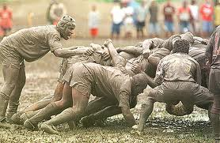
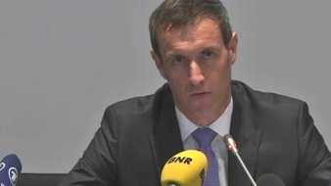
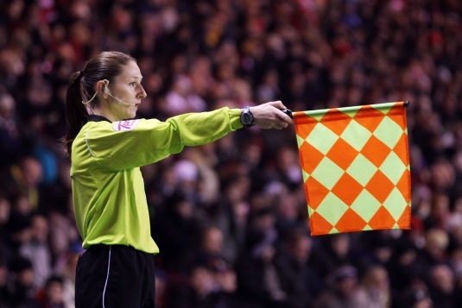
The law and officials
a duty of care
exists for officials
injury due to scrum
collapsing in rugby union
E.G.
Match fixing / allegations of bribery
have also been made involving
officials.
E.G.
Europol investigation into 680 matches and 425 match officials
http://www.bbc.co.uk/sport/0/football/21319807
http://www.youtube.com/watch?v=qb3CTxeXiUk
Equal opportunities legislation
Discrimination in workplace
The law also protects match officials from violent players and from inequality in the workplace.

Slide 29
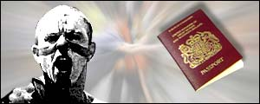
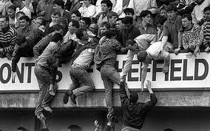
The law and spectators
Legislation to control fans
So that they behave within the law
E.G.
Police given powers to stop known hooligans travelling abroad during major football tournaments
http://www.youtube.com/watch?v=0p42Ceo1VJw
Health & Safety
Clubs have responsibility
for safety of fans
All seater stadia/ticket controls/removal of fencing/control of alcohol sales.
E.G.

Slide 30
Reasons for increased legal action/ prosecutions in sport
Larger number of contractual disputes
(due to more professionalization/ commercialisation)
More sponsorship deals
More positive drugs tests – leads to more legal challenges of results
Greater protection from inequality e.g. sexism/racism
As sports stars increasingly become celebrities there is more need for protection from the media e.g. libel

Slide 31
Re-cap Quiz
Give three reasons why performers choose to take PEDs [3]
Give three negative implications of drug use in sport [3]
How are sports performers protected by the law [3]
Explain the term ‘deviance’ [3]

Slide 32
8 marker practice:
Addressing forms of deviance, such as the use of banned performance enhancing substances, are a key role of the sports authorities.
Discuss the arguments for and against drug taking [8]

Slide 33
Discuss the arguments for and against drug taking
AO1 – 2 marks
Drugs = performance enhancing substances
Anabolic Steroids, Beta Blockers, EPO
Definitions =
Anabolic steroids – artificially produced hormones – mimic the effect of testosterone
Beta Blockers – drugs weaken effects of stress hormones
EPO – injected hormone responsible for production of RBCs
AO3 – 3 marks
Arguments for drug use:
A. Sacrifices performer makes to achieve success is personal/ performer should have right to choose
B. Level playing field for all if all allowed
C. High performance leads to more spectators/ sponsors/entertainment/money
D. Detection/testing is not effective/possible to mask drugs/ impossible to test regularly enough
E. Battle against drugs is expensive/time consuming
F. False positive tests lead to legal prosecution –costly
G. Health risks not as high if carefully monitored
H. Athletes do not ask to be role models
AO2 – 3 marks
E.g. Steroids allow sprinters to train more regularly due to enhanced muscle repair and protein storage. Their muscles get bigger and therefore more forceful so they record faster times.
E.g.
If not carefully monitored, EPO can cause blood clotting and heart failure
Arguments against drug use:
I. Side effects are dangerous/health risk
J. Young tempted to use them/ copy role model
K. Coaches/peer pressure may force performers to use drugs/exploitation
L. Sport is about using natural talent
M. Drug use is outside this concept
N. Cheating/unethical/against Olympic oath/ unfair
O. Reflects badly on the sport/ performer/ sponsors
P. Leading to reduced investment in the sport/ lower participation
Q. Only the richer countries able to afford the technology, therefore uneven playing field

Slide 34
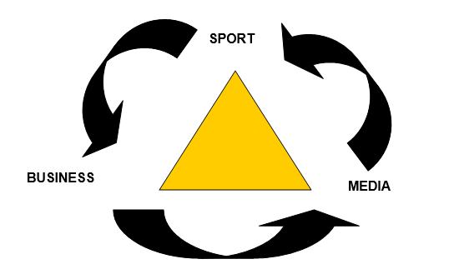
An Inter-relationship of mutual dependence
Award 3 marks for 3 explanations:
Sport & Business are mutually dependent e.g. England Netball requires sponsorship money from Mitre to distribute to clubs and business relies on the sport to for its brand awareness/product placement
Media and business are mutually dependent e.g. Fosters relies on large viewing figures of SKY coverage of Rugby League for product placement and SKY tv can only afford broadcasting rights of games thanks to money from Fosters for the advertising slot
Media and sport are mutually dependent e.g. the quality of the English premier league is only possible due to the best foreign talent purchased with billions of pounds from BTSport and the BT Sport depends upon this high quality of football to ensure that viewing figures and subscriptions remain high

Slide 35
C
O
M
M
E
R
C
I
A
L
I
S
A
T
I
O
N
ontracts (selling of merchandise/TV rights bid for)
erchandising – clothing and equipment industries develop, e.g. Nike and Adidas
edia coverage of “high profile” sports which are visually appealing/have high skill
levels/well matched competition/simple rules
ntertainment is emphasised (sport a spectacle / part of a mass entertainment industry)
aised standards of performance
thletes as commodities - asset to the companies/product endorsements
mean increased sales/profits
ponsorship by businesses
gents control performers seeking the “best “ for their client
echnology used widely
ational governing Bodies become multi-national companies (e.g. NBA, NFL).

Slide 36
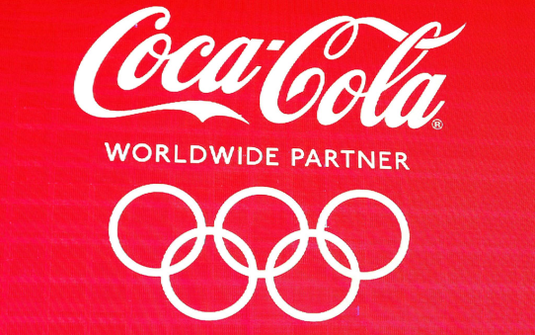
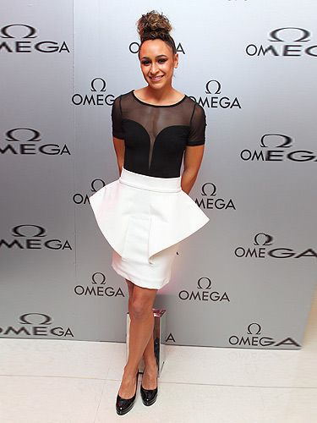
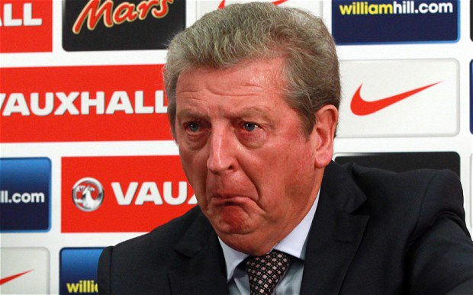
Advantages
Dis-advantages
Over-emphasis / pressure on winning /deviant behaviour e.g. drugs
Commercial opportunities promoting products/ become household name (financial security)
Poorly behaved sponsor can reflect badly on performer e.g. BP
Receive a higher income for sports participation (enables full-time training/ higher standards)
“Too controlled” by sponsor/become public commodities
Over-control of sports agents
More money in sport for development/ better staff/players/facilities
Commercial interests influences
team selection
Higher wages
Coaches given less time to succeed/ sponsors want fast return for money

Slide 37

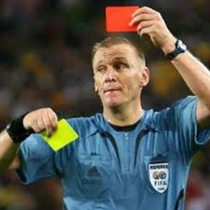
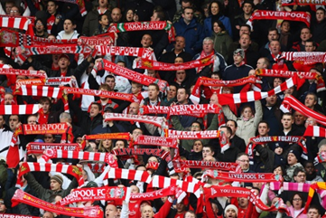
Advantages
Dis-advantages
More professionalism/ full-time careers/ earnings
More money at stake means more pressure on officials to get decisions right
More financial support from NGBs to attain higher standards e.g. training
More deviance to deal with
Better playing standards mean better quality/ more entertaining sport to watch
Advertising intrudes on events/ more breaks in play
Loss of tradition e.g. re-naming of stadia ‘The Reebok’ Stadium
Money spent on making stadia more comfortable

Slide 38
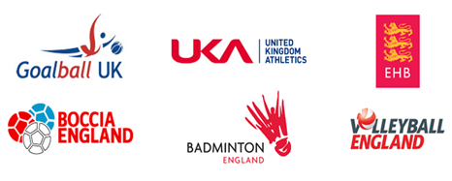
Advantages
Dis-advantages
Provides money for sport, leading to improved resources/facilities/coaching in that sport
More exposure for sport via advertising
Some sponsors may reflect badly on the sport e.g. cigarettes/ alcohol
Win-ethic/deviance gives sport poor image
Leads to more events (e.g. lots of cricket competitions not just County Championship also have 20/20, 50 over competitions)
Risk of corruption – match-fixing
Sport loses control/ over-reliance on sponsors
Sports pressured to turn professional e.g. Rugby Union

Slide 39
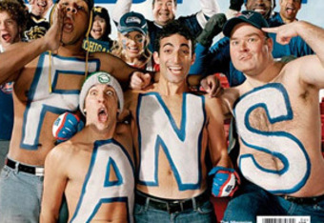
Cheat sheet! Use these general areas as scaffolding for your answer
More to watch!
Negative changes
to our sport?
Better to watch!
Enhanced environment to watch in!
Fans being exploited?

Slide 40
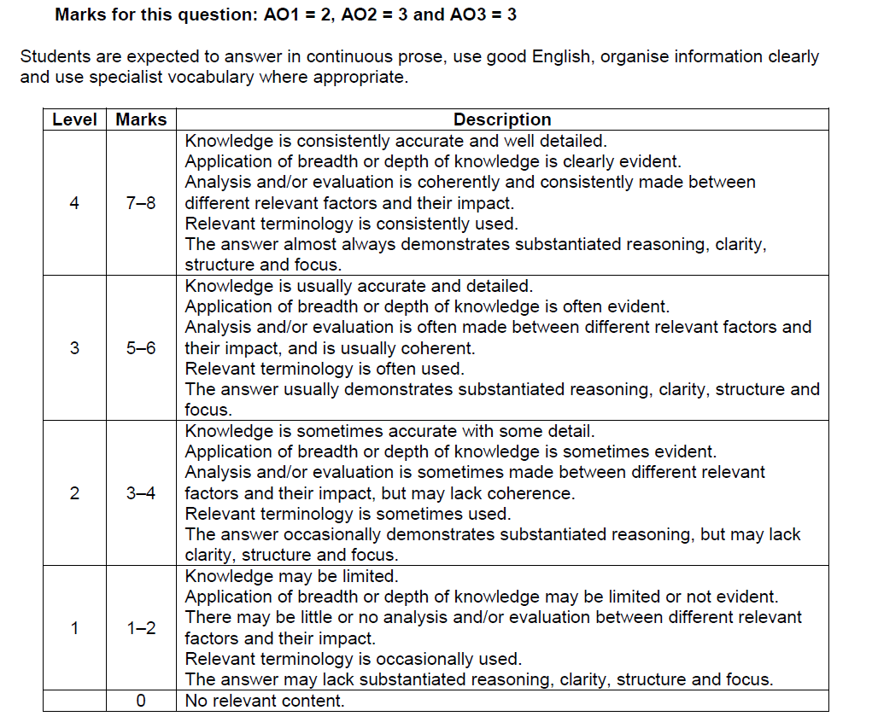

Slide 41
AO1 – knowledge
Commercialisation =
the process by which sport is used to make money/treating of sport as a commodity/ marketing of sport for profit
Sponsorship = companies pay money
in exchange for a commercial return (usually through advertising).
Sponsorship is a part of the commercialisation process.
Commercialisation also includes contracts, merchandising, advertising, endorsements
Golden triangle = inter-relationship between media, sport and sponsors
AO2 - application
AO3 – evaluation/analysis
Agree: good for fans because…
A. Players/teams of higher standard/increased excitement of watching role models
B. Better quality facilities/stadium/team merchandise to create team loyalty/change of pitch colour to make spectating easier/bigger stadiums
C. Increased number of competitions/opportunities to watch events
D. Funding to provide entertaining experience/other activities not just the sporting event/educate spectators/expert analysis
E. Variations of the sport format provide alternative viewing experience
F. Rules changed to create extra excitement/interest
G. Funding for improved technology at the ground and at home
H. Need for more correct decisions/less incorrect decisions by officials/Hawkeye/increased excitement waiting for correct decision
Disagree: bad for fans because….
I. Traditional nature of sport changed/viewing experience altered
J. Breaks in play for adverts/commercials/decisions of officials
K. Less tickets available/tickets allocated to sponsors/hospitality tickets/higher ticket prices
L. Match fixing/cheating/drug use more likely
M. Start times/kick-off times arranged to maximise viewing figures
N. Minority sports receive less coverage/major sports dominate the television schedules/pay-per-view restricts access to watch
O. Companies create monopoly of merchandise/catering in stadiums/expensive team merchandise changed regularly
e.g. selling tickets to sports events for a profit
e.g. contracts sold for broadcasting rights such as Netball Super League on SKY
e.g. large video screens for playback at the stadium and interactive technology/HD/3D for home viewers

