Slide 1
Part 3: Post-industrial Society
1950 - PRESENT

Slide 2
Golden triangle?
SPORT
SPORT OFFERS COMPANIES
HIGH PROFILE, SPONSORSHIP
OPPORTUNITIES
SKY TV PAYS
£MILLIONS IN TV RIGHTS
FOR PREMIER LEAGUE
BUSINESS
MEDIA
COMPANIES PAY FOR DIRECT SPONSORSHIP OF CLUBS
COMPANIES E.G. BUDWEISER PAY SKY TV
£MILLIONS FOR ADVERTISING SLOTS DURING GAMES

Slide 3
C
O
M
M
E
R
C
I
A
L
I
S
A
T
I
O
N
ontracts (selling of merchandise/TV rights bid for)
erchandising – clothing and equipment industries develop, e.g. Nike and Adidas
edia coverage of “high profile” sports which are visually appealing/have high skill
levels/well matched competition/simple rules
ntertainment is emphasised (sport a spectacle / part of a mass entertainment industry)
aised standards of performance
thletes as commodities - asset to the companies/product endorsements
mean increased sales/profits
ponsorship by businesses
gents control performers seeking the “best “ for their client
echnology used widely
ational governing Bodies become multi-national companies (e.g. NBA, NFL).

Slide 4
Essay practice: Evaluate the impact of sports sponsorship to the performer, the sport and the sponsor. [8]

Slide 5
Performer
Increase in wages/prize money/extrinsic rewards/professional contracts
Secondary income/e.g. endorsements
C. Performers become well known/’household’ name
D. Performers able to train fulltime
E. Loss of control/interference by sponsor
F. Distraction from performance
G. Greater pressure/expectation on performers to win
Sport
H. Raised profile/image of the sport/more awareness
I. Money for Increased no. of events/competitions/ participation/money to provide better facilities/better equipment/
technology at events to aid officials/equiv.
J. Money to develop the sport/research/talent ID
programme/ training support/better coaches
K. Better standard = attracts more media coverage/spectators
L. Increase in deviant behaviour/ cheating/ doping/violent play
M. Not all sports benefit/money mainly goes to popular sports
N. Sport loses control/organisation of events/corporate hospitality taking tickets
O. NGBs become over-reliant on money as income
P. Rules alter/format altered/forced to turn from amateur to professional
Q. Unsuitable sponsor (e.g. cigarettes, alcohol) lowers image
Sponsor
R. Advertise/ promotion/ Increase in product profile/awareness
Positive/healthy image
Increased sales/ income
Hospitality/ corporate partnership e.g. tickets
U. Possible negative PR if performer/spectator behaves badly/reflects badly on sponsor (e.g. drug use or eq)
V. Lack/unequal exposure to sponsor of less popular sports/performers e.g. Netball gets less media coverage

Slide 6
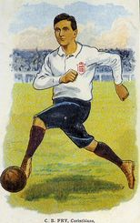
19th century
8 Issues
Amateur
Given high status in 19th Century
sport & society
Professional
Given low status in 19th century
Controlled sport/ excluded working class from amateur sports
Usually working class background
Slowly emerged through 20th
Century
Best players in most sports
Emerged from 1850s onward
(with onset of Victorianism)
Win at all cost ethic
Pressure to succeed to maintain lifestyle
Middle/upper class/Ex-public school/ Oxbridge background
Foul play/ cheating to gain
an advantage
‘Gentlemanly’ behaviour
(Sportsmanship & morality)
Had insufficient income/leisure time to play sport for love of it receiving no payment
Taking part more important than winning/ games not taken seriously

Slide 7
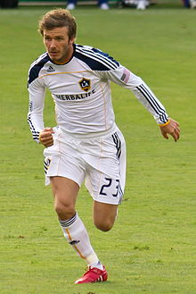
Current viewpoint
8 Issues
Professional
Amateur
Tend to be of higher status today
Tend to be of lower status today
Some high level performers in sports not professionalised (e.g. Gymnastics)
Huge wealth and fame available to some due to commercialisation / media in late 20th century
Some ‘amateurs’ receive money/
finance to pay for training expenses
via scholarships
Elite performance in most sports now more open to all classes due to more egalitarian society
Amateur sport open to all backgrounds/ Less exclusion

Slide 8
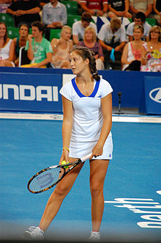
Reasons for higher status of pros today
8 Issues
Professionals have more time to train (higher standards of performance)
More media coverage/role models/celebrity status
All classes can now compete/social class no longer a barrier to participation
People now respected for their talents/efforts in reaching the top
Very high rewards for professionals (via media/sponsorship eg footballers)

