Slide 1
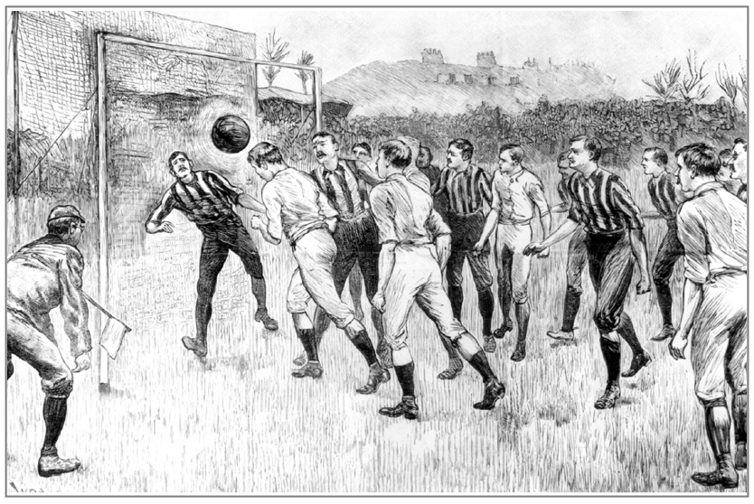
Part 2: Industrial Society

Slide 2
Why were games rationalised in the 19th Century?
4 Sport & Society
More clubs were being formed so more administration was needed
Society was becoming more civilised
Transport & Communication developed (e.g. development of steam railways)
Urbanisation led to a lack of space (so no room to play mob games anymore)
Church teams formed (mob games not suitable for them!)
It was an era of social reform
Industrialisation (this led to factory teams which disciplined the workforce)
Upper & middle classes controlled the working class using sport

Slide 3
Rational Sport
4 Sport & Society
R
Respectable
Regular
Rule based
Regional
Roles identified

Slide 4
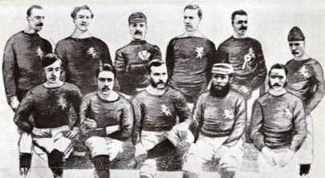
Rules/ Codification/ administration – business and administration skills & ex-public schoolboy influence
4 Sport & Society
Professionalism /Amateurism– class structure/ spectatorism
Respectable – middle-class influence / law and order
Urban/ sub-urban – the revolutions
Regular – increased free time and improved transport
Fair play – public school influence
International/ National/ Regional– improved transport
Facilities were purpose-built facilities – technological advancement
Control of gambling – increased law and order
Exclusive/ elitist – social class and gender discrimination
Scotland Football team 1870s

Slide 5
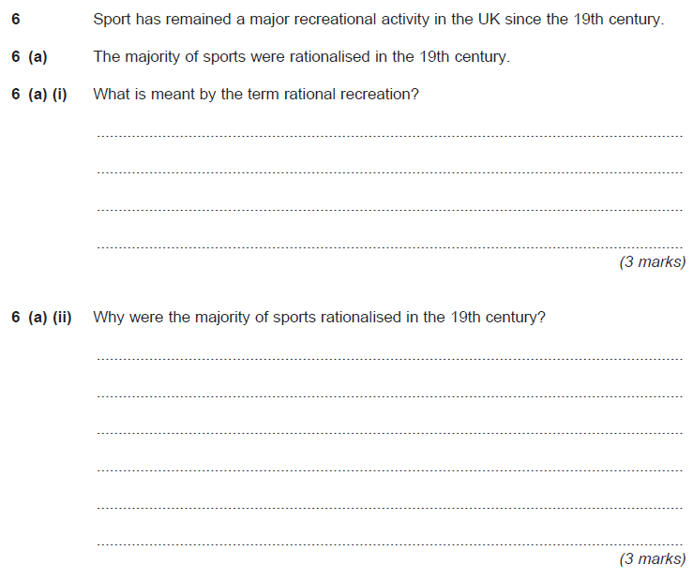
4 Sport & Society

Slide 6
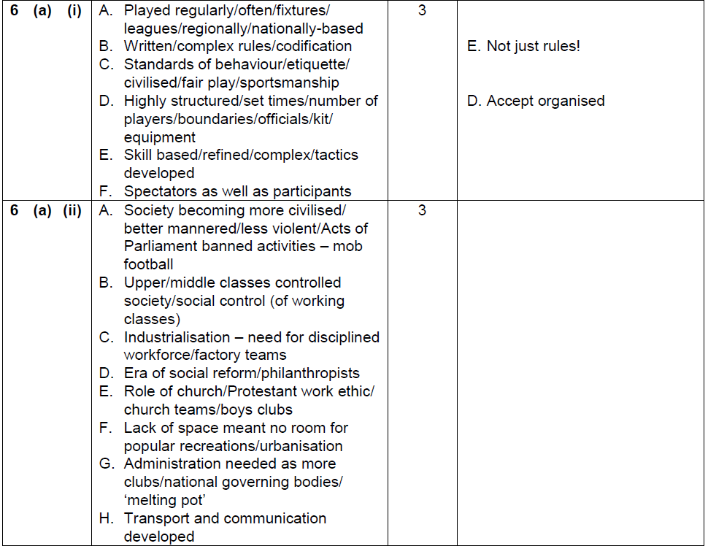
June 2012
4 Sport & Society

Slide 7
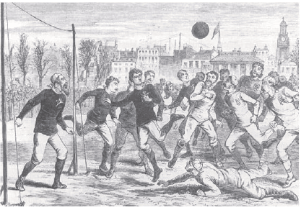
Figure 5 shows a football match between England and Scotland at the Oval in
1875. It is an example of ’rational recreation’.
5 (a) Using Figure 5 and your own knowledge, outline the characteristics of rational recreation. (4 marks)
4 marks for 4 of:
A. Played regularly/free time/middle &
upper classes/boys in school;
B. Complex, written rules/number of
players/boundaries/time
C. Highly structured/administrative/
NGBs/levels of competition;
D. Teams are wearing kit/division of
labour/positional roles/strategies/
tactics;
E. Technological aspects such as
ball/goal posts/equipment;
F. Skills based;
G. Moral values/etiquette/code of
conduct;
H. Spectator development;
I. Officials;
J. Urban development.

Slide 8
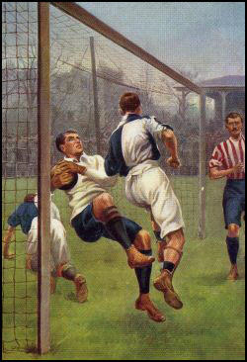

Slide 9
Urbanisation = growth of urban areas (cities, towns, suburbs) as a result of rural migration. As large numbers of manual workers were replaced by machines they were forced to move to urban areas for work.
6 Issues
The Industrial Revolution was a period from 1750 to 1850 where manual labour was exchanged for mechanisation in agriculture, manufacturing, mining, transportation, and technology. This had a profound effect on the social, economic and cultural conditions of the times.
loss of space/over crowding
Lack of time to play12 hour days Machines controlled long periods of time at work as they had to be kept running to earn money/profit
Negative effects of industrial urbanization process on sports and games playing in early part of 19th century
Loss of rights No longer allowed to play mob games/blood sports
Lack of disposable income no money to play
Poor health/ little energy to play

Slide 10
Benevolent factory owners set up factory teams /excursions to seaside) Gradual decrease from 72 hours a week;
Middle class changed ways of behaving/playing sport – it became more acceptable
6 Issues
various factory Acts led to the adoption of Saturday half day/early closing day for shops which meant more free time to watch/play sport
Influenced distances spectators/players could travel/less time to get to places/leagues established. It became cheaper to travel.
Positive effects in the later part of 19th century
Excursions paid for by some bosses; workers sports teams set up/facilities provided
Media generated spectator interest. Postal system improved organisation and administration of sport.
Church teams
Gradual increase in Public baths (Wash House acts) and public parks to improve health of the working class/ Health/hygiene improved
Ex-public schoolboy influence (TOP VICC)

Slide 11
What the working class had lost
6 Issues
Space to play
Health / energy (slaving in factories)
Rights – to do traditional activities due to criminal law, RSPCA,
Time – 72 hours per week, reduction in the number of saint days (festivals)

Slide 12
19th Century Industrialisation had a positive impact on working class recreational opportunities. Discuss. [14 marks]
6 Issues

Slide 13
Discuss the view that the 19th century had a positive impact on working class opportunities for sport [8]
Things went downhill:
N. 72 hour week – time!
O. Only 4 bank holidays a year
P. Loss of rights & acceptability - Police system
Q. Loss of right & acceptability - RSPCA
R. Loss of space to play/ overcrowding
S. Loss of health/ energy to play/ poor working conditions
T. Lack of disposable income
Things were looking up:
A. Factory Reform Acts/more time available/shorter working hours /Saturday half day/Wednesday early closing/Bank Holidays/ machine time
B. Increased wages/broken time payments/ access to professional sport
C. Factory owners established clubs/facilities
D. Churches/Youth Movements established clubs/teams/scouts/Boys Brigade/facilities
E. Public/govt. provision/parks/public baths /Municipal Reform Act
F. Philanthropists provided new facilities /libraries/ working men’s clubs or eq. /Muscular Christianity/social reform/Wenlock Olympics
G. Better communication links/trains easier to visit areas/matches/events
H. New towns developed eg seaside resorts/ countryside
I. New sports developed/rational sports/structured sport/codified
J. National Governing body established/formation of leagues and
cup competitions/regular competition
K. More working class allowed access to previously restricted competition/lifting of Manual Labour Clause/ Middle class encouraged working class sport
L. Increased opportunity for spectatorism
M. Increased media coverage/newspapers led to greater
knowledge and awareness
Migration to towns and cities
1800
1850
1900
Changes in 19thC. Working-class opportunity

Slide 14
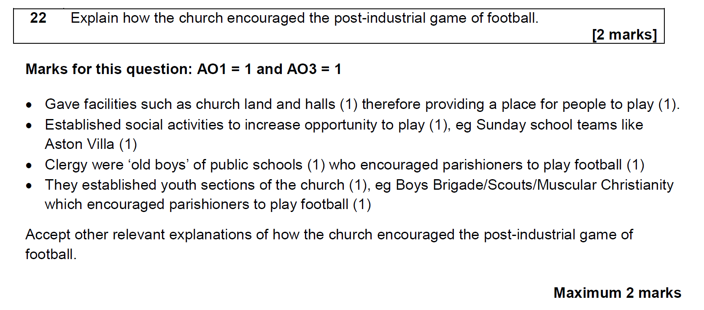

Slide 15
Characteristics of Sport
Possible content may include:
• Football has specific rules governing how it is played, which makes it highly structured therefore matching the concept of sport.
• Highly structured – time/space/rules.
• Rules externally enforced by officials.
• Winning taken seriously/serious end product.
• Skilful/refined skills.
• Training/specialisation/trials/selective.
• Administration – clubs/NGB’s.
• Display/spectators/entertainment.
• Sophisticated facilities and equipment.
• Pre-planned strategies/tactics.
Accept other relevant explanations as to how the modern form of association football can match the concept of sport.
Maximum 6 marks

Slide 16
Explain how the modern form of association football can match the concept of sport.[6 marks]
Marks for this question: AO2 = 3 and AO3 = 3
Students are expected to answer in continuous prose, use good English, organise information clearly and use specialist vocabulary where appropriate.
Level | Marks | Description
3 | 5–6 | Knowledge of the modern form of association football is clear and generally well detailed and applied to the concept of sport. Aspects of the modern form of association football are analysed to give appropriate and detailed links to the concept of sport. Relevant terminology is normally used. The answer sometimes demonstrates substantiated reasoning, is clear, coherent and focused.
2 | 3-4 | Knowledge of the modern form of association football is evident with some application to the concept of sport.Some aspects of the modern form of association football are analysed to give some appropriate links to the concept of sport.Relevant terminology is occasionally used. The answer occasionally demonstrates substantiated reasoning, but may lack clarity, coherence and focus .
1 | 1-2 | Knowledge of the modern form of association football is limited with limited application to the concept of sport. Limited or no evidence of analysis of the modern form of association football linked to the concept of sport. Relevant terminology is rarely used. The answer lacks substantiates reasoning, clarity, coherence and focus.
0 | 0 | No relevant content.

Slide 17
7 Issues
Ex-public school boys influence
Teachers
Officers
In army
Parents
Vicars
Industrialists
Community
Members
Community
Leaders
Often in the school they had attended.
Increasing the morale and fitness of their soldiers, taking British games abroad.
Influencing their own children, often sending them to their old school.
Supporting their parishioners in the formation of youth clubs and parish teams.
Keen to spread the values of athleticism to their workforce.
Playing for and running local sports clubs.
Supporting local initiatives and donating money to the town.

Slide 18
7 Issues
More leagues required
More fixtures required
More clubs forming
Maintenance of control of sport amongst upper/middle classes
Reasons for the formation of National Governing Bodies of Sport in England during the mid/late nineteenth century (C19)
Maintain ‘amateur ideal’
Rules/codification required
Threats of professionalism/ commercialism
Different public schools played different versions

Slide 19
By the late nineteenth century mob football had declined and the
rationalised game of association football emerged as a mass spectator sport.
7 Issues
Hero worship
Media
Cost
Time
Space
Community
Grounds
Transport
Church
Industrial patronage
FA Formed 1863

Slide 20
Peer-marked test
8 Issues
In the 19th Century……
Explain how ex-public school boys influenced development and spread of rational recreation within society and globally.[4]
Describe how the formation of National Governing Bodies (e.g. The F.A. in 1863) was influenced by 19th Century socio-cultural factors. [3]
3. Explain the popularity of Association Football as a spectator sport in 19th Century Britain. [4]

Slide 21
Marks
4 Marks from:
Role
Explanation
Teachers
Officers
In army
Parents
Vicars
Industrialists
Community
Members
Community
Leaders
Often in the school they had attended.
Increasing the morale and fitness of their soldiers, taking British games abroad.
Influencing their own children, often sending them to their old school.
Supporting their parishioners in the formation of youth clubs and parish teams.
Keen to spread the values of athleticism to their workforce.
Playing for and running local sports clubs.
Supporting local initiatives and donating money to the town.
Must include explanation for mark
(Max 3 marks if no reference to global spread via army)

Slide 22
Marks
3 marks for 3 from:
More clubs forming/more leagues/fixtures required
Middle/upper class wanted to control sport/ exclude working class/manual labourers/
threat of commercialisation/professionalism
3. Rule codification/written rules needed
4. Business/administration skills of middle/upper class/ ex-public school/Oxbridge ‘Blues’
5. Need for unification of rules/ different public schools plying different versions
6. Need to maintain amateur ideal/fair play

Slide 23
Football as popular spectator sport 4 marks from:
Time – fitted into limited free-time of working classes/ Saturday afternoons off
Space – limited space in towns to play
Stadia – large stadia built to cope with demand
Cost – Very cheap/ affordable for poor working class
Simplicity – simple game/no complex rules/ appealed to all
Local pride/sense of community
Media – promotion and publicity of games
Transport – rail network allowed travel to follow team on away days
Players emerged as working class heroes
More acceptable/respectable than mob version/ suited Victorian ethics

Slide 24
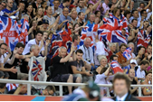
In what ways can the emergence of mass spectator sport still be seen today?
8 Issues
Huge attendances at sports events
Sport as a huge industry
Emergence as family entertainment e.g. seated stadia, cheerleaders etc
Commercialisation of sport
Promotion / marketing
Massive TV viewing figures
Drop in participation
Expansion of media coverage – satellite TV, Sky TV
Feel-good factor/ National/ Local Pride fostered
Perhaps due culture of armchair supporters
Sporting role models are national icons/ heroes

Slide 25
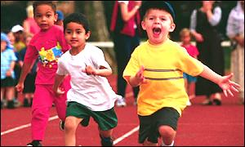
For relaxation
To improve status within society/
social/family group
8 Issues
Why did you take up your sport?
To prove myself
To Impress
(parents/family/
friends)
To let off steam
(Release aggression)
To aspire to elders/
peers/role models
To make money
(to make a career
from playing)
To burn
energy
Feeling of winning/
success
For the challenge/
self improvement
To enjoy the outdoors/
environment
For exercise
(Health & Fitness reasons)
To relieve stress
For enjoyment
To socialise/ make friends
To settle
disputes
Peer pressure
To relieve boredom/
Something to do
To improve physical appearance

Slide 26
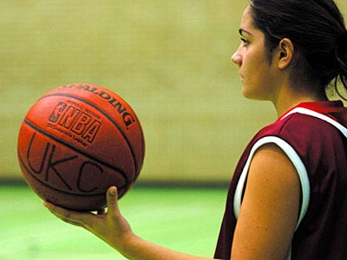
To improve status within society/
social/family group
8 Issues
For relaxation
Why do you still do your sport?
To prove myself
For enjoyment
To Impress
(parents/family/friends)
To aspire to elders/
peers/role models
To let off steam
(Release aggression)
Feeling of winning/
success
To make parents/coach happy
To make money
(to make a career from playing)
For the challenge/
self improvement
To enjoy the outdoors/
environment
To burn energy
To relieve stress
Peer pressure
To socialise/
make friends
To settle
disputes
For exercise
(Health & Fitness reasons)
To relieve boredom/
Something to do
To improve physical appearance

Slide 27
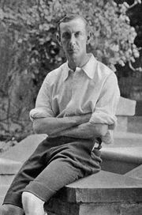
Prep/Homework focus: Corinthians Fact sheet
Did you get?
Year formed: 1882 by N. Lane Jackson, assistant secretary of the Football Association, with the intention of developing a squad capable of challenging the supremacy of the Scotland football team.
For two England matches against Wales in 1894 and 1895, the entire team consisted of members of the club
The team originally determined to play only friendly matches and often played other amateur clubs
After joining the Amateur Football Association and being banned from playing the top home opposition, all of whom were members of The Football Association, the team increased its touring of the world, popularising football.
In 1904, Corinthian beat Manchester United 11–3, which remains United's biggest defeat
Real Madrid adopted Corinthian's white shirts and Sport Club Corinthians Paulista in Brazil adopted their name

Slide 28
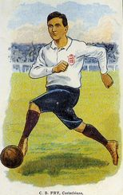
Corinthians
In 1891 when the penalty kick was introduced into the game a
number of amateur clubs objected to it. C.B. Fry called the new law
“a standing insult to sportsmen to have to play under a rule which
assumes that players intend to trip, hack and push opponents and to
behave like cads of the first kidney”.
Whenever the Corinthians were awarded a penalty, C.B. Fry would
simply roll the ball to the keeper so that play could resume.
‘The Corinthians of my day never trained, and I can say
that the need of it was never felt. We were all fit, and I
think could have played on for more than one and a half
hours without being any the worse.’
G.O. Smith

Slide 29
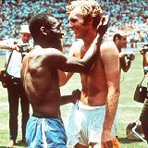
Are you a Corinthian?
“As I understand the breed he is one who has not merely braced his muscles and developed his endurance by the exercise of some great sport, but he has, in the pursuit of the exercise, learnt to:
control his anger,
to be considerate to his fellow men,
to take no mean advantage,
to resent as dishonour the very suspicion of trickery,
to bear aloft a cheerful countenance under disappointment,
and never to own himself defeated until the last breath is out of his body.”
Pa Jackson, founder of the Corinthians Football Club.

Slide 30
19th century
8 Issues
Amateur
Given high status in 19th Century
sport & society
Professional
Given low status in 19th century
Controlled sport/ excluded working class from amateur sports
Usually working class background
Slowly emerged through 20th
Century
Best players in most sports
Emerged from 1850s onward
(with onset of Victorianism)
Win at all cost ethic
Pressure to succeed to maintain lifestyle
Middle/upper class/Ex-public school/ Oxbridge background
Foul play/ cheating to gain
an advantage
‘Gentlemanly’ behaviour
(Sportsmanship & morality)
Had insufficient income/leisure time to play sport for love of it receiving no payment
Taking part more important than winning/ games not taken seriously

Slide 31
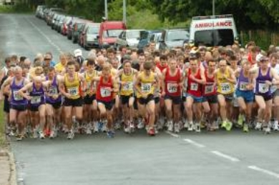
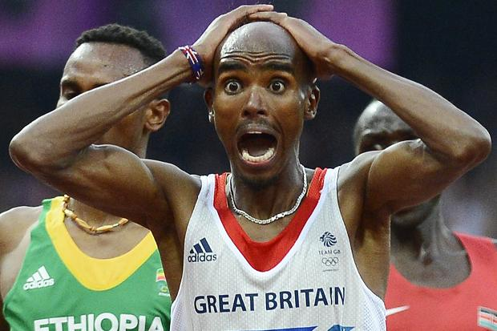
S
P
O
R
T
ERIOUS / COMPETITIVE – training/
Commitment required
ROWESS – HIGH SKILL LEVELS –
particularly professionals
RGANISED – strict NGB rules/
regulations
EWARDS – available for success
Extrinsic (prize-money for professionals)
and Intrinsic (satisfaction for amateurs)
IME & SPACE RESTRICTIONS – apply to
when/where

Slide 32
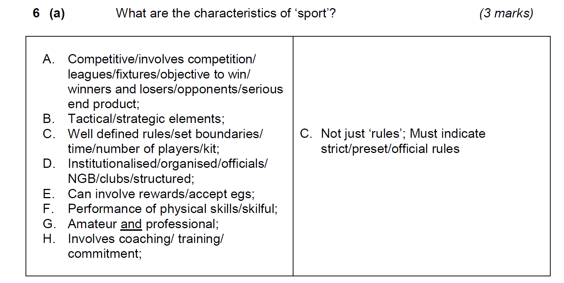
Jan 12

Slide 33
‘Be the Umpire’ - Mark scheme
Concept of Sport (AO2) | Explanation of similarities with pre-industrial Real Tennis (AO3)
A. Competitive/ leagues/ fixtures/objective to win/ serious end product | I. Winning was important to decide status in social order/ wagers
B. Tactical/strategic elements | J. Considerable number of game strategies
C. Well defined rules/time limit/boundaries/ number of players/ kit | K. Fixed territorial limits of play/ never more than a partner game/ purpose built courts/complex rules/sophisticated scoring system/equipment
D. Organised/ officials/ NGB/ clubs/ structured | L. Control dictated by regulations/ National formal organisation/ International rules
E. Can involve rewards (intrinsic or extrinsic) | M. Wagers/prize money/status OR for the games own sake
F. Skilful | N. Skill more significant than force/
G. Can be amateur and professional | O. Real Tennis mostly amateur/ aristocracy un-paid/ A few professional players
H. Involves coaching/ training/commitment | P. Coaching/regular practice for upper class males at public school or university/played by nobles who had lots of time to practice

Slide 34
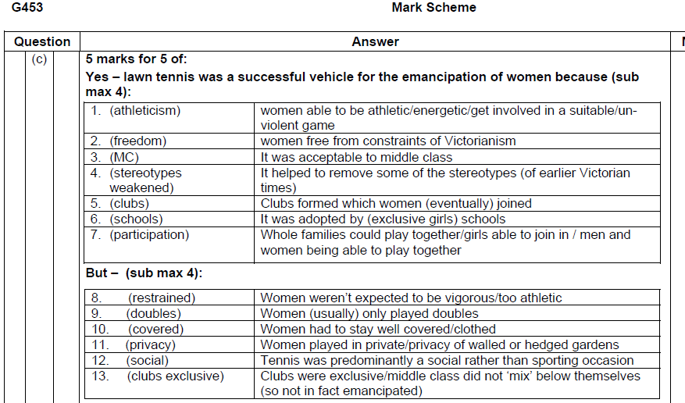

Slide 35
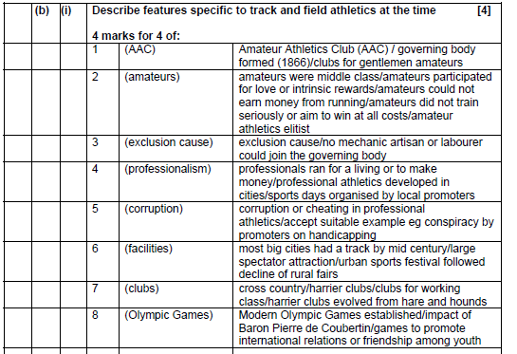

Slide 36
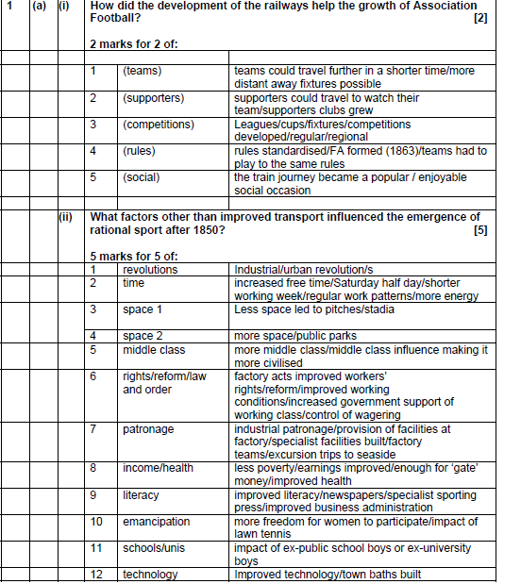

Slide 37
Peer-marked test
9 Issues
1. Give reasons for the emergence of mass spectator sport in 19th Century Britain and use an example to show how this can be still seen in the current day sporting arena. [4]
2. Compare the 19th century view of the professional sports performer when compared with the current viewpoint. Give reasons for the change from the historical viewpoint to the present day. [3]

Slide 38
Marks
3 Reasons for emergence of mass spectator sport from: (max 3 marks)
1 Mark for relevant example showing popularity today
e.g. large attendances at Olympics/Public interest/TV viewing figures
Factor
A. Exclusion | Working classes excluded from participating in most sports/ exclusion clauses in Athletics, Rowing, Swimming/ Middle class ownership of Tennis clubs
B. Cost | Affordable/ Cheap for working classes
C. Railways | Developing rail network allowed availability/ affordability of transport to ‘away’ games
D. Saturday afternoons | Working classes had Saturday afternoons off / half day closing/ time to support their local team
E. Sense of Community | Local pride/community spirit developed in supporting local team
F. Industrial patronage | Factory owners formed teams/ e.g. Arsenal
G. Role models | Working class ‘heroes’ created
H. Media | Media/ Newspapers/ Promotion/Publicised events/ created interest
I. Role of NGBs | Created more leagues/fixtures/ e.g. FA formed 1863

Slide 39
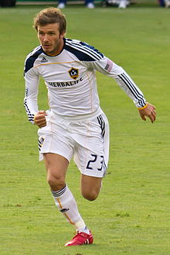
3 Marks in total:
Max 2 marks for comparison from:
19th century view | Whereas… | Current day
Professionals given Low status/ amateurs often better players
Professionals given high status
Professionals associated with cheating/gamesmanship
Praised for high skill level/ success/positive role models
Working class background
Elite performers from all classes
Max 2 marks for reasons from:
A. More egalitarian society today/less exclusion/class distinction
B. People now respected for their talents/efforts in reaching the top
C. Professionals have more time to train /higher standards of performance
D. More media coverage/role models/celebrity status
E. Very large rewards for professionals (via media/sponsorship eg footballers)

Slide 41
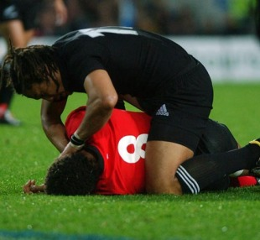
Sportsmanship
New Zealand's 2003 Test match v Wales.
Wales’ captain Colin Charvis made a dart for the try-line only to be knocked out cold from the impact of a tackle.
As the home side swept forward on a counter-attack, lay lifeless.
Umaga, recognising the seriousness of his opponent's state, left his place in an attacking move and ran to the aid of the stricken Charvis, removing his gum-shield before placing him in the recovery position.
Umaga received the Pierre de Coubertin medal - becoming the first New Zealander to win the award.
Conforming to the written rules & unwritten rules (etiquette)
Part of the Olympic ideal
Involves a ‘spirit of fair play’,
Some sports still have a very strong association with sportsmanship e.g. Golf
attempting to gain an advantage by stretching the rules to their “absolute limit”
(Eg time wasting in football)
Gamesmanship

Slide 42
Benchmark assessment 1 Marks
Sport and society and technology in sport
Which one of the following National Governing Bodies was formed in 1863?
[1 mark]
Marks for this question: AO1 = 1
A
Which one of the following was played in pre-industrial society?
[1 mark]
Marks for this question: AO1 = 1
D

Slide 43
Benchmark assessment 1 Marks
3. Explain two characteristics of pre-industrial football.
[4 marks]
Marks for this question: AO1 = 2 and AO2 = 2
Played occasionally/holy days (1) B. because no other time available to play sport (1)
No clear division of labour/little strategy (1) D. as not yet rationalised (1)
No pitch/common land between villages used (1) F. because minimal equipment and facilities available (1)
Locally based (1) H. as poor transport/communication (1)
Simple/unwritten rules [1] J. Due to widespread illiteracy
K. Violent/unskilled/brute force [1] L. Due to harsh society/ uncivilised
M. Lower class males/ no upper class/ uppers as patrons [1] N. Due to feudal system/ class division
Accept other relevant characteristics of pre-industrial football.
Maximum 4 marks

Slide 44
Benchmark assessment 1 Marks
4. Explain how the church encouraged the post-industrial game of football.
[2 marks]
Marks for this question: AO1 = 1 and AO3 = 1
Gave facilities such as church land and halls (1) B. therefore providing a place for people to play (1).
C. Established social activities to increase opportunity to play (1), D. eg Sunday school teams like Aston Villa (1)
E. Clergy were ‘old boys’ of public schools (1) F. who encouraged parishioners to play football (1)
G. They established youth sections of the church (1),H. eg Boys Brigade/Scouts/Muscular Christianity which encouraged parishioners to play football (1)
Accept other relevant explanations of how the church encouraged the post-industrial game of football.
Maximum 2 marks

Slide 45
Benchmark assessment 1 Marks
With reference to football, explain what is meant by the rationalisation of recreation.
Accept explanations of different points if relevant.
6 marks
Process of rationalisation | Explained with reference to football in 19th century
Played regularly [1] | B. Matches often (usually every Saturday afternoon)/Professional sides trained as well/High number of fixtures/ National competitions e.g. the Football league, F.A. Cup/ England v Scotland internationals [1]
C. Written rules [1] | D. Cambridge University rules established in 1840s/ Codification by FA / FA formed 1863/ ex-public schoolboy influence [1]
E. Standards of behaviour [1] | F. Sportsmanship valued/ especially at amateur teams e.g. Corinthians/ violence punished/ rules ensured fair play/ civilised/ etiquette e.g. shaking hands [1]
G. Highly structured [1] | H. Administration by FA/ set times/ no. of players limited to 11/set pitch dimensions/referees/kits/colours to differentiate teams/ equipment [1]
I. Skill based [1] | J. Professionals training to refine skills/ Coaching for public school boys/ deploying tactics/complex formations tried [1]
K. Spectators as well as participants [1] | L. Attracted huge audiences/ emergence as ‘the people’s game’/ large stadia/football important to local community pride/limited chance to play due to lack of space/cheap to watch [1]

Slide 46
Benchmark assessment 1 Marks
Define the term muscular Christianity
Award two marks for two of the following:
Combination of manliness and godliness/ strong body and strong soul
Development of strong body/soul/play hard but fair/protect those weaker than you
Sport encouraged for the glory of god/not for its own sake or for any extrinsic values
The idea became popular in the late 19th century
2 Marks

Slide 47
Benchmark assessment 1 Marks
Suggest reasons why real tennis remained exclusive to the upper classes.
High levels of skill required – upper classes received coaching/practiced at public school/university/ lower class had little free time or energy to practice skills /free time on holy days only
Tradition - brought over from France where it was a nobles’ game/important for upper class status within social order/ court control/punishments if lesser people played
Complex rules - Lower class illiterate/unable to follow very sophisticated rules/ real tennis had its own language which lower class did not understand
Purpose built courts – highly sophisticated not able to access/afford purpose-built facilities
Etiquette - designed for the nobility/lower class did not have/know the appropriate etiquette/behaviour
Specialist equipment - Lower class had limited access to/ could not afford specialist equipment used/ lower class did not have the appropriate dress code
4 marks

Slide 48
Benchmark assessment 1 Marks
Outline the roles taken up by the ex-public school boys in 19th century society and explain their influence upon improving leisure opportunities for the working classes. [8]
Ex-public schoolboy roles outline | Explain their influence upon working class leisure opportunities
A. Teachers
B. Officers in Army
C. Philanthropists/ politicians
D. Vicars/Clergy/Church
E. Industrialists/ factory owners
F. ‘Blues’ / University old boys network
G. Formed NGBs
H. Used games to increase the morale and fitness of soldiers
I. Social reform/Factory acts/ reduced working hours/free time to watch/
improved working conditions/Saturday/Wednesday afternoons
J. Public provision of facilities
K. Muscular Christianity – acceptance of sports played to glorify God
L. Church/parish teams e.g. Aston Villa FC
M. Youth clubs and sections formed e.g. YMCA, Boys brigade
N. Allowed Church land/halls to be used for sport
O. Set up factory teams/access to professional sport/broken-time payments
P. Facilities/trips/excursions
Q. Used sport to improve discipline/fitness/health of workforce
R. Led to the codification of rules
S. Led to the formation of leagues and competitions for the working class to play in

Slide 49
Outline the roles taken up by the ex-public school boys in 19th century society and explain their influence upon improving leisure opportunities for the working classes. [8]
Level | Marks | Description
4 | 7-8 | Knowledge of relevant roles of ex-public schoolboys is consistently accurate and well detailed. Application of breadth or depth of knowledge is clearly evident. Reasoning is coherently and consistently made between relevant roles and their impact upon improving working class leisure opportunities. Relevant terminology is consistently used. The answer almost always demonstrates substantiated reasoning, clarity, structure and focus.
3 | 5-6 | Knowledge of relevant roles of ex-public schoolboys is usually accurate and detailed. Application of breadth or depth of knowledge is often evident. Reasoning is often made between relevant ex-public school boy roles and their impact upon working class leisure opportunities. Relevant terminology is often used. The answer usually demonstrates substantiated reasoning, clarity, structure and focus.
2 | 3-4 | Knowledge of relevant roles of ex-public schoolboys is sometimes accurate with some detail. Application of breadth or depth of knowledge is sometimes evident. Reasoning is sometimes made between relevant roles and their impact upon working class leisure opportunities. Relevant terminology is sometimes used. The answer occasionally demonstrates substantiated reasoning, but may lack clarity, structure and focus.
1 | 1-2 | Knowledge of relevant roles of ex-public schoolboys may be limited. Application of breadth or depth of knowledge may be limited or not evident. There may be little or no reasoning between relevant roles and their impact upon working class leisure opportunities. Relevant terminology is occasionally used. The answer may lack substantiated reasoning, clarity, structure and focus.
 | 0 | No relevant content.

